Slide 1
Actions on Google
Murphy | AgileCommunity.tw | judge0648@gmail.com
Notes:
其實是 Actions on Google Assistant

Slide 2
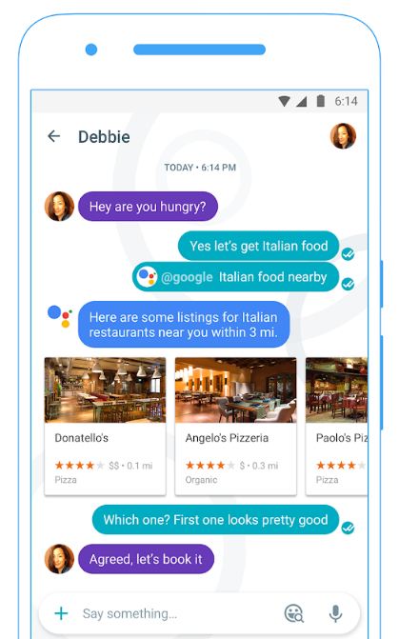
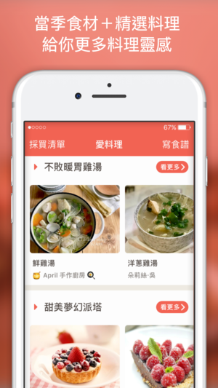
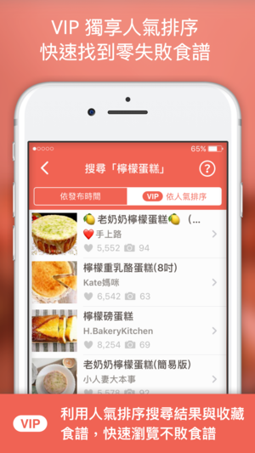
CI vs. UI
Notes:
傳統軟體的 UI
vs. 有 AI 的 CI

Slide 3

user input
{ conversation api request }
Action
Action response
{ conversation api response }
Notes:
One option is to use the Conversation API and the Actions SDK.
Your Action receives a request containing the spoken text from the user as a string.
Google handles the speech recognition for you.
You parse the strings, and then generate a response, and Google handles speaking this back to the user.
However, as we just mentioned, parsing natural language can be really difficult.

Slide 4




Ok Google, talk to Personal Chef
Speech to Text
NLP
Knowledge Graph
ML Ranking
User Profile
Sure, here’s Personal Chef
Trigger WELCOME event
What are you in the mood for?
Well, it’s kind of cold outside, so I’d like...
NLP:
Intent Matching
Entity Extraction
Speech to Text
...
...
What protein would you like to use?
Text to Speech
...
...
Notes:
So you can see here where Dialogflow fits in.
It handles the conversation invocation and fulfillment just like we showed earlier.

Slide 5
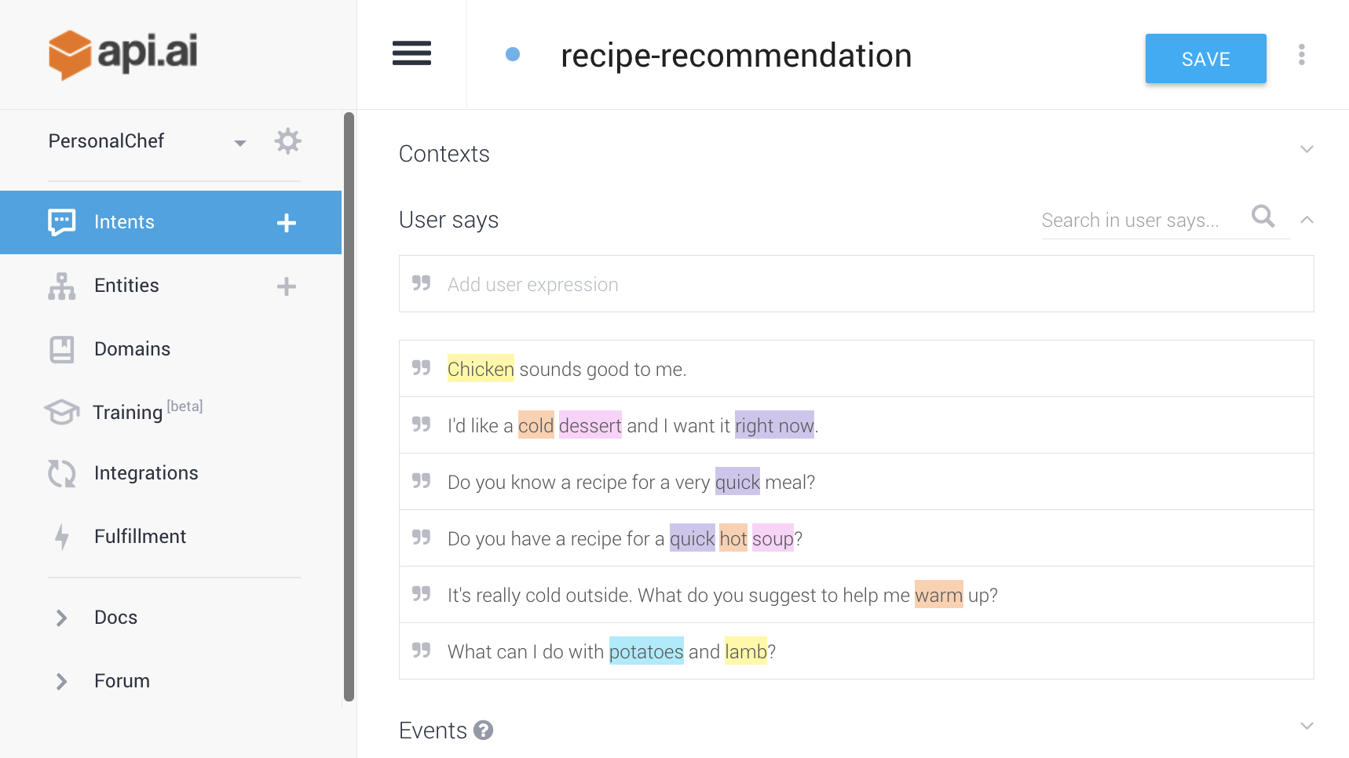

Notes:
So what is Dialogflow? It provides an intuitive graphical user interface to create conversational experiences.
You program in, few example sentences of things that a user might speak.
You can specify what values you need to get from the user.
It then uses machine learning to understand the sentences and manage the conversation.
The key part here is that you no longer need to process the raw strings - Dialogflow does this for you.

Slide 6
“
Intent Matching — Match and categorize user utterances to an intent.
@
Entity Extraction — Identify key words and phrases spoken by the user.
Notes:
Fortunately, Google provides tools that make handling this kind of thing really easy!
Dialogflow is one of these. It’s a platform that makes it incredibly straightforward to build conversational experiences. You might not even have to write any code.
We are going to give you an overview of it today, and it is what most of you should use for implementing your own Action

Slide 7
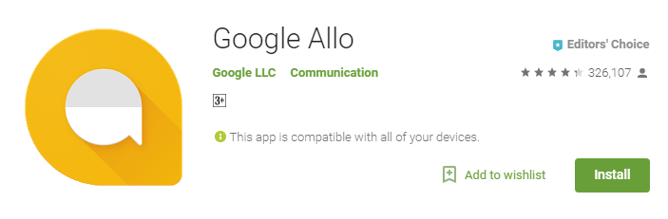
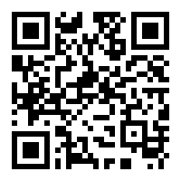
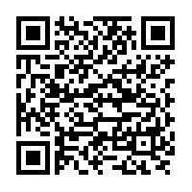
Google Allo
iOS user https://goo.gl/UfjCPV
Android user https://goo.gl/tJhibt

Slide 8
Notes:
So what is Dialogflow? It provides an intuitive graphical user interface to create conversational experiences.
You program in, few example sentences of things that a user might speak.
You can specify what values you need to get from the user.
It then uses machine learning to understand the sentences and manage the conversation.
The key part here is that you no longer need to process the raw strings - Dialogflow does this for you.

Slide 9
Ok Google, talk to Personal Chef
Speech to Text
NLP
Knowledge Graph
ML Ranking
User Profile
Sure, here’s Personal Chef
Trigger WELCOME event
What are you in the mood for?
Well, it’s kind of cold outside, so I’d like...
NLP:
Intent Matching
Entity Extraction
Speech to Text
...
...
What protein would you like to use?
Text to Speech
...
...
Notes:
So you can see here where Dialogflow fits in.
It handles the conversation invocation and fulfillment just like we showed earlier.

Slide 10
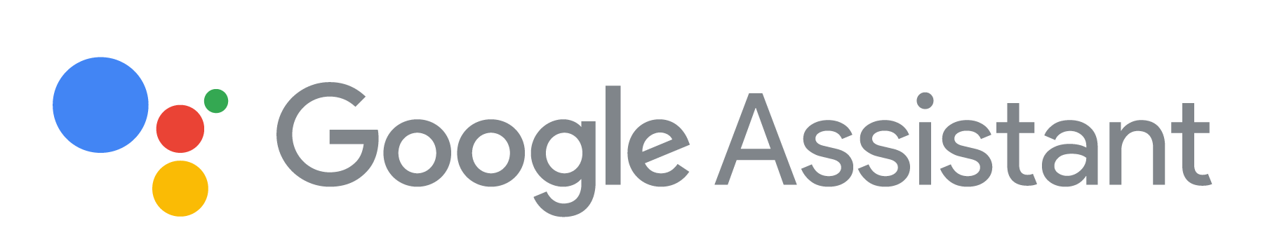
User Says
“Find me a recipe for homemade cannoli”
“Find me a recipe for homemade cannoli”
Response
“Here’s the best one I can find”
Webhook
Entities:
homemade cannoli
Notes:
Dialogflow handles the conversation for you. Once the user is talking to your Action, they then start off with something Google calls the “user says” phrase.
“Find me a recipe for homemade cannoli.”
The Google Assistant and Dialogflow then process this, and find the appropriate intent to handle this phrase. The phrase is processed to extract entities, which are important pieces of information you are looking for.
Then, it calls your webhook with these entities and the action name, and the webhook can then do something with this, and then generate a response that is spoken back to the user.
You can also create your own demo here :)

Slide 11
In Dialogue Discovery: Explicit Triggering
Ok Google, let’s talk to Personal Chef
Trigger Phrase
Action Name
Developer Specified
Ok Google, ask Personal Chef for a hot soup recipe
Trigger Phrase
Action Name
Developer Specified
Action Preposition
Action Phrase
Developer Specified
Working Examples:
Let’s speak to Domino’s
Ask Dr. Doggy if dogs can eat chocolate
Notes:
The basic way to access your Action is invoking it by name.
When you submit your Action, you can provide a set of trigger phrases that the Assistant will recognize as a request to speak to your Action.
You can also support deep links, so users can ask your Action for a particular thing.

Slide 12
In Dialogue Discovery: Implicit Triggering
Hey Google, I want to work out.
Hey Google, what’s the surf report?
Hey Google, I want to play a game.
Hey Google, tell me a joke.
Notes:
In the long term, users will be able to find your Action based on its specific capabilities.
If they ask to play a game, the Assistant will offer them a few options from the Actions available.

Slide 13
Dialogflow App Workshop

Slide 14

Project Github
Github https://goo.gl/1iWvEW
https://github.com/iM2F1/ActionsOnGoogle.git

Slide 15
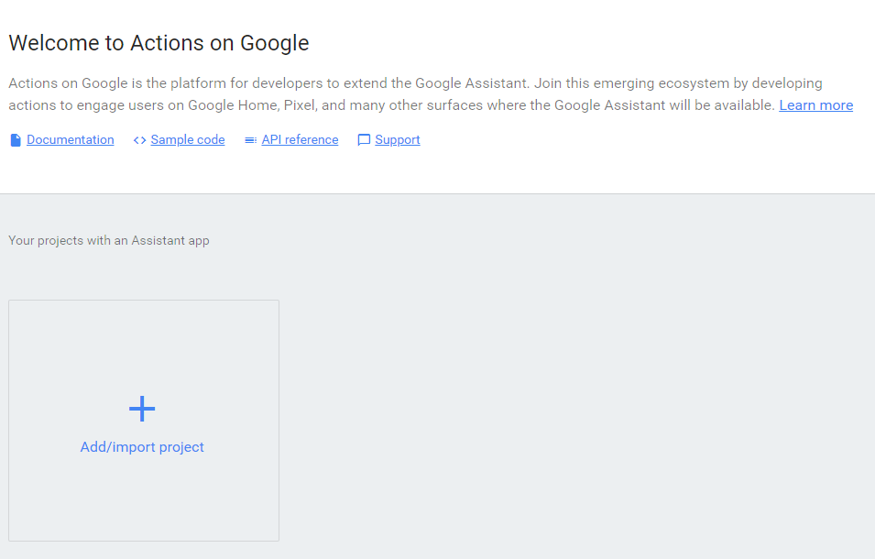
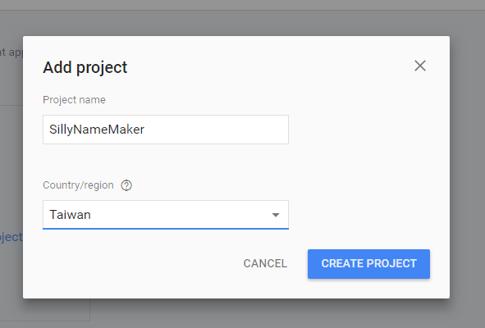
1.Create Project
Add New a new Project
Keyin Project Name
Choose Country “Taiwan”

Slide 16
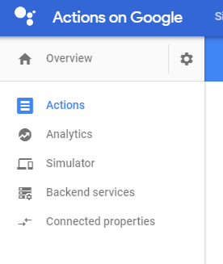
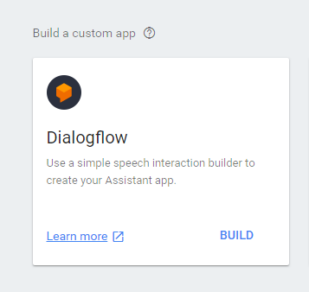
2.Create Action
Actions
Build Dialogflow
Language

Slide 17
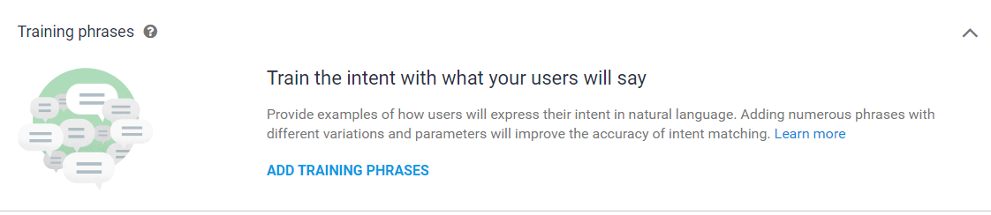
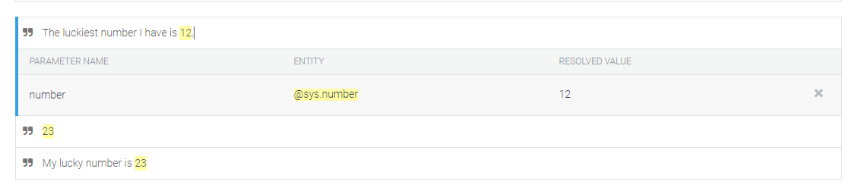
3.User Conversation Training
Keyin sentence directly.
Let google do the rest.

Slide 18
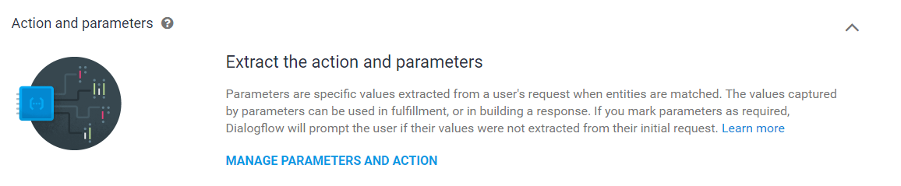
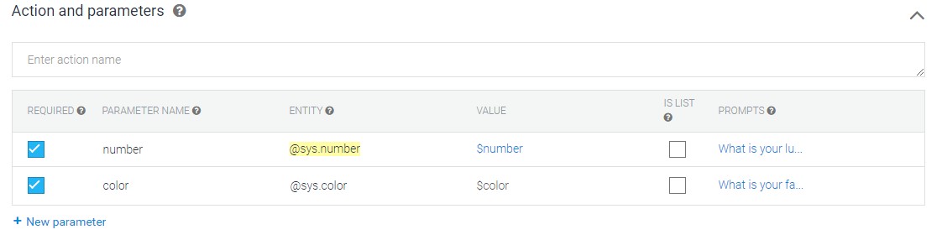
4.Actions and Parameters
Google 自動輸入
可以手動新增

Slide 19
5.Response
$number
$color
Your silly name is $color $number . Hope you like it. See you next time.

Slide 20
6.Fulfillment
Input api url
Input any other parameters if you need.
Not today.

Slide 21
6.1 Test

Slide 22
7.Integrate with Line
https://developers.line.me/en/ (Line Developer)
Messaging App
Keyin Detail Data
Choose Free Messaging Plan
Issue Channel Access Token
Paste Webhook URL from Dialogflow Integration
Copy Paste Channel Id, Channel Secret, Channel Access Token to Dialog Flow
Ref: 董大偉老師的 Blog

Slide 23
8.Deploy Your App

Slide 24
8.1Build Your App
Install Node.js
Npm install -g firebase-tools
mkdir SillyNameMaker
Cd SillyNameMaker
Firebase init
Choose Functions
Modify “index.js” and “package.json” in functions folder
Npm install (in functions folder)

Slide 25
8.2Deploy Your App
firebase deploy --only functions
Must see the Function URL (sillyNameMaker): https://

Slide 26
9.Don’t Worry
Don’t know how to build an Agent?
Google Provide Prebuild Agents
How much does it cost for Google to host the applications for you?
Totally Free (for right now XDD)
Need some sample code?
Google Provide Sample Codes

Slide 27
Thank you.

