Slide 1
Café Nova Sales Performance Analysis
BY
IMAM-MALIK MURTALA

Slide 2
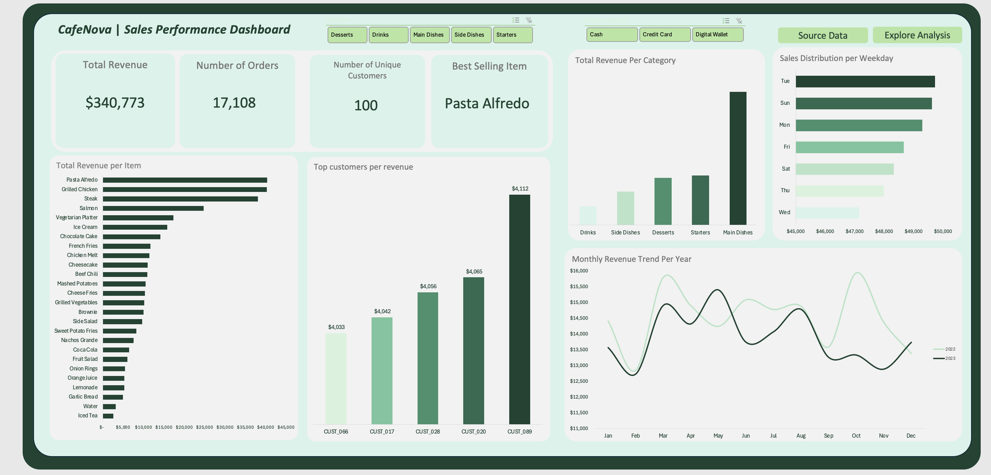

Slide 3
WHAT IS WORKING WELL?
Strong Revenue Generation:
Total revenue is $340,773, which indicates solid overall performance.
High Order Volume:
17,108 orders show consistent customer engagement and a healthy transaction rate.
Best-Selling Item: Pasta Alfredo:
Pasta Alfredo tops the item revenue chart, indicating effective product-market fit and potential for bundling or upselling.
Loyal High-Value Customers:
Top customers (e.g., CUST_089) contribute significantly to revenue, indicating good retention and repeat purchases.

Slide 4
WHAT SHOULD BE IMPROVED?
Uneven Sales Distribution by Weekday:
Sales peak on Tuesday and Sunday, but Wednesday and Thursday are significantly lower — suggesting a need to balance promotions or operations across the week.
Low-Performing Items:
Items like Iced Tea, Water, and Garlic Bread generate minimal revenue. Consider menu optimization or marketing them better.
Flat Revenue Growth in 2023:
The monthly trend for 2023 is relatively flat compared to 2022, with no significant spikes — a sign to review marketing campaigns, seasonal strategies, or external market conditions

Slide 5
RECOMMENDATION
Boost Mid-Week Sales:
Target Wednesday, Thursday, and possibly Saturday with discounts, promotions, or loyalty bonuses to increase traffic.
Push High-Margin Items:
Expand the marketing of Pasta Alfredo, Grilled Chicken, and Steak; bundle with sides/drinks to grow average order value.
Retarget Top Customers:
Incentivize loyal customers like CUST_089, CUST_020, etc., with exclusive deals, referral programs or even discounts.
Drive upsells with smarter menu design:
Use “decoy pricing” to steer choices toward higher-margin combinations (e.g., combo meals that include a drink and dessert).

