Slide 1
Investigating Tools for Web Data Harvesting
CSE 573 - Semantic Web Mining — Group 13
Group Members:
Sai Chinnu Yelike 1225513328 syelike@asu.edu
Jyotsna Sathi 1229579782 jsathi@asu.edu
Naveen Reddy Nallamilli 1225685799 nnallami@asu.edu
Manideep Meda 1225704415 mmeda2@asu.edu
Manogna Pagadala 1224798575 mpagada1@asu.edu
Bhargav Siva Chandraprakash 1229580549 bchand13@asu.edu

Slide 2
The Significance of Data in Today's World and Leveraging Web Scraping for Data Acquisition:
Data is the cornerstone of modern decision-making processes and business strategies.
Its importance lies in its ability to uncover valuable insights, drive innovation, and enhance efficiency across various industries.
With the exponential growth of digital interactions, the volume and variety of data generated have surged, presenting both opportunities and challenges.
Web scraping has emerged as a powerful solution for gathering structured data from online sources.
Through scraping bots and APIs, organizations can efficiently collect vast amounts of data from publicly accessible websites.
Evaluating scraping tools enables businesses to identify the most suitable options based on their specific requirements, optimizing data acquisition processes for better decision-making.

Slide 3
Web Scraping Techniques Overview and Exploring Web Scraping Techniques:
Introduction
Web scraping is pivotal for extracting valuable information from websites.
Various techniques are available, each with its own strengths and applications.
2. Manual Scraping
Primitive method involving manual extraction of data from web pages.
Not recommended for large-scale data extraction due to inefficiency.
3. Web Scraping Frameworks
OctoParse and Reaper are popular examples.
Enables data extraction without programming knowledge, suitable for beginners.

Slide 4
Advanced Techniques in Web Scraping:
XPath-Based Scraping
Involves parsing data and constructing HTML tree structures.
Scrapy is a widely-used framework for XPath-based scraping.
2) CSS Selector-Based Scraping
Extracts data using CSS selectors of HTML elements.
Scraper is an efficient tool that matches optimal CSS selectors for data extraction.
3) Project Application
Utilizing web scraping tools to extract user-specific attributes from social media platforms like Twitter, Facebook, and Amazon.
Performance evaluation based on predefined metrics to identify the most suitable tool for specific scenarios.
Data transformation into tabular format or CSV for further analysis.

Slide 5
Web Scraping Frameworks and Tools
Beautiful Soup : With the help of the Python web scraping program Beautiful Soup, users may effectively extract data from HTML and XML files.
Selenium : Selenium functions as a web scraping instrument that empowers users to engage with web browsers programmatically.
Scrapy : Scrapy is a sophisticated web scraping framework designed for efficient data extraction from websites,
Octoparse : Octoparse is a user-friendly web scraping tool designed for individuals without coding experience.

Slide 6
BeautifulSoup Architecture
Overview
A Python library designed for web scraping tasks.
Parses HTML and XML documents into a navigable tree structure.
Simplifies data extraction and content manipulation.
Key Components
Beautifulsoup Object: The main entry point for parsing document contents.
Parser: Used to interpret the document, with parsers like html.parser and lxml.
Tag: Represents HTML and XML tags in the document.
NavigableString: Represents text within tags, allowing easy extraction.
Parse Tree and Document Object: The structured representation of the document.

Slide 7
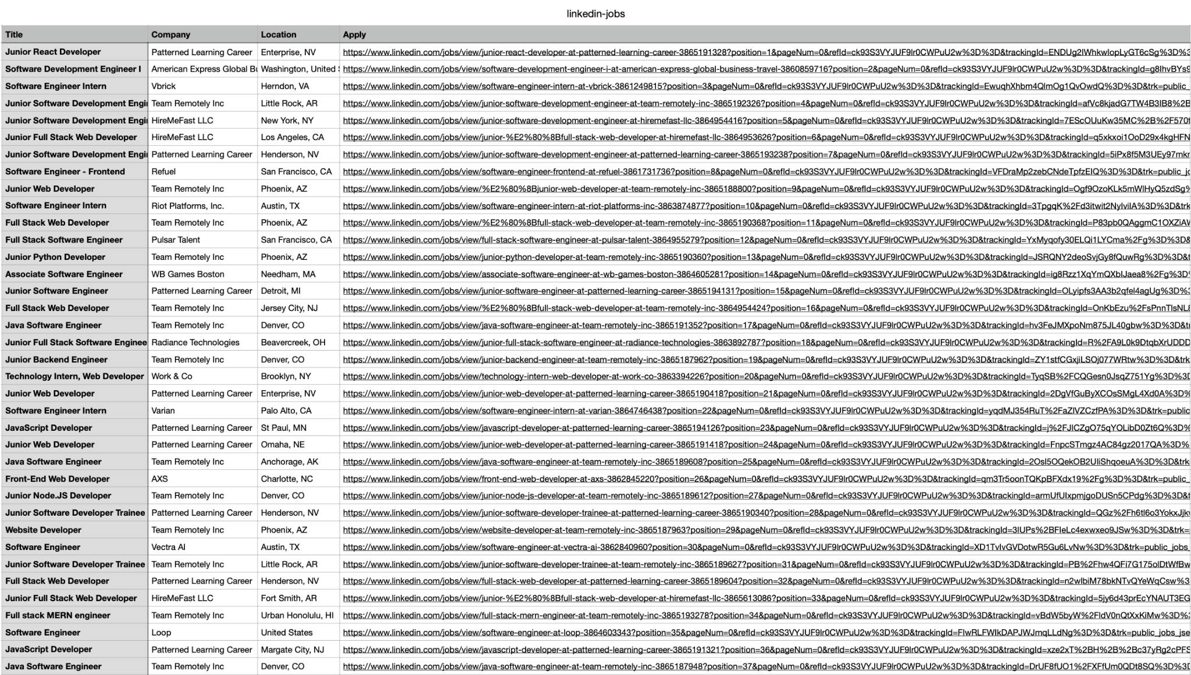
LinkedIn Data Using BeautifulSoup

Slide 8
Pros and Cons of Using Beautifulsoup
Pros:
It is open source and available at no cost.
Works across different platforms and operating systems such as Windows, macOS, and Linux.
Features versatile and customizable scheduling capabilities.
Allows for a variety of data storage solutions, including databases, local file systems, and cloud-based storage.
Integrates with numerous data processing and analytics tools, including Apache Spark and Elasticsearch.
Easy to install and user-friendly interface simplifies operation.
Cons:
Compared to other web scraping tools, it has limited support from the community and lacks extensive documentation.
Built-in functionality for handling dynamically generated content and sites rich in JavaScript is somewhat restricted.
Some level of programming expertise is required to effectively implement and utilize the tool.
Scraping certain websites might be challenging due to their anti-scraping measures or other restrictions.

Slide 9
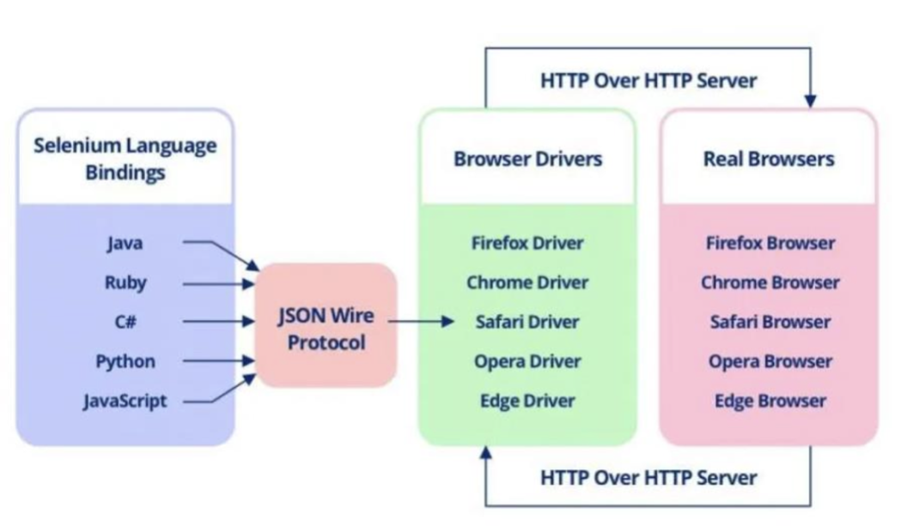
Selenium Architecture
Selenium supports a wide range of browsers, operating systems, and programming languages, enhancing its versatility for different environments.
REST APIs facilitate information exchange between servers, increasing the adaptability of automation processes.
When commands are issued to browser drivers, they are performed in the specified browser, with the HTTP response subsequently returned to the user. This process enables efficient interaction while keeping the browser's internal mechanics concealed.

Slide 10
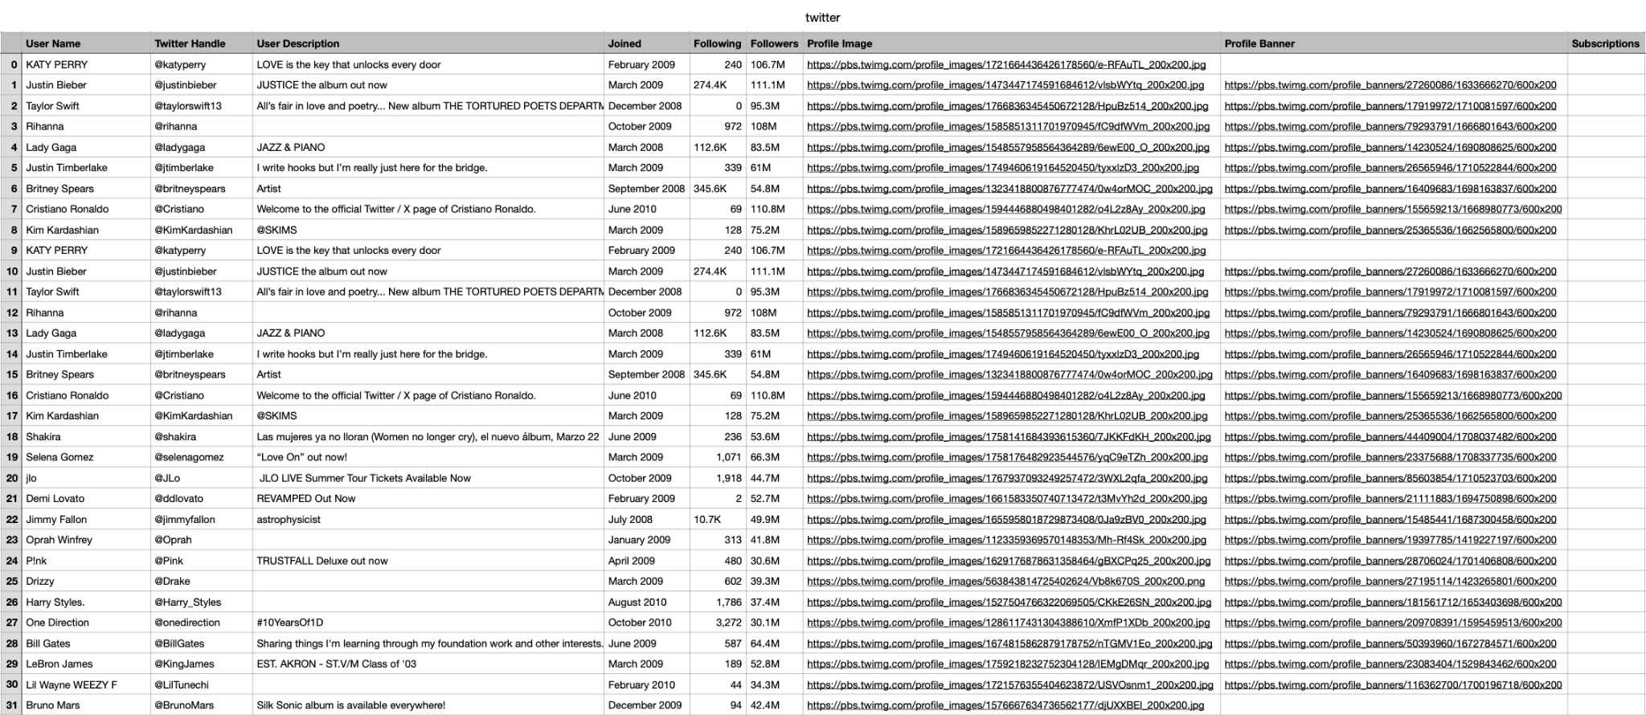
Twitter Data Using Selenium

Slide 11
Pros and Cons of Using Selenium Tool
Pros:
Selenium is open-source and benefits from regular updates and community contributions.
It provides libraries for various programming languages like Java, C#, and Python.
This tool is compatible with many browsers, is not limited by platform, and supports a wide range of plugins for enhanced functionality.
Seamless integration with other software like Maven, TestNG, and Jenkins is possible.
It supports multiple operating systems, including Android.
Cons:
Its capabilities are limited to web applications, excluding Windows-based applications.
Scraping with Selenium may be slower compared to other tools.
It lacks an inherent feature for comparing images.
Operating in a browser, it can create significant network traffic, which might affect its performance.

Slide 12
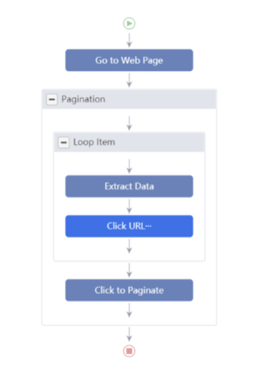
Octoparse Architecture
Octoparse is a desktop-based web scraping tool that allows users to extract data from websites without coding.
It has a built-in browser that can simulate human-like behavior, allowing users to interact with web pages and extract data more efficiently.
Octoparse uses a visual point-and-click interface to create scraping workflows, which can be easily customized and scaled up to extract large amounts of data.
The software is built on a modular architecture, with separate modules for task scheduling, data extraction, data storage, and data export.
Octoparse supports multiple data export formats, including Excel, CSV, HTML, and JSON.
Overall, Octoparse architecture is designed for ease of use and scalability, making it a popular choice for non-technical users who want to extract data from websites without writing code.

Slide 13
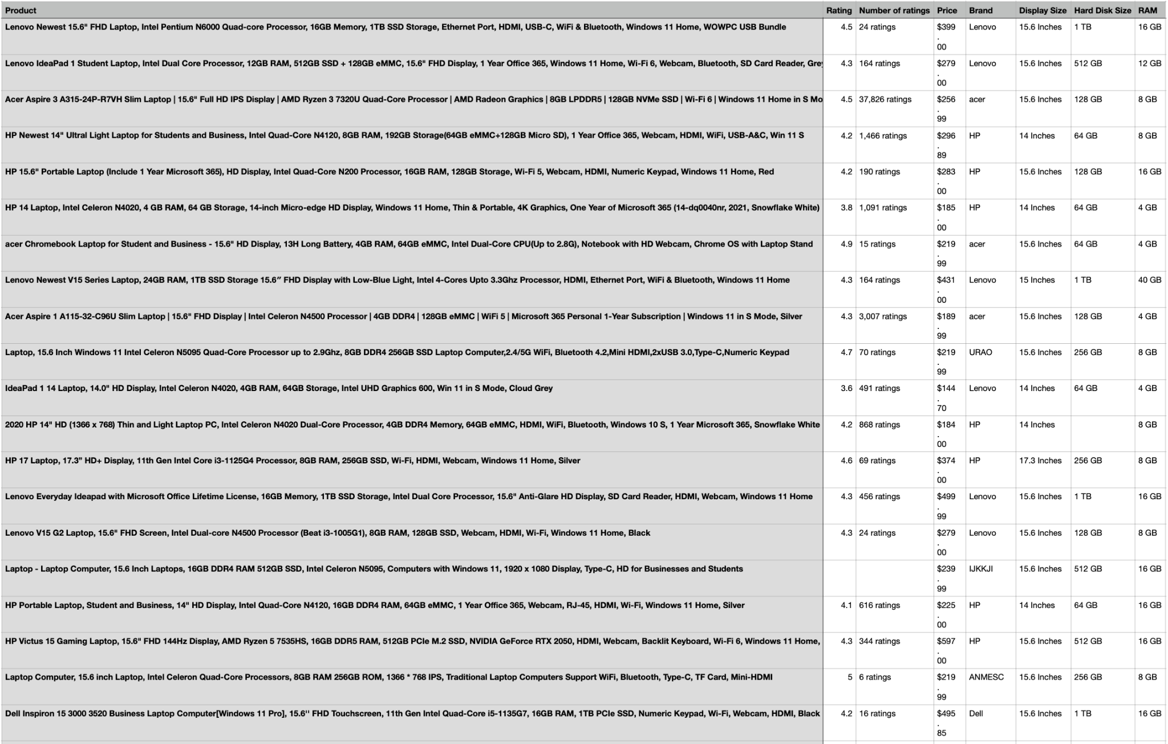
Amazon Data using Octoparse

Slide 14
Pros and Cons of Using Octoparse Tool
Pros:
Intuitive and straightforward interface for users.
Works across a wide range of websites and data sources.
Offers both cloud-based and local desktop solutions.
Features an automatic scheduler for setting up scraping tasks.
Includes a point-and-click feature for non-programmers to set up scrapes.
Cons:
Customization possibilities are less extensive than those of alternative tools.
Not ideal for intricate web scraping projects.
Has restricted capabilities in processing JavaScript-rendered content.
Performance may lag with extensive data scraping jobs.
Supports a limited variety of data export formats.

Slide 15
Comparative Analysis of Web Scraping Tools:
Features | Beautifulsoup | Octoparse | Selenium
Browser automation | No | Yes | Yes
Multiple browser support | No | Yes | Yes
Supports JavaScript | No | Yes | Yes
Scalability | Good | Moderate | Excellent
Speed | Fast | Slow | Fast
Supports multiple programming languages | No | Yes | Yes
Provides API | Yes | Yes | Yes
Support for XPath selectors | Yes | Yes | Yes
Data extraction capabilities | Yes | Yes | Yes
GUI for non-coders | Yes | No | Yes

Slide 16
PROJECT
PLAN:
Tasks | Task Description | Assigned To | Completion Date
1 | Choice of Project Topic | Entire Team | 01/11/2024
2 | Exploration of Data Sources | Entire Team | 01/15/2024
3 | Drafting of Project Plan | Entire Team | 02/26/2024
4 | Analysis of BeautifulSoup | Sai Chinnu | 03/15/2024
5 | Examination of Selenium | Manogna | 03/15/2024
6 | Review of OctoParse | Bhargav, Jyotsna | 03/15/2024
7 | Investigation of Scrapy | Manideep, Naveen | 03/15/2024
8 | Compilation and Assessment | Entire Team | 03/20/2024
9 | Project Demo | Entire Team | 04/24/2024
10 | Final Report Submission | Entire Team | 05/01/2024

Slide 17
REFERENCES:
[1] T. Johnson and P. Kumar, “Advancements in Web Scraping Techniques or Data Extraction,” in Proceedings of the 5th International Conference on Data Mining and Database Management, 2018, pp. 105-110.
[2] A. Gupta and R. Singh, “Utilizing Selenium for Automated Web Testing and Data Extraction,” Journal of Computer Science and Application, vol. 11, no. 3, pp. 213-219, June 2019.
[3] L. Chen, “A Comparative Study of Web Scraping Tools for Data Analysts,” in Innovations in Information Systems and Technologies, vol. IV, W. Zhou, Ed. Springer, 2020, pp. 289–298.
[4] S. Turner, “Exploring the Efficiency of Python Libraries in Web Scraping,” J. Web Dev. & Web Design, in press.
[5] H. Lee, J. Kim, and M. Park, “Analysis of User Interaction Patterns through Web Scraping on Social Media Platforms,” IEEE Trans. On Human-Machine Systems, vol. 50, no. 2, pp. 175-182, March 2021.
[6] B. Thompson, Web Scraping with Python: Techniques for Data Mining. New York, NY: Tech Press, 2021.
[7] N. Patel and J. Smith, “Challenges in Scraping Dynamic Web Content: A Methodological Approach,” 2017 4th International Conference on Advanced Computing and Communication Systems (ICACCS), 2017, pp. 234-239.
[8] F. Alvarez, G. Diaz, and S. Lopez, “Developing a Framework for Efficient Web Scraping and Data Analysis in Python,” in Proceedings of the 6th International Conference on Big Data Analysis and Data Mining, London, UK, 2019, pp. 320-325.

Slide 18


