Slide 1
Example: Swiss Banknotes Data
A business application for Linear Discriminant Analysis (LDA).

Slide 2
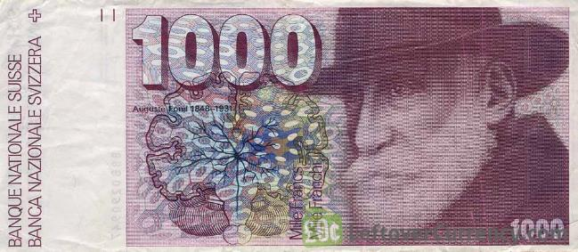
Data Description
The dataset contains six measurements made on 100 genuine and 100 counterfeit old 1000-Franc Swiss banknotes.

Slide 3
Data Description
Name | Details
Length | Length of bill (mm)
Left | Width of left edge (mm)
Right | Width of right edge (mm)
Bottom | Bottom margin width (mm)
Top | Top margin width (mm)
Diagonal | Length of diagonal (mm)
Type | 1 for genuine; 0 for counterfeit

Slide 4
Data Description
Group Means:
 | Type = 0 | Type = 1
Length | 214.823 | 214.969
Left | 130.300 | 129.943
Right | 130.193 | 129.720
Bottom | 10.530 | 8.305
Top | 11.133 | 139.450
Diagonal | 139.450 | 141.517

Slide 5
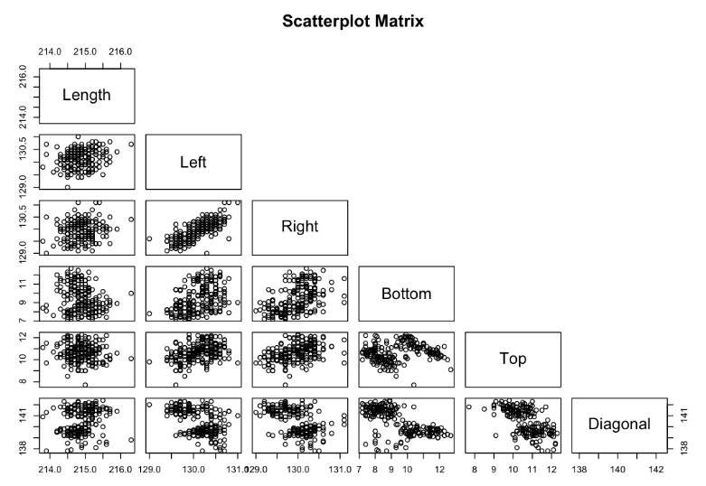
Data Description

Slide 6
Methodology
In total 200 banknote observations.
Randomly divide the whole dataset into halves.
Name them train_set and test_set.
Implement LDA using the train_set and use the test_set to evaluate the performance of the resultant linear discriminant function.
Iterate the above procedures.

Slide 7
Prior Information
Assume
Pr(A banknote is counterfeit) = Pr(Type = 0) = 0.01;
Pr(A banknote is genuine) = Pr(Type = 1) = 0.99.

Slide 8
One Iteration
Coefficients of Linear Discriminants:
Name | LD1
Length | -0.2626489
Left | 0.8026030
Right | -0.5637819
Bottom | -0.9848281
Top | -1.1832084
Diagonal | 1.6870771

Slide 9
One Iteration
Confusion Matrix
The apparent error rate (APER) = (1+0)/100 = 1%.
 | Predicted 0 | Predicted 1 | Total
Actual 0 | 48 | 0 | 48
Actual 1 | 1 | 51 | 52
Total | 49 | 51 | 100

Slide 10
Ten Iterations
Average APER = (1 + 0 + 1 + 1 + 2 + 1 + 1 + 1 + 4 + 0)% / 10 = 1.2%
High Accuracy!
Next, train a LD function using the whole dataset.

Slide 11
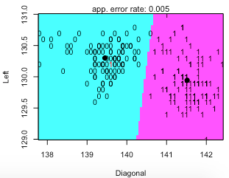
2D Partition Plots
Best partition plot, Left v.s. Diagonal:

Slide 12
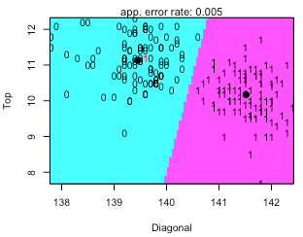
2D Partition Plots
Best partition plot, Top v.s. Diagonal:

Slide 13
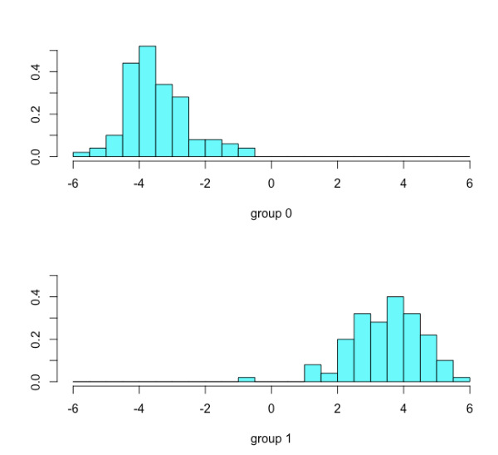
Histogram of LDA Values

Slide 14
Example: German Credit Data
A business application for Clustering Analysis.

Slide 15
Data Description
The German Credit dataset contains 1000 instances with 21 attributes in total.
7 numerical + 7 ordinal categorical + 7 nominal categorical variables.
The main objective is to find the correlation between data clusters and the Default indicator.

Slide 16
Data Description (Numerical Attributes)
Name | Details
duration | Duration in month
amount | Credit amount
installment | Installment rate in percentage of disposable income
residence | Present residential time
age | Age in years
cards | Number of credit cards
liable | Number of people being liable to provide maintenance for

Slide 17
Data Description (Ordinal Categorical Attributes)
Name | Details (Values)
checkingstatus | Checking account status (0, 1, 2, 3)
history | Credit history (0, 1, 2, 3, 4)
savings | Savings account/bonds (0, 1, 2, 3, 4)
employ | Present employment time (0, 1, 2, 3, 4)
others | Condition of other debtors/guarantors (1, 2, 3)
property | Property condition (1, 2, 3, 4)
job | Job qualification (1, 2, 3, 4)

Slide 18
Data Description (Nominal Categorical Attributes)
Name | Details
Default | 0 (no) and 1 (yes)
purpose | Purpose of money
status | Personal status and sex
otherplans | Other installment plans
housing | Housing condition
tele | Indicator for telephone
foreign | Indicator for foreign worker

Slide 19
Feature Selection
Too many variables.
Need to reduce the number of variables.
Logistic regression to select the significant ones with α = 0.05.

Slide 20
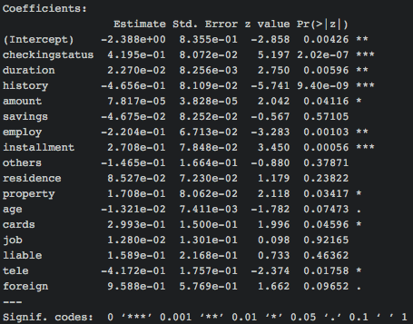
Feature Selection

Slide 21
Methodology
Implement K-means algorithm and Hierarchical Clustering algorithm on the 9 variables chosen in previous slide.
Compare the cluster results with the actual status of default.

Slide 22
K-means Results
Confusion Matrix
The apparent error rate (APER) = (228+101)/1000 = 32.9 %.
 | Predicted 0 | Predicted 1 | Total
Actual 0 | 599 | 101 | 700
Actual 1 | 228 | 72 | 300
Total | 827 | 173 | 1000

Slide 23
K-means Results
Total Sum of Squares = 7960027369.
Within Sum of Squares = 2405315502 (two clusters).
Betweeness Sum of Squares = 5554711867.

Slide 24
Hierarchical Clustering Results
Cut the dendrogram at cluster no. = 2
Confusion Matrix
The apparent error rate (APER) = (269+25)/1000 = 29.4 %.
 | Predicted 0 | Predicted 1 | Total
Actual 0 | 675 | 25 | 700
Actual 1 | 269 | 31 | 300
Total | 944 | 56 | 1000

Slide 25
Conclusion
Although in terms of APER, the aforementioned two clustering techniques are not bad, they are weak in predicting defaults if the real status is default.
Other nominal categoricals can be very important to predict the default status (e.g. purpose of money).

Slide 26
Example: Sample Stocks Data
A business application for Clustering Analysis.

Slide 27
Data Description
The dataset contains 648 instances, which correspond to 648 US stocks.
Two attributes for each stock:
Returns -- annual return in % term.
Dividend yield -- the dividend yield for the stock in % term.

Slide 28
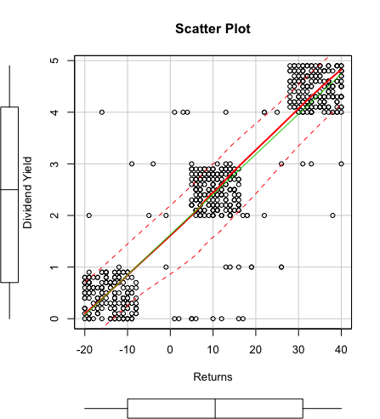
Data Description (Scatter Plot)

Slide 29
Methodology
Determine the number of clusters systematically (although it is obvious that three clusters exist in the previous plot).
Run K-means algorithm.
Run Hierarchical Clustering algorithm.

Slide 30
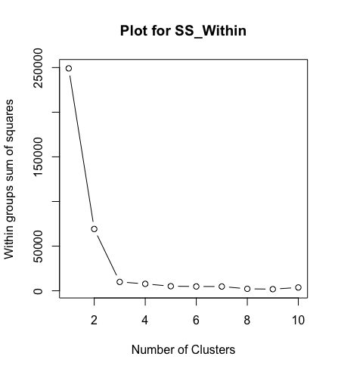
How many clusters?
Three clusters are optimal
for this dataset.

Slide 31
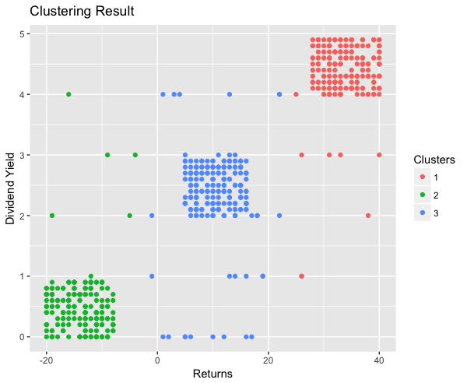
K-means clustering for k=3

Slide 32
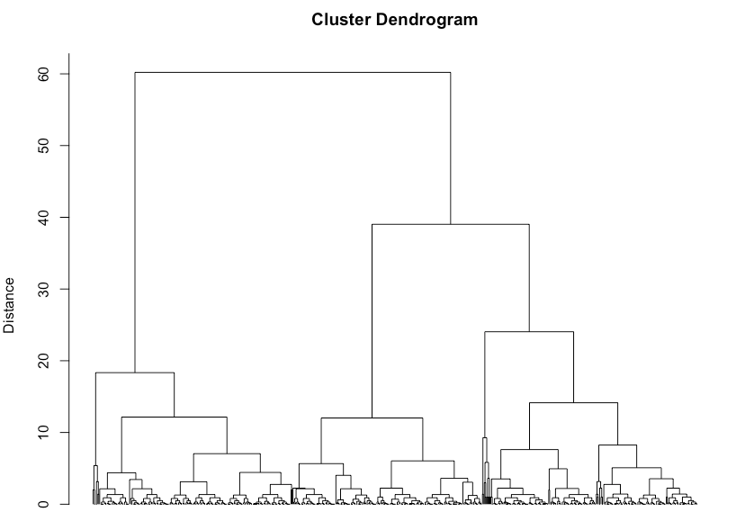
Hierarchical Clustering

