Slide 1
Linear Regression

Slide 2
SLR
Simple Linear Regression
Simple linear regression is when you want to predict values of one variable, given values of another variable. For example, you might want to predict a person's height (in inches) from his weight (in pounds).
Imagine a sample of ten people for whom you know their height and weight. You could plot the values on a graph, with weight on the x axis and height on the y axis.

Slide 3
SLR
If there were a perfect linear relationship between height and weight, then all 10 points on the graph would fit on a straight line. But, this is never the case (unless your data are rigged). If there is a (nonperfect) linear relationship between height and weight (presumably a positive one), then you would get a cluster of points on the graph which slopes upward. In other words, people who weigh a lot should be taller than those people who are of less weight. (See graph.)

Slide 4
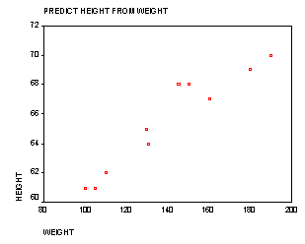
SLR

Slide 5
SLR
The purpose of regression analysis is to come up with an equation of a line that fits through that cluster of points with the minimal amount of deviations from the line. The deviation of the points from the line is called "error." Once you have this regression equation, if you knew a person's weight, you could then predict their height. Simple linear regression is actually the same as a bivariate correlation between the independent and dependent variable.

Slide 6
Residuals
After verifying that the linear correlation between two variables is significant, next we determine the equation of the line that can be used to predict the value of y for a given value of x.
y
Observed y-value
d₂
For a given x-value,
d = (observed y-value) – (predicted y-value)
d₁
Predicted y-value
d₃
x
Each data point d_{i} represents the difference between the observed y-value and the predicted y-value for a given x-value on the line. These differences are called residuals.

Slide 7
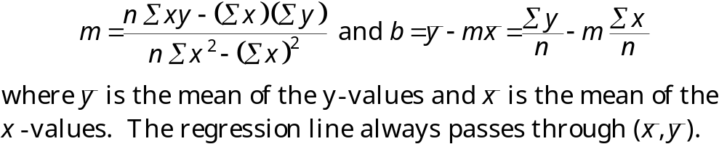
Regression Line
A regression line, also called a line of best fit, is the line for which the sum of the squares of the residuals is a minimum.
The Equation of a Regression Line
The equation of a regression line for an independent variable x and a dependent variable y is
ŷ = mx + b
where ŷ is the predicted y-value for a given x-value. The slope m and y-intercept b are given by

Slide 8





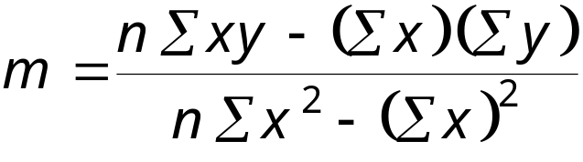
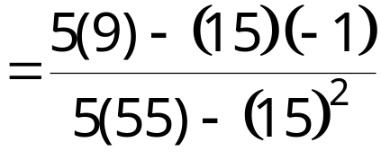
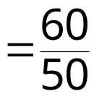

Regression Line
Example:
Find the equation of the regression line.
x | y | xy | x² | y²
1 | – 3 | – 3 | 1 | 9
2 | – 1 | – 2 | 4 | 1
3 | 0 | 0 | 9 | 0
4 | 1 | 4 | 16 | 1
5 | 2 | 10 | 25 | 4
Continued.

Slide 9
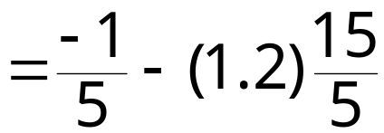


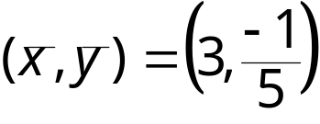
Regression Line
Example continued:
The equation of the regression line is
ŷ = 1.2x – 3.8.
y
2
1
x
−1
1
2
3
4
5
−2
−3

Slide 10





Regression Line
Example:
The following data represents the number of hours 12 different students watched television during the weekend and the scores of each student who took a test the following Monday.
a.) Find the equation of the regression line.
b.) Use the equation to find the expected test score for a student who watches 9 hours of TV.
Hours, x | 0 | 1 | 2 | 3 | 3 | 5 | 5 | 5 | 6 | 7 | 7 | 10
Test score, y | 96 | 85 | 82 | 74 | 95 | 68 | 76 | 84 | 58 | 65 | 75 | 50
xy | 0 | 85 | 164 | 222 | 285 | 340 | 380 | 420 | 348 | 455 | 525 | 500
x² | 0 | 1 | 4 | 9 | 9 | 25 | 25 | 25 | 36 | 49 | 49 | 100
y² | 9216 | 7225 | 6724 | 5476 | 9025 | 4624 | 5776 | 7056 | 3364 | 4225 | 5625 | 2500

Slide 11
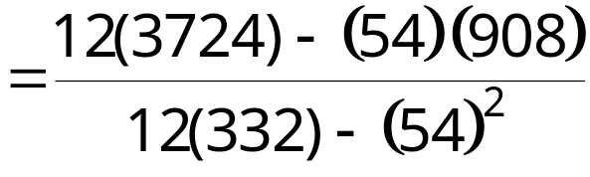

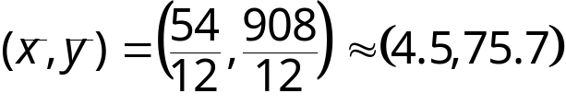
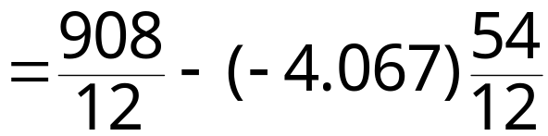

Regression Line
Example continued:
y
100
80
60
Test score
40
ŷ = –4.07x + 93.97
20
x
2
4
6
8
10
Hours watching TV
Continued.

Slide 12
Regression Line
Example continued:
Using the equation ŷ = –4.07x + 93.97, we can predict the test score for a student who watches 9 hours of TV.
ŷ = –4.07x + 93.97
= –4.07(9) + 93.97
= 57.34
A student who watches 9 hours of TV over the weekend can expect to receive about a 57.34 on Monday’s test.

Slide 13
Measures of Regression and Prediction Intervals

Slide 14






Variation About a Regression Line
To find the total variation, you must first calculate the total deviation, the explained deviation, and the unexplained deviation.
y
(x_{i}, y_{i})
Unexplained deviation
Total deviation
(x_{i}, ŷ_{i})
Explained deviation
(x_{i}, y_{i})
x

Slide 15
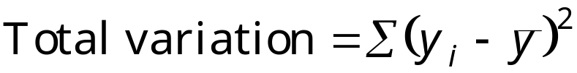

Variation About a Regression Line
The total variation about a regression line is the sum of the squares of the differences between the y-value of each ordered pair and the mean of y.
The explained variation is the sum of the squares of the differences between each predicted y-value and the mean of y.
The unexplained variation is the sum of the squares of the differences between the y-value of each ordered pair and each corresponding predicted y-value.

Slide 16
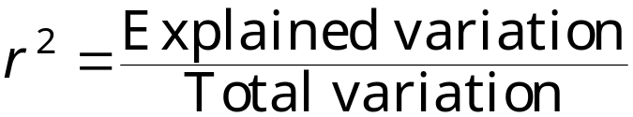


Coefficient of Determination
The coefficient of determination r² is the ratio of the explained variation to the total variation. That is,
Example:
The correlation coefficient for the data that represents the number of hours students watched television and the test scores of each student is r ≈ −0.831. Find the coefficient of determination.
About 69.1% of the variation in the test scores can be explained by the variation in the hours of TV watched. About 30.9% of the variation is unexplained.

Slide 17
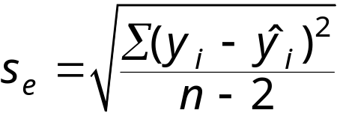
The Standard Error of Estimate
When a ŷ-value is predicted from an x-value, the prediction is a point estimate.
An interval can also be constructed.
The standard error of estimate s_{e} is the standard deviation of the observed y_{i} -values about the predicted ŷ-value for a given x_{i} -value. It is given by
where n is the number of ordered pairs in the data set.
The closer the observed y-values are to the predicted y-values, the smaller the standard error of estimate will be.

Slide 18
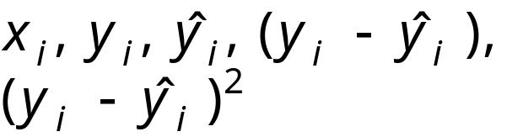


The Standard Error of Estimate
Finding the Standard Error of Estimate
In Words In Symbols
Make a table that includes the column heading shown.
Use the regression equation to calculate the predicted y-values.
Calculate the sum of the squares of the differences between each observed y-value and the corresponding predicted y-value.
Find the standard error of estimate.

Slide 19

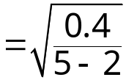

The Standard Error of Estimate
Example:
The regression equation for the following data is
ŷ = 1.2x – 3.8.
Find the standard error of estimate.
x_{i} | y_{i} | ŷ_{i} | (y_{i} – ŷ_{i} )²
1 | – 3 | – 2.6 | 0.16
2 | – 1 | – 1.4 | 0.16
3 | 0 | – 0.2 | 0.04
4 | 1 | 1 | 0
5 | 2 | 2.2 | 0.04
Unexplained variation
The standard deviation of the predicted y value for a given x value is about 0.365.

Slide 20
The Standard Error of Estimate
Example:
The regression equation for the data that represents the number of hours 12 different students watched television during the weekend and the scores of each student who took a test the following Monday is
ŷ = –4.07x + 93.97.
Find the standard error of estimate.
Hours, x_{i} | 0 | 1 | 2 | 3 | 3 | 5
Test score, y_{i} | 96 | 85 | 82 | 74 | 95 | 68
ŷ_{i} | 93.97 | 89.9 | 85.83 | 81.76 | 81.76 | 73.62
(y_{i} – ŷ_{i})² | 4.12 | 24.01 | 14.67 | 60.22 | 175.3 | 31.58
Hours, x_{i} | 5 | 5 | 6 | 7 | 7 | 10
Test score, y_{i} | 76 | 84 | 58 | 65 | 75 | 50
ŷ_{i} | 73.62 | 73.62 | 69.55 | 65.48 | 65.48 | 53.27
(y_{i} – ŷ_{i})² | 5.66 | 107.74 | 133.4 | 0.23 | 90.63 | 10.69
Continued.

Slide 21

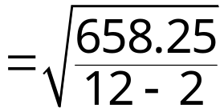

The Standard Error of Estimate
Example continued:
Unexplained variation
The standard deviation of the student test scores for a specific number of hours of TV watched is about 8.11.

Slide 22
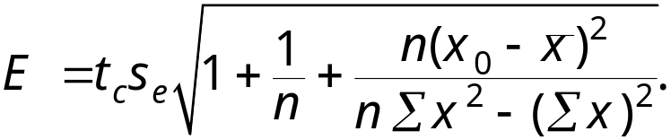
Prediction Intervals
Two variables have a bivariate normal distribution if for any fixed value of x, the corresponding values of y are normally distributed and for any fixed values of y, the corresponding x-values are normally distributed.
A prediction interval can be constructed for the true value of y.
Given a linear regression equation ŷ = mx + b and x₀, a specific value of x, a c-prediction interval for y is
ŷ – E < y < ŷ + E
where
The point estimate is ŷ and the margin of error is E. The probability that the prediction interval contains y is c.

Slide 23

Prediction Intervals
Construct a Prediction Interval for y for a Specific Value of x
In Words In Symbols
Identify the number of ordered pairs in the data set n and the degrees of freedom.
Use the regression equation and the given x-value to find the point estimate ŷ.
Find the critical value t_{c} that corresponds to the given level of confidence c.
Use Table 5 in Appendix B.
Continued.

Slide 24
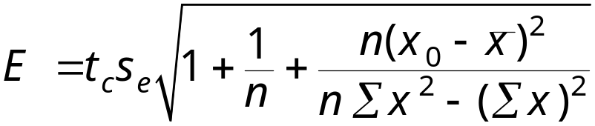
Prediction Intervals
Construct a Prediction Interval for y for a Specific Value of x
In Words In Symbols
Find the standard error of estimate s_{e}.
Find the margin of error E.
Find the left and right endpoints and form the prediction interval.
Left endpoint: ŷ – E Right endpoint: ŷ + E
Interval: ŷ – E < y < ŷ + E

Slide 25
Prediction Intervals
Example:
The following data represents the number of hours 12 different students watched television during the weekend and the scores of each student who took a test the following Monday.
Hours, x | 0 | 1 | 2 | 3 | 3 | 5 | 5 | 5 | 6 | 7 | 7 | 10
Test score, y | 96 | 85 | 82 | 74 | 95 | 68 | 76 | 84 | 58 | 65 | 75 | 50
ŷ = –4.07x + 93.97
s_{e} ≈ 8.11
Construct a 95% prediction interval for the test scores when 4 hours of TV are watched.
Continued.

Slide 26
Prediction Intervals
Example continued:
Construct a 95% prediction interval for the test scores when the number of hours of TV watched is 4.
There are n – 2 = 12 – 2 = 10 degrees of freedom.
The point estimate is
ŷ = –4.07x + 93.97
= –4.07(4) + 93.97
= 77.69.
The critical value t_{c} = 2.228, and s_{e} = 8.11.
ŷ – E < y < ŷ + E
77.69 – 8.11 = 69.58
77.69+ 8.11 = 85.8
You can be 95% confident that when a student watches 4 hours of TV over the weekend, the student’s test grade will be between 69.58 and 85.8.

Slide 27
§ 9.4
Multiple Regression

Slide 28
Multiple Regression Equation
In many instances, a better prediction can be found for a dependent (response) variable by using more than one independent (explanatory) variable.
For example, a more accurate prediction of Monday’s test grade from the previous section might be made by considering the number of other classes a student is taking as well as the student’s previous knowledge of the test material.
A multiple regression equation has the form
ŷ = b + m₁x₁ + m₂x₂ + m₃x₃ + … + m_{k}x_{k}
where x₁, x₂, x₃,…, x_{k} are independent variables, b is the y-intercept, and y is the dependent variable.
* Because the mathematics associated with this concept is complicated, technology is generally used to calculate the multiple regression equation.

Slide 29
Predicting y-Values
After finding the equation of the multiple regression line, you can use the equation to predict y-values over the range of the data.
Example:
The following multiple regression equation can be used to predict the annual U.S. rice yield (in pounds).
ŷ = 859 + 5.76x₁ + 3.82x₂
where x₁ is the number of acres planted (in thousands), and x₂ is the number of acres harvested (in thousands). (Source: U.S. National Agricultural Statistics Service)
a.) Predict the annual rice yield when x₁ = 2758, and x₂ = 2714.
b.) Predict the annual rice yield when x₁ = 3581, and x₂ = 3021.
Continued.

Slide 30
Predicting y-Values
Example continued:
a.) ŷ = 859 + 5.76x₁ + 3.82x₂
= 859 + 5.76(2758) + 3.82(2714)
= 27,112.56
The predicted annual rice yield is 27,1125.56 pounds.
b.) ŷ = 859 + 5.76x₁ + 3.82x₂
= 859 + 5.76(3581) + 3.82(3021)
= 33,025.78
The predicted annual rice yield is 33,025.78 pounds.

