Slide 1
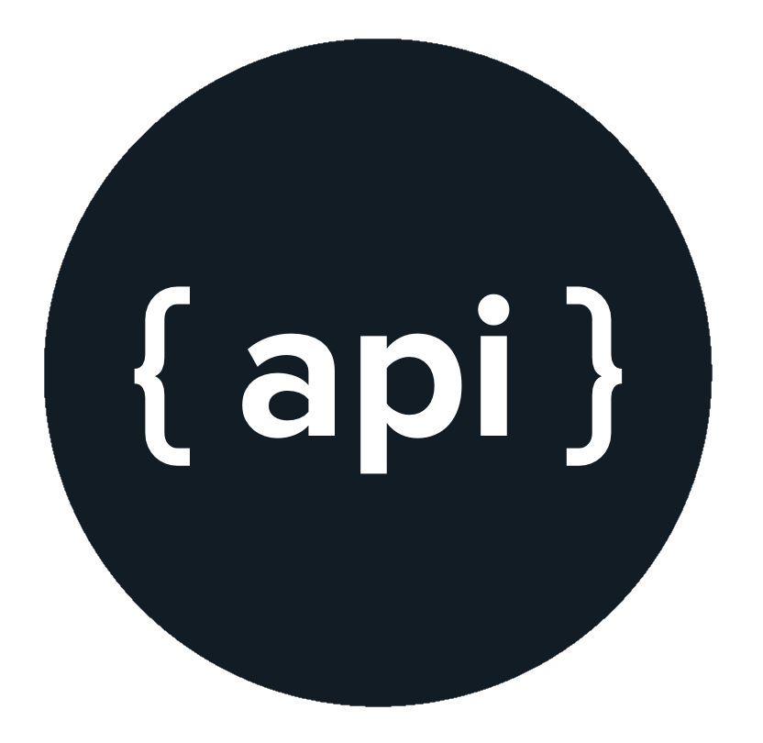
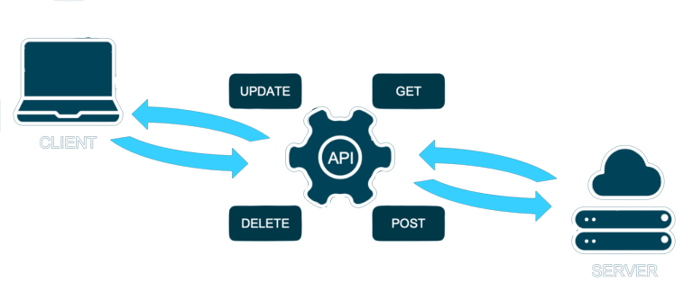
API

Slide 2
What is an API?
Application Programming Interface, abbreviated as API, enables connection between computers or computer programs. It is a Software Interface that offers services to other software to enhance the required functionalities.
As API enables businesses to open their applications’ data and functionality to external third-party developers, it eventually grows business partnerships, driving more revenue.

Slide 3




What is an API?

Slide 4



Type of API
Based on their uses and application, API can primarily be of three types:
Program API
Web API
Local API

Slide 5
Local API
Local APIs are OS or middleware services offered to an application program. For instance, Microsoft’s .NET APIs, the TAPI (telephony API), and database access APIs are forms of Local APIs.

Slide 6
Program API
Program APIs are based on Remote Procedure Call (RPC) technology that makes a remote program component appear local to the rest of the software. One such program API is the service-oriented architecture API of Microsoft’s WS-series.

Slide 7
Web API
Web API is an Open-Source Interface that can be easily accessed using the HTTP Protocol, generally called an API over the web. It leverages a large number of client entities, like Smartphones, Tablets, or Laptops.
A Web API can be developed using various technologies like Javascript and Python, providing superior performance and faster service development. However, as Web APIs are designed for distributed services, they are lightweight and have limitations in bandwidth.

Slide 8
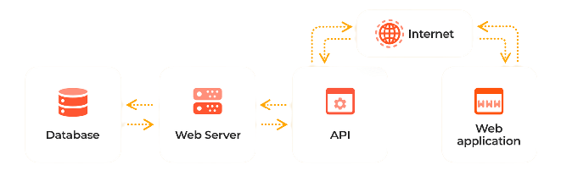
Web API

Slide 9
Type of API Protocols & Architecture
As the use of web APIs has increased, certain protocols have been developed to provide users with a set of defined rules that specifies the accepted data types and commands. In effect, these API protocols facilitate standardized information exchange:
XML-RPC
JSON-RPC
SOAP(Simple Object Access Protocol)
REST

Slide 10
XML-RPC
The XML-RPC protocol was created by Dave Winer to exchange information between two or more networks. The client performs RPC by using XML to encode its calls and HTTP requests for data transfer.
<?xml version="1.0" encoding="UTF-8"?>
<note>
<to>Tove</to>
<from>Jani</from>
<heading>Reminder</heading>
<body>Don't forget me this weekend!</body>
</note>

Slide 11
JSON-RPC
The JSON-RPC is a lightweight RPC encoded in JSON, similar to XML-RPC, which allows notifications and multiple calls to the server, which may be asynchronously answered.
{ "employees" : [' +
'{ "firstName":"John" , "lastName":"Doe" },' +
'{ "firstName":"Anna" , "lastName":"Smith" },' +
'{ "firstName":"Peter" , "lastName":"Jones" } ]
}

Slide 12
SOAP(Simple Object Access Protocol)
SOAP is an established Web API protocol for exchanging structured information. It uses XML to Authenticate, Authorize, and Communicate processes running on operating systems.
Since web protocols like HTTP run on most operating systems, SOAP allows clients to invoke web services and receive responses irrespective of language and platform.

Slide 13
REST
Representational State Transfer (REST) is an architectural style to provide standards between systems on the web. REST is neither a protocol, nor library, nor a tool, so communication between systems becomes easy. REST architecture makes the implementation of Client and Server independent without affecting the operation of the other.

Slide 14
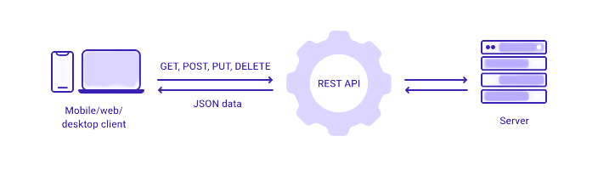
Introduction to REST API

Slide 15
Introduction to REST API
REST API is an API that follows a set of rules for an application and services to communicate with each other.
As it is constrained to REST architecture, REST API is referred to as RESTful API. REST APIs provide a way of accessing web services in a flexible way without massive processing capabilities.

Slide 16
Introduction to REST API
Below are the underlying rules of REST API:
Statelessness
Cacheable
Decoupled
Layered

Slide 17
Statelessness
Systems aligning with the REST paradigm are bound to become stateless. For Client-Server communication, stateless constraint enforces servers to remain unaware of the client state and vice-versa.
A constraint is applied by using resources instead of commands, and they are nouns of the web that describe any object, document, or thing to store/send to other resources.

Slide 18
Cacheable
Cache helps servers to mitigate some constraints of statelessness. It is a critical factor that has improved the performance of modern web applications.
Caching not only enhances the performance on the client-side but also scales significant results on the server-side. A well-established cache mechanism would drastically reduce the average response time of your server.

Slide 19
Decoupled
REST is a distributed approach, where client and server applications are decoupled from each other. Irrespective of where the requests are initiated, the only information the client application knows is the Uniform Resource Identifier (URI) of the requested resource.
A server application should pass requested data via HTTP but should not try modifying the client application.

Slide 20
Layered
A Layered system makes a REST architecture scalable. With RESTful architecture, Client and Server applications are decoupled, so the calls and responses of REST APIs go through different layers.
As REST API is layered, it should be designed such that neither Client nor Server identifies its communication with end applications or an intermediary.

Slide 21
REST to action
We are going to be making use of the hacker news API, to get top news online. We’ll use the fetch API in javascript.
fetch(url)
.then(response => response.json())
.then(response => console.log(response))
.catch(err => console.error(err));

Slide 22
Summary
API is an interface between two application
Types of API: Local, Program and Web API
Local API is within a system, Program API is within a system but provide remote interface while Web API works with the http protocol.
Web API consist of XML-RPC, JSON-RPC, SOAP and REST.
REST API does not have a ties server-client configuration.

Slide 23

But wait, there’s more
Graphql

Slide 24

And we areee
DONE
Thanks for listening
Questions and Observation

