Slide 1
Full Stack
Made By: Misha
UDACITY

Slide 2
Object Relational Mapper ( SQL Alchemy )
UDACITY

Slide 3
Database
MenuItem
Restaurant
Name
Id
Name
Description
Id
price
Course
restaurant_id
UDACITY

Slide 4
Setting up a database in SQL Alchemy
UDACITY

Slide 5
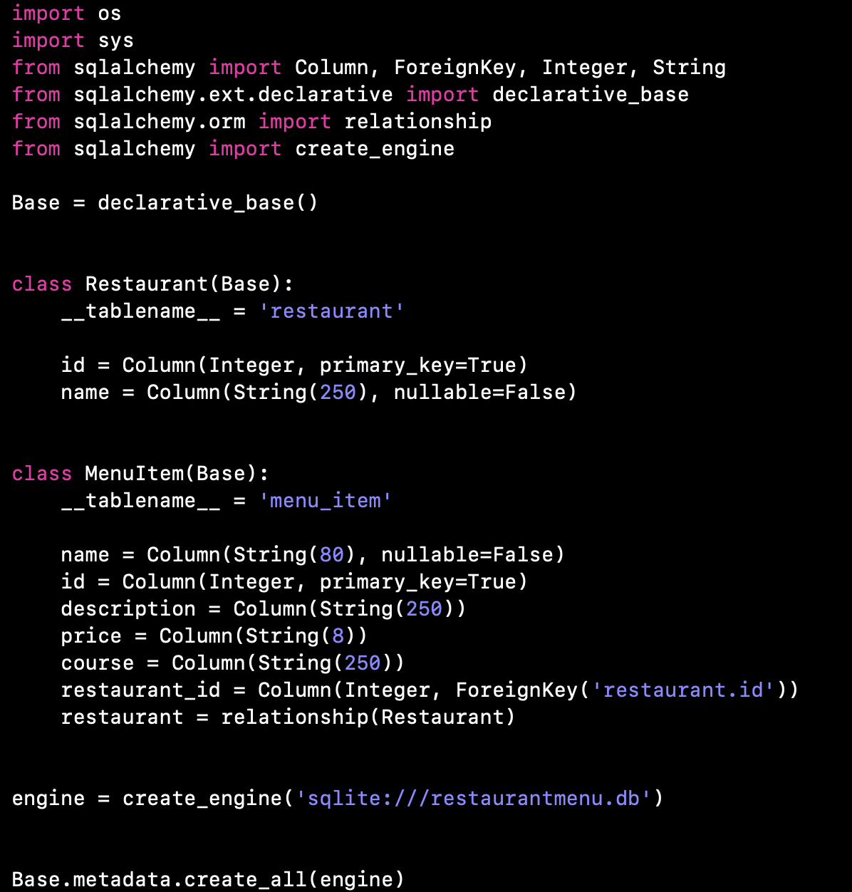
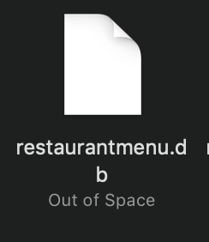
Configuration
Classes
Table name
Attributes = Columns
Will generate empty database
UDACITY

Slide 6
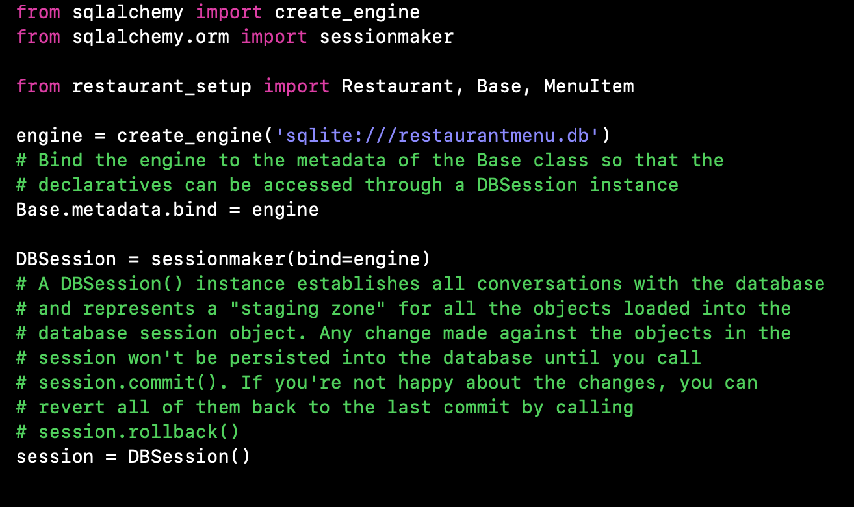
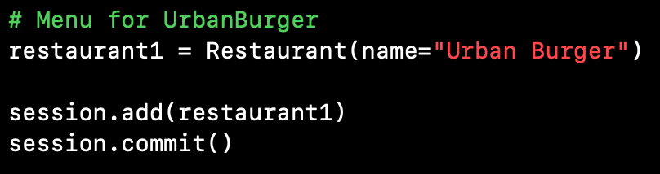
Configuration
Inserting into database
UDACITY

Slide 7
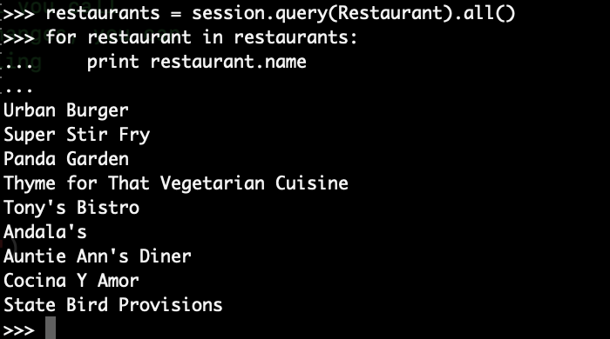
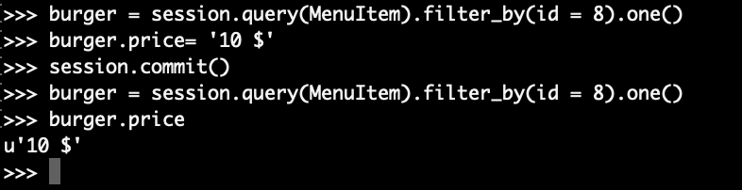
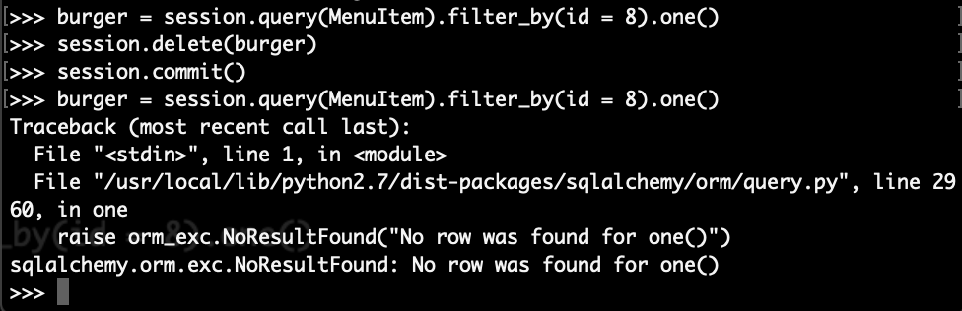
Reading
Updating
Deleting
UDACITY

Slide 8
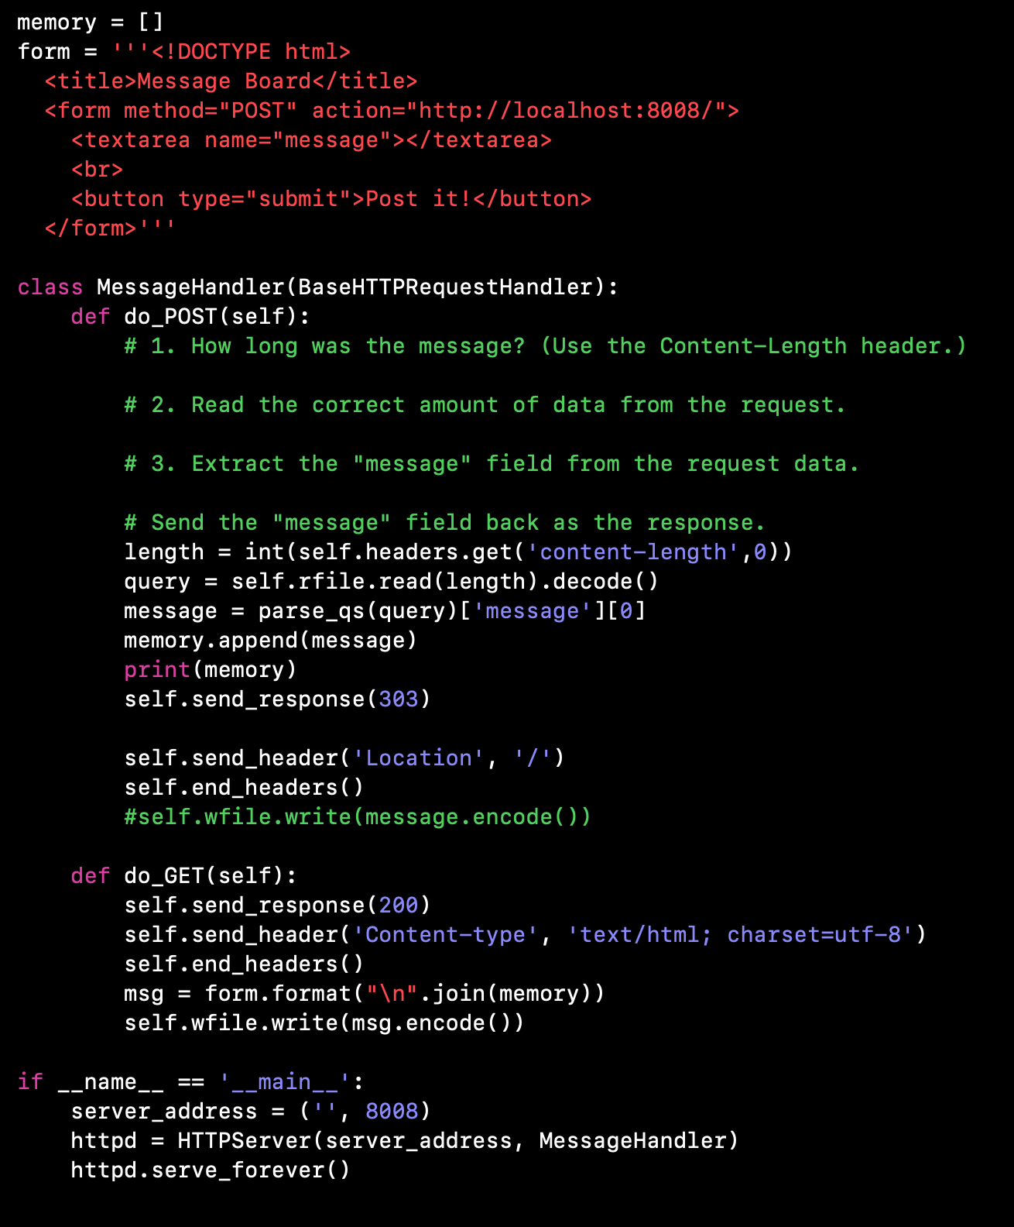
Python Server
UDACITY

Slide 9
Routing

Slide 10
GET
Viewing a page
with no data
Viewing a page
With data

Slide 11
POST

Slide 12
/restaurants
Requests
/restaurants/id
GET
/restaurants/new
POST
/restaurants/edit
For each request, we need a route.
/restaurants/delete
/restaurants/id/menu
For each route, it could be used for the two kind of requests depending on the logic
POST /restaurants/edit
POST /restaurants
GET /restaurants/edit
GET /restaurants

Slide 13
Activity
Describe each route,
what request it could handle
what’re the results of each route for each request
/
/startups/id
/startups/id/edit
/startups/id/delete
/startups/founders

Slide 14
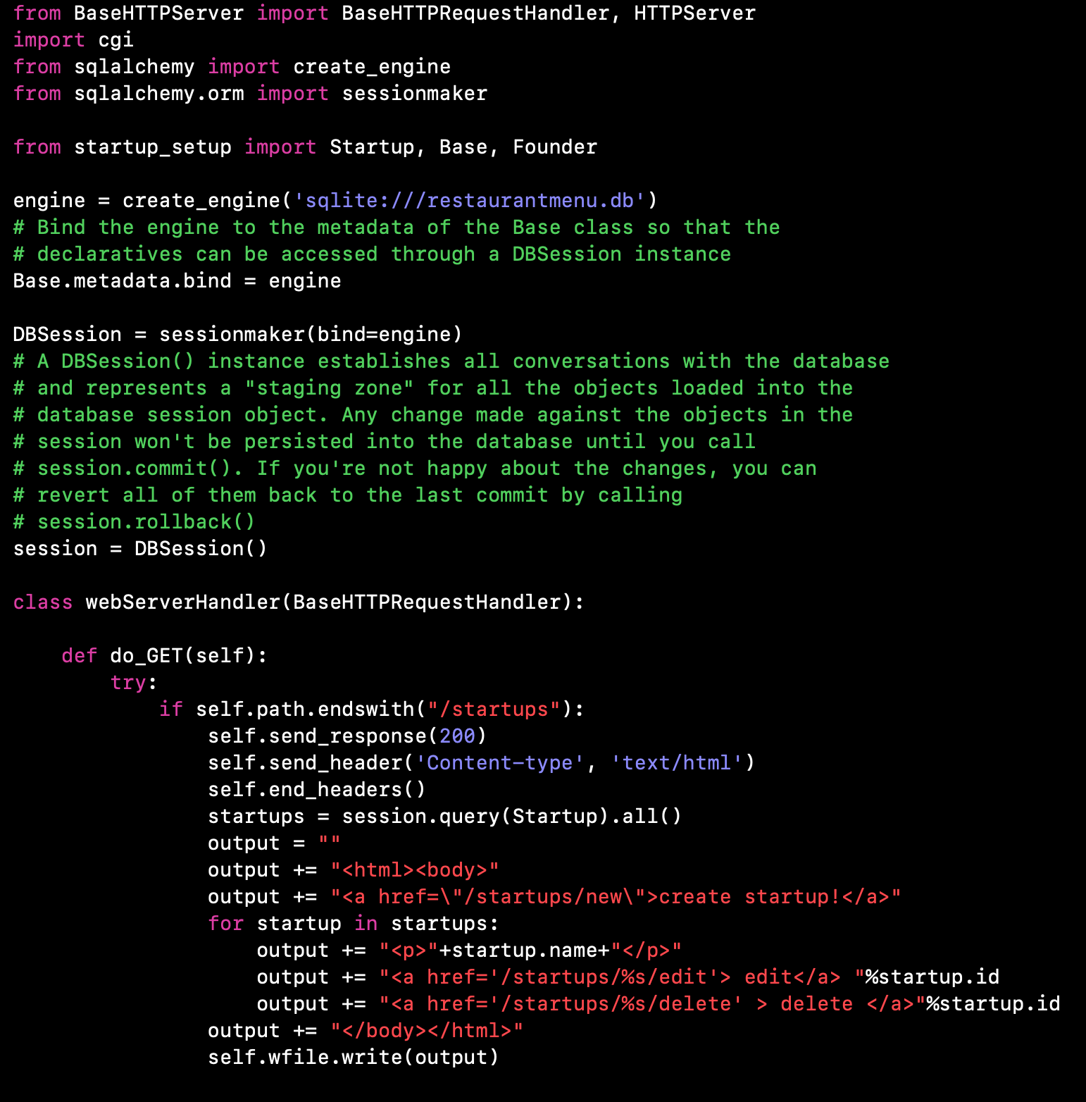
/startups
————————————————————————————
UDACITY

Slide 15
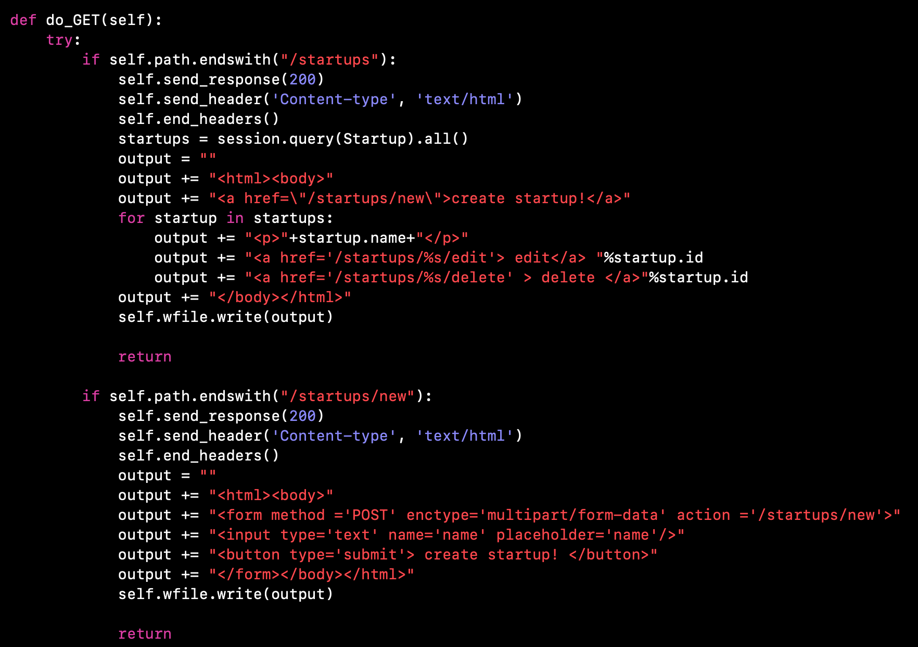
/startups/new
————————————————————————————
UDACITY

Slide 16
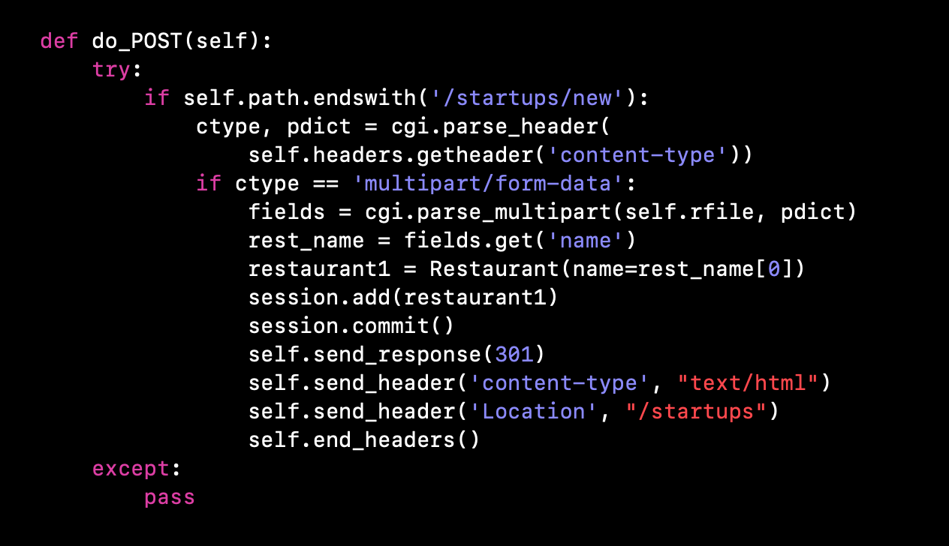
/startups/new
————————————————————————————
UDACITY

Slide 17
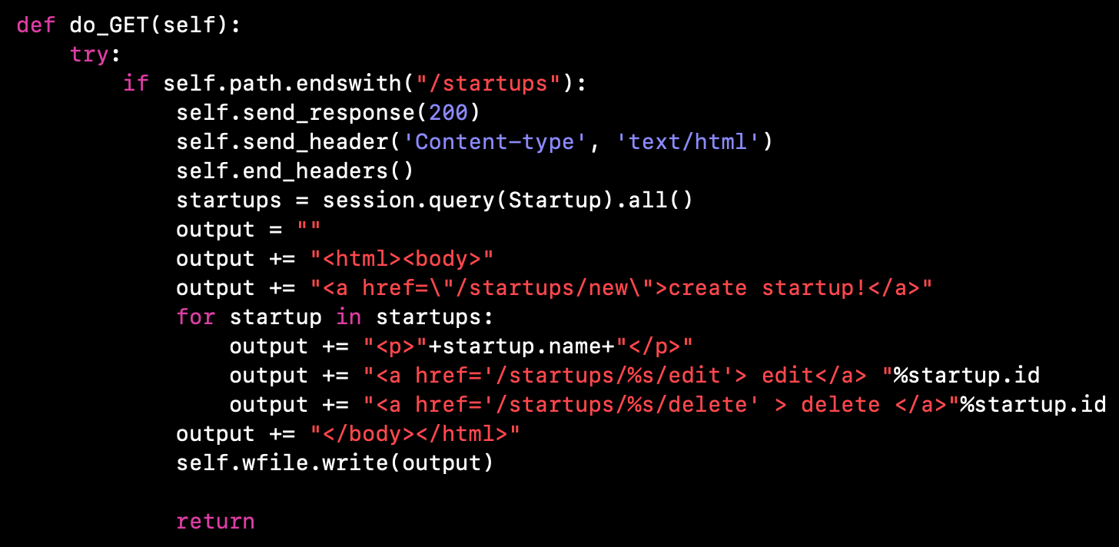
/startups
————————————————————————————
UDACITY

Slide 18
Another scenario…
UDACITY

Slide 19
/startups
————————————————————————
UDACITY

Slide 20
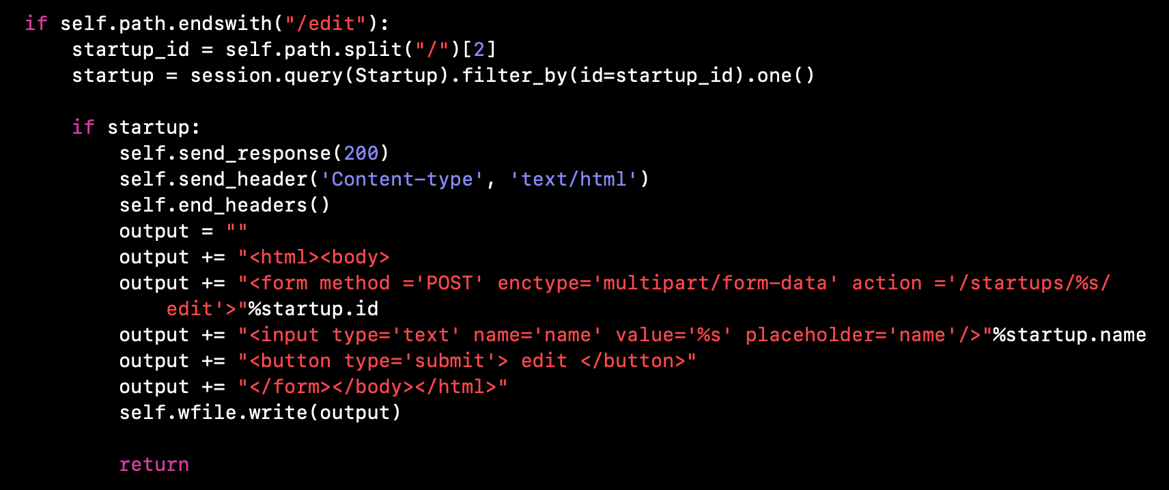
/startups/{id}/edit
————————————————————————————
UDACITY

Slide 21
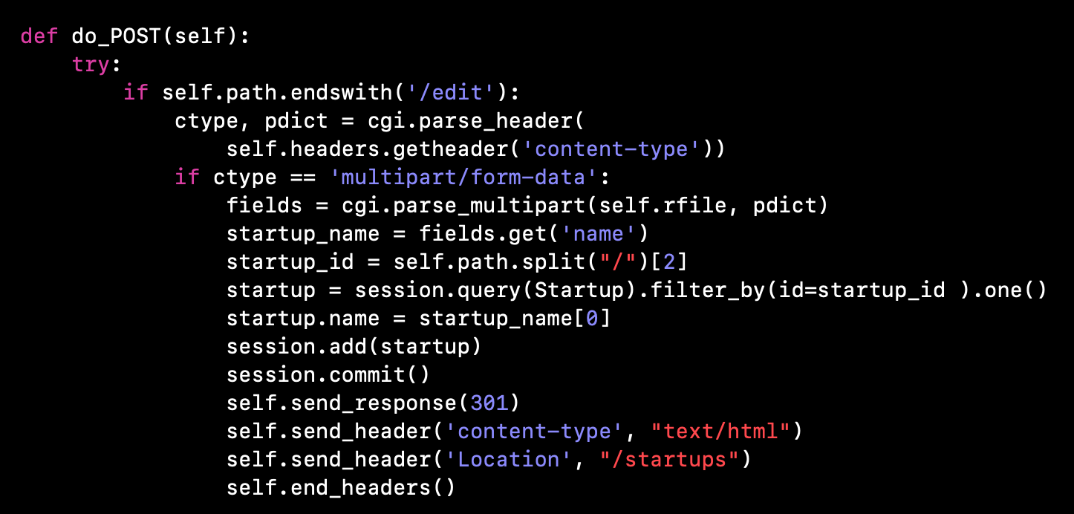
/startups/{id}/edit
————————————————————————————
UDACITY

Slide 22
/startups
————————————————————————————
UDACITY

Slide 23
There are many scenarios ..
UDACITY

Slide 24
Activity
1. Take some time to read the code
2. List all startups in the root route
3. By clicking on startup name, opens up a page with startup details: name and founders
4. In the detailed page, we can add a founder
UDACITY

