Slide 1
Aluminum Electrolytic Capacitor
Introduction of
Life Calculation Formula
February 11th, 2014

Slide 2
Agenda
Key Factors
Introduction of Life Calculation Formulas
Temperature Measurement

Slide 3
Agenda
Key Factors
Introduction of Life Calculation Formulas
Temperature Measurement

Slide 4
Key Factors
A. Key factors affects Life of Alum. E-CAP
Ambient Temperature
Internal Rising Temperature of E-CAP
Applied Voltage on E-CAP

Slide 5
Key Factors
Ambient Temperature
Deteriorated rubber sealing
Evaporation of electrolyte
Deterioration of electrolyte
Deteriorated aluminum foil

Slide 6
Key Factors
Internal Rising Temperature of E-CAP
Caused by Ripple Current (AC dissipation I²R)
Internal heat extrusion electrolyte gasification
Deterioration of acceleration electrolyte
Vicious circle of acceleration temperature rising

Slide 7
Key Factors
Applied Voltage on E-CAP
Recovering the surface of aluminum foil to produce hydrogen.
DC dissipation IV generates heat

Slide 8
Agenda
Key Factors
Introduction of Life Calculation Formulas
Temperature Measurement

Slide 9
Life Calculation
B. Life Calculation Formulas
E-CAP Load Life Formula and Example
E-CAP Ripple Life Formula and Example
E-CAP Ripple Life & Voltage≧160V
Solid Cap Life Formula and Example
Other Life Calculation Formulas

Slide 10
Life Calculation
E-CAP Load Life Formula and Example
Life formula
Lx = L0×k^((T0-Tx)/10) × k^(-ΔTx)/5)
where △Tx=△T0 x ( Ix / I0 )2, Ix>I0,K=4; Ix≦I0,K=2
Lx : Expected life period (hrs) at actual operating temperature
L0 : Expected life period (hrs) at maximum operating temperature allowed
To : Maximum operating temperature (℃) allowed
Tx : Actual operating ambient temperature (℃)
ΔTo : ≦5℃= Maximum temperature rise (℃) for applying Io (mArms)
Ix : Actual applied ripple current (mArms) at operating frequency fo (Hz)
Io : Rated maximum permissible ripple current IR(mArms) x frequency
multiplier (Cf) at f0 (Hz)
※Ripple Current calculation: no need Temperature Multiplying Factor
Note:15years(131,400h) is the maximum so that the deterioration of the sealing material

Slide 11
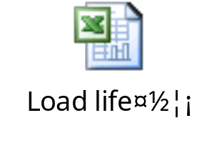
Life Calculation
E-CAP Load Life Formula and Example
For Example :
SH 1000/6.3 8*15 used at 60℃ 120HZ RC=0.223Arms, rated 105 ℃ 120HZ RC=0.445Arms,it is about 4.34 years according to formula calculation.
Value (uF) | V (rated) | Manufacturer | Series | Dimension |  | Freq Coeff. F | Rated | Rated | Rated ripple current | Actual ripple current | Ambient temp | Apply I_{x} Temp Rise | LIFE
 |  |  |  | case |  |  | temp | Life |  |  |  |  | EXPECTED
 |  |  |  | D | L |  | T_{o} | L0 | I_{o} | I_{x} | T_{x} | △T_{x} | Lx
 |  |  |  | (mm) | (mm) |  | deg C | Hours | Arms | Arms | deg C | deg C | Hours | Years
1000 | 6.3 |  | SH | 8 | 15 | 1 | 105 | 2000 | 0.445 | 0.223 | 60 | 1.26 | 38,025 | 4.34

Slide 12
Life Calculation
E-CAP Ripple Life Formula and Example
Life formula
Lx = Lr×k^((T0-Tx)/10) × k^(ΔTo -ΔTx)/5)
where △Tx=△T0 x ( Ix / I0 )2, Ix>I0,K=4; Ix≦I0,K=2
Lx : Expected life period (hrs) at actual operating temperature
Lr : Expected ripple life period (hrs) at maximum operating temperature
allowed
To : Maximum operating temperature (℃) allowed
Tx : Actual operating ambient temperature (℃)
ΔTo : ≦5℃= Maximum temperature rise (℃) for applying Io (mArms)
Ix : Actual applied ripple current (mArms) at operating frequency fo (Hz)
Io : Rated maximum permissible ripple current IR(mArms) x frequency
multiplier (Cf) at f0 (Hz)
※Ripple Current calculation: no need Temperature Multiplying Factor
Note:15years(131,400h) is the maximum so that the deterioration of the sealing material

Slide 13
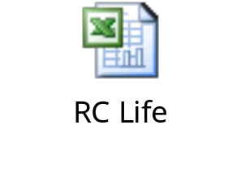
Life Calculation
E-CAP Ripple Life Formula and Example
For Example :
SC 1000/6.3 8*15 at 70℃ 100KHZ RC=0.42Arms, rated 105℃ 100KHZ RC=0.84Arms,it is about 6.63 years according to formula calculation.
Value (uF) | V (rated) | Manufacturer | Series | Dimension |  | Freq Coeff. F | Rated | Rated | Rated ripple current | Actual ripple current | Ambient temp | Apply I_{x} Temp Rise | LIFE
 |  |  |  | case |  |  | temp | Life |  |  |  |  | EXPECTED
 |  |  |  | D | L |  | T_{o} | Lr | I_{o} | I_{x} | T_{x} | △T_{x} | Lx
 |  |  |  | (mm) | (mm) |  | deg C | Hours | Arms | Arms | deg C | deg C | Hours | Years
1000 | 6.3 |  | SY | 8 | 15 | 1 | 105 | 4000 | 0.84 | 0.42 | 70 | 3.20 | 58,081 | 6.63

Slide 14
Life Calculation
E-CAP Ripple Life & Voltage≧160V
Life formula
Lx = Lr×k^((T0-Tx)/10) × k^(ΔTo -ΔTx)/5) x(V0/VX)^{4.4}
where △Tx=△T0 x ( Ix / I0 )2, Ix>I0,K=4; Ix≦I0,K=2
Lx : Expected life period (hrs) at actual operating temperature
Lr : Expected ripple life period (hrs) at maximum operating temperature allowed
To : Maximum operating temperature (℃) allowed
Tx : Actual operating ambient temperature (℃)
ΔTo : ≦5℃= Maximum temperature rise (℃) for applying I0 (mArms)
Ix : Actual applied ripple current (mArms) at operating frequency f0 (Hz)
Io : Rated maximum permissible ripple current IR(mArms) x frequency
multiplier (Cf) at f0 (Hz)
※Ripple Current calculation: no need Temperature Multiplying Factor
Vo : Rated voltage(V)
VX : Actual applied voltage(V)，Vx Should be 80% equal or more of Vo Note:15years(131,400h) is the maximum so that the deterioration of the sealing material

Slide 15
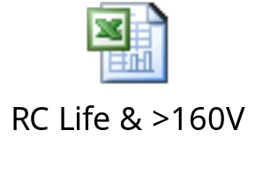
Life Calculation
E-CAP Ripple Life & Voltage≧160V
For Example :
LG 330/400 30*45 used at 75℃ 120HZ RC=0.7Arms 320V,
rated 105 ℃ 120HZ RC=1.4Arms 400V,it is about 6.26 years according to formula calculation.
Value (uF) | V₀ (rated) | Vx (Actual) | Series | Dimension |  | Freq Coeff. F | Rated | Rated | Rated ripple current | Actual ripple current | Ambient temp | Apply I_{x} Temp Rise | LIFE
 |  |  |  | case |  |  | temp | Life |  |  |  |  | EXPECTED
 |  |  |  | D | L |  | T_{o} | Lr | I_{o} | I_{x} | T_{x} | △T_{x} | Lx
 |  |  |  | (mm) | (mm) |  | deg C | Hours | Arms | Arms | deg C | deg C | Hours | Years
330 | 400 | 320 | LG | 30 | 45 | 1 | 105 | 2000 | 1.4 | 0.7 | 75 | 3.20 | 54,814 | 6.26

Slide 16
Life Calculation
Solid Cap Life Formula and Example (example 1)
Life formula
Lx = Le×B^((T0-Tx)/10) × B^(-ΔTx)/10)
Lx : Estimated life time at operating temperature
Le : Predictably-effective at specified maximum temperature (hours)
B : Temp. acceleration factor (≒2)
To : Maximum operating temperature (℃)
Tx : Actual ambient temperature (℃)
ΔTx : Heat rise by actual ripple current (℃) *
[ΔTx= ΔTo× (Ix / Io)^2]
ΔTo : Self-heating temperature by rated ripple current (20℃ const.)
Ix : Actual flow of ripple current (Arms)
Io : Rated ripple current Arms
Note:15years(131,400h) is the maximum so that the deterioration of the sealing material
series | CG | CF | CR | CP | CH | CT
Le | 15000 | 15000 | 15000 | 15000 | 20000 | 20000

Slide 17
Life Calculation
Solid Cap Life Formula and Example (example 2)
Life formula
LX = LO*10^((TO-TX) /20)
Lx : Estimated life time at operating temperature
Lo :Expected life period (hrs) at maximum operating temperature allowed
To : Maximum operating temperature (℃)
Tx : Actual ambient temperature (℃)
Note:15years(131,400h) is the maximum so that the deterioration of the sealing material

Slide 18
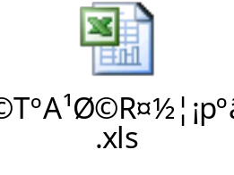
Life Calculation
Solid Cap Life Formula and Example
example 1: CG 220/6.3 6.3*5.4 used at 75℃ 100KHZ RC=1.2Arms, 6.3V working voltage, it is about 7.45 years according to formula calculation.
example 2: CG 220/6.3 6.3*5.4 used at 6.3V working voltage, at 75℃,
it is about 7.22 years according to formula calculation.
Location | Value (uF) | V₀ (rated) | Series | Dimension |  | Freq Coeff. F | Rated |  | Rated ripple current | Actual ripple current | Ambient temp | Apply I_{x} Temp Rise | LIFE
 |  |  |  | case |  |  | temp |  |  |  |  |  | EXPECTED
 |  |  |  | D | L |  | T_{o} | LE | I_{o} | I_{x} | T_{x} | △T_{x} | Lx
 |  |  |  | (mm) | (mm) |  | deg C | Hours | mArms | mArms | deg C | deg C | Hours | Years
 | 220 | 6.3 | CG | 6.3 | 5.4 | 1 | 105 | 15000 | 1810 | 1200 | 75 | 8.79 | 65,245 | 7.45
Location | Value (uF) | V₀ (rated) | Series | Dimension |  | Freq Coeff. F | Rated | Load life | ambient temperature | LIFE
 |  |  |  | case |  |  | temp |  |  | EXPECTED
 |  |  |  | D | L |  | T_{o} | L₀ | T_{x} | Lx
 |  |  |  | (mm) | (mm) |  | deg C | Hours | deg C | Hours | Years
 | 220 | 6.3 | CG | 6.3 | 5.4 | 1 | 105 | 2000 | 75 | 63,246 | 7.22

Slide 19
Life Calculation
Other Life Calculation Formulas

Slide 20
Agenda
Key Factors
Introduction of Life Calculation Formulas
Temperature Measurement

Slide 21
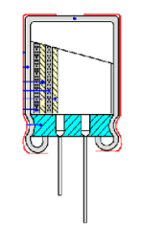
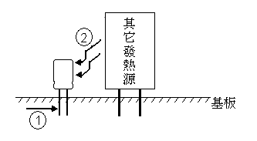
Measurement
C. Temperature Measurement
Heat Source：
① Conduction heat: By the copper foil to capacitor
② Radiant heat: Influenced by heat source around.
③ Dissipation heat of capacitor: (AC dissipation I2R, DC dissipation IV)
③

Slide 22
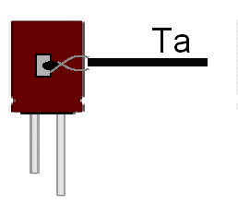
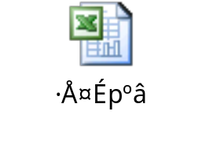
Measurement
D. Measurement of rising temp. of R.C.
After applying rated ripple current on capacitor and
voltage keep stabilization in 1h,
1. Measuring surface temperature of capacitor as shown in figure Ta (normal temperature)
2. Measuring around temperature of capacitor setting Tb (normal temperature)
3. Temperature rise ΔT of capacitor (normal temperature) =Tb-Ta
4. Measuring normal temperature and high temperature ESR for conversion thermal resistivity,according to thermal resistivity and normal temperature rise for calculation high temperature rise ΔT, which judgment standard of high temperature rise is ≦5℃.
5. Calculation formula as below (Detailed formula and example as attachment)
High temp. ΔT=W2*Q Q means thermal resistivity at normal temperature
Therein W1=I2*R1 W2=I2*R2 Q=ΔT/W1
W1 means power loss RC*ESR at normal temperature
W2 means power loss RC*ESR at normal temperature
NO | Series | Spec. | Size | Temp. rise at normal temp. | RC required | ESR (Normal temp.) | ESR (High temp.) | Power loss (Normal temp.) | Power loss (Normal temp.) | Thermal resistivity (Normal temp.) | High temp. rise
 |  |  |  | ΔT | I(A) | R1(Ω) | R2(Ω) | W1 | W2 | Q | ΔT
1 | SY | 1000/16 | 8*20 | 5 | 1.5 | 0.029 | 0.011 | 0.065 | 0.025 | 76.628 | 1.897

Slide 23
Q & A
Sincerity, Innovation & Competition TEAPO

