Slide 1
COMP390/3/4/5
Final Year Project
Design
Irina Biktasheva
http://www.csc.liv.ac.uk/~comp39x/2017-18

Slide 2

Submission Deadlines
Specification (5%): completion week 4
submission Thu 16.11.17 noon
Design documentation: Thu 16.11.17 noon
Design presentation: Mon 20.11.17 -
(whole design stage 15%) Fri 1.12.17
Interim Report: Fri 16.02.18
Demonstration slides: Thu 12.04.18 noon
Demonstration (15%): Mon 16.04.18 –
Fri 20.04.18
Dissertation (65%): Thu 10.05.18 noon
You should make yourself available during the weeks for design presentation & demonstration

Slide 3

Project Stages
Four phases
  Phase 1: Specification (3.5 weeks)
  Phase 2: Design (4.5 weeks)
  Phase 3: Implementation & Testing (12 weeks)
  Phase 4: Demonstration & Dissertation (3 weeks)
specification
document
design
document
design
presentation
 | w1 | w2 | w3 | w4 | w5 | w6 | w7 | w8 | w9 | w10 | w11 | w12
Sem 1
Sem 2
interim report
demonstration
dissertation

Slide 4
Design (15% of total mark)
Purpose
  To record the research and analysis done
  To detail the design of the system to be built
  To detail the design of evaluation
  ethics of the project
Design Documentation: due 16.11.17 noon
  Submit pdf via E-project
Design Presentation: 20.11.17 – 1.12.17
  20 minutes including 5 minutes for questions
  You must make yourself available during the two weeks

Slide 5
Design Structure
Summary of Proposal
Design
  Design of system
  Design of evaluation
  Ethical use of data, including use of human data & human participants
Review against Plan
  Gantt Chart showing what has been completed, progress to date & any necessary changes

Slide 6
Summary of Proposal
Statement of background, aims and objectives
  design document should be self-contained
Highlight changes to original specification
  what changes were needed and why?
  justification is important
Summary of research and analysis done so far
  summary of what you have read, tested (e.g., technical issues)? how outcomes affect the design?
  any analysis done? and their implications

Slide 7
Design
Typically should include
  description of anticipated components
  description of data structures to be used
  algorithms to manipulate these data structures
  design of interfaces
  description of evaluation of system
  ethical use of data
Presentation gives a summary
Documentation gives all details
How much details? Ask yourself: Would other people be able to implement the system by following your design?

Slide 8

System Design
Object-oriented methodology
Functional methodology
Traditional (aka “web based DB”) methodology
Empirical investigation of hypothesis
Devising new algorithms
Others…

Slide 9
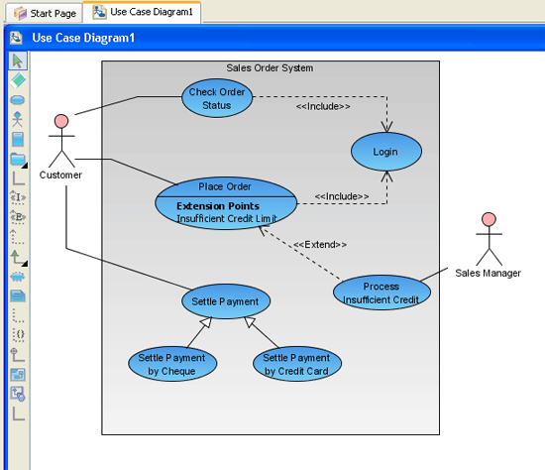

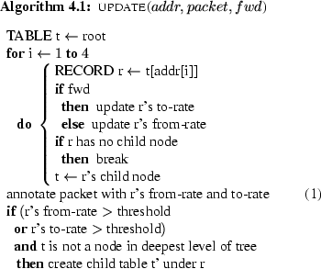
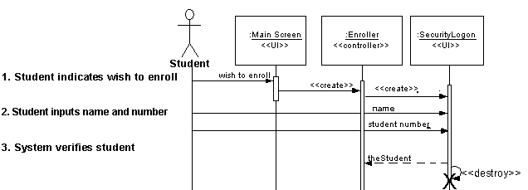
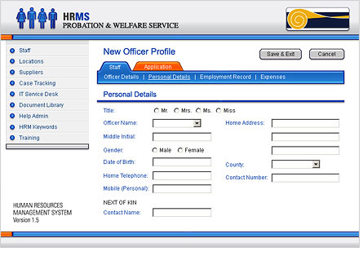
Example – OO design
use cases (actions)
actors
association
system boundary
use-case diagram
interaction chart
list of objects, attributes & methods
pseudo code of main methods
interface design
and necessary data structures
how components interact
information flow
make reference to the objects listed
create using Java OR
draw in Word

Slide 10
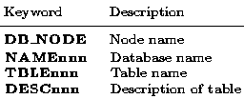
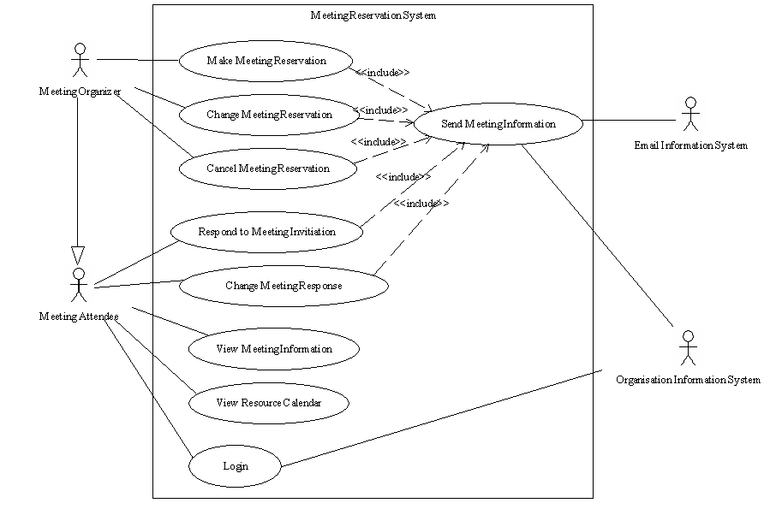
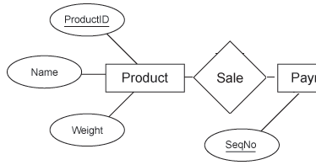
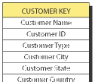
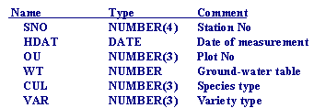
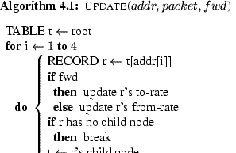
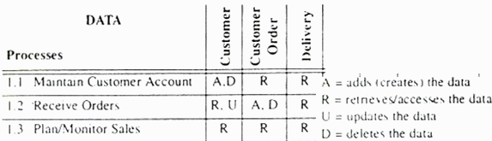

Example – Traditional Design
data dictionaries
system boundary diagram
ER diagram
logical/physical table structure
transaction matrix
pseudo code of main methods
interface design
etc
entities & relationships
type of relationship
Data Flow Diagram
normalisation applied?
process vs data
A / D / R / U
create using the language to be employed OR
draw in Word

Slide 11
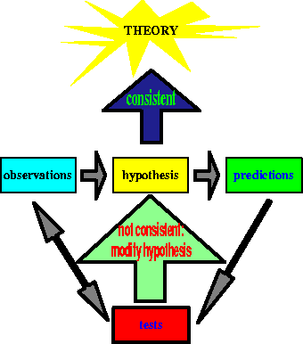
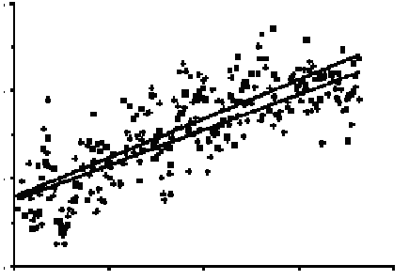
Example – Empirical Investigation
Expect to see these IN ADDITION
  statement of hypotheses to be tested
  description of test data to be used
  experiment design: experiments to be performed, any control to be used
  how the results will be analysed, including any statistical techniques that will be used
  anticipated conclusions
For this type of project, design of evaluation is very important

Slide 12

Example – Devise New Algorithms
Expect to see these IN ADDITION
  description of problem to be solved
  existing algorithms of related problem and a critical evaluation
  approach to be used to solve the problem
  how the new algorithms will be analysed, including mathematical and experimental analysis
  details of mathematical/experimental analysis
For this type of project, literature review and design of evaluation is important
system design required here

Slide 13
Others…
It is possible to use a combination of the above approaches
Different projects may follow different ways
Seek advice from your supervisor which approach best suits your project

Slide 14


Evaluation Design
What criteria to evaluate system?
  E.g., specification satisfied?
  number of features completed
  user friendliness
  users' feedback, etc.
How to assess these criteria?
Who are involved in evaluation?
  Ethical use of 3rd party evaluation, if applicable.
What testing?
What conclusion expected?

Slide 15
Ethics: human data & human participants.
ethical use of data
explicitly specify whether you use
  Synthetic data
  Real Non Human data
  Real Human data
If applicable, confirm that a relevant Professional Body Ethical approval has been obtained for the use of the human data in your project.
ethical use of human participants (other then 3rd party evaluation)
  If applicable, Confirm that a relevant Professional Body Ethical approval has been obtained for the use of human participants in your project.
  If applicable, Include into your design documentation compulsory human participants information sheet and consent form.

Slide 16


Resources
Project webpage
  http://www.csc.liv.ac.uk/~comp39x/2017-18
  especially guidelines for each assessment
Your project supervisor
Research papers
Books / Lecture Notes
  Christian W. Dawson, Projects in Computing
  and Information Systems: A Student's Guide,
  3rd Edition, Pearson Education Ltd, 2015.
  (previous editions can also be used)
  COMP208/214/215/216, COMP201, COMP207, etc.
The Web

Slide 17


Assessments
 |  | Supervisor | 2nd Supervisor
Design
Normally you will receive email from the 2nd supervisor the week before telling you the date/time/venue for your presentation
You should reply to confirm recipient

Slide 18

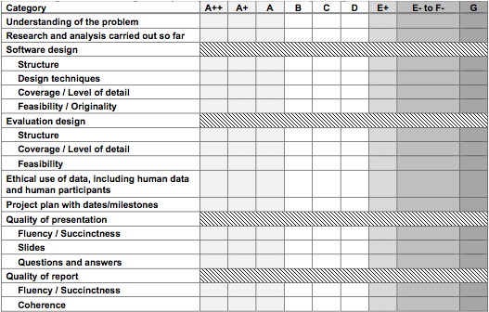
Assessment Form
Snapshot of the form, available at webpage

Slide 19

Late Submission
According to University standard penalties
5 marks deducted for each working day of lateness
Up to a maximum of 5 working days
Note: for electronic submission “working day”==24 hours following the deadline
Work received after 5 working days will receive a mark of 0
For any mitigating circumstances you should
  contact supervisor first (recommended)
  submit mitigating circumstances form with evidence to the Student Office asap
  decision will be communicated to you shortly after

Slide 20
Other Penalties
To observe the design documentation & presentation format requirements the following penalties are applicable
If the electronic submission is not a PDF file, 5 marks will be subtracted for each non PDF file submission.
For every 5 minutes in excess of the 15 minutes reserved for your presentation, that is excluding the time reserved and actually spent on questions, 5 marks will be subtracted.

Slide 21

Coming Lectures
4 lectures (or more)
Introduction & Specification
  week 1, Tuesday 26 September 2017
Design
  week 5, today
How to proceed with the design & implementation
  week 6, Tuesday 31 October 2017 (by Phil Jimmieson)
Demonstration & Dissertation
  semester 2

Slide 22
Submission Deadlines
Specification (5%): completion week 4
submission Thu 16.11.17 noon
Design documentation: Thu 16.11.17 noon
Design presentation: Mon 20.11.17 -
(whole design stage 15%) Fri 1.12.17
Interim Report: Fri 16.02.18
Demonstration slides: Thu 12.04.18 noon
Demonstration (15%): Mon 16.04.18 –
Fri 20.04.18
Dissertation (65%): Thu 10.05.18 noon
You should make yourself available during the weeks for design presentation & demonstration

