Slide 1
Preliminary Experiments Results
Sentence & Document Level

Slide 2
Used Dataset: 2wiki
Question | Context | Supporting Facts | Answer
Are director of film Move (1970 Film) and director of film Méditerranée (1963 Film) from the same country? | ['Stuart Rosenberg (August 11, 1927 – March 15, 2007) was an American film and television director whose motion pictures include "Cool Hand Luke" (1967), "Voyage of the Damned" (1976), "The Amityville Horror" (1979), and "The Pope of Greenwich Village" (1984). He was noted for his work with actor Paul Newman.', 'Méditerranée is a 1963 French experimental film directed by Jean-Daniel Pollet with assistance from…] | [['Move (1970 film)', 0], ['Méditerranée (1963 film)', 0], ['Stuart Rosenberg', 0], ['Jean-Daniel Pollet', 0]] | no
The dataset is good for document and sentence level (each document has separated sentences)
It is a multi-hop like dataset
There is a ground truth (supporting facts)
We selected 100 queries for the experiments of which 78 cases where correctly answered by the LLM, 14 cases where the LLM incorrectly answered, 8 cases where the LLM claims that there is no information in the context.

Slide 3
Using model for FMD and FMW is bad?
LDS score analysis
FMWeigth | FMWeightD | FMWeight_no_model | FMWeightD_no_model
0.635 | 0.685 | 0.747 | 0.781
We see a strong improvement when we do not rely on the model prediction but only on utilities. This is further confirmed with the rmse and r2 metrics:
Rmse:
FMWeight: 16.935
FMWeightD: 78.502
r2:
FMWeight: -2.447
FMWeightD: -5.413
r2 = 1 – actual_y / predicted_y
The RMSE is very high showing the scale of error of the model (in terms of comparison CC’s rmse is 3.679)
The r2 is negative, showing that the model is actually useless we can just use the mean instead of relying on the prediction of the model (CC’s r2 is 0.708).
Ccl: This shows that the model is incorrectly trained (overfit or underfit) or is simply useless. Our hypothesis is that there is a big disparity of in terms of absolute values between positive documents and useless ones, which makes the model incapable to learn anything about the useless documents.

Slide 4
Metric: lds
Cases where the LLM answered correctly
ContextCite | FBII | Spex | FSII | FM_WeightsD | FM_Weights | LOO | ARC-JSD | FMW_no_ML | FMW_D_no_ML
0.804 | 0.745 | 0.79 | 0.745 | 0.685 | 0.635 | 0.643 | 0.787 | 0.747 | 0.781
We see that the version of our method without the model perform better (close to the top).
Cases where the LLM answered incorrectly (14 cases)
ContextCite | FBII | Spex | FSII | FM_WeightsD | FM_Weights | LOO | ARC-JSD | FMW_no_ML | FMW_D_no_ML
0.716 | 0.67 | 0.68 | 0.67 | 0.585 | 0.472 | 0.565 | 0.715 | 0.617 | 0.736
In the case where the LLM is incorrect, we become more competitive (best lds for FMWD).

Slide 5
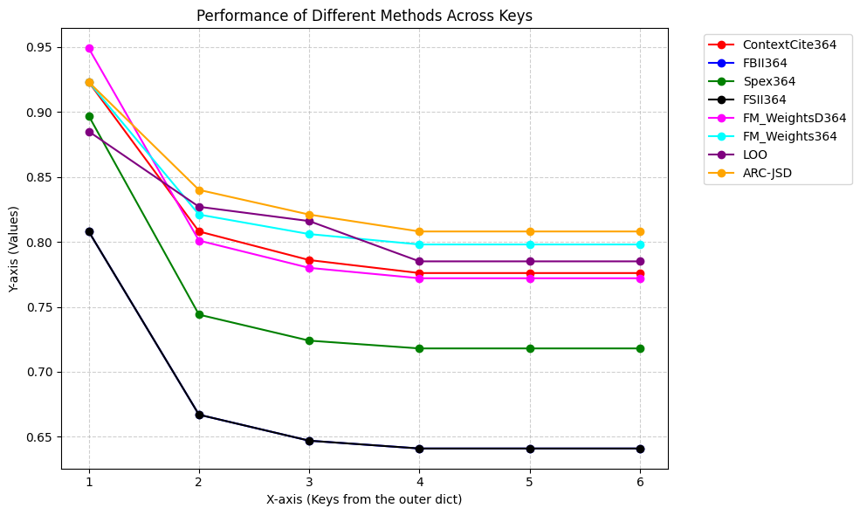
Metric: precision
Precision with k = nb. Positive support
ContextCite | FBII | Spex | FSII | FM_WeightsD | FM_Weights | LOO | ARC-JSD
0.776 | 0.641 | 0.718 | 0.641 | 0.772 | 0.798 | 0.785 | 0.808
Adjusted precision @ k
We divide the number of correctly found documents by the minimum between k and size of ground truth (smallest at 2)
For k = 1, the best is our method FMWD but there is a big drop after showing that we have difficulties getting the second document all the time.

Slide 6
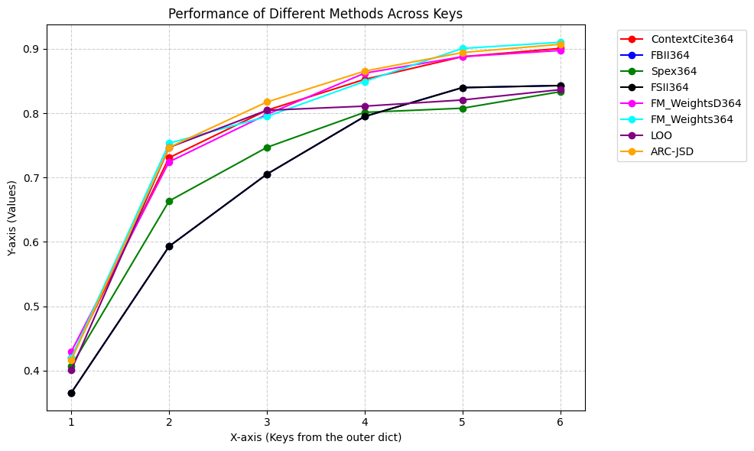
Metric: precision
Recall precision @ k
We divide unconditionally by the size of ground truth
There are either 2 or 4 positive sentences, we can see the distinction between methods that manage to detect the 2scd doc from the k = 3 and after

Slide 7
Annectodes
Focus on CC vs Our Methods & precision metric
From a general view, it seems the cases where our methods are better than CC is when the question is complementary and each document holds a part of the information (complementary synthetic data may be interesting to check for confirmation).
Example:
Question: 'Which film came out first, The Love Route or Engal Aasan?’
Support: 'Engal Aasan is a 2009 Tamil action comedy- drama film directed by R. K. Kalaimani.', 'The Love Route is a 1915 American Western silent film directed and written by Allan Dwan based upon a play by Edward Henry Peple.'

