Slide 1

Restaurant Order Analysis using MySQL
- NISHANT SHARMA | Aspiring Data Analyst

Slide 2

Project Overview
📌 Goal: Analyze restaurant order trends and Customer behavior.
🛠️ Tools: MySQL, Business Intelligence and MS – Excel.
💾 Data: On my GitHub Profile

Slide 3
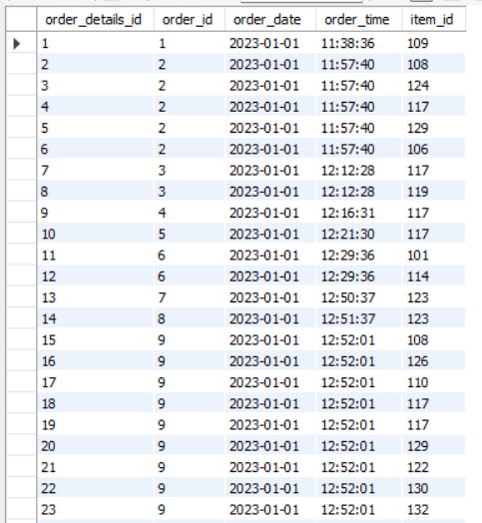
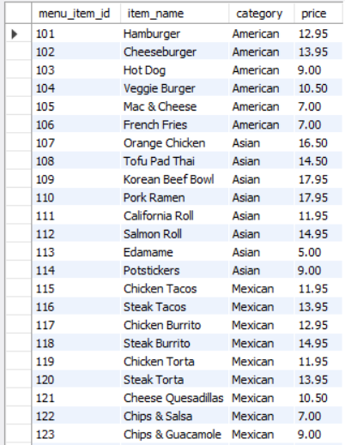
Database Schema
Order_Details Table
Menu_Details Table

Slide 4

write a query to find the number of items on the menu.
Select count(item_name) from menu_items;
Query :-
Output :-

Slide 5

What are the least and most expensive items on the menu?
Query :-
Select min(price) as Least_expensive, max(price) as most_expensive from menu_items;
Output :-

Slide 6

How many Italian dishes are on the menu?
Query :- Select count(category)as Italian_Dishes from menu_items where category = "Italian“.
Output :-

Slide 7
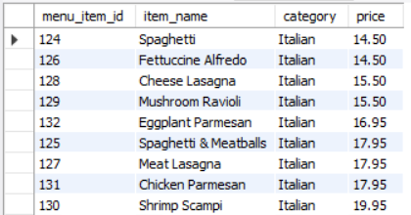
What are the least and most expensive Italian dishes on the menu?
Query :- Select * from menu_items where category = "Italian“ Order by price;
Output :-

Slide 8
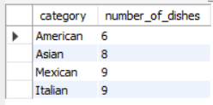
How many dishes are in each category?
Query :- Select category, count(item_name) as number_of_dishes from menu_items group by category;
Output :-

Slide 9
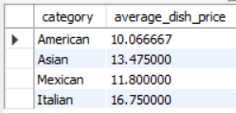
What is the average dish price within each category?
Query :- Select category, avg(price) as average_dish_price from menu_items group by category;
Output :-

Slide 10
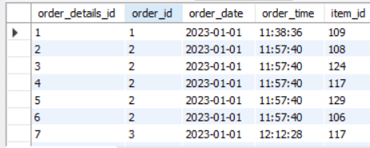
What is the date range of the table?
Query :- Select * from order_details order by order_date;
Output :-

Slide 11

How many orders were made within this date range?
Query :- Select count(distinct(order_id)) as Total_orders from order_details order by order_date;
Output :-

Slide 12

How many items were ordered within this date range?
Query :- Select count(*) as Total_items_orders from order_details order by order_date;
Output :-

Slide 13
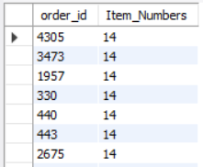
Which orders had the most number of items?
Query :- Select order_id, count(item_id) as Item_Numbers from order_details group by order_idorder by Item_Numbers DESC;
Output :-

Slide 14

How many orders had more than 12 items?
Query :- select count(*) as Total_odr from(Select order_id, count(item_id) as Item_Numbers from order_details group by order_id having Item_Numbers > 12) AS Odr_num;
Output :-

Slide 15
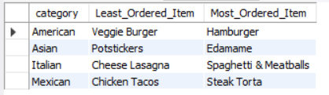
What were the least and most ordered items? What categories were they in?
Query :- WITH item_counts AS ( SELECT mi.menu_item_id, mi.item_name, mi.category, COUNT(od.order_id) AS order_count FROM menu_items mi JOIN order_details od ON mi.menu_item_id = od.item_id GROUP BY mi.menu_item_id, mi.item_name, mi.category),ranked_items AS ( SELECT *, RANK() OVER (PARTITION BY category ORDER BY order_count ASC) AS least_rank, RANK() OVER (PARTITION BY category ORDER BY order_count DESC) AS most_rank FROM item_counts)SELECT category, MAX(CASE WHEN least_rank = 1 THEN item_name END) AS Least_Ordered_Item, MAX(CASE WHEN most_rank = 1 THEN item_name END) AS Most_Ordered_ItemFROM ranked_itemsGROUP BY category;
Output :-

Slide 16
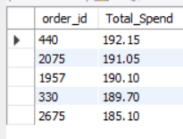
What were the top 5 orders that spent the most money?
Query :- Select od.order_id, sum(mi.price) as Total_Spend from order_details od Left join menu_items mi on od.item_id = mi.menu_item_id group by od.order_idorder by Total_Spend DESC limit 5;
Output :-

Slide 17

View the details of the highest spend order.
Query :- SELECT od.order_id, SUM(mi.price) AS total_spent FROM order_details od JOIN menu_items mi ON od.item_id = mi.menu_item_id GROUP BY od.order_id ORDER BY total_spent DESC LIMIT 1;
Output :-

Slide 18
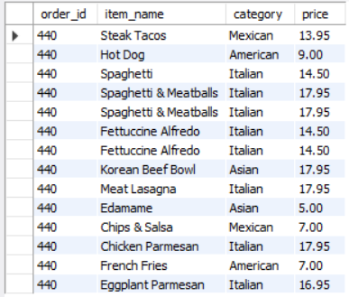
Which specific items were purchased?
Query :- SELECT od.order_id, mi.item_name, mi.category, mi.price FROM order_details od JOIN menu_items mi ON od.item_id = mi.menu_item_id WHERE od.order_id = 440;
Output :-

Slide 19
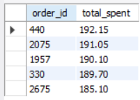
View the details of the top 5 highest spend orders
Query :- SELECT od.order_id, SUM(mi.price) AS total_spent FROM order_details od JOIN menu_items mi ON od.item_id = mi.menu_item_id GROUP BY od.order_id ORDER BY total_spent DESC LIMIT 5;
Output :-

Slide 20

How much was the most expensive order in the dataset?
Query :- SELECT MAX(total_spent) AS most_expensive_order FROM ( SELECT od.order_id, SUM(mi.price) AS total_spent FROM order_details od JOIN menu_items mi ON od.item_id = mi.menu_item_id GROUP BY od.order_id) AS order_totals;
Output :-

Slide 21
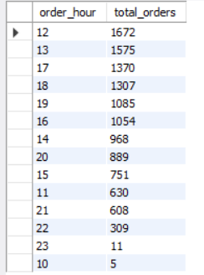
What are the peak ordering hours?
Query :- SELECT HOUR(order_time) AS order_hour, COUNT(*) AS total_orders FROM order_details GROUP BY HOUR(order_time) ORDER BY total_orders DESC;
Output :-

Slide 22
Overview
This project is the result of consistent effort and hands-on practice in data analysis using a combination of tools including MySQL, MS Excel, and Power BI. Through this project, I strengthened key skills such as data manipulation, data analysis, and data visualization.
A special thank you to Maven Analytics for providing access to a wide range of real-world projects—both guided and unguided. I discovered this dataset on their platform, which served as the foundation for exploring and drawing meaningful insights from restaurant order data.

Slide 23
THANK YOU!
For Datasets and project viewing check my - GITHUB PROFILE
For any suggestions, feedback and want to connect with me,
check my - LINKEDIN PROFILE
Note :-
Your suggestions and feedbacks are welcome.
Sizes of screenshots reduced due to limitation of space.

