Slide 1
Modern CollectionView Layouts in iOS
iOS Cafe Event
Presented By
- Abhishek and Niraj

Slide 2


This meeting will be recorded

Slide 3
Prerequisites
Knowledge of Swift and UIKit
Basic understanding about UICollectionView / UICollectionViewController
Knowledge of Protocols, Delegates and Data Source
Prior experience of working with UITableViews

Slide 4
AGENDA
CollectionView building blocks
CollectionView before iOS 13
Modern APIs in CollectionView
Ease of use
Demo

Slide 5
CollectionView Building Blocks
Cells
Layout
DataSoure
Delegate
Parent View Controller

Slide 6
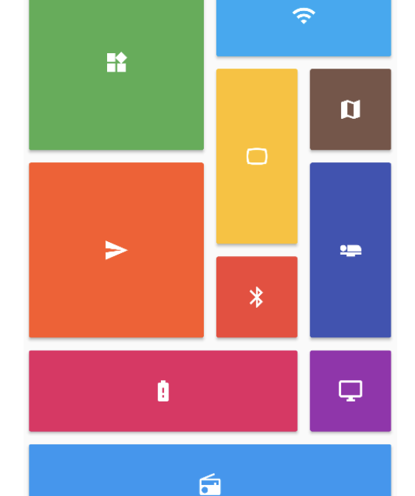
CollectionView before iOS 13
Define a Flow Layout
Conform to Flow Layout Delegate
Too much efforts required for achieveing complex grid layouts 😫
Making multiple horizontal scrollable views in single vertical scroll view was pain
Snapping behavior required developer side efforts😖

Slide 7
Modern APIs in CollectionView
Launched in WWDC 2019
Minimum target SDK version iOS 13
Compositional Layout is one modern api launched in iOS 13
Allows us to combine items in highly adaptive and flexible visual arrangements.

Slide 8
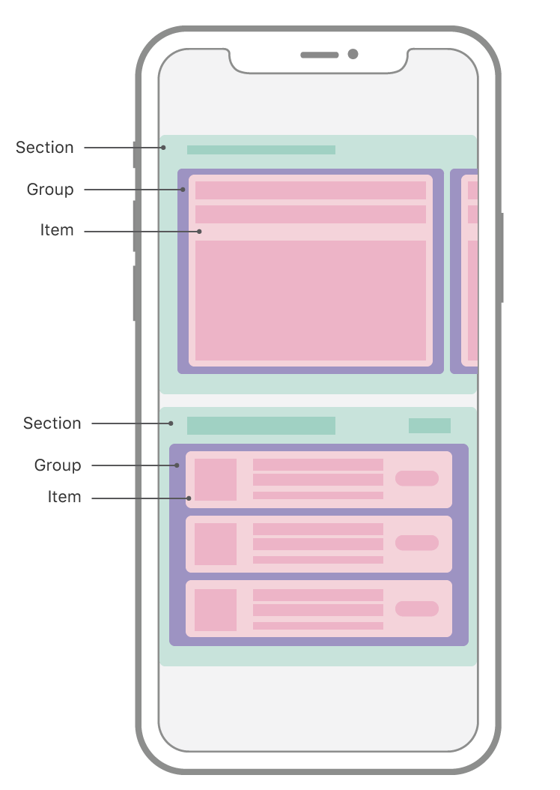
Ease of use
Compositional layout consists of major parts
Section: organizes the data and helps in representation
Group: It determines whether an item should be aligned horizontally or vertically.
Item : It is comparable to a cell in any collection view or table view.
Picture courtesy: https://developer.apple.com/documentation/uikit/uicollectionviewcompositionallayout

Slide 9
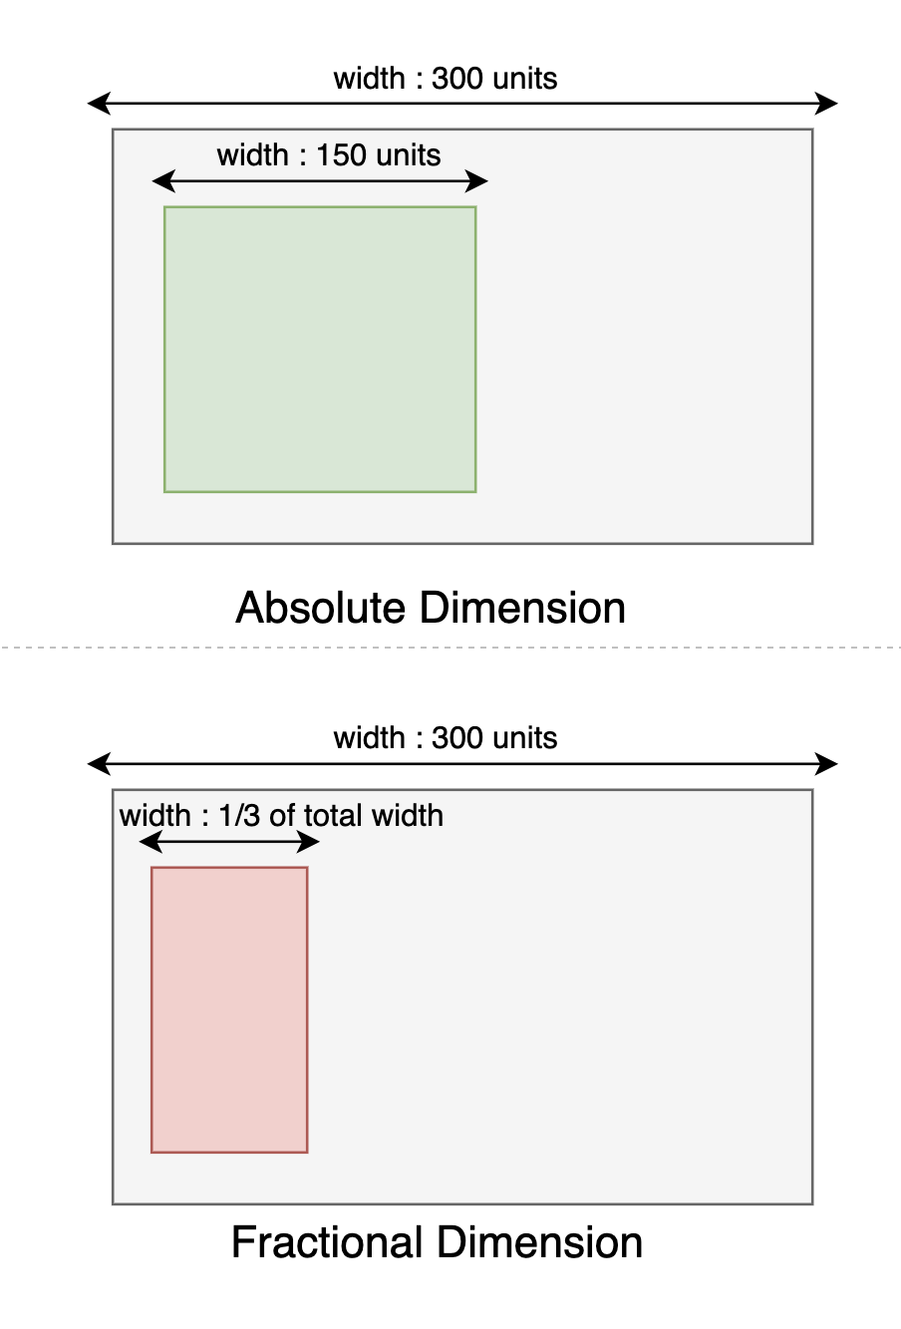
Layout Dimensions
Absolute
Fractional
Estimated

Slide 10

Demo Time
Lets see the DEMO!!!!
Enough of Talk... ..show me the code 😤..

