Slide 1

Drivers for change in STEM
Leonie Walsh, Lead Scientist
13th November 2015

Slide 2
STEM Education Supply Chain integrates Industry Engagement
Industry – including
Professional Services -IT & Finance..
Food and Fibre
Transport, Defence and Construction
Medical Technologies and Pharmaceuticals
New Energy Technology
Industry Engagement
Primary Education
Secondary Education
Tertiary Education
Post-Graduate Education
Job Market
VET
Communication
Teamwork
Leadership
Collaboration
Strategic thinking
Entrepreneurship
Extracurricular – Sport/Work experience/Internships/Volunteering

Slide 3
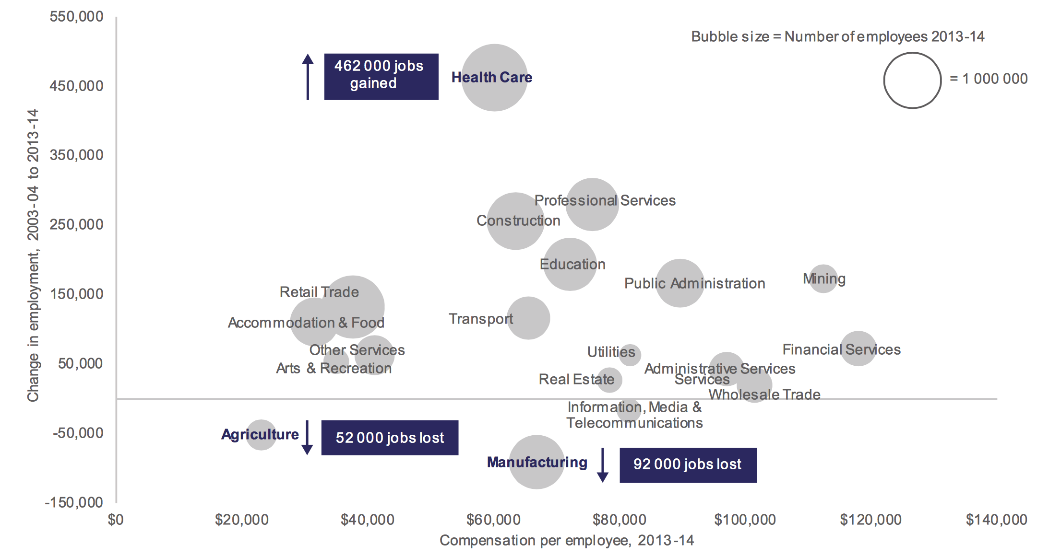
Changes in employment and compensation 2003/4 to 2013/14
Source: ABS cat. No. 6291.0.55.003 and 5204.0.
Notes:
Technological change over the last two decades has been extremely fast and that is likely to continue. This will mean that a significant portion of Australian jobs that exist today will no longer exist in 20 years’ time.
In fact, modelling in this report has found that almost five million Australian jobs – around 40 per cent of the workforce – face the high probability of being replaced by computers in the next 10 to 15 years.
While we have seen automation replace some jobs in areas such as agriculture, mining and manufacturing, other areas such as the health sector has remained largely untouched by technological change.

Slide 4
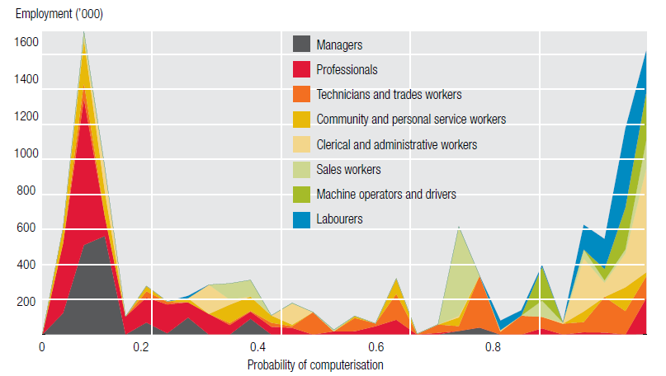
Transitioning workforce
Distribution of job categories against probability of computerization
CEDA - Australia’s future workforce? June 2015
Notes:
Almost two-thirds of Australian students are being trained for jobs that will vanish or look completely different in the future, a statistic that is “deeply alarming” and warrants the “serious” assessment of the vocational education sector.
New research commissioned by the Foundation for Young Australians reveals 58 per cent of stud­ents and 71 per cent of vocational education students are on a career path that may dis­appear or be funda­mentally rerouted.

Slide 5
National and International Focus
State Government sectors | Federal Govt. Growth Centres | Societal Challenges
Medical Technologies and Pharmaceuticals | Medical Technologies and Pharmaceuticals | Health, demographic change and wellbeing
Food and Fibre | Food and Agribusiness | Food security, sustainable agriculture and forestry, marine and the bio economy
New Energy Technology | Oil, Gas and Energy Resources | Secure, clean and efficient energy
Professional Services | Mining equipment, Technology and Services | Smart, green and integrated transport
Transport, Defence and Construction Technology | Advanced Manufacturing | Climate action, environment, resource efficiency and raw materials
International Education
Notes:
Four broad themes:
encouraging collaboration and the commercialisation of new products;
enhancing management and improving workforce skills;
identifying opportunities to reduce regulatory burden ; and
improving capabilities to engage with international markets and global supply chains.
Consultation process started for the Commonwealth Vision for a Science Nation - Overview
The Australian Government is developing a comprehensive science policy that will be underpinned by a strategy for a science nation in which scientific thinking and applied science can be found in all sectors of our economy.
A paper from the Chief Scientist, released in September 2014, set out the case for concerted effort in STEM. It has received positive feedback from all sectors of the community. In April this year, the Commonwealth Science Council considered actions the Government could take to respond.

Slide 6
Significant trends impacting graduates
Digital Future – new careers emerging
Entrepreneurship rising
Global collaborative marketplace
Health reimagined – Personalised medicine
Climate change impacts – New energy, agriculture, health
Increased focus on returns from research investment
5 - 10 careers in a life time
Soft skills becoming higher in importance to employers

Slide 7
STEM trends of concern
Year 12 higher-level mathematics participation has almost halved over the past 20 years
Only 10.0% of students participated in advanced mathematics in 2014 (compared with 14.2% in 1995) and 19.3% in intermediate mathematics (compared with 27.3% in 1995).
Participation rates for girls are particularly poor with only 6.8% enrolled in advanced maths and 18.2% in intermediate, compared with 13.4% and 20.6% for boys.
86 per cent of science degrees do not have intermediate mathematics as an entry prerequisite while Year 12 enrolments slide
At least 30 per cent of Year 7-10 maths classes are taught without a qualified maths teacher

Slide 8
STEM Education Supply Chain integrates Industry Engagement
Industry – including
Professional Services -IT & Finance..
Food and Fibre
Transport, Defence and Construction
Medical Technologies and Pharmaceuticals
New Energy Technology
Industry Engagement
Primary Education
Secondary Education
Tertiary Education
Post-Graduate Education
Job Market
VET
Communication
Teamwork
Leadership
Collaboration
Strategic thinking
Entrepreneurship
Extracurricular – Sport/Work experience/Internships/Volunteering

Slide 9
Summary
Many different drivers impacting the future economy that will impact education, jobs and policy direction.
Multiple, interconnected challenges along the education supply chain requiring integrated solutions
Change is occurring rapidly impacting quality of data and advice to students/teachers and parents
A 21st century graduates education and experience will need to be broader than STEM disciplines

