Slide 1
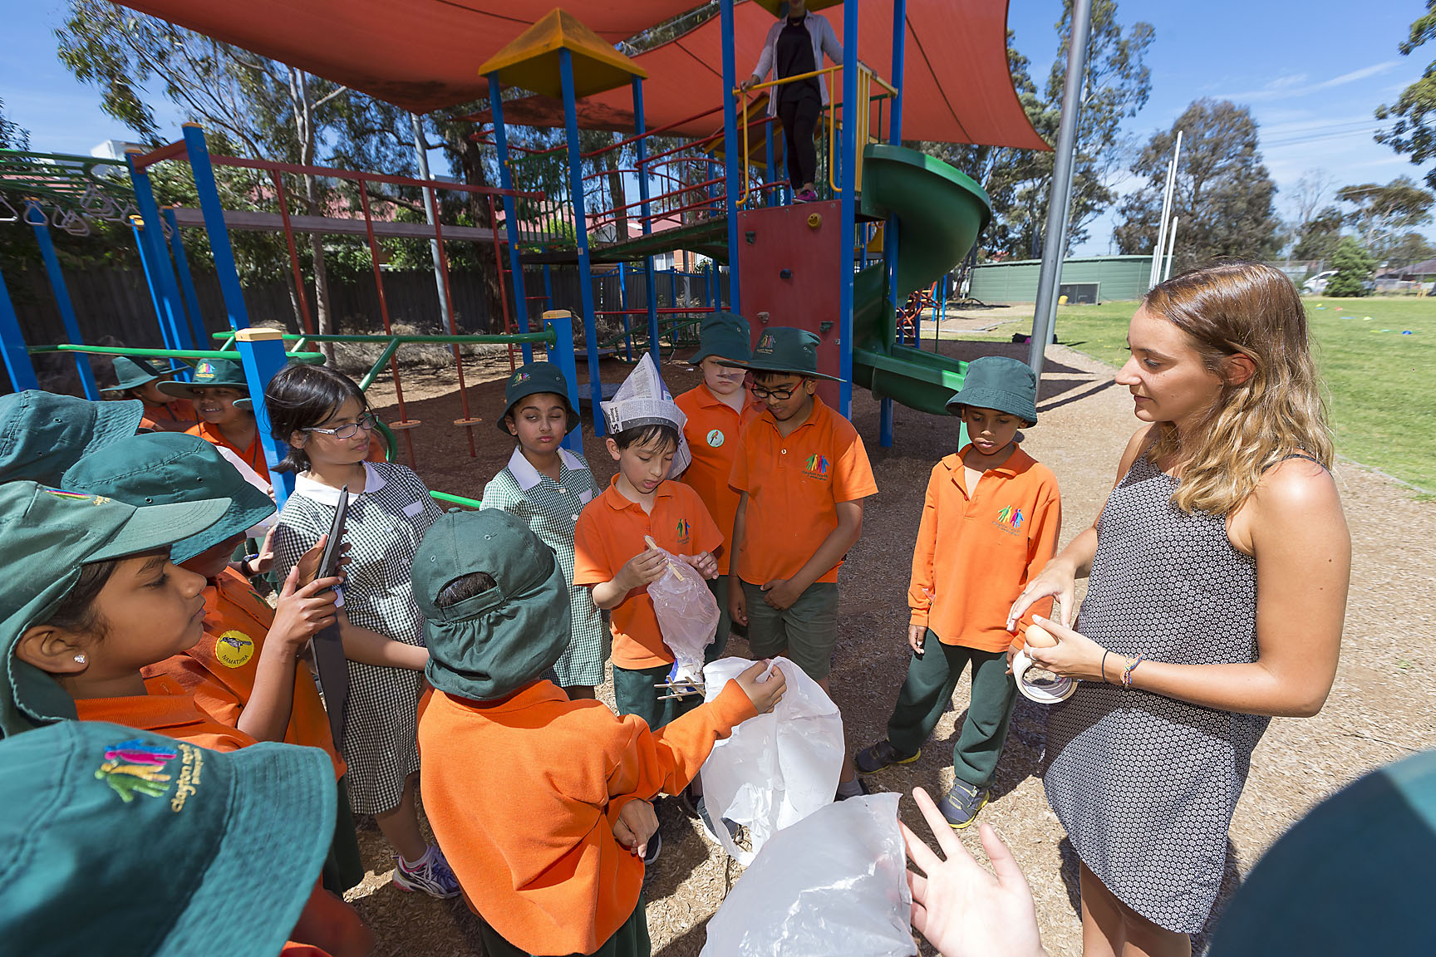
Building recruitment pathways for high quality mathematics and science teachers
Professor Deborah Corrigan, Monash University
Professor Cristina Varsavsky, Monash University
Dr Leissa Kelly, Deakin University
Dr Rannah Hetherington, The University of Melbourne

Slide 2
Workshop plan
What are we trying to achieve?
How have we addressed this need?
What do we know so far?
Q&A
Your input: What can push this agenda further?
Wrap up: What do we need to consider next?

Slide 3
What are we trying to achieve?
The notion of pathway rather than pipeline
The notion of high quality rather than high potential
The crossing of boundaries between science and education
Approaches need to be sustainable (can live on beyond the funding) and scalable (can stepped up to address quality across the profession
The role of outreach as part of mainstream education practices

Slide 4
How have we addressed this?
Unit for BSc students: Schools science project
Unit for MTeach students: Engaging with practices of contemporary sciences
Connecting PSTs with scientists
Science in Schools

Slide 5
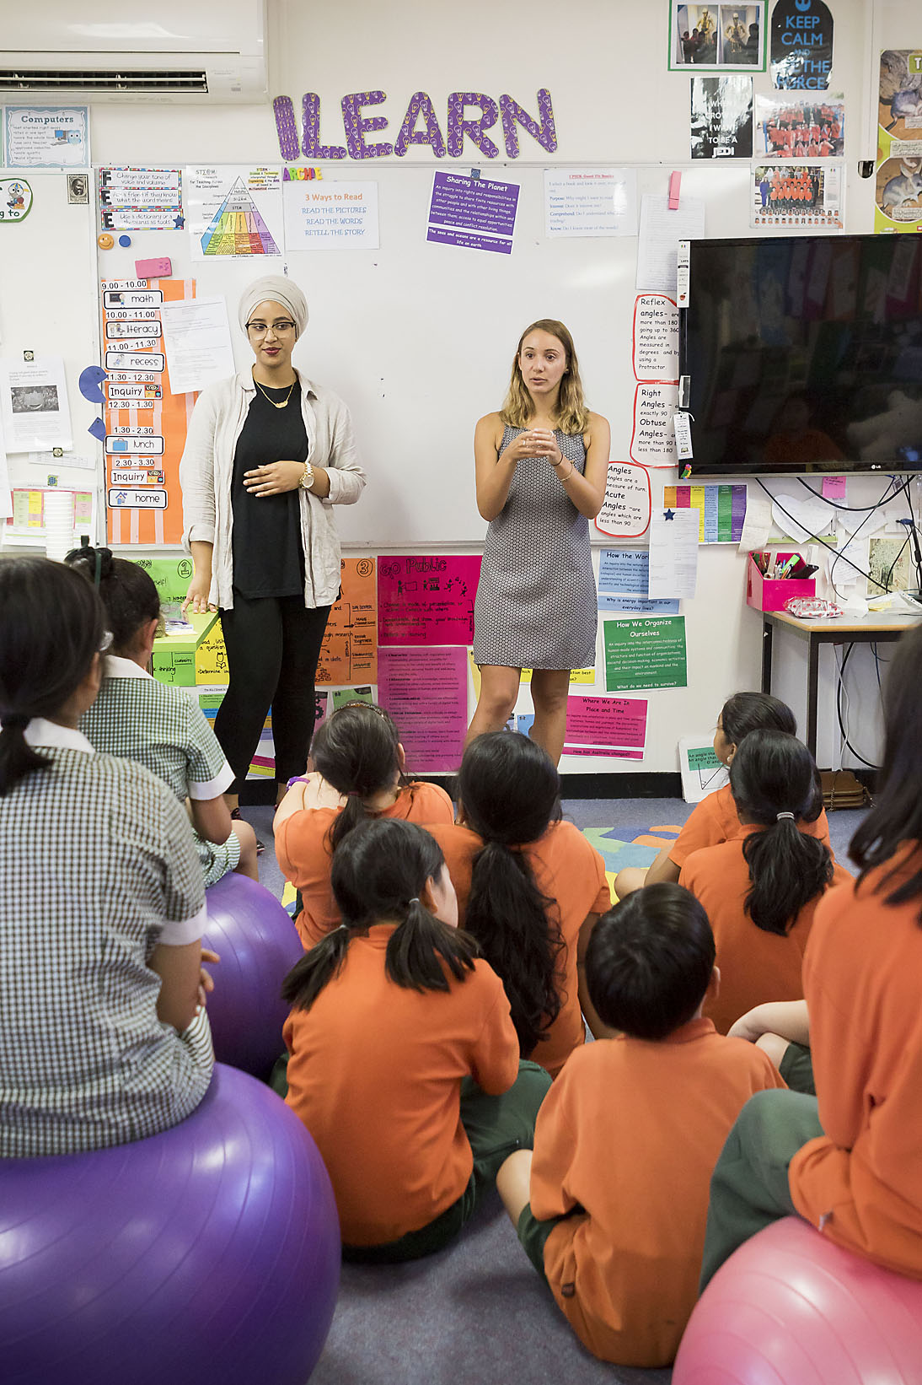
BSc unit: Schools science project
10 day school placement:
Students research, develop, manage and deliver a science based module that matches the learning outcomes specified to them by their client.
Generic skills for workplace:
Interpret client brief
Manage expectations, schedules, resources, risks,
Assessment of own understanding of science
Use of feedback for learning

Slide 6
MTeach unit: Engaging with practices of contemporary sciences
The unit
Preservice and inservice teachers
Frame - 5 levels of cognitive engagement for analysing authentic science practices
Uses existing Monash University STEM activities/outreach/programs
Outcomes
Rethinking their personal view of the Nature of science/maths based on analysing current sciences practices
Translating this new understanding into practical outcomes for the classroom – and seriously addresses science as a human endeavour

Slide 7
Connecting PSTs with scientists
Community Science Project — a B.Sc. unit:
Students interact with industry/community organisations on a science project.
ReMSTEP links with the museum enable students to interact with museum scientists to develop digital resources.
Biology Methods students construct digi-explanations:
Biology method students interview scientists to develop multi media resources around aspects of contemporary biology for schools
Chemistry Methods students develop contemporary science resources:
Chemistry methods students work one-on-one with research science PhD students to interpret their research and develop school resources
Communicating Science students interpret science research:
Science communication students translate a scientist’s description of their work into a resource suitable for use by school students in the classroom

Slide 8
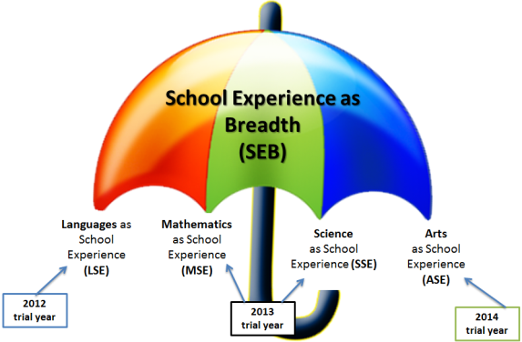
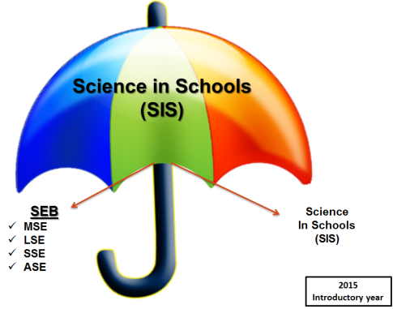
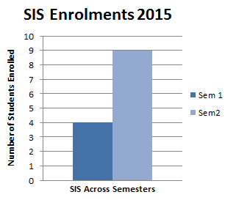
Science in schools subject
Collaborative venture between UoM’s MGSE & the Faculty of Science
Team of academics design and deliver the subject content
Schools provide opportunities for Tertiary Student Assistants (TSA) to support student learning in schools
Students undertake volunteer experience of 20 hours
These experiences are aimed to:
enhance students breadth of education and employability skills
support students’ development of critical understandings and the nature of citizenship and volunteering
embed learning in real world contexts

Slide 9
What do we know so far?
Students in schools:
Students love it, and ask for more
Schools cry for help with science:
University students bring fresh science to schools
Teachers learned new science (PD)
Appreciated access to equipment
Students came prepared with equipment, were professional, adaptable, respectful
Translating contemporary science into school activities can require high level skills and needs support

Slide 10
What do we know so far?
PST-ISTs interacting with scientists:
Can be highly beneficial for pre-service teachers but the interaction needs to be properly framed
PhD science research students are a productive link to the science research community as the experience can be valuable for them as an opportunity to both communicate their science and to develop their science communication skills.
For rethinking of our view on the Nos/Nom there needs to be sustained support for analysing contemporary practices

Slide 11
What do we know so far?
ReMSTEP has opened up a suite of productive interactions between science and education that we expect will be ongoing
There is a real appetite for collaborative efforts between schools and with universities
There is a lot of goodwill in the science community for collaborations with educators including PSTs
There are many KPIs for outreach programs within the science community that can be ‘hooked’ into

Slide 12
Questions?

Slide 13
Workshop
What can push this agenda further?
What other pathways should be explored for high quality science and maths teachers that enable crossing boundaries, are sustainable and are scalable?
Each table to discuss
and present major idea(s)

