Slide 1






Conference
@ReMSTEP
#remstep
13 Nov 2015
Supported by the Australian Government Office for Learning and Teaching

Slide 2
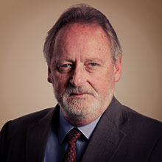
Opening Address
Conference Nov 2015
Prof Stephen Dinham, The University of Melbourne

Slide 3
Reconceptualising Mathematics and Science Teacher Education Programs through collaborative partnerships between scientists and educators
3 years – 2014-2017
One of 5 projects within OLT program:
Enhancing the Training of Mathematics and Science Teachers (ETMST)
http://www.olt.gov.au/maths-and-science-teachers

Slide 4
A CYCLE THAT NEEDS TO BE BROKEN

Slide 5
A CYCLE THAT NEEDS TO BE BROKEN
Some primary teachers report lack of competence and confidence in teaching maths and science
Teachers lack competence and confidence

Slide 6
A CYCLE THAT NEEDS TO BE BROKEN
Teachers lack competence and confidence
Students develop negative attitudes
Primary students develop negative attitudes towards maths and science

Slide 7
A CYCLE THAT NEEDS TO BE BROKEN
Primary maths and science test results relatively poorer than secondary
Teachers lack competence and confidence
Students develop negative attitudes
Primary maths and science test results relatively poorer than secondary

Slide 8
A CYCLE THAT NEEDS TO BE BROKEN
Teachers lack competence and confidence
Students develop negative attitudes
Shortage of maths and science teachers 7-10
Primary maths and science test results relatively poorer than secondary
Shortage of maths and science teachers years 7-10

Slide 9
A CYCLE THAT NEEDS TO BE BROKEN
Declining maths and science performance 7-10, especially low SES, Indigenous, remote, government schools
Teachers lack competence and confidence
Students develop negative attitudes
Primary maths and science test results relatively poorer than secondary
Shortage of maths and science teachers years 7-10
Declining maths and science performance years 7-10, especially low SES, Indigenous, remote, government schools

Slide 10
A CYCLE THAT NEEDS TO BE BROKEN
Teachers lack competence and confidence
Students develop negative attitudes
Students don’t take higher levels maths and science years 11-12
Primary maths and science test results relatively poorer than secondary
Shortage of maths and science teachers years 7-10
Students don’t take higher levels maths and science years 11-12
Declining maths and science performance years 7-10, especially low SES, Indigenous, remote, government schools

Slide 11
A CYCLE THAT NEEDS TO BE BROKEN
Fewer undergrad maths and science students
Shortage of ITE maths and science (physics, chemistry) candidates
Some ITE primary candidates struggle with maths and science because of background/attitudes
Teachers lack competence and confidence
Students develop negative attitudes
Primary maths and science test results relatively poorer than secondary
Fewer undergrad maths and science students
Shortage of maths and science teachers years 7-10
Students don’t take higher levels maths and science years 11-12
Declining maths and science performance years 7-10, especially low SES, Indigenous, remote, government schools

Slide 12
A CYCLE THAT NEEDS TO BE BROKEN
Teachers lack competence and confidence
Students develop negative attitudes
Primary maths and science test results relatively poorer than secondary
Fewer undergrad maths and science students
Shortage of maths and science teachers years 7-10
Students don’t take higher levels maths and science years 11-12
Declining maths and science performance years 7-10, especially low SES, Indigenous, remote, government schools

Slide 13
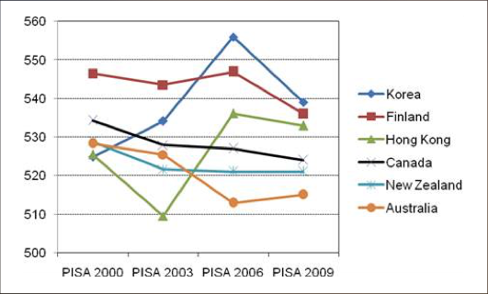
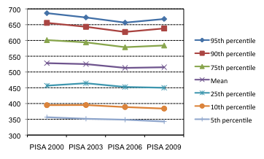
Australia’s Performance on PISA
Figure 1:
Mean reading scores in OECD/PISA
Figure 2:
Trends in Australian students’ reading performances

Slide 14
International Test Results (2012)
TIMSS (Trends in International Mathematics and Science Study)
Year 4 Maths: 18th out of 50 countries
Year 4 Science: 25th out of 50 countries
Year 8 Maths & Science: 12th out of 42 countries
PIRLS (Progress in International Reading Literacy Study)
Year 4 Reading: 27th out of 45 countries
PISA (Programme for International Student Assessment)
[15 year olds]
Reading Literacy: =13th out of 52 countries.
Mathematical Literacy: 19th out of 53
Scientific Literacy: =16th out of 55
Computer-based Mathematical Literacy and Digital Reading literacy: 13th out of 32

