Slide 1
Science specialisations within primary pre-service programs
Conference Nov 2015 – Session 2
Dr Melody Anderson, The University of Melbourne
Dr John Cripps Clark, Deakin University
Jacinta Duncan, Gene Technology Access Centre

Slide 2
Session Outline
10:30 - 10:45am | Overview: Science and Mathematics Specialisations at the University of Melbourne
10:45 - 10:50am | Science Specialists Strand at Deakin University
10:50 - 11:00am | Primary Science and Mathematics Elective: collaboration with Gene Technology Access Centre (GTAC)
11:00 - 11:05am | Video showcasing the pre-service teacher experience of the Primary Science and Mathematics Elective
11:05 - 11:10am | Introduction to the collaborative forum with the pre-service teachers
11:10 - 11:30am | Forum with the pre-service teachers
11:30 - 11:40am | Feedback from the forum is sought and uploaded to a central repository
11:40 - 11:55am | Panel discussion and Q&A
11:55 - 12:00pm | Close

Slide 3


7 InnovationS
Contemporary science and mathematics in integrated science and pre-service units of study.
Undergraduate science students engaging with schools.
Science specialisations within primary pre-service programs.
Specialist Science and Technology Centre collaborations.
Practicum opportunities in world-class research environments.
Building on existing student expertise in science and mathematics.
Building a recruitment pipeline of high potential mathematics and science teachers.

Slide 4
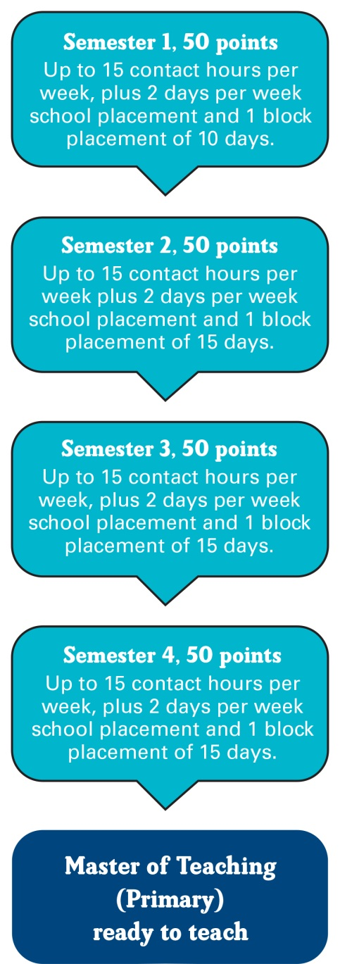

Master of Teaching (Primary) Program
The Master of Teaching (Primary) is a two year, full-time post-graduate program that qualifies Teacher Candidates to teach across all primary years as a generalist teacher.

Slide 5
National Program Standards
Graduate entry primary programs must comprise at least two years of full-time equivalent professional studies in education.
These programs must include at least one year of full-time equivalent study (100 points) of discipline-specific curriculum and pedagogical studies across the learning areas of the primary school curriculum.
Programs must include at least one-quarter of a year of full-time equivalent study (25 points) of discipline-specific curriculum and pedagogical studies in each of English/literacy and mathematics/numeracy, and at least one-eighth of a year of full-time equivalent study (12.5 points) of discipline-specific curriculum and pedagogical studies in science.
These programs may include up to one-quarter of a year of full-time equivalent study (25 points) of relevant discipline studies as elective units which could be undertaken by applicants who do not fully meet prerequisite discipline study requirements

Slide 6
2016 program overview
200 points completed over four semesters (2 years full-time)
1 | S1 | Professional Practice & Seminar 1 (6.25) | Learners, Teachers & Pedagogy (12.5) |  | ICT in Primary Education (6.25) | Foundational English Literacy (12.5) |  | Primary Mathematics Education 1 (12.5)
 | S2 | Professional Practice & Seminar 2 (12.5) |  | Assessment for Teaching (6.25) | Primary Humanities Education (6.25) | Primary Arts Education (12.5) |  | Advanced English Literacies (6.25) | Primary Mathematics Education 2 (6.25)
2 | S3 | Professional Practice & Seminar 3 (12.5) |  | Social & Professional Contexts (6.25) | Researching Education Practice (12.5) |  | Science & Technology Education (12.5) |  | Health & Physical Education (6.25)
 | S4 | Professional Practice & Seminar 4 (6.25) | Education Research Project (Primary) (12.5) |  | Designing Personalised Learning (6.25) | Literacy, Assessment & Learning (6.25) | Primary Mathematics Education 3 (6.25) | Elective subject (12.5)
Course Handbook: MC-TEACHPR Master of Teaching (Primary)
https://handbook.unimelb.edu.au/view/current/MC-TEACHPR

Slide 7
Maths Specialisation 2016
1 | S1 | Professional Practice & Seminar 1 (6.25) | Learners, Teachers & Pedagogy (12.5) |  | ICT in Primary Education (6.25) | Foundational English Literacy (12.5) |  | Primary Mathematics Education 1 (12.5)
 | S2 | Professional Practice & Seminar 2 (12.5) |  | Assessment, for Teaching (6.25) | Primary Humanities Education (6.25) | Primary Arts Education (12.5) |  | Advanced English Literacies (6.25) | Primary Mathematics Education 2 *Extension (6.25)
2 | S3 | Professional Practice & Seminar 3 (12.5) |  | Social & Professional Contexts (6.25) | Researching Education Practice (12.5) *Lit Review and Project Proposal Maths Focus |  | Science & Technology Education (12.5) |  | Health & Physical Education (6.25)
 | S4 | Professional Practice & Seminar 4 (6.25) | Education Research Project (Primary) (12.5) *Maths Capstone |  | *Designing Personalised Learning (6.25) | Literacy, Assessment & Learning (6.25) | Primary Mathematics Education 3 *Extension (6.25) | Elective subject (12.5) *Maths Elective
Primary Mathematics Education 1 12.5
Primary Mathematics Education 2 Extension 6.25
Primary Mathematics Education 3 Extension 6.25
Prof Prac/Clinical Assessment 3.75
Researching Education Practice 12.5
Education Capstone Project 12.5
Maths Elective 12.5
TOTAL: 66.25 Credit Points

Slide 8
Science Specialisation 2016
1 | S1 | Professional Practice & Seminar 1 (6.25) | Learners, Teachers & Pedagogy (12.5) |  | ICT in Primary Education (6.25) | Foundational English Literacy (12.5) |  | Primary Mathematics Education 1 (12.5)
 | S2 | Professional Practice & Seminar 2 (12.5) |  | Assessment For Teaching (6.25) | Primary Humanities Education (6.25) | Primary Arts Education (12.5) |  | Advanced English Literacies (6.25) | Primary Mathematics Education 2 (6.25)
2 | S3 | *Professional Practice & Seminar 3 (12.5) *Clinical Assessment 30% |  | Social & Professional Contexts (6.25) | *Researching Education Practice 12.5 *Lit Review and Project Proposal with Science Focus |  | *Science & Technology in Practice (12.5) *Only available for science specialisation |  | Health & Physical Education (6.25)
 | S4 | Professional Practice & Seminar 4 (6.25) | Education Research Project (Primary) (12.5) *Science Capstone |  | *Designing Personalised Learning (6.25) *Science Project | Literacy, Assessment & Learning (6.25) | Primary Mathematics Education 3 (6.25) | Elective subject (12.5) *Science Elective
Science & Technology in Practice 12.5
Science Elective 12.5
Designing Personalised Learning 6.25
Prof Prac/Clinical Assessment 3.75
Researching Education Practice 12.5
Education Capstone Project 12.5
TOTAL: 59.0 Credit Points

Slide 9
Elective subjects 2016
Subject code | Subject | Credit points
EDUC90425 | Australian Indigenous Education | 12.5
EDUC90428 | Promoting Student Wellbeing | 12.5
EDUC90727 | Teaching Global Perspectives | 12.5
EDUC90493 | Arts & Artistry: Studio to Classroom | 12.5
EDUC90543 | LOTE in the Primary Classroom | 12.5
EDUC90793 | Positive Pedagogy: Science of Teaching | 12.5
EDUC90711 | Foundations of Physical Education | 12.5
EDUC90722 | Education, Practice and Place | 12.5
EDUC90794 | Science in the Integrated Curriculum | 12.5
EDUC90861 | Leading Mathematics in Primary Schools | 12.5
EDUC90504 | Leadership in schools | 12.5
*2015 Elective
EDUC90376 Science and Mathematics in the classroom 12.5

Slide 10
Expressions of Interest
Introduced at Open days and Orientation
Information session at the beginning of semester
Expressions of Interest:
Selection Criteria
Previous undergraduate/post graduate studies in maths/science
Previous employment in the field/s
Other experience/justification
Results in Semester 1 maths subject (H2A average)

Slide 11
PRIOR STUDY: What is their background?
Undergraduate/ Honours Course Categories | Candidate Numbers | Science Specialisation | Maths Specialisation
SCIENCE | 14 | 12 | 2
ENVIRONMENTAL SCIENCE | 1 | 1 | 0
AGRICULTURE | 1 | 1 | 0
HEALTH SCIENCE | 4 | 3 | 1
PHARMACEUTICAL SCIENCE | 1 | 1 | 0
ARTS/ PSYCHOLOGY | 3 | 1 | 2
ARTS | 3 | 1 | 2
PSYCHOLOGY | 6 | 3 | 3
BIOMEDICINE | 1 | 1 | 0
BUSINESS | 4 | 0 | 4
PHYSIOTHERAPY | 1 | 0 | 1
ENGINEERING | 2 | 0 | 2
DESIGN/ ARCHITECTURE/ MULTIMEDIA | 2 | 0 | 2
COMMERCE/ ACCOUNTING/ FINANCE | 5 | 1 | 4
 | 48 | 25 | 23

Slide 12
PREVIOUS EMPLOYMENT: What is their background?
EMPLOYMENT EXPERIENCE | NUMBERS
LABORATORY | 2
HEALTH/ PHARMACY | 3
TUTOR | 8
TEACHER | 4
TEACHER AID | 1
UNIVERSITY LECTURER/ DEMONSTRATOR | 2
FINANCE/ ACCOUNTANT | 3
BUSINESS ANALYST | 3
CORPORATE | 2
ENGINEER | 3
ARCHITECT/ DESIGN | 1
IT/ SOFTWARE | 1
CARTOGRAPHY | 1
VOLUNTEER WORK IN RELATED INDUSTRY | 1
RESEARCH | 2
OTHER | 6

Slide 13
Expressions of Interest #Example
I have had various roles throughout my career which have provided experience in science and technology. These are broadly grouped as Teaching Experience, Scientific Research and Professional Experience.
TEACHING EXPERIENCE:
Laboratory class demonstrator (teaching 2nd & 3rd year) in the Zoology Department at The University of Melbourne
Acting head demonstrator for undergraduate Biology
Biology tutor at University College
Volunteer Centre Guide at the Marine Studies Centres in Queenscliff and Tooradin.
POST DOC EXPERIENCE: (1996-2001)
Completed PhD in 1996 at the Department of Zoology UniMelb.
Research Officer in the Department of Physiology at UniMelb.
Supervisor of graduate and undergraduate students.
Co-researcher on project funded by National Heart Foundation and NH & MRC Grants.
My area of interest was cardiac electrophysiology.
PROFESSIONAL EXPERIENCE: (2001-2014)
Completed Graduate Diploma in Business computing in 2000 from Victoria University of Technology
Business Analyst and System Architect
Developer of computer system designs and IT requirements.

Slide 14
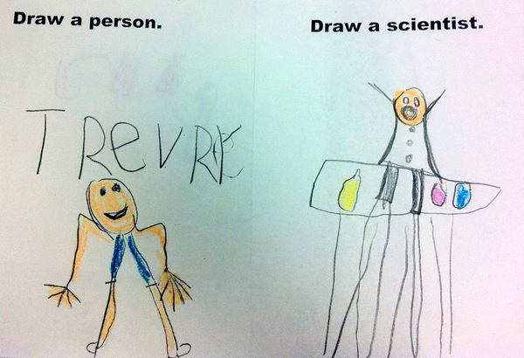

Science & Mathematics Elective
EDUC90376 Science and Mathematics in the Classroom
The subject focuses on supporting the effective integration of Science, Technology, Engineering and Mathematics (STEM) into the Primary Classroom environments.

Slide 15

Science & Mathematics Elective
Work collaboratively with a team of academics; education officers from specialist science centres, scientists, mathematicians, school-based staff and teachers;
Together, plan, prepare and rehearse model lessons for the teaching of the Adaptations topic, embedding Mathematics and drawing on Technology;
Implement rehearsed lessons in PLTs over six weeks in our partner schools; and
Modify and refine in response to student needs to produce units of work for sharing on ReMSTEP site.

Slide 16
Graduate Science Specialists
Let’s hear about the experience from the Teacher Candidates …

Slide 17

Planned Deakin University MTeach Science Specialist Program: Context
Declining participation in science – Government & Chief Scientist – and identification of primary schooling as a key stage for STEM engagement
Increasing demand and marketing by schools as Science or STEM-focused
MTeach is the postgraduate entry qualification – 3 semesters covering developing the knowledge and skills to become a primary teacher and 1 semester to develop a specialisation (inclusive education, leadership, research … )
About one fifth of MTeach students have STEM qualifications and a similar proportion express a preference for a science specialism

Slide 18
Primary Science Education at Deakin
Long history of primary school based science & technology curriculum units – strong relationships with schools
PrimSS: Deakin delivery of the Victorian Government Primary Science Specialists professional development program
Science Education Partnerships with Schools Project – model of collaboration

Slide 19
Planned Program
One term school based – integration of research into teaching curriculum implementation & leadership
Two days at school – one at university
Assessment integrated, portfolio, collection and analysis of evidence of student learning
Units (1 semester – F/T: 2 P/T):
Becoming an effective teacher of science
Resources in the contemporary science curriculum
Integration across the curriculum: STEM and sustainability
Leadership in primary science education

Slide 20
Collaborative forum with pre-service teachers: A table-based activity
20mins
An opportunity to hear firsthand from pre-service teachers’ who have participated in the Science and Mathematics Specialisation.
Questions to guide the conversation around the table:
How important is a Primary Science and Mathematics specialisation in current teaching and learning context?
What are your impressions of the quality of the experience the participants had throughout the specialisation?
If you were to be involved in implementing this type of specialisation in 2016, what would you do differently? Where would be your focus on improvement?
What opportunities would science and mathematics specialists provide for schools? And, how could/would the schools utilise the specialists?

Slide 21
Collaborative forum with pre-service teachers: Your feedback is needed!
10mins
Using your phones, or other devices provided in the room, enter your responses to the questions using the following URL:
https://www.surveymonkey.com/r/remstep

