Slide 1
Session THree: PST Learning with scientists

Slide 2
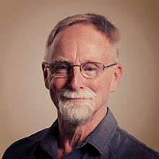
Session Three: PST Learning with scientists
Prof Vaughan Prain, La Trobe University

Slide 3
Pre-Service Teachers Learning with Scientists
What is the value to participants, including pre-service teachers, scientists, teacher educators, teachers and students, of interactions/partnerships between pre-service teachers and scientists?
What diversity of productive interactions are possible?
What are enablers and constraints in these interactions?
How can these interactions support PSTs’ understanding of contemporary science practices?
How can these interactions enable school science curriculum renewal and innovative practices?
What are future directions in these interactions?
What are the opportunities for up-scaling these interactions and their effects?

Slide 4
Pre-Service Teachers Learning with Scientists
What is the value to participants, including pre-service teachers, scientists, teacher educators, teachers and students, of interactions/partnerships between pre-service teachers and scientists?
What diversity of productive interactions are possible?
What are enablers and constraints in these interactions?
How can these interactions support PSTs’ understanding of contemporary science practices?
How can these interactions enable school science curriculum renewal and innovative practices?
What are future directions in these interactions?
What are the opportunities for up-scaling these interactions and their effects?

Slide 5
Pre-Service Teachers Learning with Scientists
What is the value to participants, including pre-service teachers, scientists, teacher educators, teachers and students, of interactions/partnerships between pre-service teachers and scientists?
What diversity of productive interactions are possible?
What are enablers and constraints in these interactions?
How can these interactions support PSTs’ understanding of contemporary science practices?
How can these interactions enable school science curriculum renewal and innovative practices?
What are future directions in these interactions?
What are the opportunities for up-scaling these interactions and their effects?

Slide 6
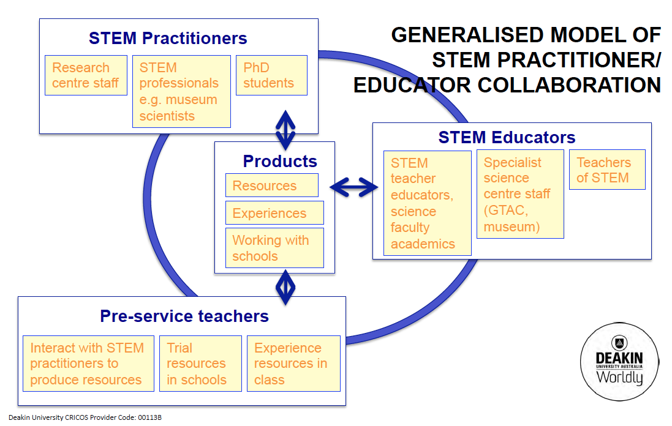

Slide 7
Pre-Service Teachers Learning with Scientists
What is the value to participants, including pre-service teachers, scientists, teacher educators, teachers and students, of interactions/partnerships between pre-service teachers and scientists?
What diversity of productive interactions are possible?
What are enablers and constraints in these interactions?
How can these interactions support PSTs’ understanding of contemporary science practices?
How can these interactions enable school science curriculum renewal and innovative practices?
What are future directions in these interactions?
What are the opportunities for up-scaling these interactions and their effects?

Slide 8
Pre-Service Teachers Learning with Scientists
What is the value to participants, including pre-service teachers, scientists, teacher educators, teachers and students, of interactions/partnerships between pre-service teachers and scientists?
What diversity of productive interactions are possible?
What are enablers and constraints in these interactions?
How can these interactions support PSTs’ understanding of contemporary science practices?
How can these interactions enable school science curriculum renewal and innovative practices?
What are future directions in these interactions?
What are the opportunities for up-scaling these interactions and their effects?

Slide 9
Pre-Service Teachers Learning with Scientists
What is the value to participants, including pre-service teachers, scientists, teacher educators, teachers and students, of interactions/partnerships between pre-service teachers and scientists?
What diversity of productive interactions are possible?
What are enablers and constraints in these interactions?
How can these interactions support PSTs’ understanding of contemporary science practices?
How can these interactions enable school science curriculum renewal and innovative practices?
What are future directions in these interactions?
What are the opportunities for up-scaling these interactions and their effects?

Slide 10
Pre-Service Teachers Learning with Scientists
What is the value to participants, including pre-service teachers, scientists, teacher educators, teachers and students, of interactions/partnerships between pre-service teachers and scientists?
What diversity of productive interactions are possible?
What are enablers and constraints in these interactions?
How can these interactions support PSTs’ understanding of contemporary science practices?
How can these interactions enable school science curriculum renewal and innovative practices?
What are future directions in these interactions?
What are the opportunities for up-scaling these interactions and their effects?

Slide 11
Pre-Service Teachers Learning with Scientists
What is the value to participants, including pre-service teachers, scientists, teacher educators, teachers and students, of interactions/partnerships between pre-service teachers and scientists?
What diversity of productive interactions are possible?
What are enablers and constraints in these interactions?
How can these interactions support PSTs’ understanding of contemporary science practices?
How can these interactions enable school science curriculum renewal and innovative practices?
What are future directions in these interactions?
What are the opportunities for up-scaling these interactions and their effects?

Slide 12
Multidisciplinary science and technology in education
Jana Mollison

Slide 13
MSTIE at Bendigo discovery centre
https://youtu.be/uf6zlsjKvd0

Slide 14
Scientists as partners in education
Jennifer Ling

Slide 15
grime scene detectives
https://youtu.be/nRZjw0QuZc8

Slide 16
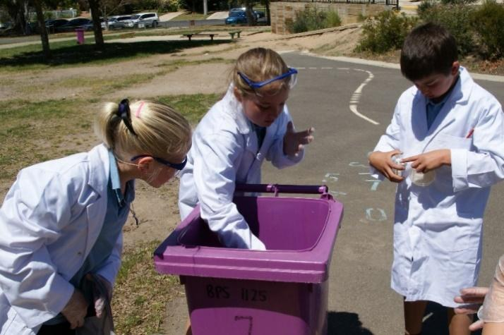
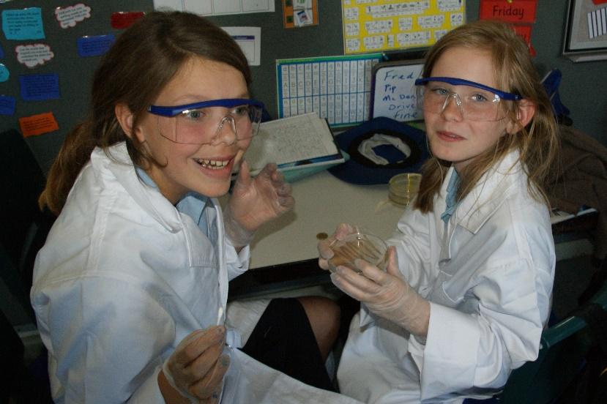
ReMSTEP - Grime Detectives
1. ReMSTEP - Plan and Production
2. Primary Setting
3. Student Engagement
4. Quality communication to teachers and schools

Slide 17
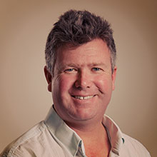
Growing tall poppies with ReMSTEP
Dr David Hoxley, La Trobe University

Slide 18

tackles
Teacher quality/capacity
Content
Stereotypes
Lack of perceived need for educational or career pursuits
Parent & Career Councillor advice
Not required as prerequisite
Lack of interest as little humanistic connection –interest
Lack of own perceived ability (too hard)
Perceived as highly mathematical and requiring high maths ability
Seen as compromising or not optimising ATAR
Research: Murphy & Whiteleg; Pino & Couso; Daly et al., 2006, 2007, 2009
To connect with physics girls need
Self efficacy –social cognitive theory (how do girls come to decide that they can succeed in physics) [The self-efficacy literature links student science self-efficacy to persistence in science study and career choices in science]
Self concept – Physics Identity - able to identify with physics gives a sense of belonging)
Social constructivist theory suggests 2 aspects which are important for girls to connect with physics
Social context of content learning – perceived relevance or authenticity of what they learn – girls need social relatedness
Social context of the subject i.e. the people associated with it [girls placed a high value on references to society and social involvement when learning physics]
Notes:
We need to take into account that girls have a tendency to lack self efficacy, identity, relevance of physics and un

Slide 19
Tall Poppies and remstep
PSTs in Growing Tall Poppies SPIEs (Scientists as Partners in Education)
MTeach Practicum/PRP linkup
Rachel, Mun-Xing

Slide 20
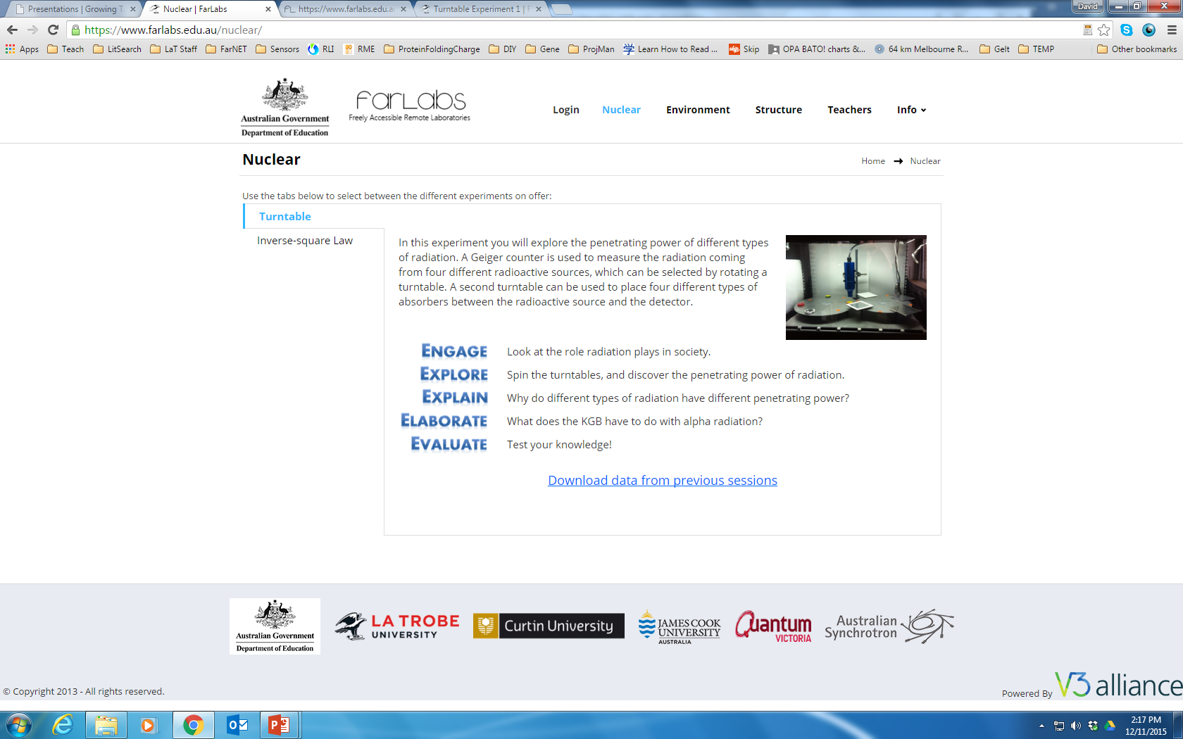
FARLABS
FarLabs (David)

Slide 21
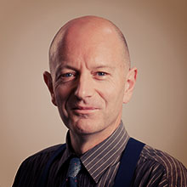
science as a human endeavor: the institute for frontier materials
Assoc Prof Stuart Palmer, Deakin University

Slide 22


Research in Deakin University’s Institute of Frontier Materials
This initiative aims to develop teacher education materials based around Year 7-10 modules that introduce students to the work of engineers and scientists at the IFM. The package will include school activities and challenge activities for pre-service teachers

Slide 23
Dr Mandy De Souza, Research Fellow
How did the main question behind your research come about?
https://youtu.be/PCGKsE6Jk1E

Slide 24
Mr Matt Jennings, PhD Candidate
Do you rely on the assistance/contributions of other staff in your work?
https://youtu.be/_5yD-9dXUSo

Slide 25
Dr Maryam Naebe, Research Fellow
How is your research work funded?
https://youtu.be/qX8sshXRmec

Slide 26
Dr Ben Allardyce, Postdoctoral Research Fellow
How did you get to be a researcher at Deakin University?
https://youtu.be/udwiw5Qdd70

Slide 27
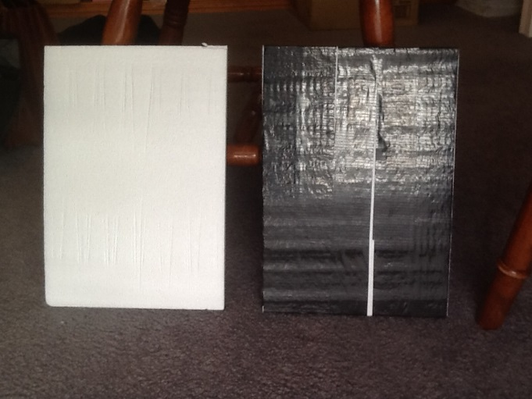
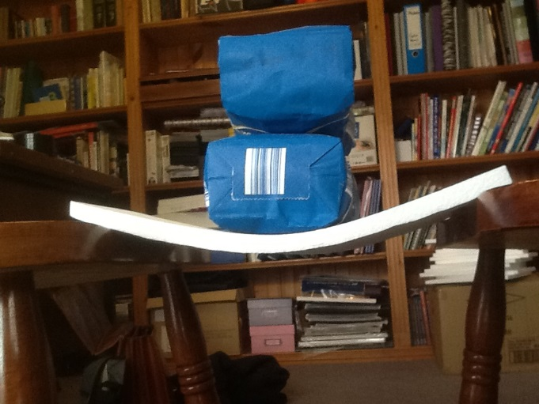
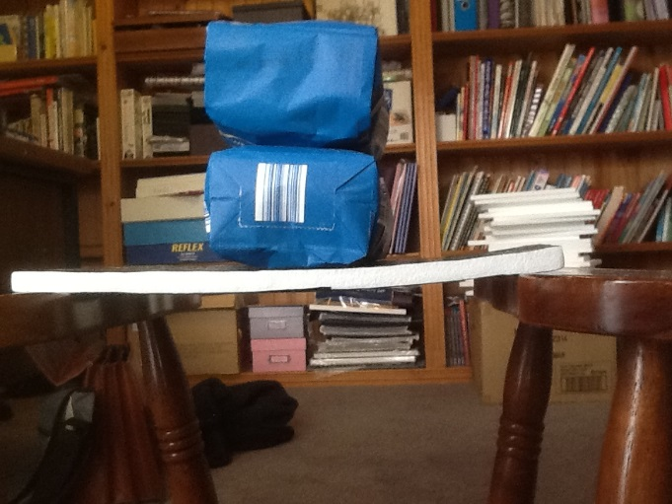
“Lightweight strands of carbon fibre have very high strength when stretched in tension, but crumple if pushed from the sides or ends. These fibres can be set (‘cured’) into a hard plastic resin and the resultant carbon fibre composite material is lightweight and combines the tensile strength of the fibres with the rigid structure of the resin matrix when it sets solid. Carbon fibre composites are light and strong, but the raw materials used are expensive and a lot of energy is required for their production, and the curing process to produce a carbon fibre product takes a long time compared to the manufacture of similar products made from metals.
Carbon fibre composites are used in applications where weight is more critical than cost, such as aircraft. Scientific research continues to find cheaper and more sustainable raw materials from which to make carbon fibres, and engineering efforts are directed at minimising the energy needed to produce the fibres and the time required to curing of products made from carbon fibre composites.”

Slide 28
PSTs developing contemporary biology multi-media resources
Peta White

Slide 29
panel discussion
David Hoxley
Gail Chittleborough
Stuart Palmer
Jen Ling
Russell Tytler
Rachel Beagley

Slide 30
Session 2 slide 12
What are key insights?
Personal experience of being a scientist
Understanding professional practices of scientists
Exploring new topics & areas of research in science
Adding value to the professional practice
Formal learning outcomes

Slide 31
wrapup: what are the key insights?
Prof Vaughan Prain, La Trobe University

