Slide 1
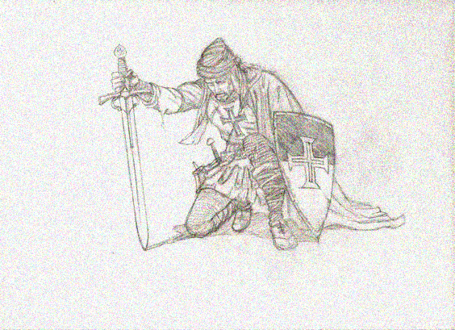
LETTER TO TEMPLARS
PROJECT BY: MANZOOR & GAURAV

Slide 2
Deliverables | Owner | Completed by+ Percentage Distribution | Comment
Software to implement the software | Gaurav , Manzoor | Gupta, Gaurav (70%) Ahmed, Manzoor(30%) | Had two versions, using Gaurav’s version for better optimization
Software to crack the project | Gaurav, Manzoor | Gupta, Gaurav (60%) Ahmed, Manzoor(40%) | Optimized key selection process which optimizes by 99.92% factor
Estimate and document work factor for attack | Manzoor, Gaurav | Ahmed, Manzoor(90%) Gupta, Gaurav (10%)
Write report that includes a detailed description and analysis of your work and result | Manzoor, Gaurav | Ahmed, Manzoor(80%) Gupta, Gaurav (20%)
Capture screenshot | Manzoor | Ahmed, Manzoor(100%) | Generated graphics, and provided visuals
Quality Assurance | Gaurav, Manzoor | Gupta, Gaurav (50%) Ahmed, Manzoor(50%)

