Slide 1
Project 2 Demo
CS266
Manzoor Ahmed
Pierre Vachon

Slide 2
Files
args.py : Input validator
lorem.txt : simple text file for encryption and decryption
instructionrunner.py : run given instruction to generate noise at cpu
noisegerator.py : generates noise
psutil: python module for monitoring system resources
stats.py : used for storing system resources
rc4.py :main program

Slide 3
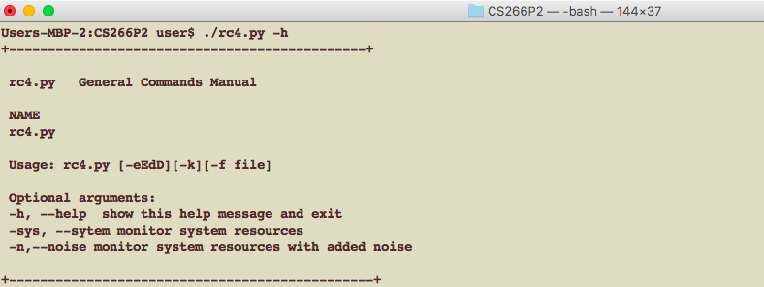
Usage

Slide 4
Encryption Example

Slide 5
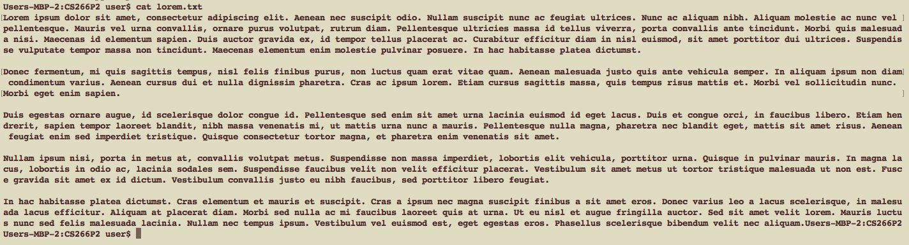
Simple lorem.txt file content

Slide 6
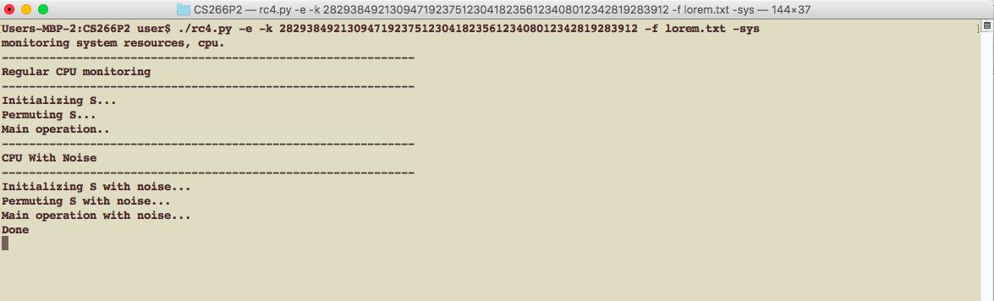
RUNNING…

Slide 7

Encrypted Content

Slide 8
Occurrence of each value* for 500,000 generated values (Truncated Axis)

Slide 9
Matrix of *values by preceding generated *value, 500,000 generated values
959 | 399 | 484 | 914 | 584 | 489 | 366 | 662 | 519 | 582 | 404 | 360 | 656 | 695 | 335 | 373 | 367 | 584 | 407 | 361 | 397 | 554 | 631 | 369 | 336 | 732 | 656 | 655 | 405 | 355 | 552
555 | 950 | 398 | 481 | 914 | 582 | 485 | 365 | 661 | 522 | 588 | 399 | 361 | 655 | 690 | 336 | 371 | 364 | 586 | 408 | 359 | 397 | 554 | 628 | 370 | 331 | 734 | 658 | 654 | 403 | 356
361 | 552 | 952 | 400 | 481 | 914 | 585 | 481 | 365 | 665 | 516 | 586 | 394 | 364 | 651 | 693 | 332 | 369 | 365 | 585 | 401 | 366 | 401 | 551 | 627 | 372 | 331 | 733 | 654 | 656 | 406
402 | 361 | 544 | 963 | 398 | 481 | 917 | 592 | 482 | 368 | 667 | 512 | 590 | 395 | 368 | 653 | 694 | 331 | 368 | 366 | 586 | 398 | 366 | 403 | 554 | 623 | 376 | 335 | 736 | 658 | 659
656 | 400 | 357 | 545 | 968 | 399 | 478 | 910 | 589 | 488 | 368 | 664 | 517 | 587 | 400 | 359 | 661 | 691 | 335 | 371 | 371 | 589 | 402 | 361 | 400 | 557 | 625 | 370 | 337 | 736 | 655
654 | 654 | 404 | 354 | 550 | 957 | 400 | 483 | 912 | 585 | 485 | 365 | 665 | 519 | 586 | 403 | 359 | 657 | 696 | 337 | 374 | 368 | 583 | 405 | 362 | 395 | 556 | 629 | 367 | 336 | 730
735 | 656 | 655 | 402 | 354 | 556 | 950 | 399 | 484 | 912 | 584 | 484 | 364 | 665 | 521 | 585 | 402 | 361 | 654 | 693 | 333 | 370 | 364 | 584 | 410 | 358 | 396 | 553 | 632 | 369 | 331
332 | 732 | 656 | 653 | 406 | 360 | 550 | 950 | 400 | 480 | 914 | 587 | 482 | 365 | 664 | 516 | 586 | 396 | 365 | 653 | 691 | 332 | 370 | 364 | 587 | 405 | 363 | 400 | 552 | 625 | 371
378 | 333 | 733 | 657 | 659 | 404 | 364 | 546 | 961 | 398 | 479 | 912 | 586 | 482 | 367 | 666 | 513 | 588 | 394 | 368 | 654 | 691 | 332 | 368 | 366 | 587 | 397 | 368 | 404 | 551 | 626
623 | 372 | 340 | 737 | 657 | 655 | 400 | 360 | 545 | 966 | 399 | 477 | 910 | 591 | 488 | 367 | 666 | 514 | 588 | 400 | 362 | 659 | 688 | 333 | 371 | 369 | 586 | 401 | 365 | 400 | 556
554 | 630 | 367 | 335 | 735 | 654 | 654 | 402 | 354 | 551 | 964 | 400 | 484 | 911 | 588 | 488 | 367 | 660 | 519 | 585 | 403 | 358 | 658 | 694 | 338 | 374 | 368 | 586 | 406 | 361 | 396
394 | 556 | 629 | 369 | 330 | 731 | 656 | 654 | 404 | 355 | 555 | 949 | 399 | 484 | 911 | 582 | 483 | 365 | 664 | 520 | 586 | 400 | 360 | 654 | 692 | 336 | 371 | 365 | 585 | 406 | 360
361 | 400 | 551 | 629 | 369 | 330 | 733 | 656 | 654 | 406 | 359 | 552 | 950 | 401 | 480 | 912 | 586 | 480 | 364 | 668 | 518 | 586 | 398 | 365 | 652 | 694 | 331 | 370 | 363 | 586 | 408
399 | 365 | 405 | 551 | 625 | 376 | 331 | 731 | 657 | 655 | 405 | 361 | 547 | 960 | 399 | 481 | 917 | 588 | 480 | 367 | 663 | 512 | 587 | 397 | 368 | 653 | 694 | 331 | 367 | 367 | 587
588 | 399 | 367 | 402 | 555 | 625 | 374 | 339 | 735 | 657 | 656 | 403 | 362 | 543 | 964 | 397 | 476 | 909 | 590 | 486 | 369 | 666 | 517 | 588 | 398 | 362 | 659 | 687 | 334 | 369 | 370
368 | 585 | 404 | 362 | 397 | 557 | 627 | 367 | 337 | 732 | 651 | 654 | 403 | 357 | 549 | 959 | 400 | 482 | 910 | 588 | 491 | 367 | 663 | 519 | 584 | 404 | 360 | 661 | 692 | 337 | 373
371 | 363 | 586 | 408 | 359 | 393 | 553 | 631 | 368 | 331 | 734 | 656 | 655 | 402 | 354 | 557 | 954 | 401 | 486 | 912 | 583 | 486 | 365 | 660 | 523 | 587 | 404 | 360 | 655 | 692 | 336
334 | 369 | 363 | 586 | 405 | 360 | 397 | 554 | 627 | 370 | 329 | 731 | 656 | 651 | 405 | 358 | 553 | 948 | 400 | 480 | 908 | 586 | 482 | 364 | 667 | 520 | 588 | 397 | 364 | 653 | 692
696 | 331 | 367 | 367 | 585 | 400 | 363 | 405 | 552 | 625 | 374 | 331 | 730 | 656 | 660 | 404 | 364 | 549 | 954 | 402 | 480 | 917 | 587 | 480 | 368 | 664 | 513 | 588 | 396 | 368 | 652
658 | 692 | 333 | 369 | 369 | 589 | 400 | 362 | 404 | 555 | 625 | 374 | 337 | 736 | 660 | 656 | 402 | 361 | 542 | 969 | 397 | 478 | 913 | 589 | 486 | 368 | 664 | 514 | 589 | 398 | 363
360 | 662 | 690 | 340 | 373 | 371 | 589 | 401 | 362 | 398 | 554 | 626 | 368 | 337 | 732 | 655 | 654 | 400 | 358 | 549 | 963 | 398 | 480 | 908 | 589 | 488 | 368 | 662 | 518 | 584 | 401
403 | 359 | 656 | 693 | 336 | 373 | 364 | 585 | 406 | 360 | 395 | 556 | 632 | 367 | 333 | 736 | 652 | 657 | 404 | 356 | 555 | 953 | 400 | 485 | 914 | 583 | 485 | 366 | 660 | 522 | 584
589 | 399 | 364 | 652 | 693 | 334 | 372 | 362 | 588 | 407 | 361 | 396 | 552 | 627 | 369 | 331 | 734 | 657 | 655 | 401 | 355 | 555 | 952 | 400 | 479 | 910 | 585 | 483 | 366 | 663 | 522
515 | 587 | 396 | 367 | 652 | 691 | 331 | 368 | 365 | 586 | 401 | 364 | 403 | 552 | 624 | 374 | 331 | 730 | 655 | 655 | 405 | 363 | 549 | 954 | 399 | 480 | 917 | 588 | 482 | 366 | 662
666 | 513 | 590 | 396 | 365 | 658 | 693 | 331 | 368 | 368 | 586 | 399 | 364 | 404 | 556 | 627 | 375 | 338 | 734 | 657 | 660 | 402 | 363 | 545 | 963 | 400 | 476 | 912 | 590 | 484 | 369
367 | 662 | 515 | 587 | 403 | 360 | 659 | 693 | 336 | 373 | 371 | 587 | 403 | 362 | 400 | 555 | 625 | 368 | 340 | 736 | 657 | 653 | 402 | 356 | 546 | 967 | 398 | 481 | 909 | 587 | 490
488 | 367 | 660 | 522 | 584 | 401 | 360 | 657 | 692 | 339 | 374 | 366 | 586 | 405 | 359 | 397 | 555 | 629 | 367 | 333 | 733 | 656 | 655 | 402 | 354 | 555 | 955 | 398 | 483 | 914 | 584
581 | 482 | 365 | 664 | 521 | 587 | 398 | 361 | 652 | 693 | 337 | 371 | 363 | 587 | 405 | 359 | 396 | 553 | 630 | 369 | 331 | 737 | 655 | 658 | 403 | 358 | 557 | 948 | 400 | 482 | 911
919 | 588 | 481 | 368 | 664 | 514 | 588 | 395 | 367 | 651 | 693 | 331 | 370 | 364 | 588 | 401 | 365 | 401 | 551 | 625 | 371 | 331 | 734 | 656 | 658 | 404 | 359 | 550 | 952 | 400 | 480
477 | 917 | 589 | 484 | 369 | 664 | 515 | 588 | 397 | 366 | 656 | 692 | 332 | 368 | 368 | 588 | 399 | 364 | 403 | 553 | 625 | 376 | 334 | 732 | 655 | 657 | 402 | 362 | 545 | 962 | 398
398 | 480 | 908 | 589 | 486 | 365 | 664 | 517 | 589 | 401 | 360 | 660 | 691 | 334 | 372 | 372 | 586 | 402 | 364 | 399 | 557 | 626 | 368 | 340 | 733 | 655 | 656 | 404 | 357 | 547 | 963

Slide 10
3D plot of generated *values by previous generated *value, 500,000

Slide 11
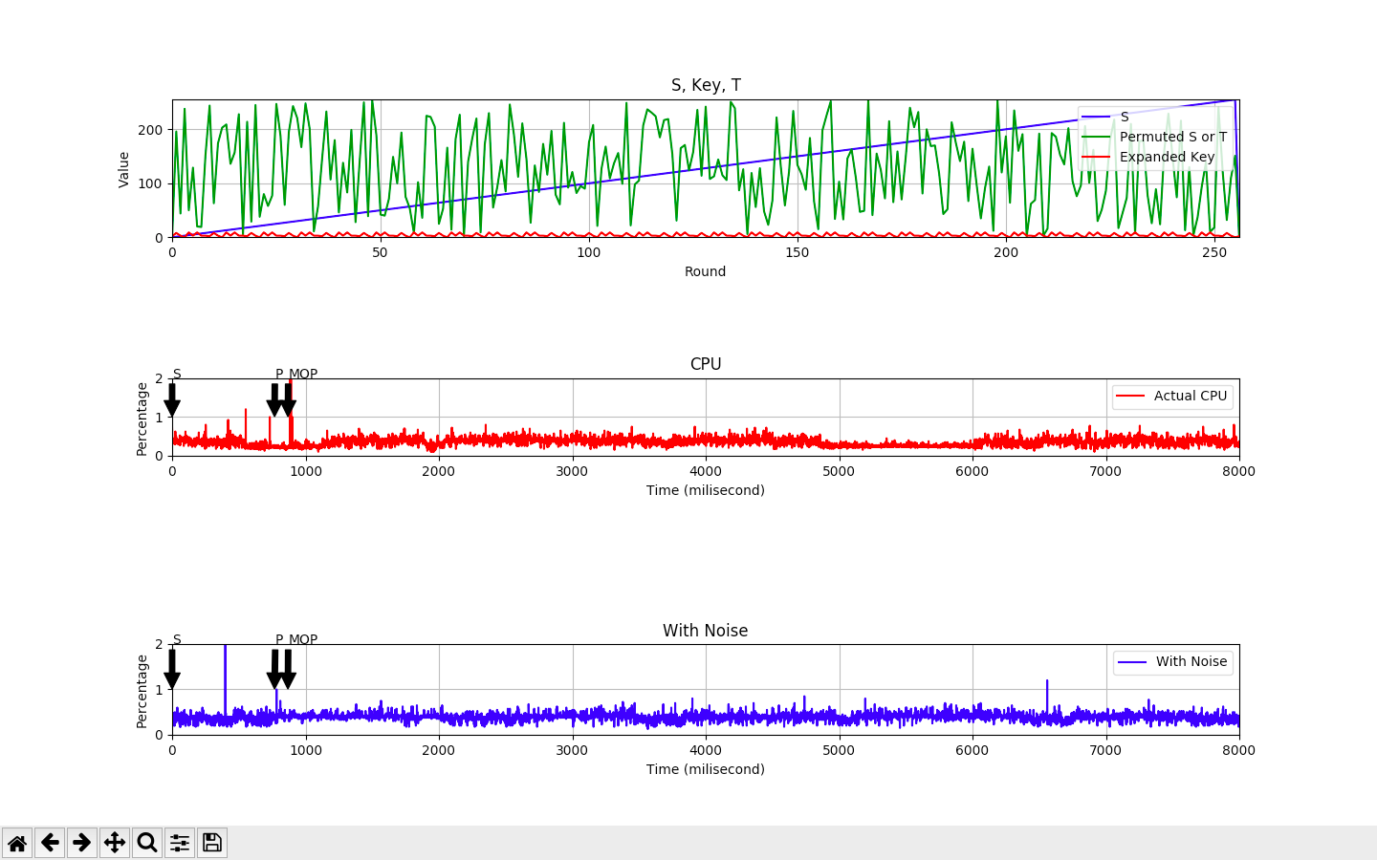
CPU usage for runs of RC4, one raw and one with noise, for the same Key

Slide 12
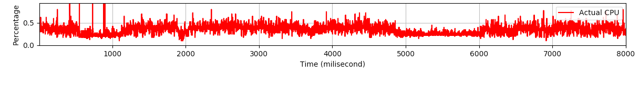
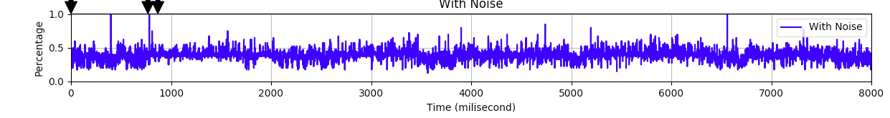
CPU usage for runs of RC4, one raw and one with noise, for the same Key – close up

Slide 13
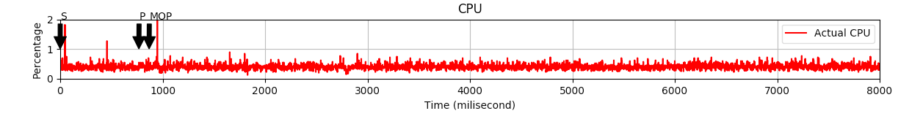
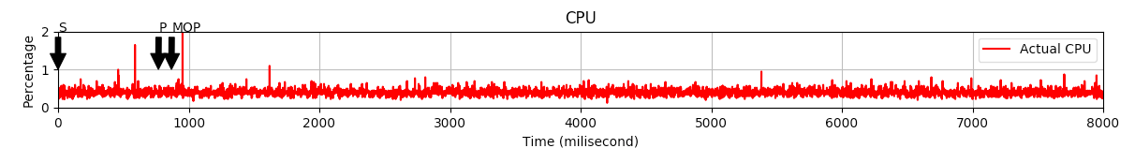
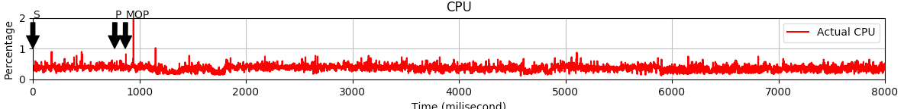
CPU: three consecutive runs of a given key, without noise

Slide 14
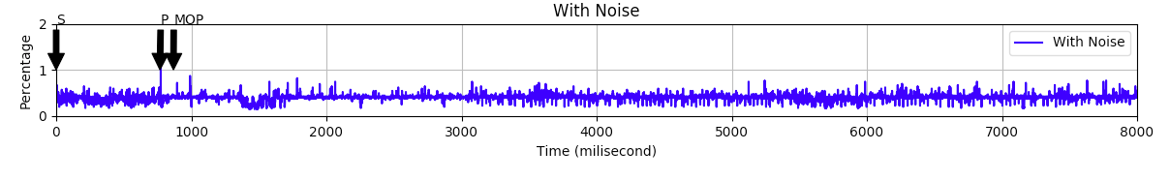
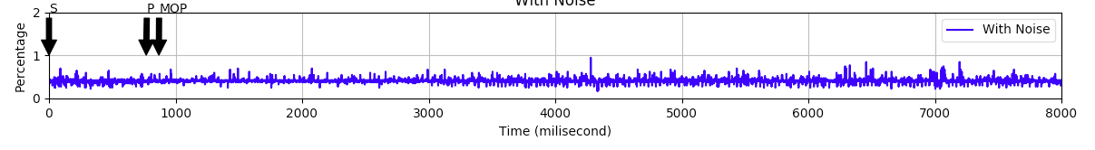
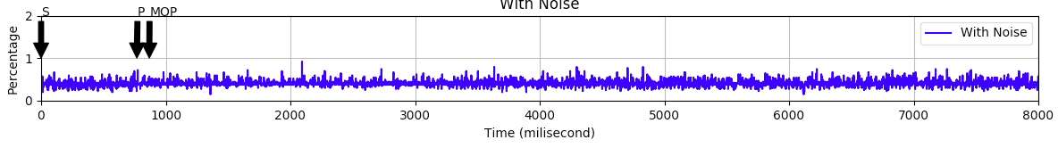
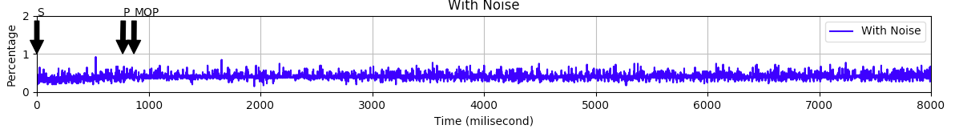
CPU: Four consecutive runs of a given key, with noise

Slide 15
Overlay of CPU: two pairs of consecutive runs of a given key, with noise

Slide 16
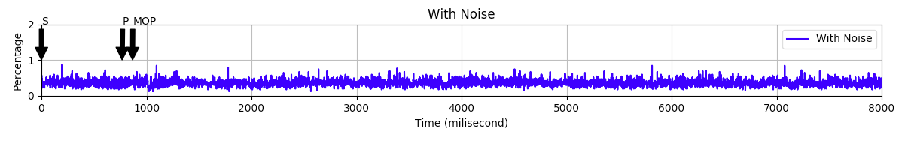
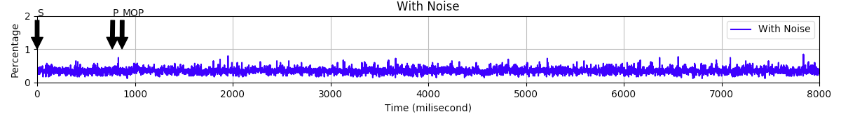
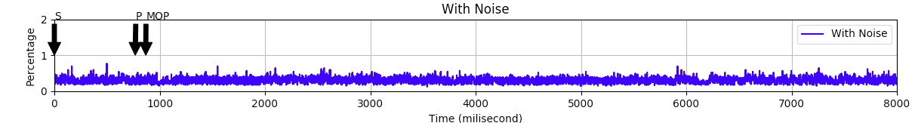
CPU measurement: three runs, different keys, with noise
36376289283083773720189566554
09280002022181810189566554
329876455559000000142522554

Slide 17
Improvements and Future Directions
Fix randomness in noise
Separate timing from level
Test with actual power meter instead of CPU usage

Slide 18
Conclusion
Same key, same noise
Different key, different noise
Natural variations

