Slide 1
HUMAN-ROBOT INTERACTION (HRI) WITH ROBOT PEPPER
by Hernán Indíbil de la Cruz Calvo Alejandro Zornoza Martínez

Slide 2
Index
1. Introduction 1
2. Objectives 2
3. Preliminaries 3
3.1. Interface 4
3.2. How to connect 5
4. Speech recognition 6
4.1. Animations 9
4.2. Movement 10
5. Face recognition 13
6. Dialogue 16
7. Conclusions 20

Slide 3
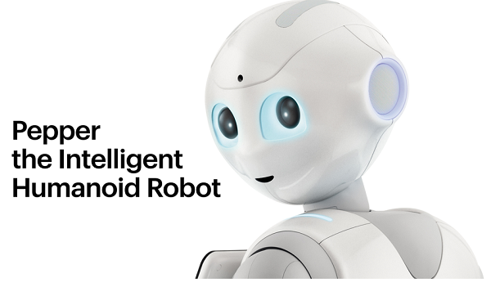
1. Introduction
The evolution of technology has improved the way humans can interact with machines. Robots will provide us a lot of tools that can make our lives more easier.

Slide 4
2. Objectives
Speech-based commands with animations
“Follow me” and “Come here” behaviours
Face learning and recognition
Speech-based dialogue

Slide 5
3. Preliminaries
In order to work with Pepper we are using Choregraphe. We will talk about:
Choregraphe interface
How to connect to the robot

Slide 6
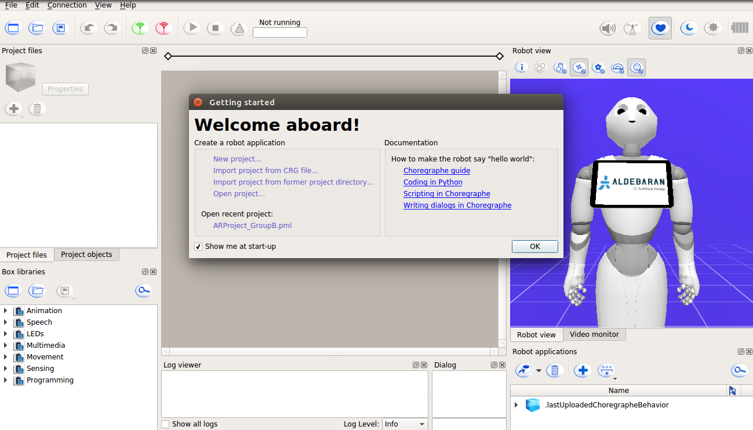
3.1. Interface

Slide 7
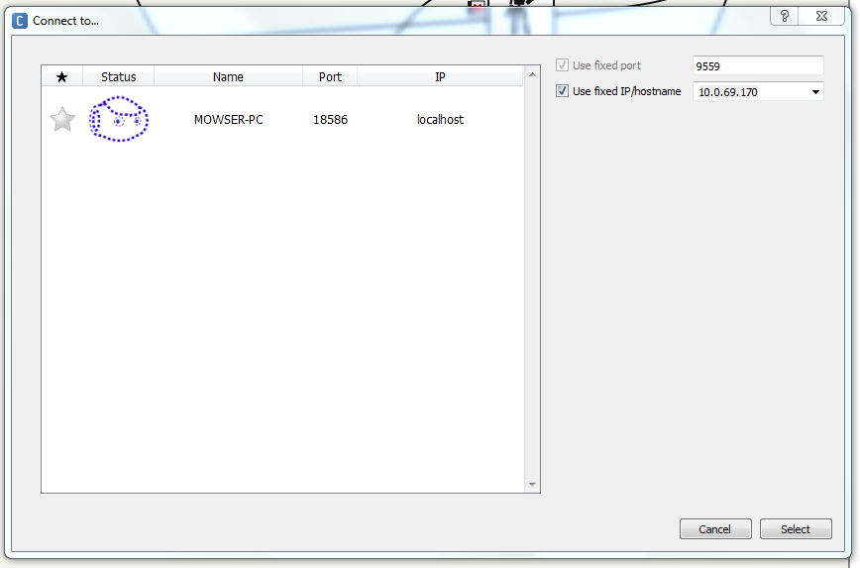
3.2. How to connect

Slide 8
4. Speech recognition
Two objectives fit in this part:
Animations (Speech-based commands with animations)
Movement (“Follow me” and “Come here” behaviours)
We also need to talk about two common boxes used in both behaviours :
Awaken box
FaceAndSpeech box

Slide 9
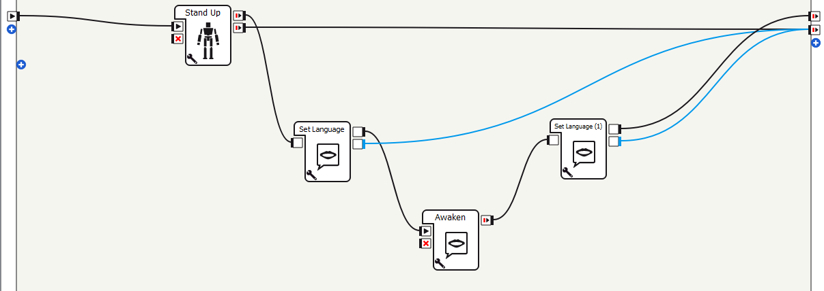
4. Speech recognition: Awaken

Slide 10
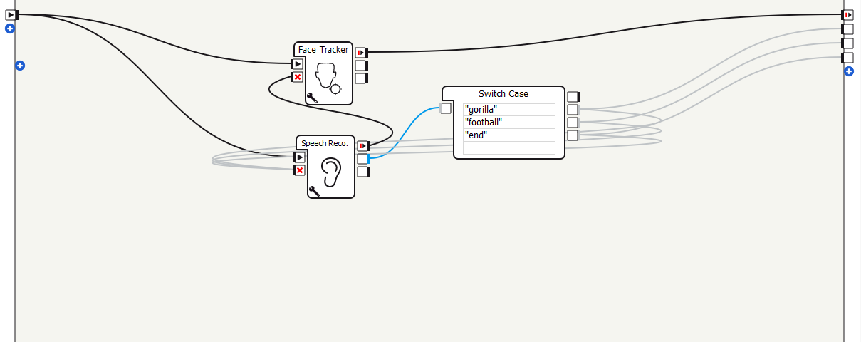
4. Speech recognition: Face and Speech

Slide 11
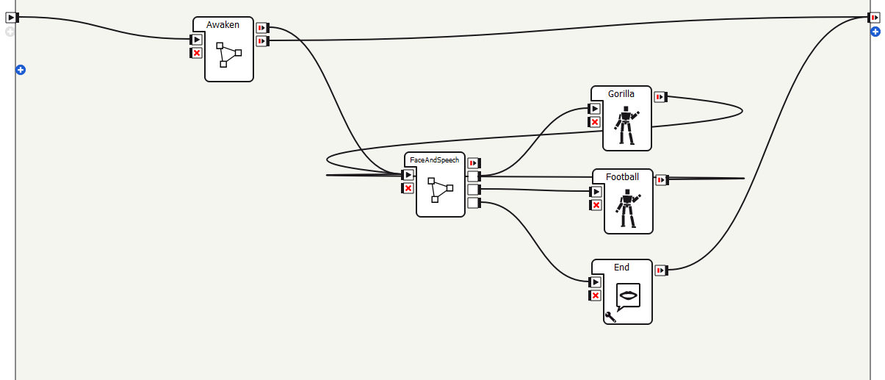
4.1. Animations

Slide 12
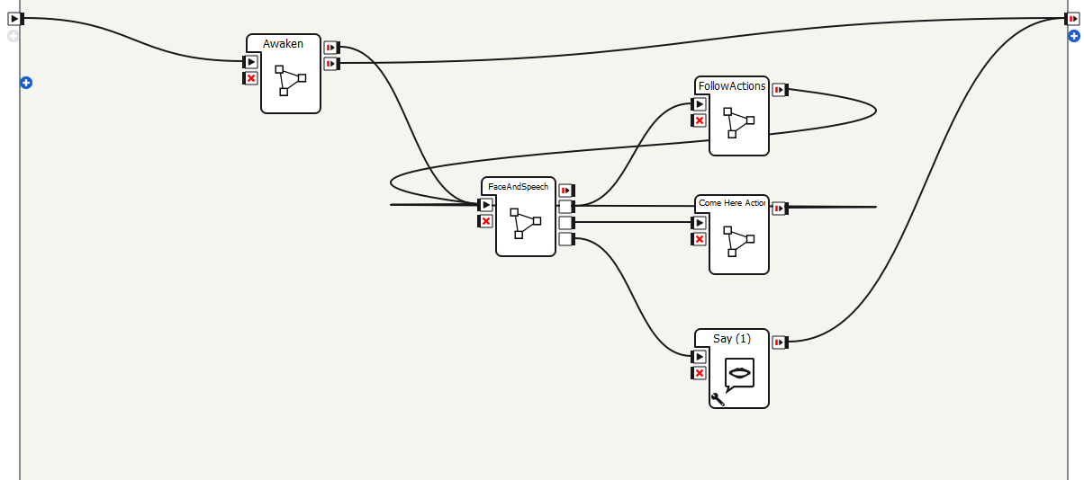
4.2. Movement

Slide 13
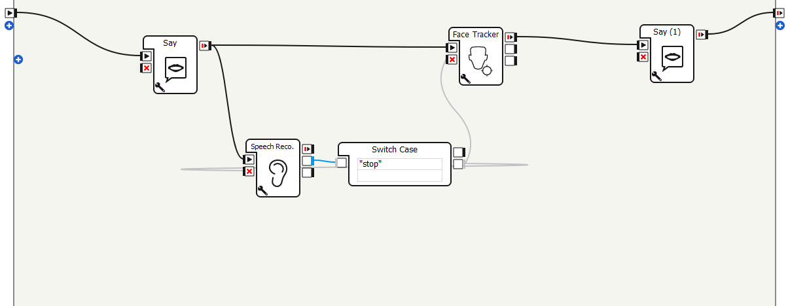
4.2. Movement: Follow Me

Slide 14
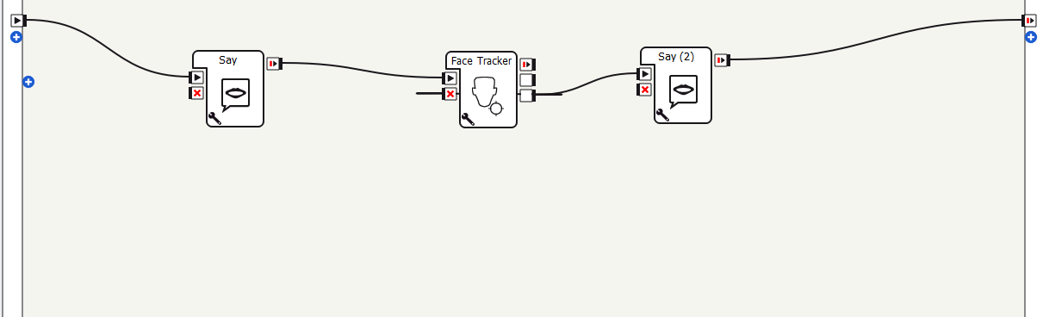
4.2. Movement: Come here

Slide 15
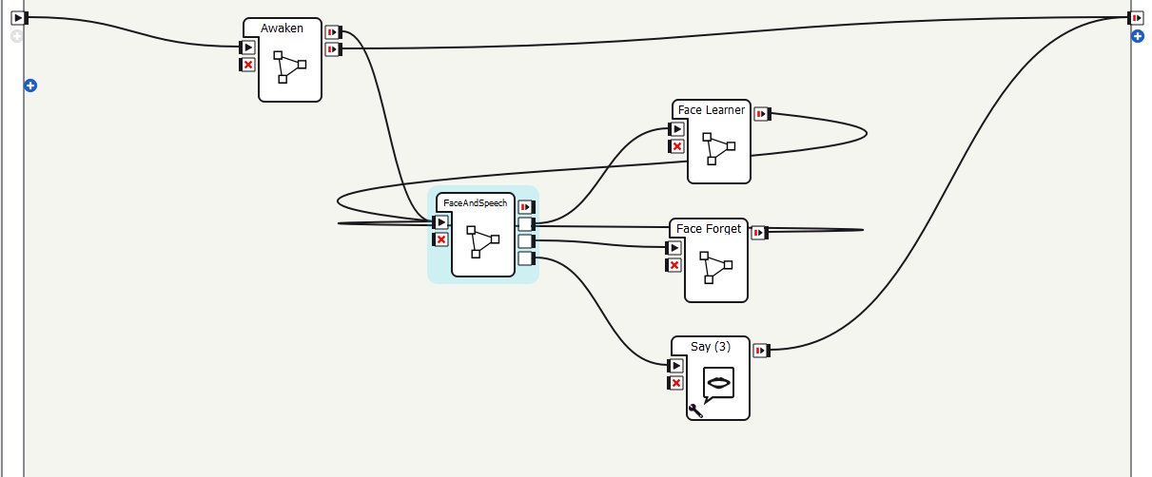
5. Face recognition

Slide 16
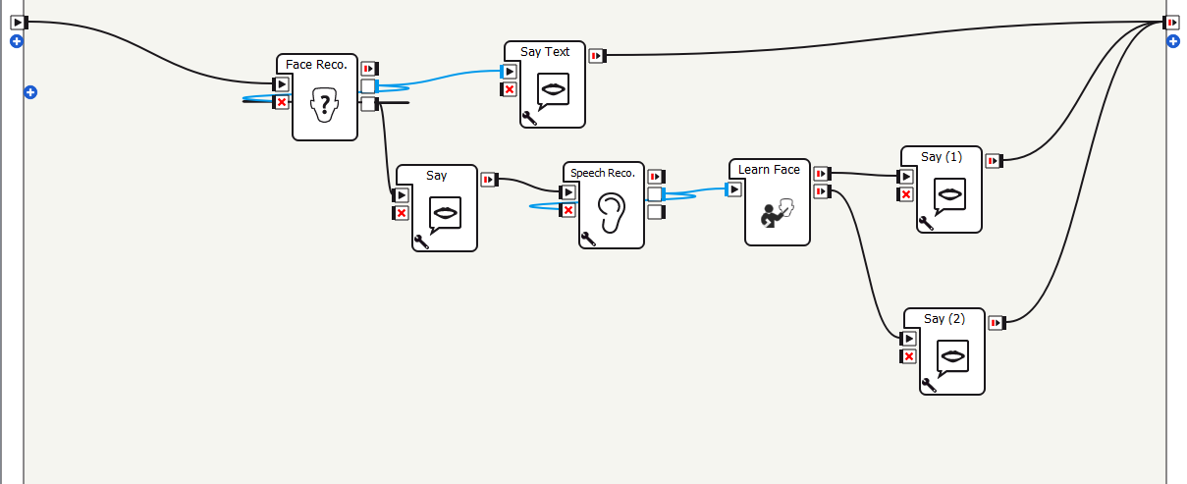
5. Face recognition: learn

Slide 17
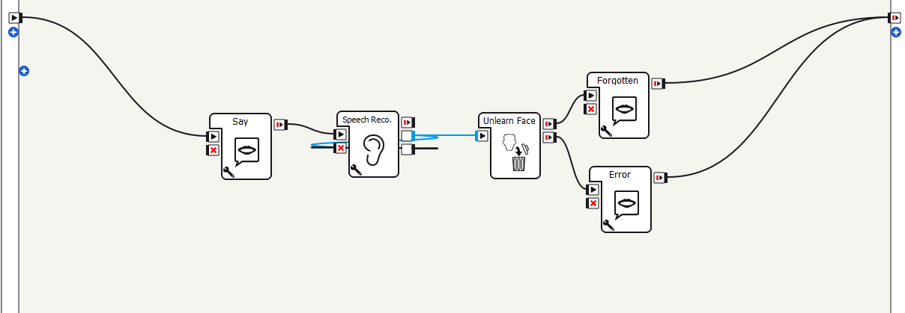
5. Face recognition: forget

Slide 18
6. Dialogue
The dialogues in Pepper have their own box with a special syntax when programming.
You have to create topics and to prepare responses when a specific concept is said by the user.

Slide 19
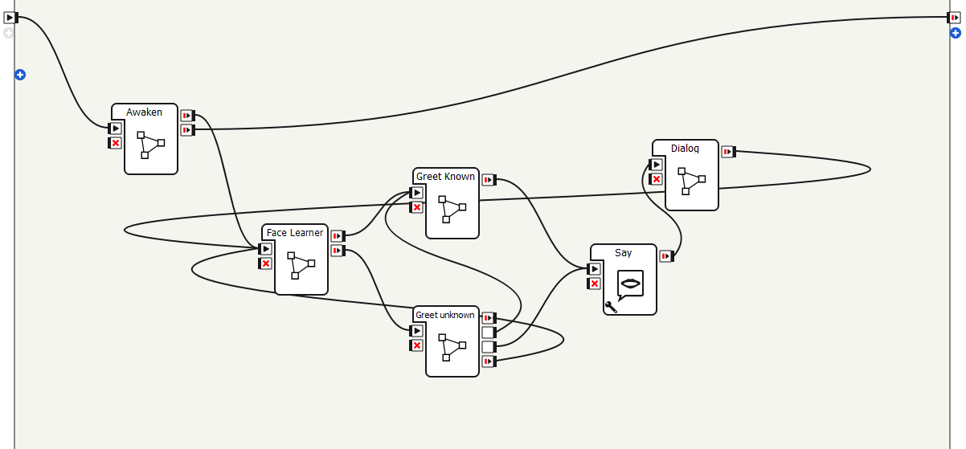
6. Dialogue

Slide 20
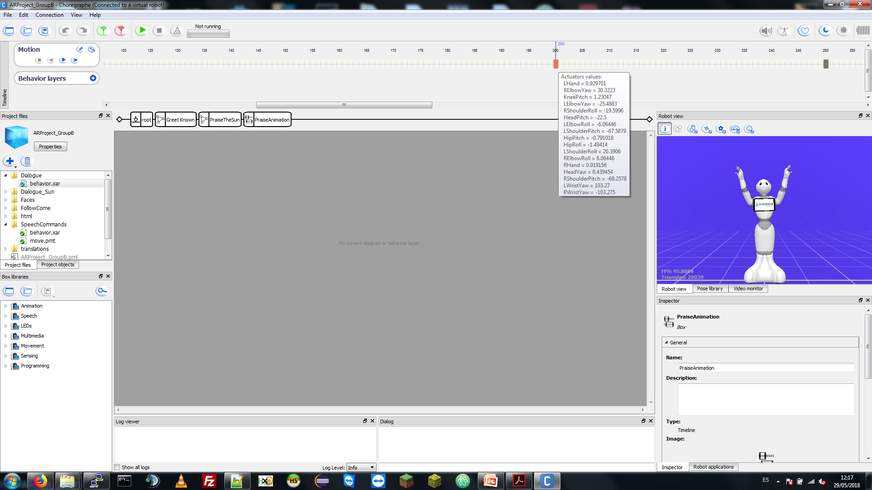
6. Dialogue
We also created our own animation using a timeline editor provided in Choregraphe.

Slide 21
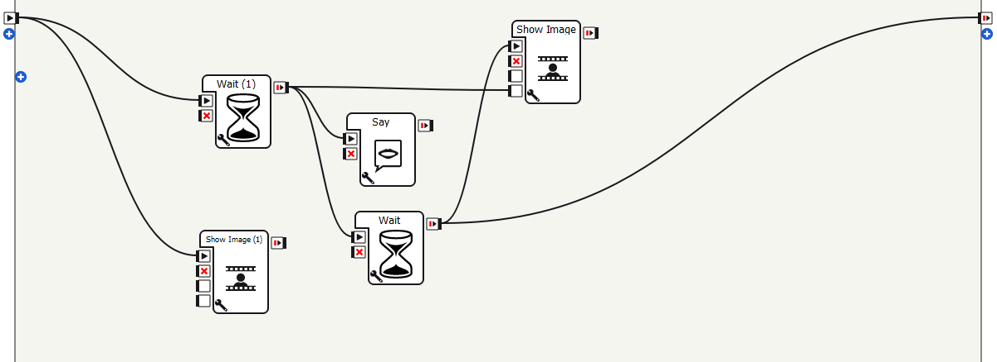
6. Dialogue
In order to display a image, the Show Image block is used.

Slide 22
7. Conclusions
We have learnt how to work with Pepper and Choregraphe.
We have implemented behaviours based on human-robot interaction.
It was an interesting project where we had the opportunity to work with one of the most modern commercial robots.

