Slide 1
Final
Presentation
by
Hernan Indibil of the Cross Bald
Francis Xavier Celdran Martinez

Slide 2
Index
Introduction 1
Components 3
Usage 6
Examples 7

Slide 3
Introduction
We are going to review all the presentations we have done except this, because we don’t want to enter in a infinite loop.

Slide 4
Wow game
In the wow game presentation we talked about Undertale.
First we exposed the description of the game and after that we told how do we think the game AI works.

Slide 5
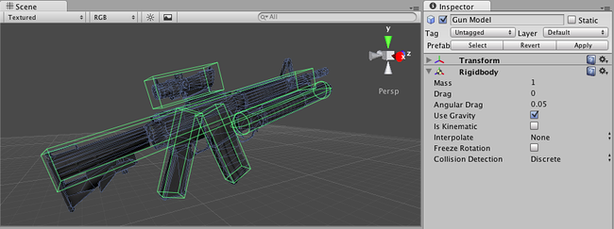
Colliders
Our second presentation was about colliders. We made a proposal of how to implement a collider in a 2D game and we explained mesh colliders.

Slide 6
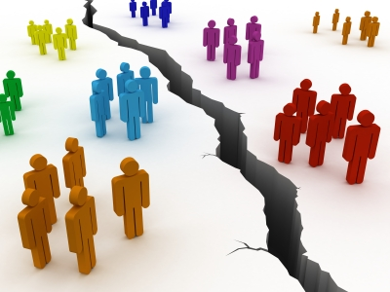
Division
After that, our team parted ways. Each team member created its own storyboard about the game we wanted to make in Unity.

Slide 7
Moderdonia
Yeha

Slide 8
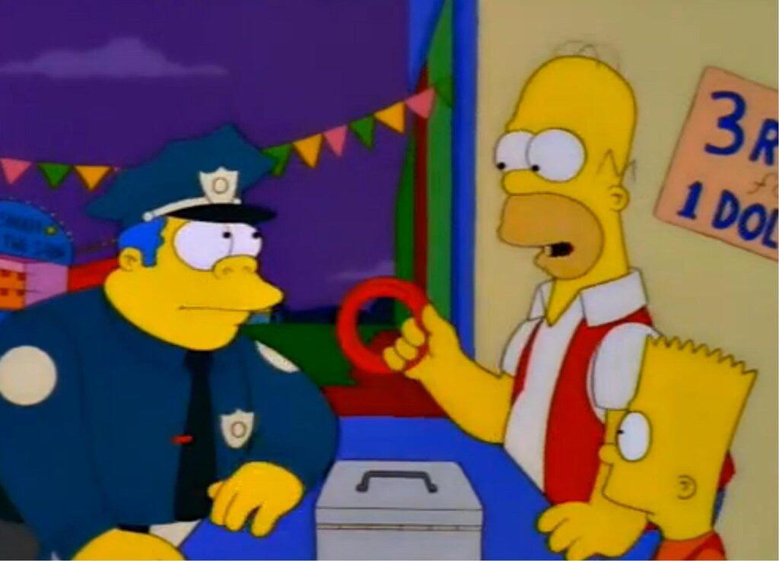
I am the O
The game proposed by Hernan.
It’s a ring toss game.

Slide 9

Back together
Finally after a few weeks we started working together again with the common practice assignment:
Mamversity

Slide 10
Examples
Now we want an event to be triggered. In this example, a letter will be sent to the main character if the friendship is higher than a certain value.
Friendship(player, npc) > 8 => Send(player, letter3)

Slide 11
Examples
Another example, we can add a new fact to the fact base when something happens.
Friendship(player, npc) > 6 AND Time < 12:00
=>
EventSeen(34) AND Friendship(player, npc) +1

