Slide 1


Japantum
Soki Sakurai
Hirotaka Yokoyama
Hiromasa Kamezawa

Slide 2
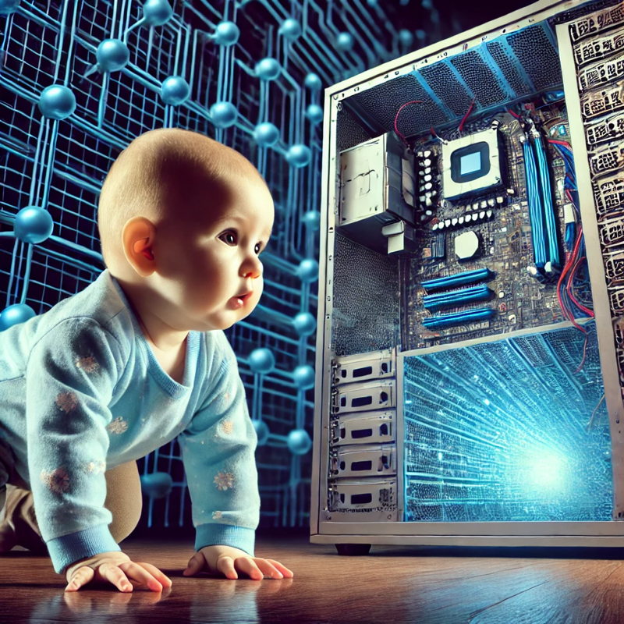
Background
We are all first-year SDM students at MIT and have more than five years of work experience
Quantum computing have been gaining attention in business recently, and we participated in iQuHACK to understand what quantum computer is and stay updated on the latest trend.
We have NO background, knowledge, or skills in quantum computing.

Slide 3

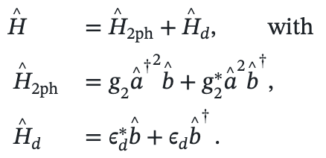

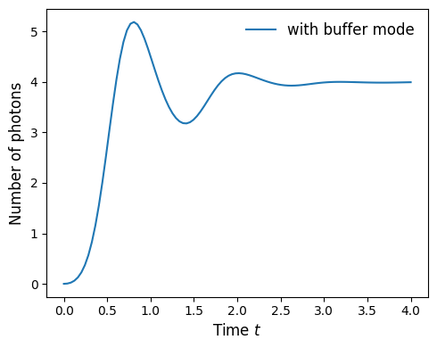
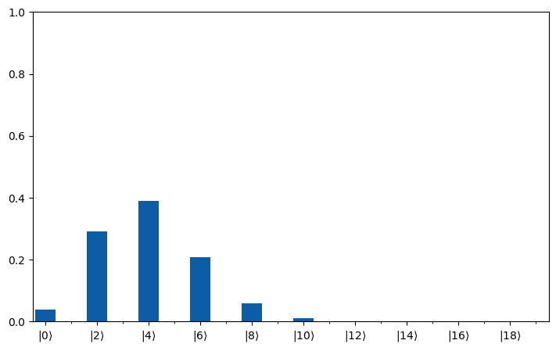
Task1.1
Simulated time evolution of α with the buffer mode:
Parameters: Time=4 sec , g₂=1.0, ε_{d}=-4.0, κb=10
=>The number of photons converged to 4(=α²) after over/under-shooting for ~2.5 sec

Slide 4
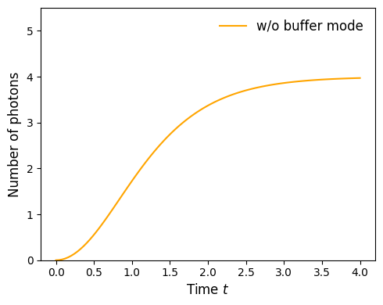
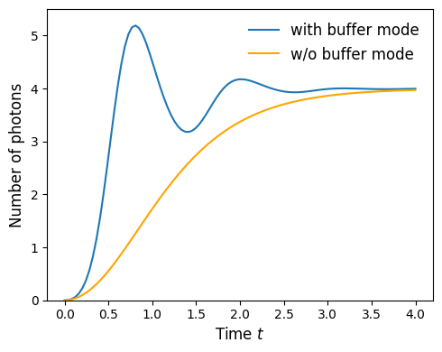
Task1.2
Simulated time evolution of α without the buffer mode:
Parameters: Time=4 sec , g₂=1.0, ε_{d}=-4.0, κb=10
=>The number of photons slowly converged to 4(=α²)
=>the buffer mode makes the convergence faster? (but causes over/under-shoot)

Slide 5
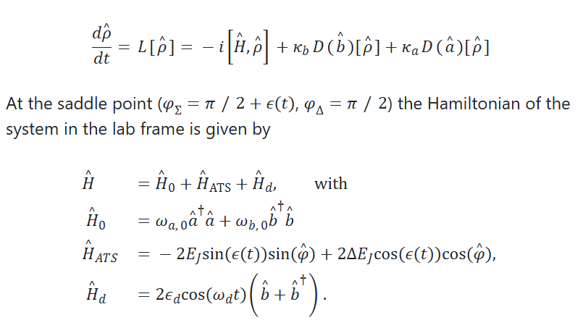
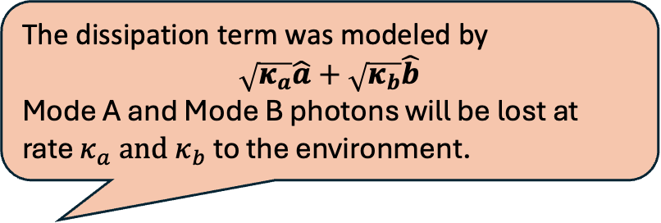
Task2.1
The dissipation term was modeled by
$\sqrt{κ_{a}}\hat{a}+$ $\sqrt{κ_{b}}\hat{b}$
Mode A and Mode B photons will be lost at rate $κ_{a} and κ_{b}$ to the environment.
Lindblad master equation
Code Snippet
res = dq.mesolve(H, [jnp.sqrt(kappa_a)*a + jnp.sqrt(kappa_b)*b], psi0, tsave)
print(res.states[-1] - res.states[0]) =
[[0.0000000e+00+0.000000e+00j 4.6064574e-16+7.721896e-12j] [4.6064574e-16-7.721896e-12j 0.0000000e+00+0.000000e+00j]]
Not Zero! But the change is in the order of e-12 in 10 mirosec simulation…

Slide 6
Takeaway
Really fun
We learned the concept and challenges about quantum computing
On the other hand, understanding the principles of quantum computing requires further study.

