Slide 1
The Council of Alexs
Expermenting with SignalR in Unity

Slide 2
Purpose
Implement a realtime multiplayer game with Unity and SignlaR.
Explore the possibilities and limitations that SignalR provides
Use .net core libraries on Unity 😵

Slide 3
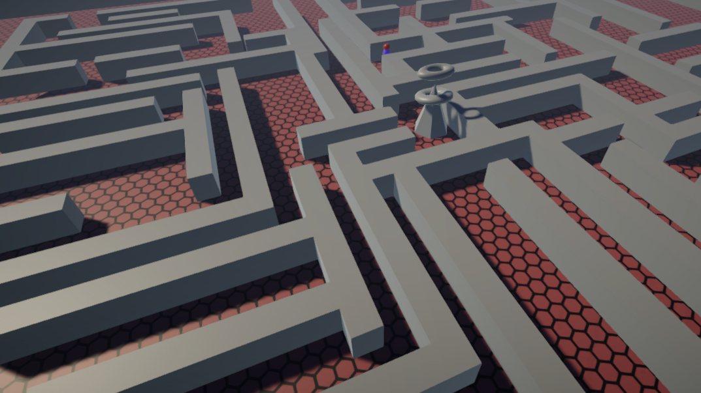
The Game
Very simple gameplay:
The player spawns as one of the many Alex inside a maze
They have to get to The Council of Alexs in time for the meeting.
Other Alex(es) are inside the maze

Slide 4
The server
SignalR hub
Acts more as a relay for the clients.
Takes an action from 1 client, broadcasts it to everyone else.
Some interface for monitoring
There is no state on the server besides current players
This is needed for initialization when a new player joins.

Slide 5
The problem with Unity
ASP.NET Core SignalR works in Unity (using some nuget hackery).
Unity now supports .netstandard2.0
BUT…
Using the current “MonoBehaviour“ pattern is very much single threaded.
Accessing almost anything related to Unity Engine outside the main thread will result in a very nice silent crash of that thread.
SignalR events are async ☹

Slide 6
The solution
SignalR events need to set some intermediary state that is then applied on Update()
UnityMainThreadDispatcher to the rescue 🦸
How it works:
A singleton MonoBehaviour
Add any action from any thread to an Execution Queue.
Update locks the executionQueue and invokes all the actions.
The actions are treated as good ol’ unity coroutines.

Slide 7
Performance and Lessons Learned
SignalR is fast but not that fast.
Local you we had about 10ms delay between sending and receiving a message between clients
Using Azure free tier US, we had 240ms, rarely below 200ms
Using Azure D1 dev tier (cheapest) on West EU, we had about 50ms.
It is very easy to use and setup.
Is fast enough for action based communication,
The threading issues is something of a hassle at first.
In the future might be avoided completed using the new ECS (link here) data driven framework
For true realtime gameplay something else might more suitable.

Slide 8
Thank You!

