Slide 1
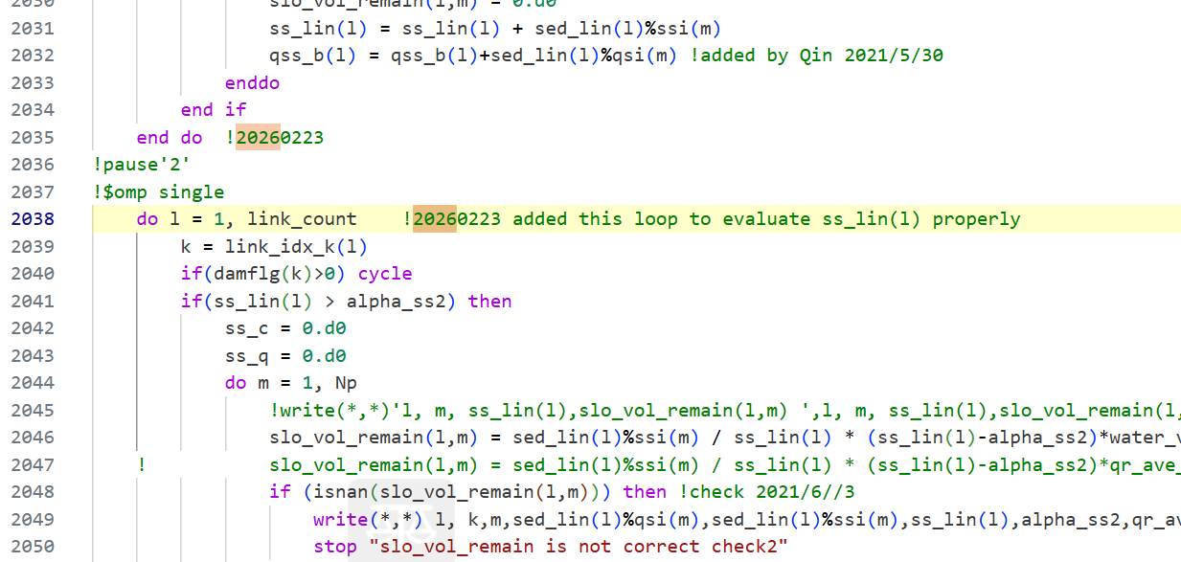
RRI_sediment.f90 :Added a loop to calculate ‘ss_lin(l)’ properly (This is just a bug for ‘ss_lin(l)’ fix)

Slide 2
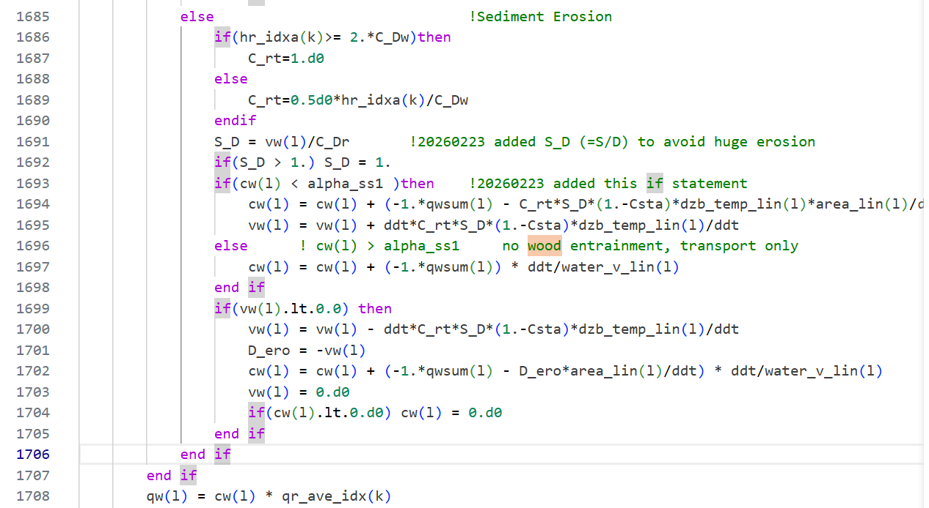
RRI_sediment.f90 :Modified to correctly calculate in regions where the wood concentration is excessively high.

Slide 3
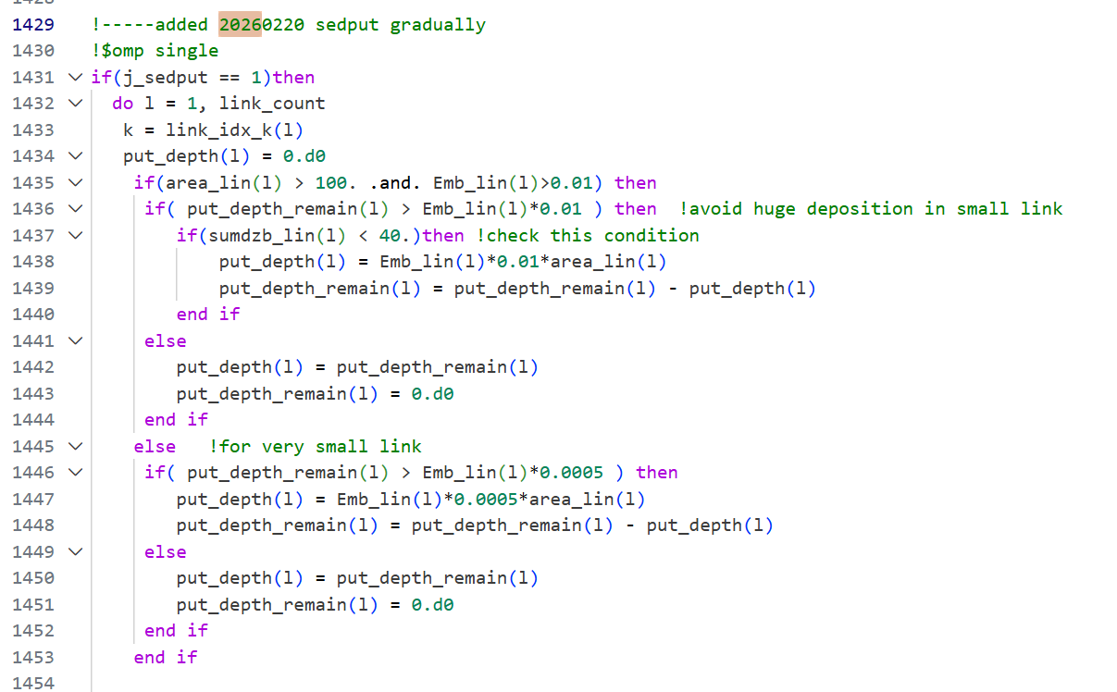
RRI_sediment.f90 :Modified ‘sedput’ function

