Slide 1

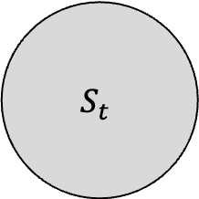
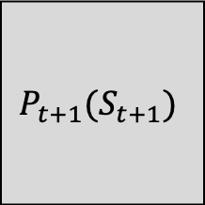
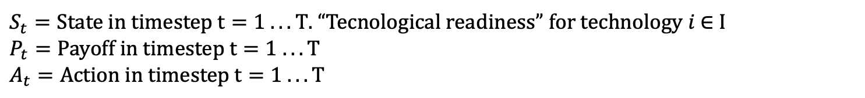

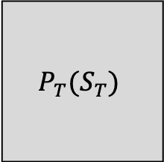
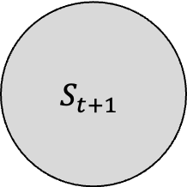
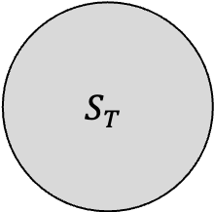
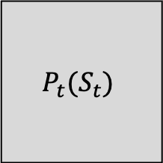

$A_{t}(P_{t}, E_{t})$
$A_{t+1}(P_{t+1}, E_{t+1})$
$A_{T−1}(P_{T−1}, E_{T−1})$
$$S_{t}$$
$$S_{t+1}$$
$$S_{T}$$
. . .
$$P_{t}(S_{t})$$
$$P_{t+1}(S_{t+1})$$
$$P_{T}(S_{T})$$
$S_{t}=State in timestep t=1 . . . T$. “Tecnological readiness” for technology $i \text{∈} \text{I}$
$$P_{t}=Payoff in timestep t=1 . . . T$$
$$A_{t}=Action in timestep t=1 . . . T$$

