Slide 1
Developing a Framework for Analyzing Real-Time Tweets to Detect Terrorism
Supervised by:
Dr. Mohammad Shamsul Arefin
Professor &
Head of the Department, Department of CSE,CUET
Presented by :
Mohammad Fahim Abrar
1304079

Slide 2
Contents
Introduction
Related Works
Objectives
Challenges
Framework Architecture
Flow Graph of the framework
Implementation
Experimental Results
Limitations and Future Works
References

Slide 3
Introduction
Terrorism is a threat to the humanity.
Terrorist organizations have highly benefited by the worldwide reach, speed, and growth of the Internet.
By using social media platform, mostly Twitter, terrorist organizations spread their views.
In last two years, Twitter suspended around a million twitter account for spreading terrorism. [1]

Slide 4
Related Works
Detecting jihadist messages on twitter [2]
Work Done:
- Used sentiment analysis to detect if a message
supports ISIS or not.
- Experiment was applied on Twitter.
- Used hashtag to extract terrorism related tweets from
historic tweets.
Limitation:
- Didn’t test their methods in real-time environment.
- Didn’t have any framework to detect real-time tweets.

Slide 5
Related Works (Contd.)
Twitter Data Analysis in Python [3]
Work Done:
- Described several analysis on tweets such as term frequencies, bigram terms, most used hash tag, most used mentions.
- Used a python library called ‘Tweepy’
Limitation:
- Didn’t study advance technique of analysis such as sentiment analysis, natural language processing etc.

Slide 6
Objectives
To develop a framework for crawling and analyzing real-time tweets to detect terrorism.
To build a mechanism that will be able to re-train the model to detect terrorism more accurately.
To crawl a large number of tweets in different time-frame and analyze the performance of our system

Slide 7
Challenges
Real-Time crawling and analysis of the tweets without any interruption
Building a dataset of tweets which will help us to build our classifier to detect terrorism.

Slide 8
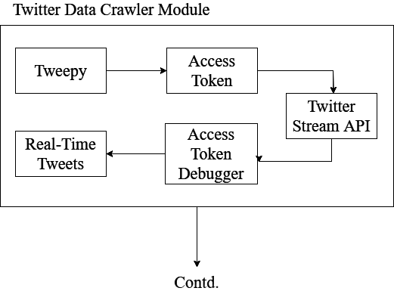
Framework Architecture
Figure 1: Twitter Data Crawler Module

Slide 9
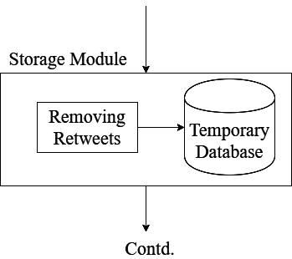
Framework Architecture
Figure 2: Storage Module

Slide 10
Framework Architecture
Figure 3: Tweets Analysis Module

Slide 11
Framework Architecture
Figure 4: Output Module

Slide 12
Framework Architecture
Figure 5: Training Module

Slide 13
Flow Graph of the Framework
Figure 7: Re-Train Module

Slide 14
Training
Figure 7: Training workflow

Slide 15
Training : Train Data
Table 1: Summary of tweet collection method
Collection Type | No of tweets
Randomly from Real-Time Tweet Stream | 21248
Using Terrorism Related Hashtags | 15770
Crawling Terrorist Profiles | 18105
Total = | 55123

Slide 16
Training : Train Data
Table 2 : Summary of Train Data
Type of Tweets | Numerical Value | No of tweets
Terrorism Supporting | 0 | 13369
Terrorism Non-Supporting | 1 | 16506
Random | 2 | 38617
 | Total = | 55123

Slide 17
Training : Pre-Processing Tweets
URL removed
User mention removed
Hash (#) removed from hashtag
Stop words removed
Contracted word converted to their long form
Tokenization

Slide 18
Training : Features
We have used styleometric features [4] in our experiment.
The features are:
Frequency of bi-gram
Term Frequency Inverse Document Frequency of bi-gram
Presence of words
Counts of words
Use of punctuations

Slide 19
Training : Logistic Regression Algo

Slide 20
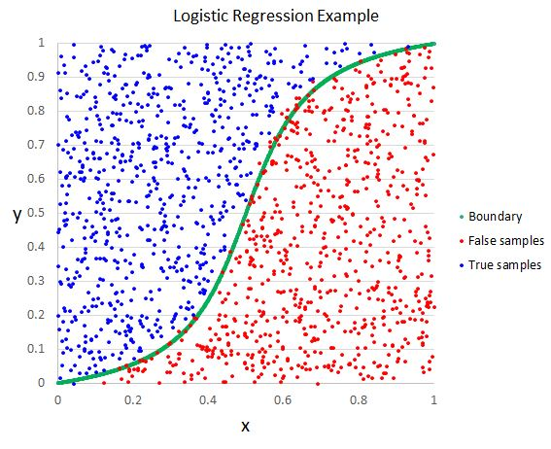
Training : Logistic Regression Algo
Figure 8: Logistic Regression curve

Slide 21
Training : Support Vector Machine

Slide 22
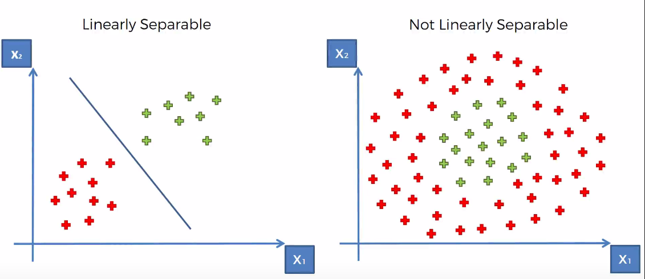
Training : Support Vector Machine
Figure 9: Linear hyper plane in SVM

Slide 23
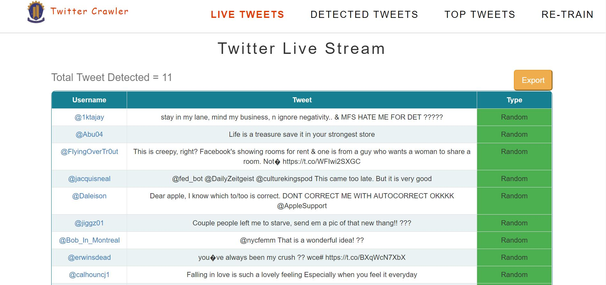
Implementation
Figure 10: Live Tweets Screen

Slide 24
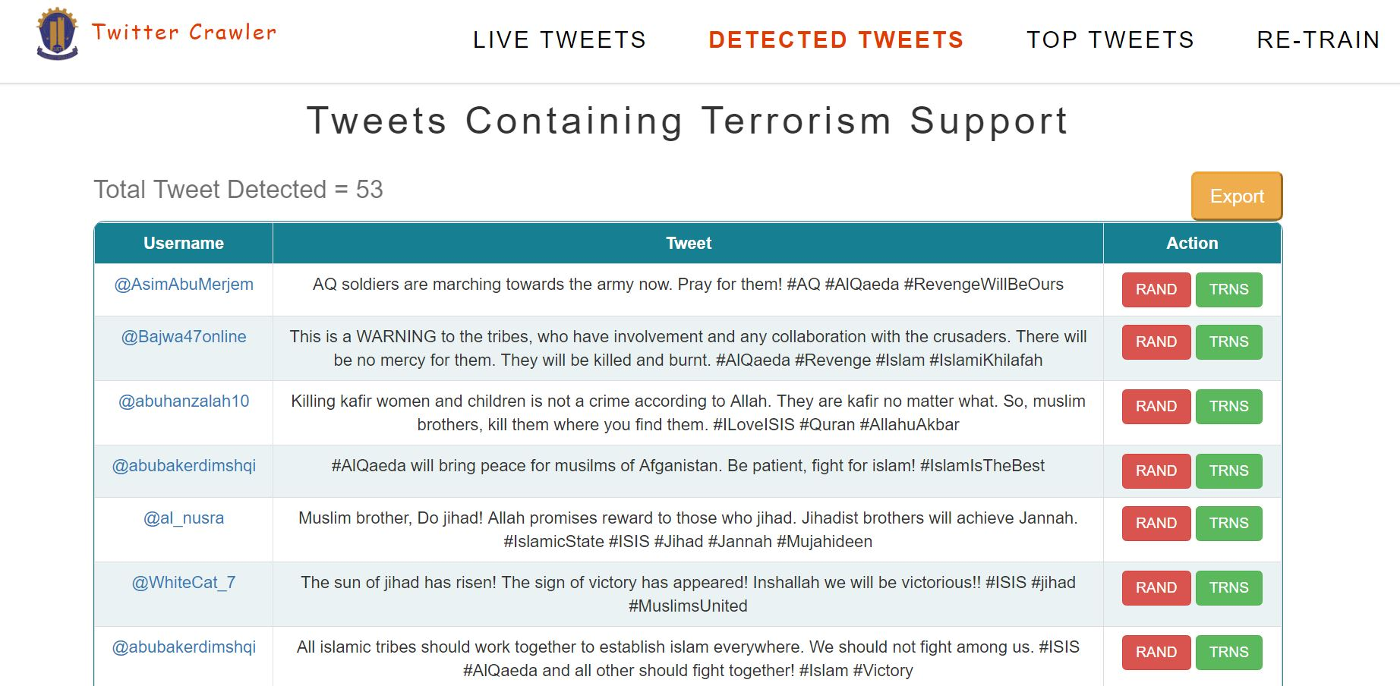
Implementation
Figure 11: Detected Tweets Screen

Slide 25
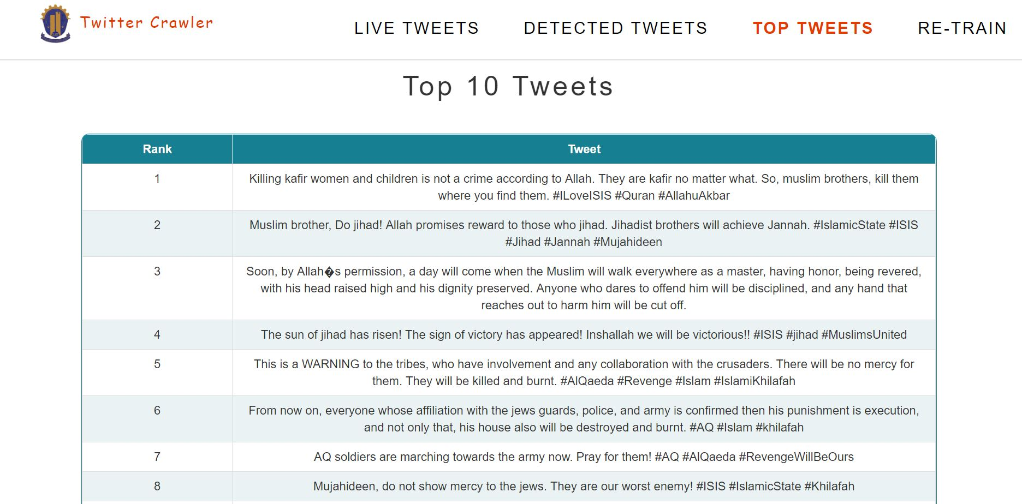
Implementation
Figure 12 : Top Tweets Screen

Slide 26
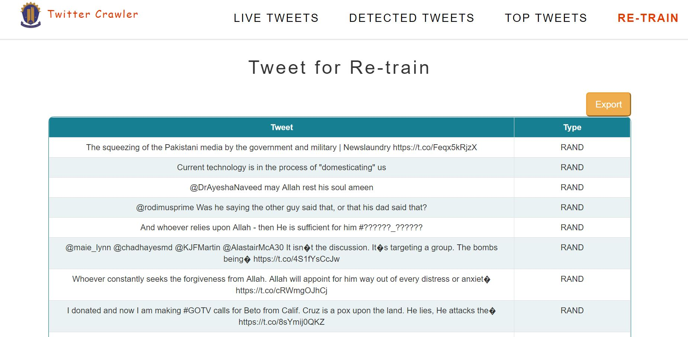
Implementation
Figure 13 : Training Screen

Slide 27
Experimental Results
Table 3: Confusion Matrix for Test data
 | TRS | TRNS | Accuracy | Precision | Recall
SVM | 5152 | 87 | 95% | 87% | 98%
 | 732 | 10565
Logistic Regression | 4677 | 73 | 94% | 83% | 98%
 | 896 | 10890
As, SVM performs better than Logistic Regression, we have used SVM in our real-time framework

Slide 28
Experimental Results (Contd.)
Table 5.4: Summary of real-time collection of tweets
Table 4: Summary of Real-Time Analysis
Date | Day | Time Frame | No of Tweets Analyzed | Total No of Tweets Analyzed
16/10/2018 | Tuesday | 10:43 – 13:25 | 40,000 | 40,000
17/10/2018 | Wednesday | 15:30 – 18:15 | 40,000 | 80,000
18/10/2018 | Thursday | 09:00 – 11:50 | 40,000 | 1,20,000
19/10/2018 | Friday | 8:00 – 10:45 | 40,000 | 1,60,000
20/10/2018 | Saturday | 14:25 – 18:10 | 40,000 | 2,00,000

Slide 29
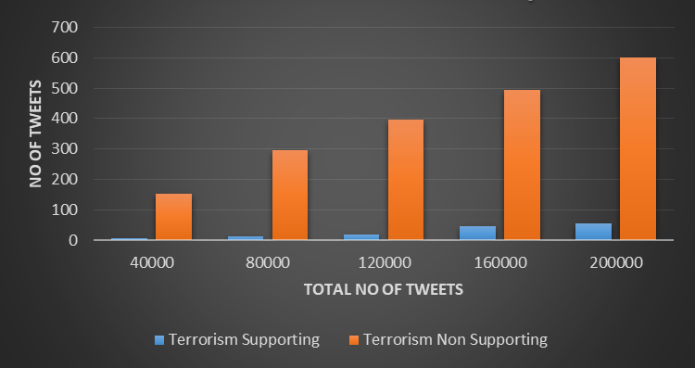
Experimental Results (Contd.)
Figure 14 : Summary of Real-Time Test

Slide 30
Experimental Results (Contd.)
Table 5 : Top 5 Tweets detected by the framework
No | Tweets
1 | Killing kafir is not a crime according to Allah. They are kafir no matter what. So, muslim brothers, kill them where you find them. #ILoveISIS #Quran #AllahuAkbar
2 | Do jihad! Allah promises reward to those who jihad. Jihadist brothers will achieve Jannah. #IslamicState #ISIS #Jihad #Jannah #Mujahideen
3 | Soon, by Allah’s permission, a day will come when the Muslim will walk everywhere as a master, having honor, being revered, with his head raised high and his dignity preserved. Anyone who dares to offend him will be disciplined, and any hand that reaches out to harm him will be cut off. #AQ #AlQaeda
4 | The sun of jihad has risen! The sign of victory has appeared! Inshallah we will be victorious!! #ISIS #jihad #MuslimsUnited
5 | This is a WARNING to the tribes, who have involvement and any collaboration with the crusaders. There will be no mercy for them. They will be killed and burnt. #AlQaeda #Revenge #Islam #IslamiKhilafah

Slide 31
Experimental Results (Contd.)
Table 6 : Comparison of actual and framework data
Support Vector Machine | Tweet Type | Framework | Actual | Accuracy
 | Terrorism Supporting | 55 | 40 | 72%
 | Terrorism Non-Supporting | 601 | 433

Slide 32
Limitations and Future Works
We have analyzed only English tweets, Future work can include various languages especially Arabic.
Our framework can only analyze textual content. This framework can be extended to analyze image and videos.
Our framework can’t detect sarcastic tweets which seems to be terrorism supporting but actually it isn’t. Future work can include a method to detect sarcastic tweets.

Slide 33
References
[1] “Twitter reveals it has suspended almost a million accounts in the last two years for promoting terrorism.” Available at: http://www.dailymail.co.uk/sciencetech/article-4899742/Twitter-suspends-million-accounts-promoting-terrorism-two-years.html
[2] M. Ashcroft, A. Fisher, L. Kaati, E. Omer, and N. Prucha, “Detecting jihadist messages on twitter,” in Proceedings of the Intelligence and Security Informatics Conference (EISIC), 2015 European, Sept 2015, pp. 161–164.
[3] Vivek Wisdom and Rajat Gupta, “An Introduction to Twitter data Analysis in Python”.
[4] Stavrianou, Anna, et al. "NLP-based feature extraction for automated tweet classification." Interactions between Data Mining and Natural Language Processing 145 (2014).

Slide 34
The End
Thank You

