Slide 1
Conspiracy Detection by Real Time
Email Analysis
Supervised By :
Abu Hasnat Mohammad Ashfak Habib
Associate Professor Department of CSE
Chittagong University of Engineering & Technology
Presented By :
Md. Ikramul Hoque
ID : 1304115

Slide 2

Contents
Introduction
Motivation
Objective
Related Work
Challenges
Framework Architecture
Implementation
Experimental Result
Limitations and Future Works
References

Slide 3

Introduction
Conspiracy has become an epidemic problem through out the organizations .
So ensuring the conspiracy free working environment has become a challenge.
To detect the conspiracy from the email data to alert the owner has become a time demanding thesis.

Slide 4

Motivation
Powerful groups secret malevolent object achievement[5].
There exist some big named company once that spiraled downward into bankruptcy due to the conspiracy between their employees
Thus it needs to ensure the conspiracy free working facilities in the organization

Slide 5
Objectives
The study will be carried out to achieve the following goals specified:
To develop a framework for extracting the contents of emails.
To develop a technique for conspiracy detection by analyzing the extracted email contents.
To send an alert message to the owner of the organization.
To implement a mail server with public IP for mail exchanging .

Slide 6
Related Research
A Hybrid Sentiment Analysis Framework for Large Email Data
Works:
- Proposed the sentimental analysis framework
Sentiment clustering: a novel method to explore in the blogosphere
Works:
-Feng, Wang only proposed the sentiment analysis

Slide 7
Related Research Cont.
NLP-based Feature Extraction for Automated Tweet Classification
Work
1. Process of natural language processing
2. Use hybrid method with Logistic regression
Learning Word Vectors for Sentiment Analysis
Work
1. Supervised sentiment analysis using vectorization.
Limitations of these works:
They all classify some sentiment not but the conspiracy.

Slide 8
Challenges
Extract the concept of the conspiracy theory
To learn a psychological concept to a machine
Predicting the conspiracy in Real-Time

Slide 9
Methodology
We will use machine learning for training our model
We will use the real email of Enron Email Dataset
We will classify the dataset into two sets
a. Green mail dataset
b. Red mail dataset
We will analyze the data using Logistic regression classifier.

Slide 10
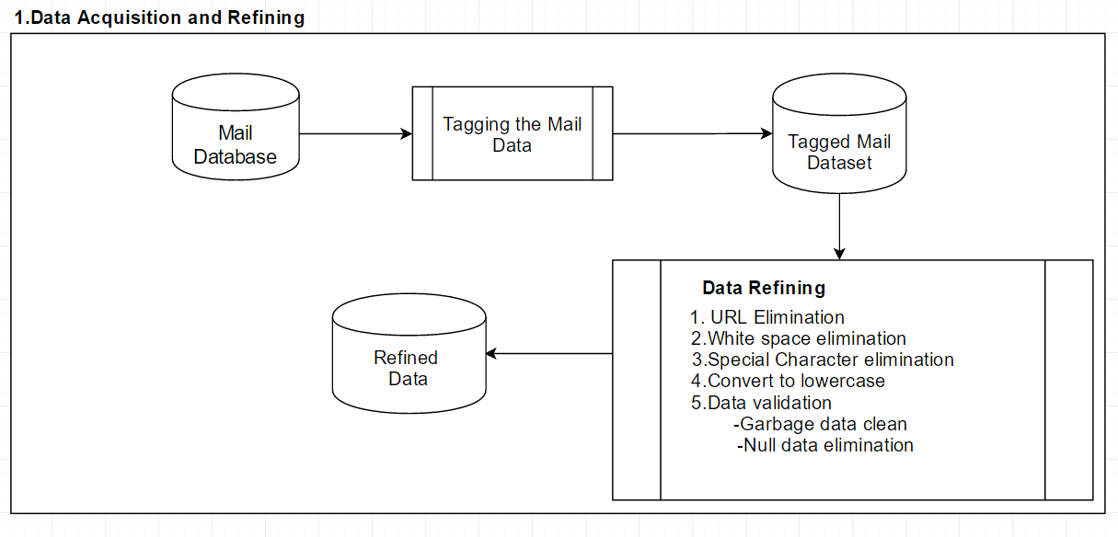
Framework Architecture

Slide 11
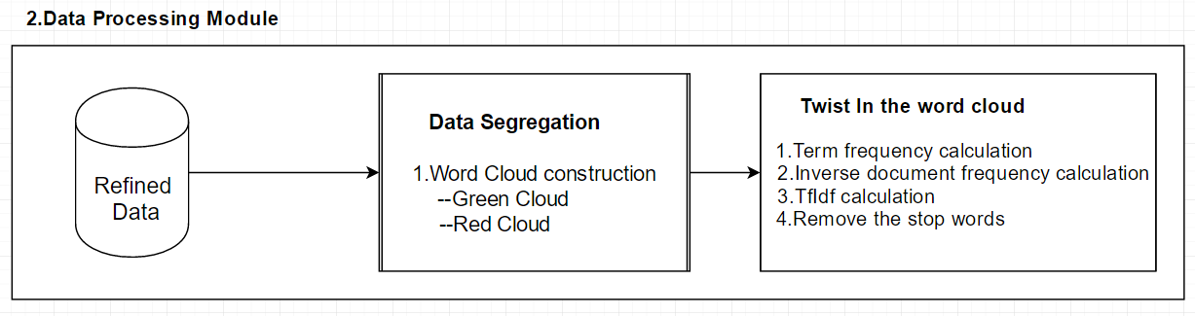
Framework Architecture(Contd.)

Slide 12
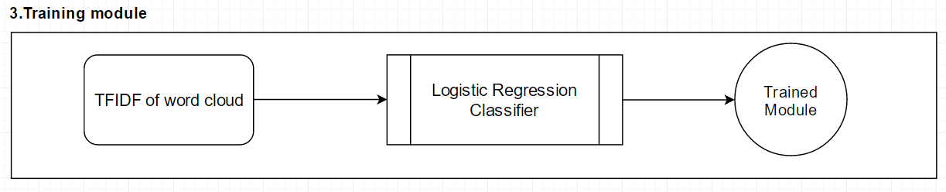
Framework Architecture(Contd.)

Slide 13
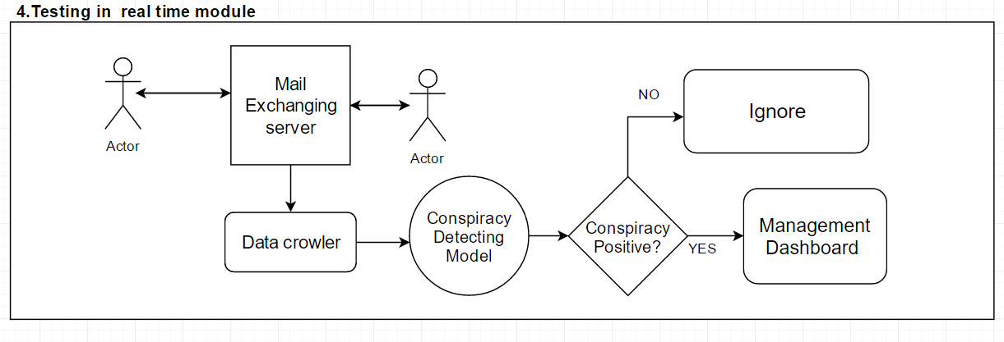
Framework Architecture(Contd.)

Slide 14
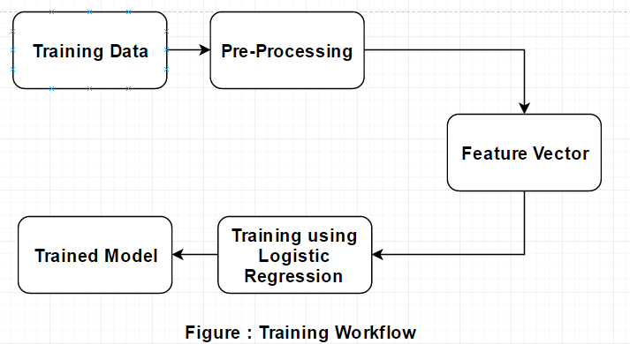
Training

Slide 15

Training: Training Data
Types of Email | Sentiment | No of Email
Green Data | 0 | 5016
Red Data | 1 | 4624
 | Total = | 9640

Slide 16
Training: Pre-Processing
URL removed
White space elimination
Stop words removed
Contracted word converted to their long form
Special character elimination
Convert to lowercase
Tokenization

Slide 17

Training: Features
We have used style metric features [4] in our experiment
The features are:
  Frequency of bi-gram
  Term Frequency Inverse Document Frequency of bi-gram
  Presence of words
  Counts of words
  Use of punctuations

Slide 18
Training: Logistic Regression Algo.

Slide 19
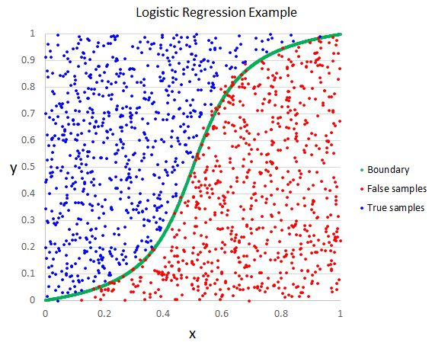
Training: Logistic Regression Algo.
Figure: Logistic Regression Curve

Slide 20
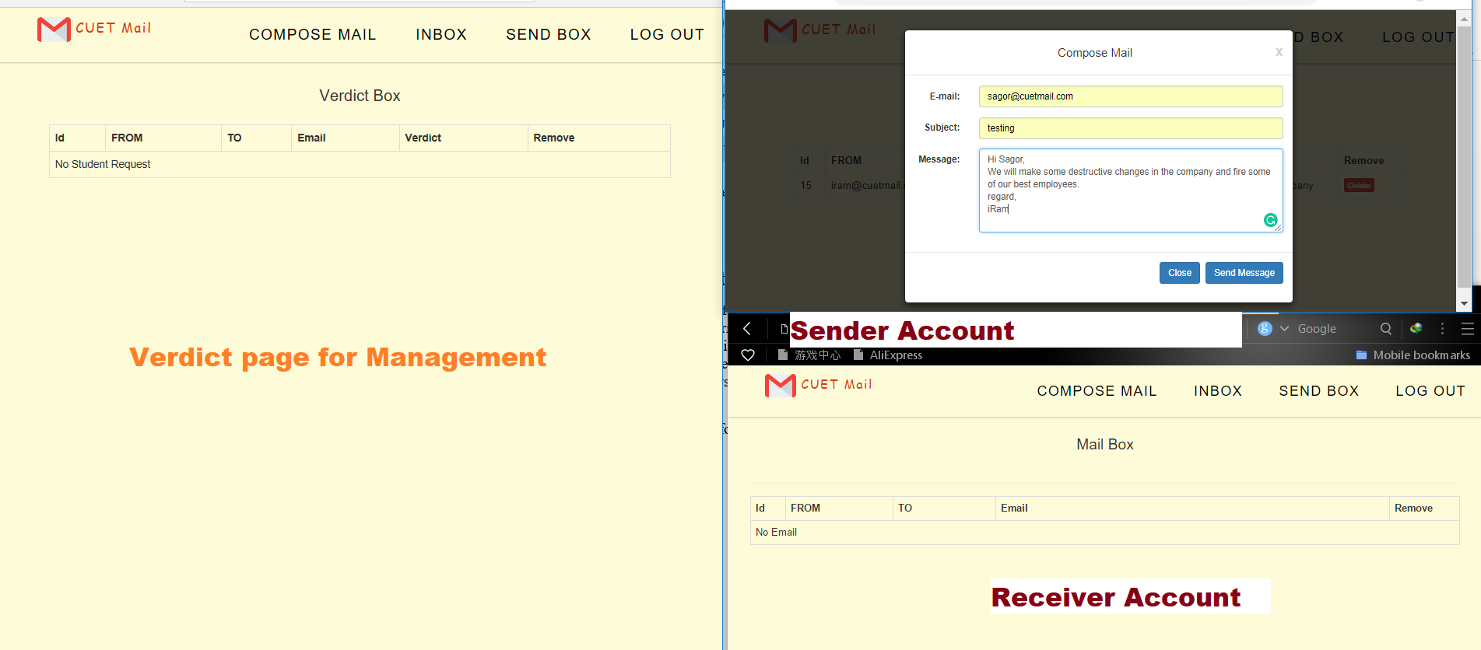
Implementation
Fig: Email Typing Screen

Slide 21
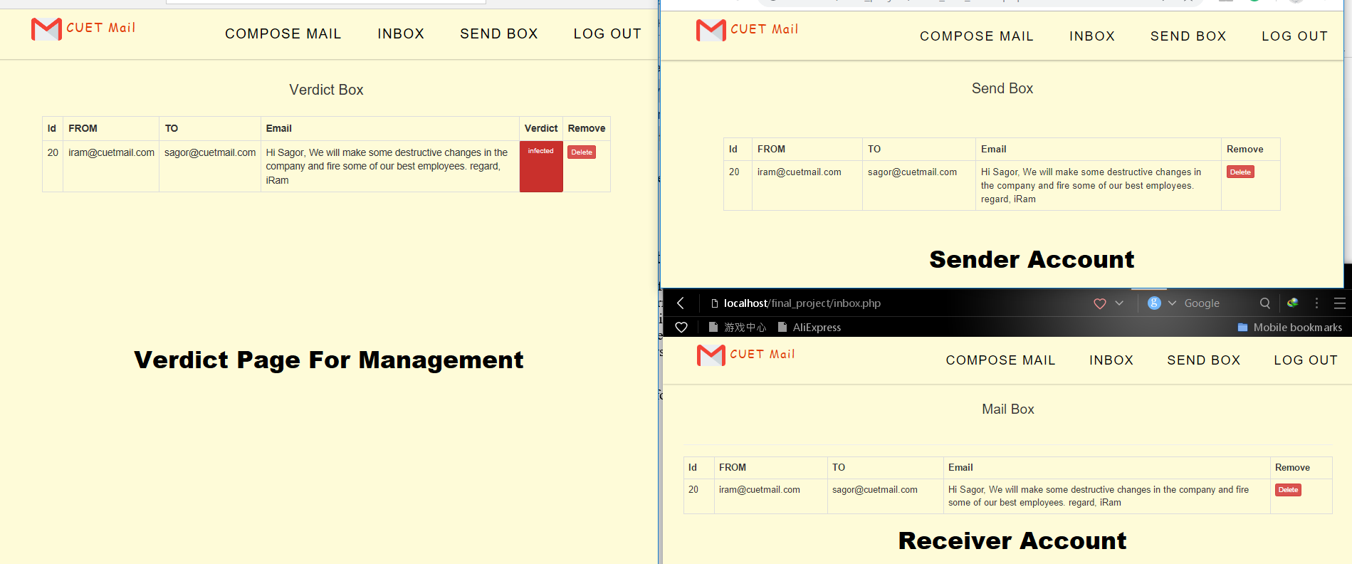
Implementation(Cont.)
Fig: Conspiracy Detected Screen

Slide 22
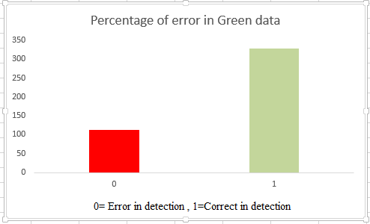
Experimental Results
For Green data detection: 450 green data was given as input
324 correctly detected, 126 false detection
Accuracy=72%
Fig: Accuracy in Green Data

Slide 23
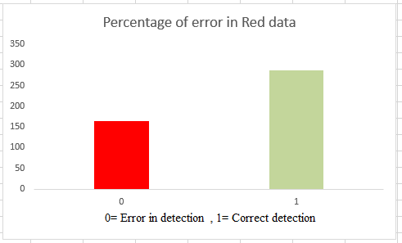
Experimental Results(cont.)
For Red data detection:450 input has been set
286 right detection and 164 false detection
Accuracy =65%
Fig: Accuracy in Red Data

Slide 24
Experimental Results(cont.)
In Real time accuracy:100 mixed data has given as input
Among them 60% was green(True) and 40% red(false) data.
Total Email | True Positive | True Negative | False Positive | False Negative
100 | 42 | 18 | 26 | 14
Fig: Real time Accuracy
So the Real Time Accuracy is 68%

Slide 25
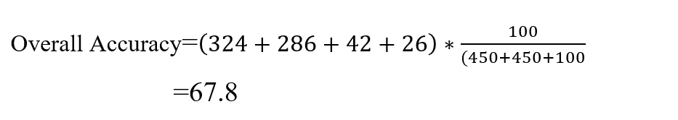
Experimental Results(cont.)

Slide 26


Slide 27
Limitations and Future Works
We can not extract the URL information and attachment data in training model
With some more data the accuracy could be improved

Slide 28
References
[1]. S. Liu and I. Lee, A hybrid sentiment analysis framework for large email data, Intelligent Systems and Knowledge Engineering (ISKE), 2015 10th International Conference on, IEEE, 2015, pp. 324–330.
[2]. Feng, S., Wang, D., Yu, G., Yang, C. and Yang, N. Sentiment clustering: a novel method to explore in the blogosphere. Springer, City, 2009.
[3]. Stavrianou, A., Brun, C., Silander, T., & Roux, C. (2014). NLP-based feature extraction for automated tweet classification. Interactions between Data Mining and Natural Language Processing, 145.

Slide 29
References(cont.)
[4]. Maas, A. L., Daly, R. E., Pham, P. T., Huang, D., Ng, A. Y., & Potts, C. (2011, June). Learning word vectors for sentiment analysis. In Proceedings of the 49th annual meeting of the association for computational linguistics: Human language technologies-volume 1 (pp. 142-150). Association for Computational Linguistics.
[5]. Karen, Douglas and A. C. Leite, Suspicion in the workplace: Organizational conspiracy theories and work-related outcomes. British journal of psychology 108 3 (2017), 486–506.

Slide 30
Thank You

Slide 31
Appendix
Conspiracy theories explain events as the result of secret, deliberate actions and cover ups at the hands of malicious and powerful groups
Three possible conspiracy :
1. Financial Conspiracy
2. Organizational Conspiracy
3. Reputational Conspiracy

Slide 32
Appendix(cont.)
Symptoms of Conspiracy in Work place:
1.Hire preferred candidate
2.Employee fired
3.Spreading rumor and gossip
4.Employees turnover

Slide 33
Appendix(cont.)
Outcomes of conspiracy in work place:
1.Reputaion hamper
2. Less profit
3. Overpower
4. Turnover intention

Slide 34
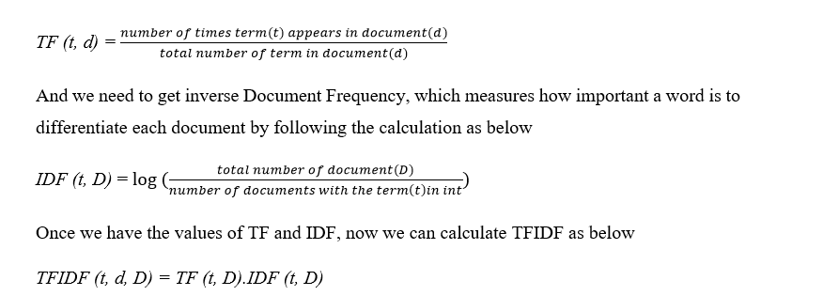
Appendix(cont.)
TF-IDF:

Slide 35
Appendix(cont.)
Example:
1.I love dogs
2. I hate dogs and knitting
tf(I,d1)=1/3=.33
tf(I,d2)=1/5=.2
idf(I,D)=log(2/2)=0
TFIDF=0 for both tf.

