Slide 1
Diagnosis Expert System
Rahaf Alghamdi. 1709138
Raneem Alomari. 2006452
Elaf Alghamdi. 1911456

Slide 2
Outline
-WHAT IS (DExS)
-INTRODUCTION
-HOW CAN (DExS) PROGRAM APPLIED
-CONCLUSION

Slide 3
INTRODUCTION
An expert system is a computer software that mimics the decision-making abilities of a human expert. By doing so, it mimics the behavior of a human expert, using human knowledge to solve problems that would normally require human intelligence.

Slide 4
What is Diagnosis Expert System(DExS)
A Diagnosis Expert System (DExS) can substantially aid in identifying diseases and describing treatment methods while considering the user's ability to cope with and engage with the expert system in a simple and plain manner.

Slide 5
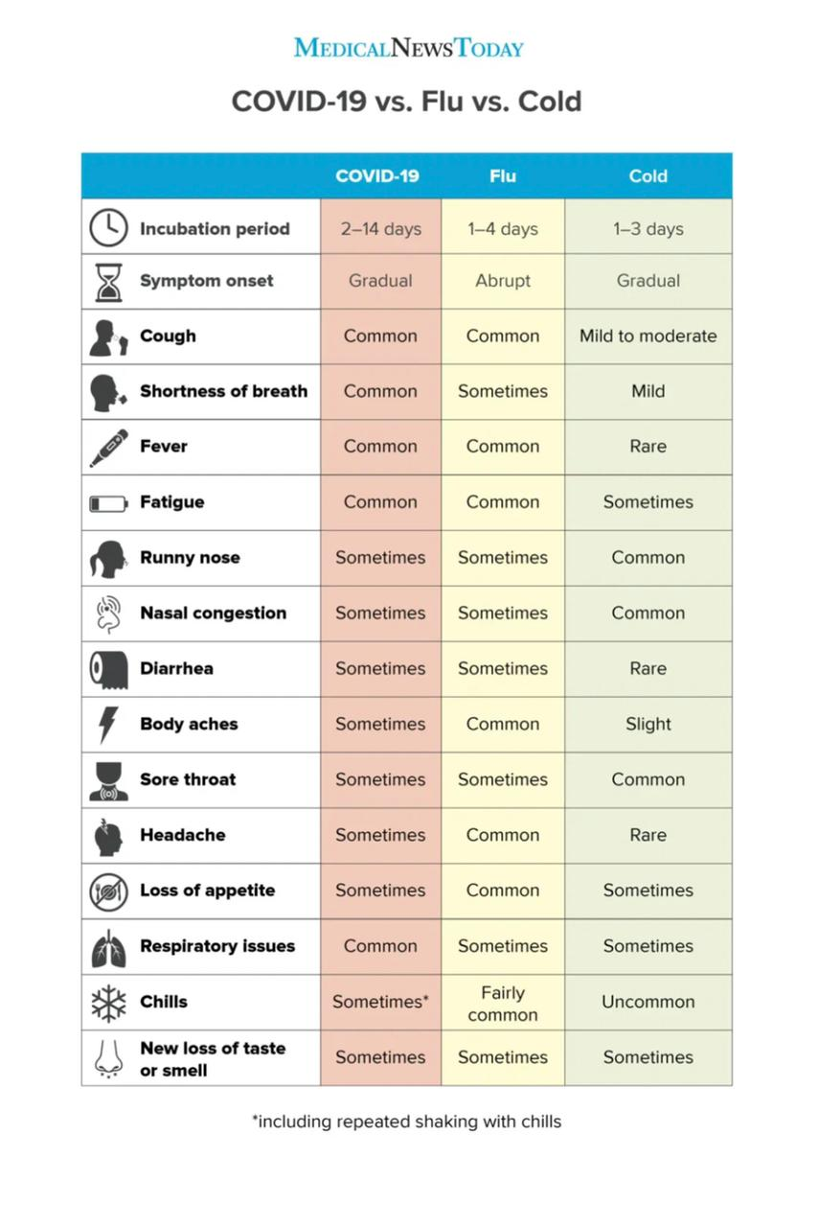
How can the DExS program applied?
The DExS Technique can be applied in consultations since it immediately displays the diagnosis and clarifies of results ,then expert system store "exploratory knowledge, and it will come to a conclusion about the diagnosis based on the user's responses to certain questions posed by the system.

Slide 6
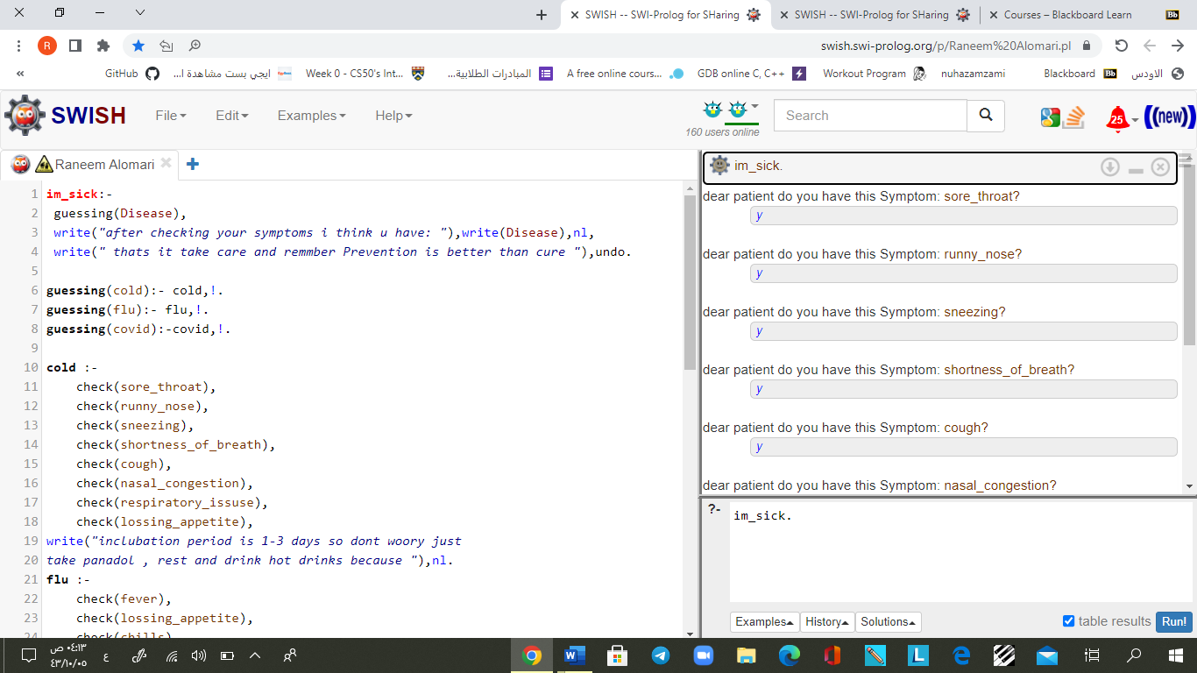
Screenshots of solving problem

Slide 7
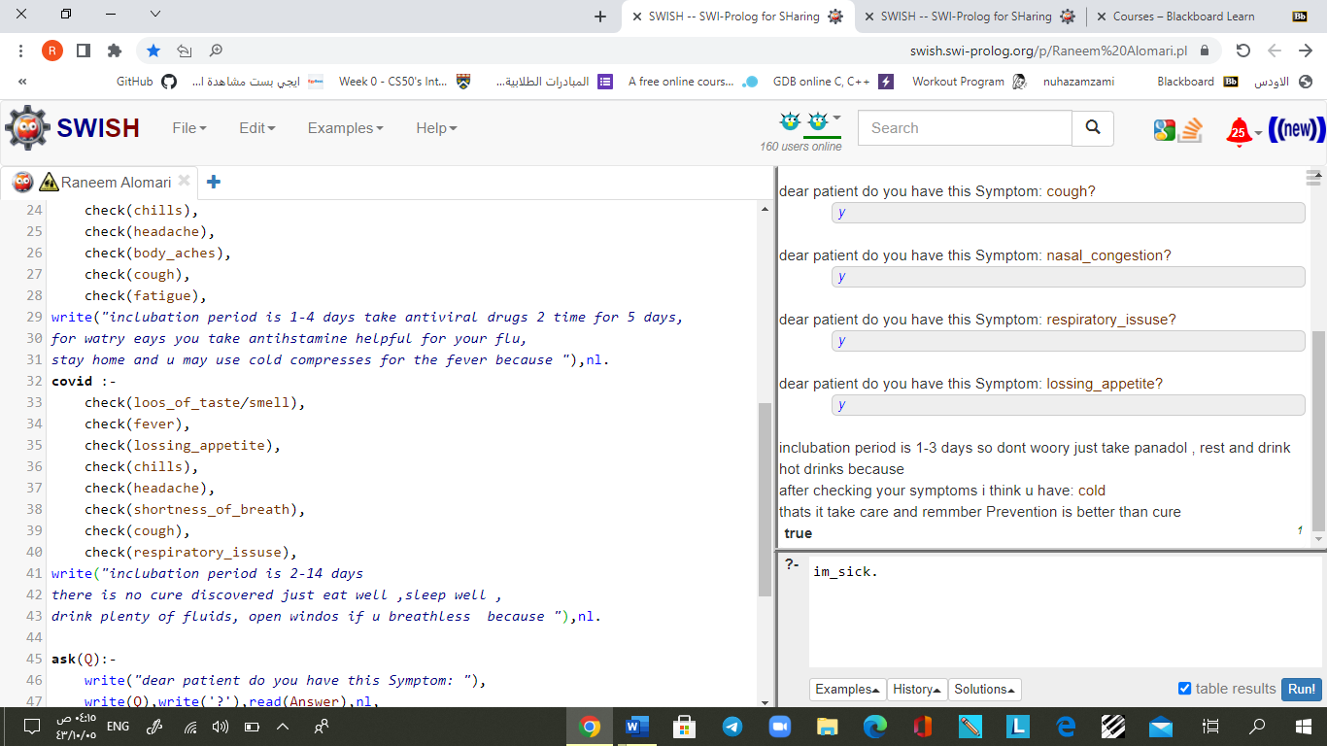

Slide 8
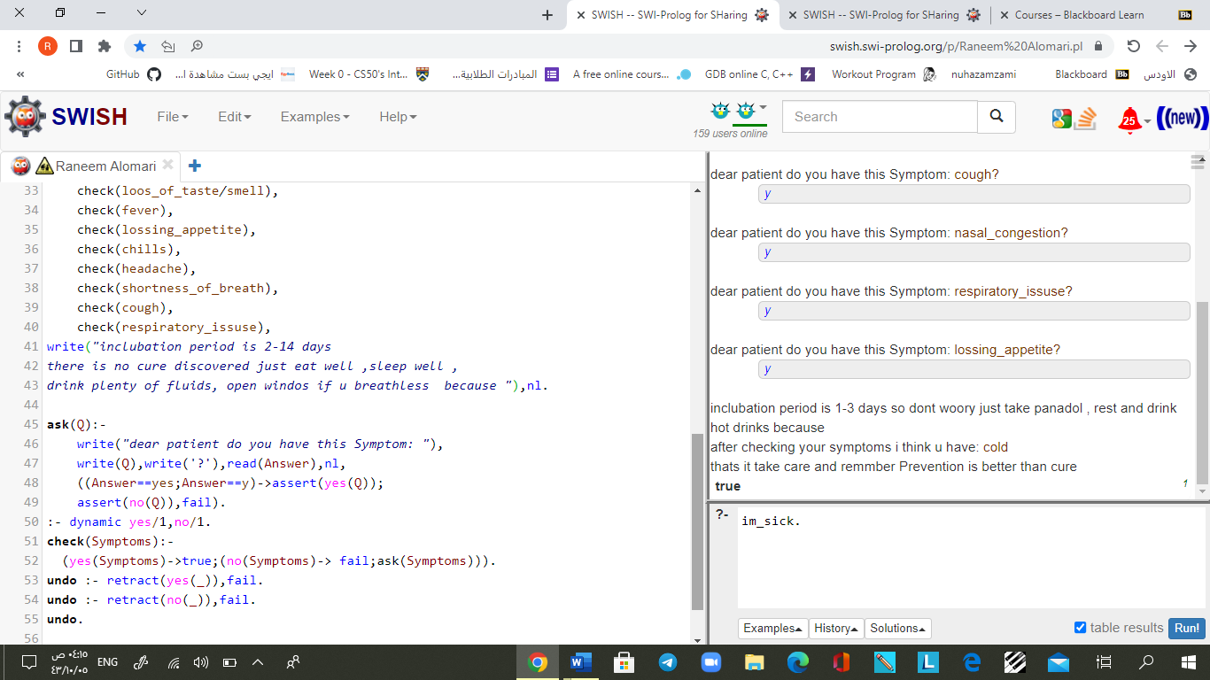

Slide 9

conclusion
If you have any symptoms, you can consult a doctor through this system, and it will diagnose your medical condition in a quick, clear and direct way, while also assuring that the diagnosis is correct and reliable.

Slide 10
THANKS!
Any questions?

