Slide 1
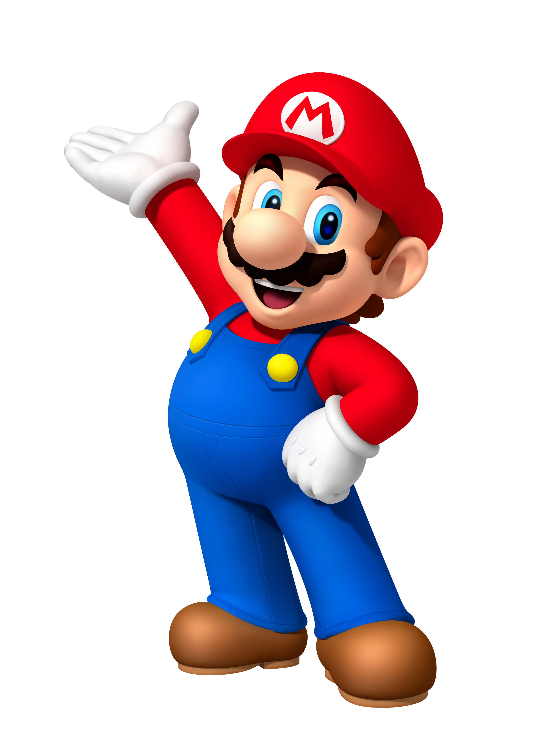
Project: Party
Lorenzo, Tim, Luuk, Rowin
GMD1A

Slide 2
Inleiding
Rolverdeling
Planning
Concepts
Programming
Vragen

Slide 3
Rolverdeling
Rowin – Producer (Programming, Art, Animations?, (All Round))
Lorenzo – Lead Programmer.
Luuk – Programmer, Artist.
Tim – Lead Artist, Level Design, UX

Slide 4
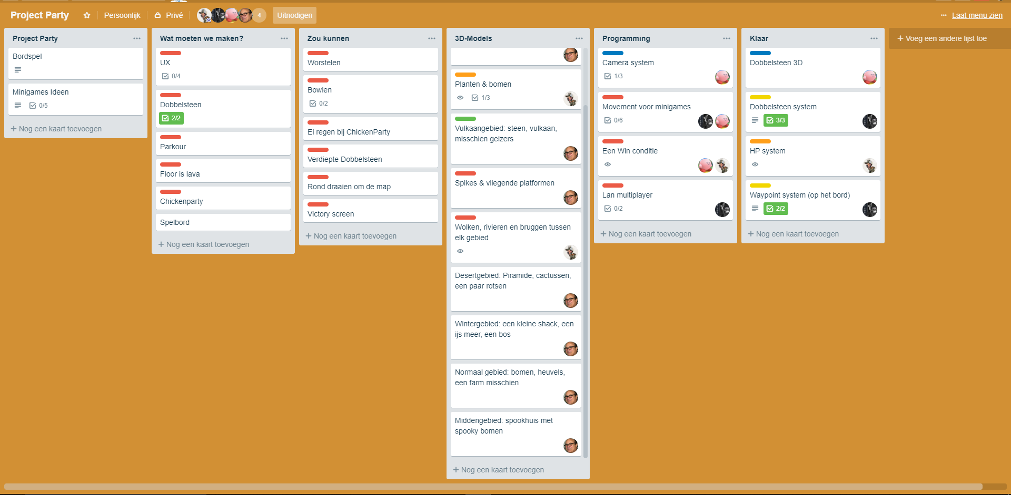
Planning
Eerst keer
All over the place
Concrete doelen
Duidelijk overzicht.

Slide 5
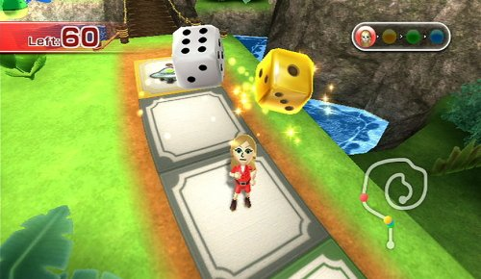
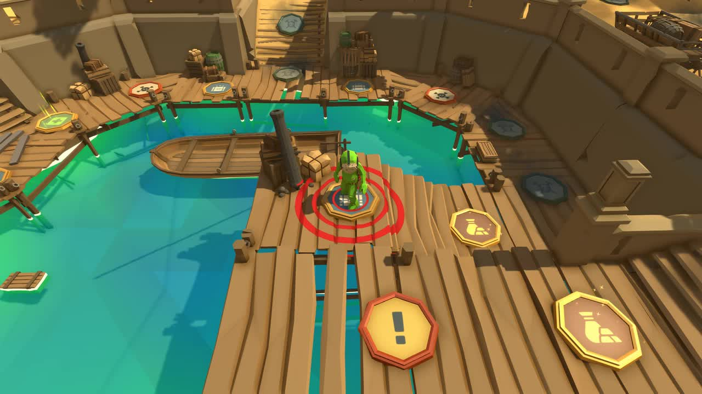
Concept voorbeelden
Low Poly
Cartoonish
Wii Party Island
Pummel Party
Mini Games
Lan Multiplayer

Slide 6
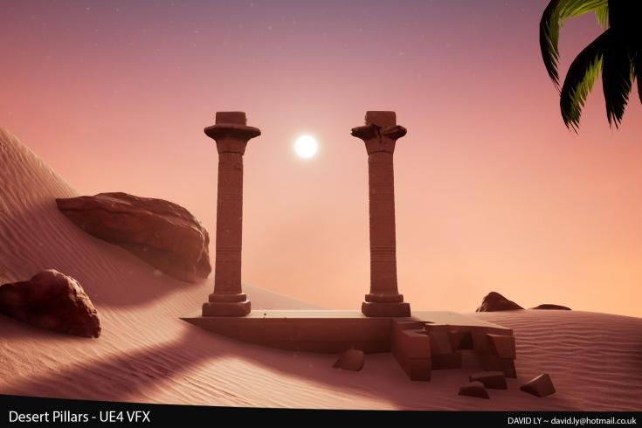
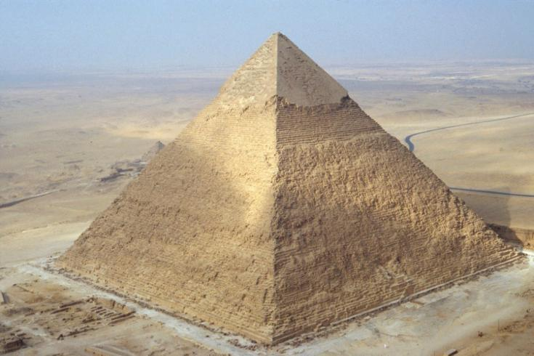
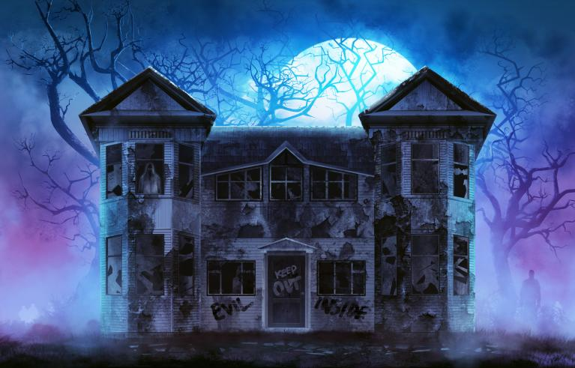
Inspiratie

Slide 7
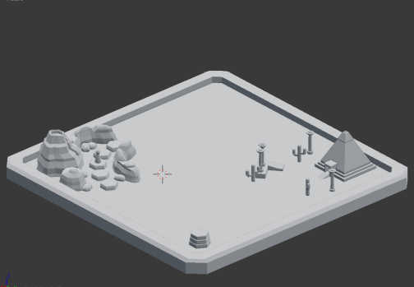
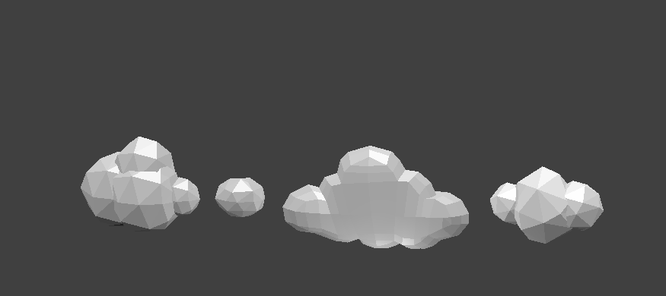
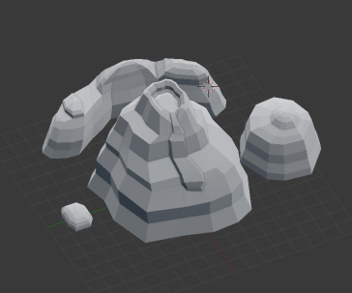
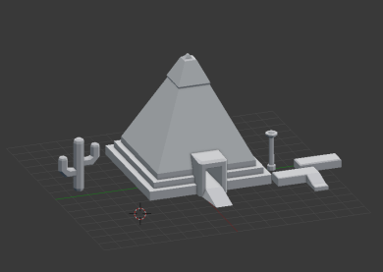
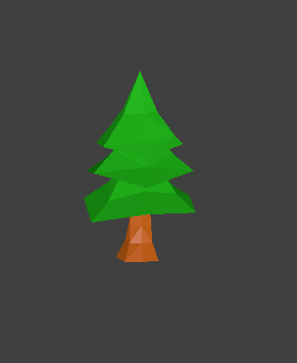
Concept creaties

Slide 8
Programming
Camera systeem
Dobbel systeem / waypoint system
Turn system
Multiplayer
Health Systeem
Mini Games

Slide 9
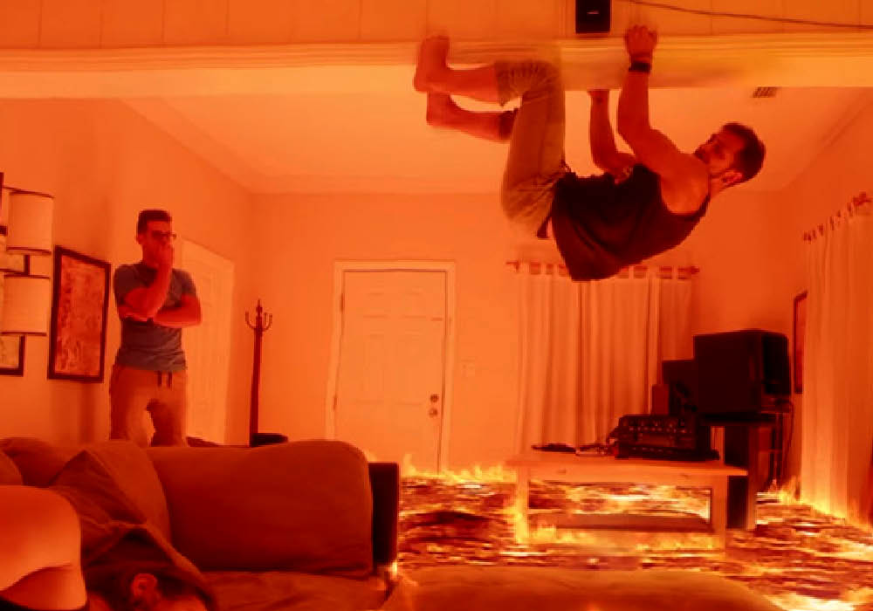
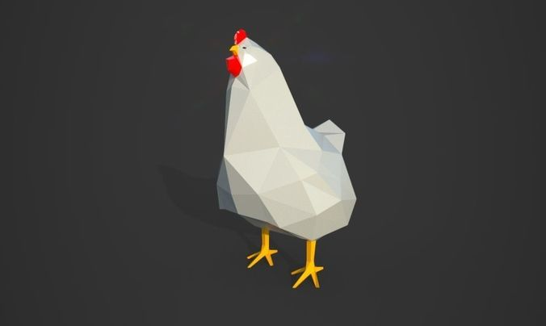
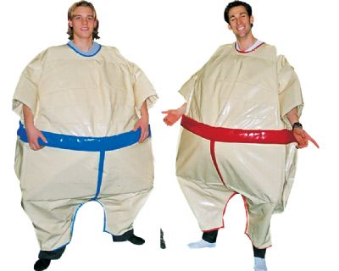
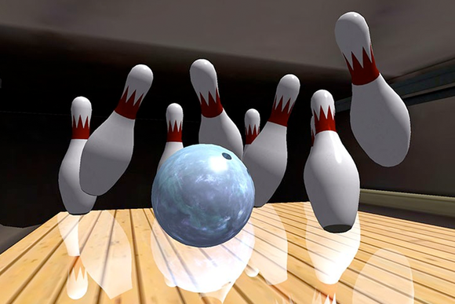
Mini Games
Chicken Party, Parkour/Death Run, Floor is Lava.
Bowlen, Sumo Worstelen.

Slide 10
Vragen?

