Slide 1
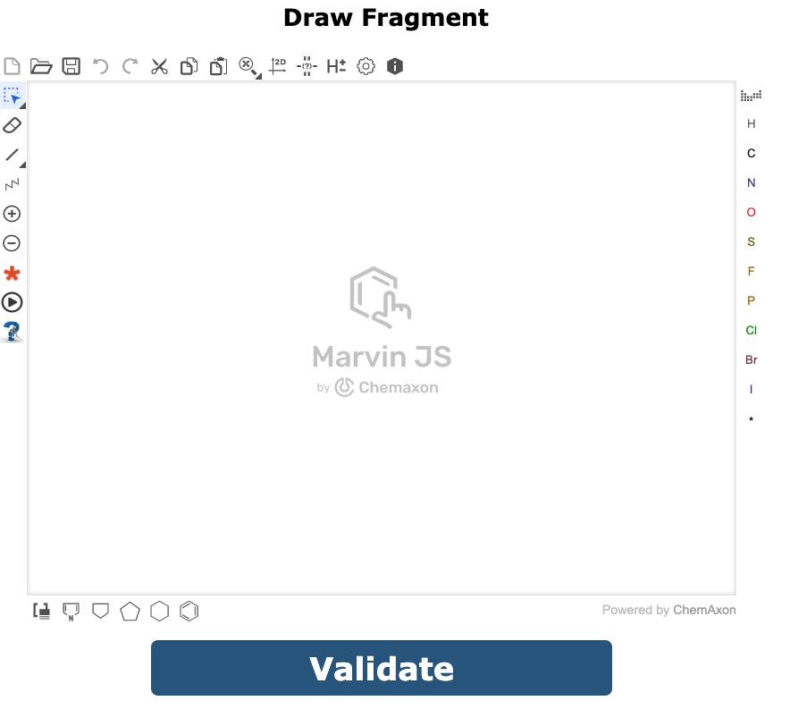

Select Mode
(Growing or Linking)
GROWING
LINKING
Target
Target
1 FRAGMENT
2 FRAGMENTS
Growing
Step 1
Draw your fragment
in sketcher
OR import your fragment
In skectcher

