Slide 1

In these set of slides we shall consider:
scattering from an electron
scattering from an atom
structure factor calculations (scattering from an unit cell)
➢ the relative intensity of ‘reflections’ in power patterns
Click here to directly jump to structure factor calculations
MATERIALS SCIENCE
&
ENGINEERING
Part of
A Learner’s Guide
AN INTRODUCTORY E-BOOK
Anandh Subramaniam & Kantesh Balani
Materials Science and Engineering (MSE)
Indian Institute of Technology, Kanpur- 208016
Email: anandh@iitk.ac.in, URL: home.iitk.ac.in/~anandh
http://home.iitk.ac.in/~anandh/E-book.htm
Elements of X-Ray Diffraction
B.D. Cullity & S.R. Stock
Prentice Hall, Upper Saddle River (2001)

Slide 2
Intensity of the Scattered electrons
Scattering by a crystal
To understand scattering from a crystal, we have to understand scattering from 3 levels: (i) electron, (ii) atom, (iii) unit cell.
For crystals the unit cell repeats to give us the crystal and hence all the information required can be obtained at the unit cell level.
Usually materials scientists need to start understanding from the atomic scattering factor. Most students can jump directly to structure factor calculations.
A
Electron
Polarization factor
B
Atom
Atomic scattering factor (f)
C
Unit cell (uc)
Structure factor (F)
Click here to jump to structure factor calculations

Slide 3
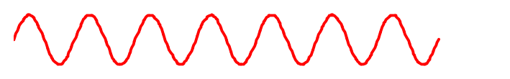
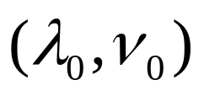
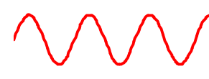
A
Scattering by an Electron
Incoming radiation
Scattered beams
Emission in ‘all’ directions
Sets electron into oscillation
Coherent
(definite phase relationship)
The electric field (E) of the incoming radiation (with wavelength λ₀ and frequency ν₀) is the main cause for the acceleration (& deceleration) of the electron (in an atom)→ i.e. the oscillating magnetic field component can be ignored. The effect on the nucleus can be ignored.
The oscillating electron is a source of electromagnetic radiation and radiates most strongly in a direction perpendicular to its motion.
Hence, the radiation emitted will be polarized along the direction of its motion.
There is fixed phase relationship between the incoming radiation and the scattered wave.
The incoming wave may be polarized on un-polarized. We consider the intensity in these two situations next.

Slide 4
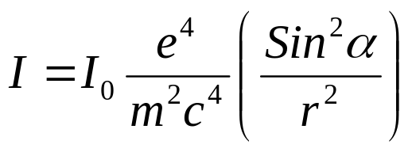
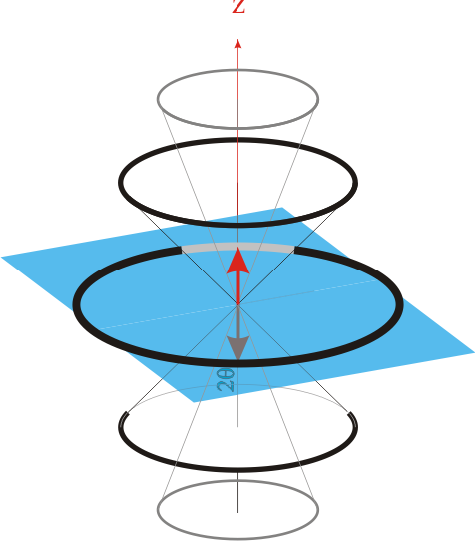
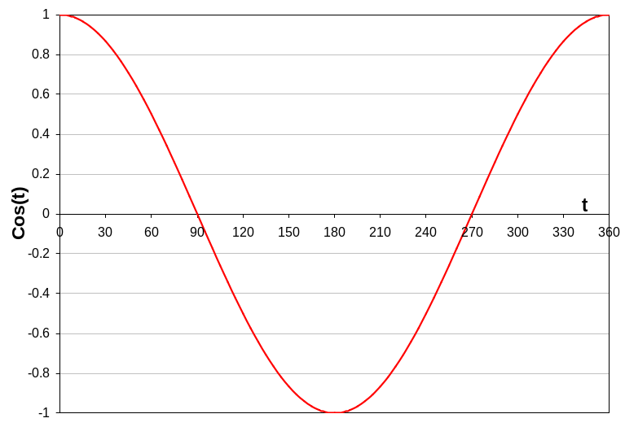
Case A: intensity of the scattered wave for an polarized wave
z
P
For a wave oscillating in z direction
r
α
x
Intensity of the scattered beam due to an electron (I) at a point P such that r >> λ is given by:
The reason we are able to neglect scattering from the protons in the nucleus
The scattered rays are also plane polarized

Slide 5
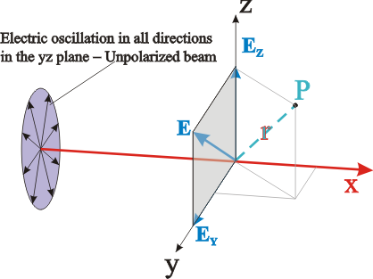
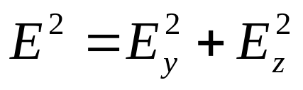
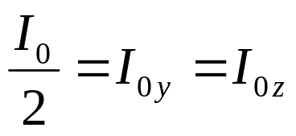
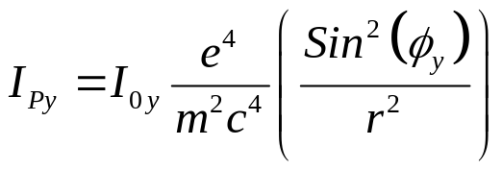
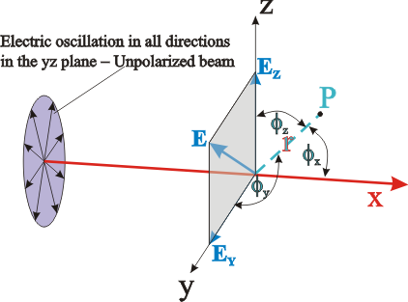
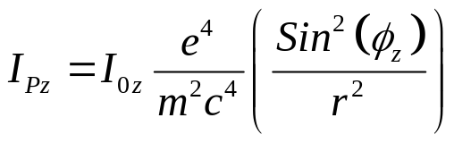
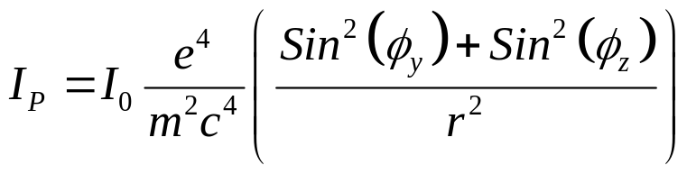
Case B: intensity of the scattered wave for an un-polarized wave
I_{Py} = Intensity at point P due to E_{y}
E is the measure of the amplitude of the wave & E² = Intensity
I_{Pz} = Intensity at point P due to E_{z}
Total Intensity at point P due to E_{y} & E_{z}

Slide 6
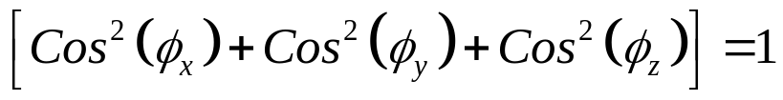
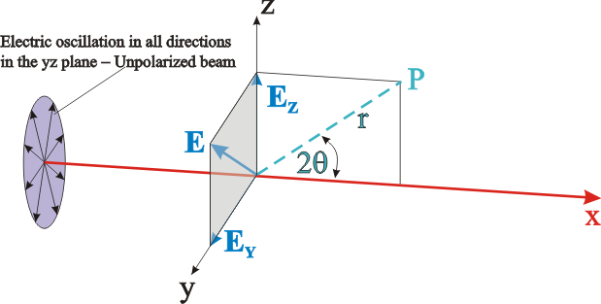
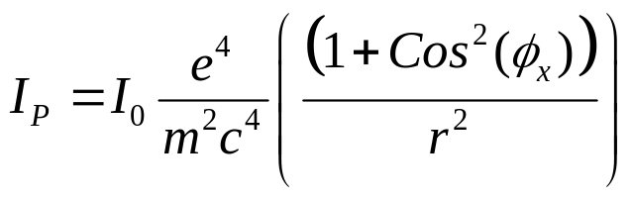
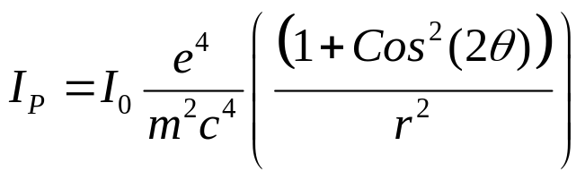
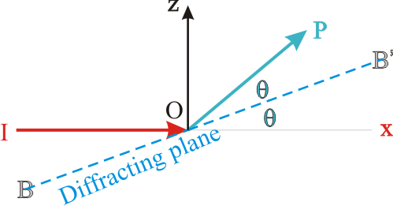
Sum of the squares of the direction cosines =1
Hence
⇒
In terms of 2θ

Slide 7
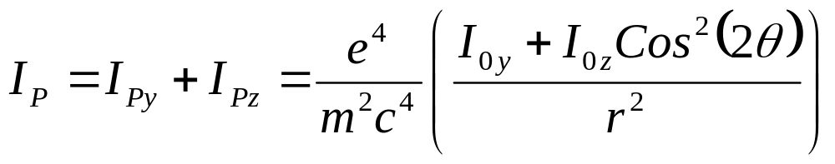
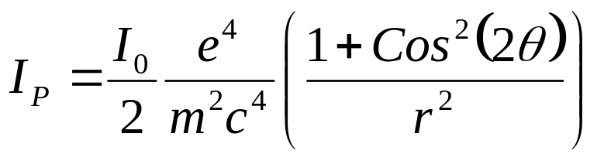
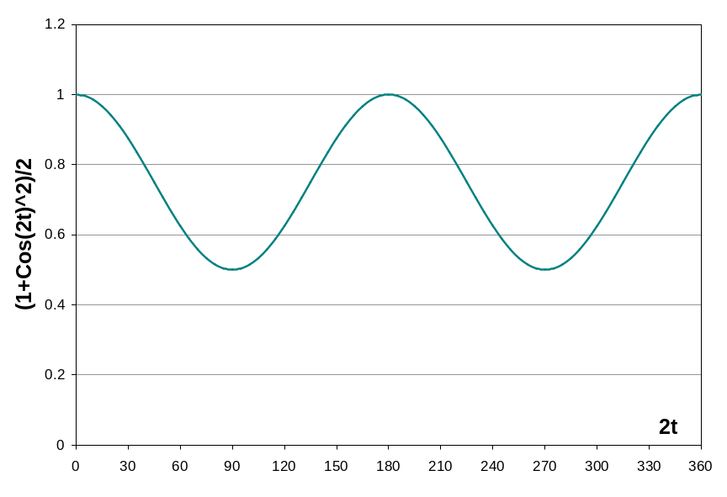
⇒ Scattered beam is not unpolarized
Polarization factor
Comes into being as we used unpolarized beam
Very small number
Forward and backward scattered intensity higher than at 90°.
Scattered intensity minute fraction of the incident intensity.

Slide 8
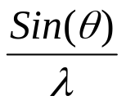
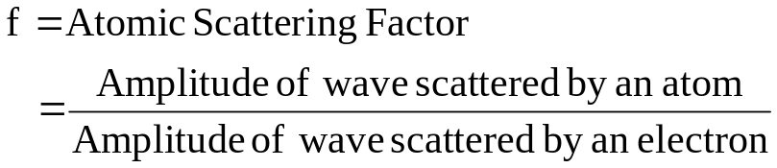
B
Scattering by an Atom
Atomic Scattering Factor or Form Factor (f)
The scattering by an atom is the sum (vectoral sum, including phase) of the waves scatted by the electrons. Angular differences involved in scattering leads to path differences.
In the forward direction all scattered waves are in phase.
The scattering from an atom is captured in the atomic scattering factor (f), which is the ratio of the amplitude of the wave scattered by the atom to that scattered by a single electron. It shows the amplification obtained by the presence of multiple electrons in an atom.
Scattering by an atom is proportional to the atomic number (the number of electrons). The natural coordinates to plot the variation of ‘f’ is not θ or 2θ, but Sin(θ)/λ. At 0° the curve starts at the atomic number as in the schematic below.
Scattering by an atom ∝ [Z, (θ, λ)]
30
Equals number of electrons, say for f = 29, it should Cu or Zn⁺
Scattering by an atom ∝ [Atomic number, (path difference suffered by scattering from each e⁻, λ)]
20
Schematic showing variation in atomic scattering factor with Sin(θ)/λ
 | Coherent scattering | Incoherent (Compton) scattering
Z ↑ | ↑ | ↓
Sin(θ) / λ ↓ | ↑ | ↓
f →
10
(Å⁻¹) →
As θ↓, path difference ↓ → constructive interference
As λ↓, path difference ↑ → destructive interference
0.2
0.4
0.6
0.8
1.0

Slide 9
B
Scattering by an Atom
BRUSH-UP
The conventional UC has lattice points only at the vertices/corners.
Additional lattice points may be present within the unit cell, if the unit cell is non-primitive.
Needless to say, lattice in itself cannot scatter and atoms are required.
Motif is associated with lattice and motif may consist of one or more atoms, ions, molecules (or combinations).
There may or may not be atoms located at the lattice points.
The shape of the UC is a parallelepiped (Greek parallēlepipedon) in 3D.
There may be additional atoms in the UC due to two reasons:
➢ The chosen UC is non-primitive (hence additional lattice points exist within the cell, which are associated with atoms).
➢ The additional atoms may be part of the motif.
We use the Bragg’s viewpoint to derive the general structure factor equation.

Slide 10
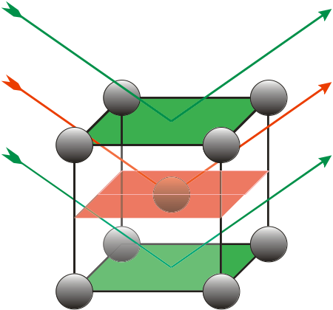
C
Scattering by the Unit cell (uc)
We use the following points to derive the scattering from a unit cell (which is captured in the structure factor (F)): (i) the scattering is coherent, (ii) Unit Cell (UC) is representative of the crystal structure, (iii) scattered waves from various atoms in the UC interfere to create the diffraction pattern.
The essential feature of the need for structure factor calculation can be understood from the figure below. Let us assume a BCC crystal. If the waves are in phase for the ‘reflection’ from the green planes, then the presence of the additional atom in the orange plane will lead to scattering of waves, which are exactly out of phase with that scattered from the green planes and hence the 100 reflection will ‘go missing’. Note that the atomic density of both the planes (green and orange) is the same (one atom per a²) and hence the scattering power of these planes is the same.
If we consider a simple cubic crystal with a two atom motif with atoms as: A at (0,0,0) and B at (½, ½, ½), then the atomic scattering factor of the two atoms will not be the same (i.e. f_{A} ≠ f_{B}) and hence there will be a ‘residual’ intensity from the 100 planes (i.e. 100 reflection will ‘not go totally missing’, but will be weak− called a superlattice reflection).
The wave scattered from the middle plane is out of phase with the ones scattered from top and bottom planes. I.e. if the green rays are in phase (path difference of λ) then the red ray will be exactly out of phase with the green rays (path difference of λ/2).

Slide 11



Let us consider scattering of waves (or “rays”) R₁ and R₂ from planes P₁ and P₂ (belonging to the (h00) set of planes. The scattered rays are denoted by ‘primes’.
Let there be an additional atom located at a distance ‘x’ along x-axis (on plane P₃).
The rays R₂ and R₃ travel longer distances than R₁ and hence accrue path (δ) & phase differences (ϕ).
Ray 1 = R₁
Ray 3 = R₃
θ_{B}
A
θ
P₁
Unit Cell
x
R
S
Ray 2 = R₂
P₃
B
d_{(h00)}
M
N
a
P₁
(h00) plane
C

Slide 12
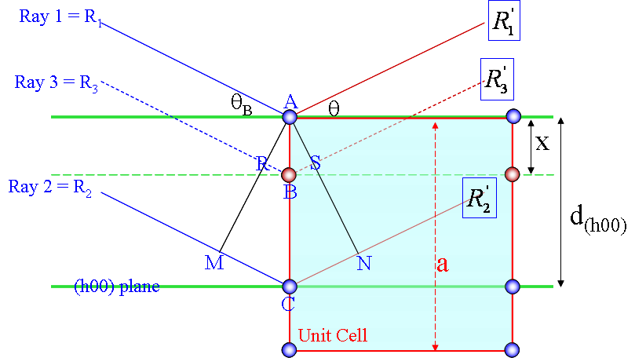
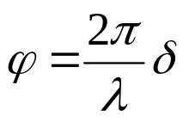
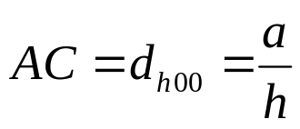

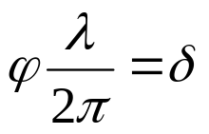

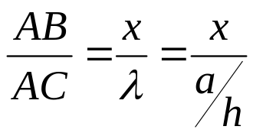

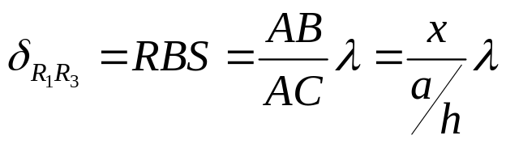
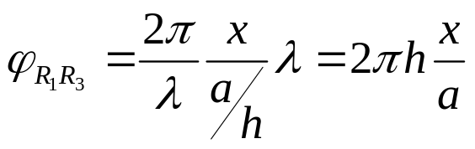
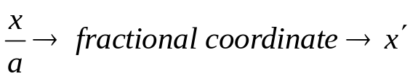


To satisfy Bragg’s equation the path difference between rays R₁ & R₃ has to be λ
Correspondingly the path difference between rays R₁ and R₃ will be
The phase difference can be written as
Using fractional coordinates (x’) the phase difference becomes
Extending to 3D
Independent of the shape of UC
Note: R₁ is from corner atoms and R₃ is from atoms in additional positions in UC

Slide 13

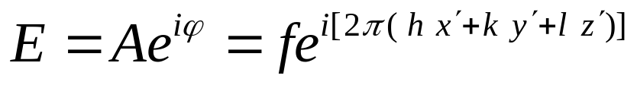

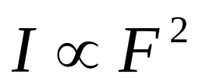
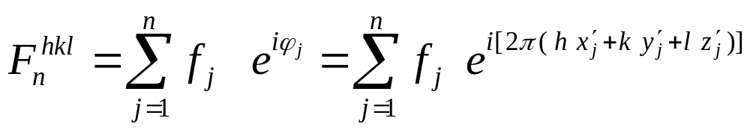
The phase difference gives rise to the amplitude (which can be written in complex notation as)
If atom B is different from atom A → the amplitudes must be weighed by the respective atomic scattering factors (f).
The resultant amplitude of all the waves scattered by all the atoms (say ‘n’ atoms) in the UC gives the scattering factor for the unit cell .
The unit cell scattering factor is called the Structure Factor (F).
The intensity of the wave is proportional to the square of F.
Once we have the structure factor then the intensity obtained from a set of planes (hkl) is known.
Scattering by an unit cell = f(position of the atoms, atomic scattering factors)
For n atoms in the UC
Structure factor is independent of the shape and size of the unit cell!
F → F^{hkl}
If the UC distorts so do the planes in it!!

Slide 14
Funda Check
How to understand the structure factor? Is there a simpler way so as to avoid calculations?
Structure factor (F) tells us that which planes in the crystal scatter from an unit cell and what are their intensities.
I.e. which (hkl) are present and which are absent. Which ‘hkl’ has what intensities (which have higher intensities and which have lower intensities). The ‘F’ has each term weighed by the atomic scattering factor (f) and hence (we will see soon) that intensities are weighed by some function of the ‘f’ of atoms in the unit cell.
Using the ‘F’ calculations we can construct the reciprocal crystal. And we will see later that diffraction patterns are nothing but selective sampling of this reciprocal crystal (displayed/plotted in 2θ axis or 1/x axis).
The structure factor calculation is performed by evaluating the sum for all “non-equivalent” (this term will become clear from the examples considered soon) atoms in the unit cell.
○ What is the source of these additional atoms*?
Ans: (i) The unit cell may be non-primitive and hence there might be additional lattice points associated with additional atoms. (ii) The motif may have many atoms.
* “Atoms” is used in a general sense here, it includes neutral atoms, ions, molecules etc.

Slide 15
Plotting Structure Factor calculations
Please refer to topic on Reciprocal Lattice to know all the details
A set of planes (hkl) in real space becomes a point in reciprocal space (labeled without the brackets as hkl ).
These points define the reciprocal lattice (a purely geometrical construction).
Structure factor calculations give us the intensity associated with each of these points. We use a sphere to designate the intensity, with the diameter of the sphere proportional to the intensity.
On decorating the reciprocal lattice with intensities, we get the reciprocal crystal.
Real Space | Reciprocal Space
Lattice decorated with Motif | Reciprocal lattice decorated with Intensities as motif
Planes | Points (planes in real space become points in reciprocal space)
Motif | Intensities (motif in real space determines the intensities in reciprocal space)

Slide 16
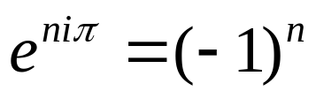


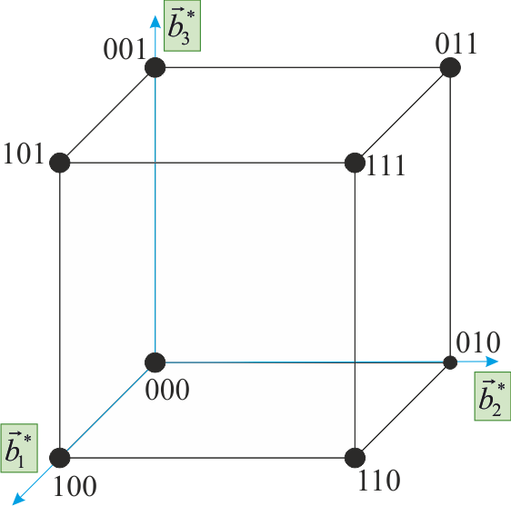
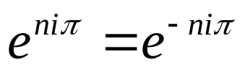
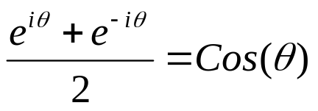
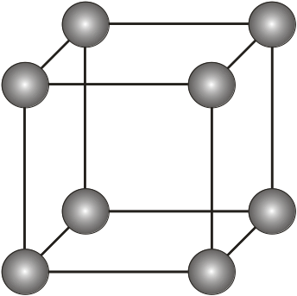


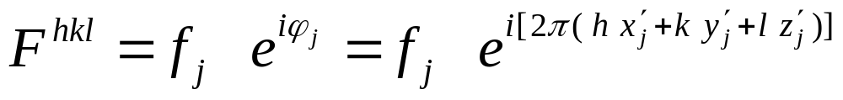
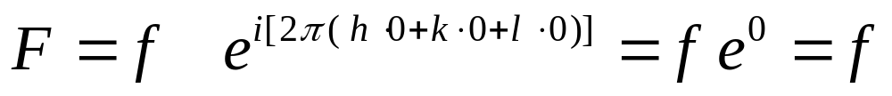
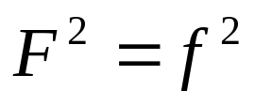
Structure factor calculations
Some useful relations
Now we perform calculation of structure factor calculations for some simple crystal structure unit cells.
We basically perform the summation of the function fexp(iϕ) for the different atoms ions in the unit cell and work out the restrictions on the allowed values of hkl (and the corresponding intensities).
A
Atom at (0,0,0) and equivalent positions
Simple Cubic
Note:
UC in reciprocal space
a
n is an integer
1/a
We note that in simple cubic crystals there is no restrictions on the allowed values of hkl (i.e. for all values of hkl reflections are present).
⇒ All reflections are present
⇒ F is independent of the scattering plane (h k l)

Slide 17
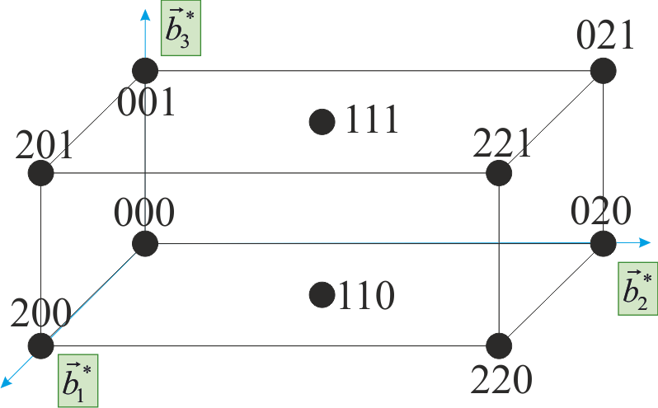
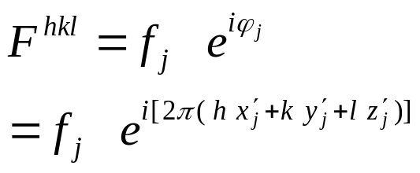
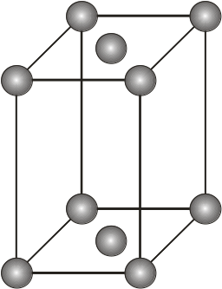
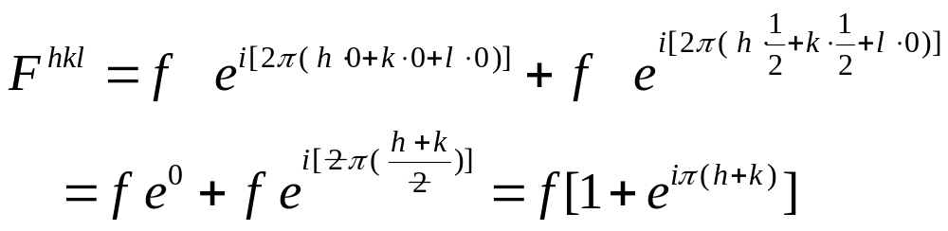

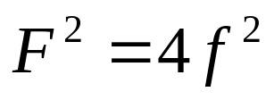
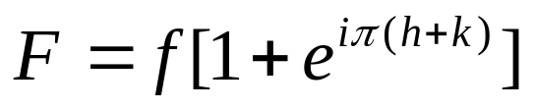

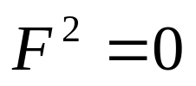
B
Atoms at (0,0,0) & (½, ½, 0) and equivalent positions
C- centred Orthorhombic
For this case there is one additional lattice point with an associated atom. Hence, there will be two terms in the summation for the structure factor.
1/c
UC in reciprocal space
1/b
1/a
Important note:
The 100, 101, 210, etc. points in the reciprocal lattice exist (as the corresponding real lattice planes exist), however the intensity decorating these points is zero.
Real
(h + k) even
Both even or both odd
e.g. (001), (110), (112); (021), (022), (023)
Mixture of odd and even
(h + k) odd
⇒ F is independent of the ‘l’ index
e.g. (100), (101), (102); (031), (032), (033)

Slide 18




The result derived (i.e. the effect of lattice centring) can be understood by a simple geometric consideration. This is illustrated for the C-centred OR crystal considered before, but is valid for all crystals.
Let us view the [001] projection of the crystal and consider two sets of planes: (210) and (310) planes.
On introducing a centring a new set of lattice planes between the original (210) planes have to be introduced, which scatter exactly out of phase with the original planes and hence the 210 reflection goes missing on introducing a C-centring. In the case of the (310) planes no new planes need to be introduced and this reflection survives.
If the blue planes are scattering in phase then on C- centering the red planes will scatter out of phase (with the blue planes- as they bisect them) and hence the (210) reflection will become extinct
This analysis is consistent with the extinction rules: (h + k) odd is absent
In case of the (310) planes no new translationally equivalent planes are added on lattice centering ⇒ this reflection cannot go missing.
This analysis is consistent with the extinction rules: (h + k) even is present

Slide 19





C
Atom at (0,0,0) & (½, ½, ½) and equivalent positions
Body centred Orthorhombic
Real
UC in reciprocal space
(h + k + l) even
e.g. (110), (200), (211); (220), (022), (310)
(h + k + l) odd
This implies that (h+k+l) even reflections are only present.
The situation is identical in BCC crystals as well.
e.g. (100), (001), (111); (210), (032), (133)

Slide 20







D
Atom at (0,0,0) & (½, ½, 0) and equivalent positions
Face Centred Cubic
(½, ½, 0), (½, 0, ½), (0, ½, ½)
Real
CCP (“FCC crystal”) becomes “BCC crystal” in reciprocal space
(h, k, l) unmixed
(111), (200), (220), (333), (420)
h,k,l → all even or all odd
(h, k, l) mixed
(100), (211); (210), (032), (033)
Two odd and one even (e.g. 112); two even and one odd (e.g. 122)
Continued…

Slide 21
Mixed indices
Two odd and one even (e.g. 112); two even and one odd (e.g. 122)
Face Centred Cubic
Mixed indices | CASE | h | k | l
 | A | o | o | e
 | B | o | e | e
(h, k, l) mixed
e.g. (100), (211); (210), (032), (033)
Unmixed indices
All odd (e.g. 111); all even (e.g. 222)
Unmixed indices | CASE | h | k | l
 | A | o | o | o
 | B | e | e | e
This implies that in FCC only h,k,l ‘unmixed’ reflections are present.
(h, k, l) unmixed
e.g. (111), (200), (220), (333), (420)

Slide 22




E
Na⁺ at (0,0,0) + Face Centering Translations → (½, ½, 0), (½, 0, ½), (0, ½, ½)
Cl⁻ at (½, 0, 0) + FCT → (0, ½, 0), (0, 0, ½), (½, ½, ½)
NaCl: FCC lattice

Slide 23

NaCl: FCC lattice
Zero for mixed indices
Mixed indices | CASE | h | k | l
 | A | o | o | e
 | B | o | e | e
Mixed indices
(h, k, l) mixed
(100), (211); (210), (032), (033)
Unmixed indices | CASE | h | k | l
 | A | o | o | o
 | B | e | e | e
Unmixed indices
Continued…

Slide 24






NaCl: FCC lattice
(h, k, l) unmixed
(111), (222); (133), (244)
h,k,l → all even or all odd
If (h + k + l) is even
(222),(244)
If (h + k + l) is odd
(111), (133)
UC in reciprocal space*
* NaCl gives B2 in reciprocal space !!

Slide 25








F
Al at (0, 0, 0), Ni at (½, ½, ½)
NiAl: Simple Cubic (B2- ordered structure)
Click here to know more about ordered structures
SC
Real
Explained in next page
(h + k + l) even
e.g. (110), (200), (211), (220), (310)
(h + k + l) odd
e.g. (100), (111), (210), (032), (133)
When the central atom is identical to the corner ones− we have the BCC case.
This implies that (h+k+l) even reflections are only present in BCC.
This term is zero for BCC

Slide 26


Reciprocal lattice/crystal of NiAl
Click here to know more about
e.g. (110), (200), (211); (220), (310)
UC in reciprocal space*
e.g. (100), (111), (210), (032), (133)
* B2 gives NaCl in reciprocal space !!

Slide 27







G
Al at (0,0,0), Ni at (½, ½, 0) and equivalent positions
Click here to know more about ordered structures
Simple Cubic (L1₂ ordered structure)
(½, ½, 0), (½, 0, ½), (0, ½, ½)
Ni
Real
Al
Explained in next page
(h, k, l) unmixed
(111), (200), (220), (333), (420)
h,k,l → all even or all odd
(h, k, l) mixed
(100), (211); (210), (032), (033)
Two odd and one even (e.g. 112); two even and one odd (e.g. 122)

Slide 28

Reciprocal lattice/crystal of Ni_{3Al}
Click here to know more about
e.g. (111), (200), (220), (333), (420)
e.g. (100), (211); (210), (032), (033)

Slide 29
⇒ Presence of additional atoms/ions/molecules in the UC can alter the intensities of some of the reflections

Slide 30
Selection / Extinction Rules
Bravais Lattice | Reflections which may be present | Reflections necessarily absent
Simple | all | None
Body centred | (h + k + l) even | (h + k + l) odd
Face centred | h, k and l unmixed | h, k and l mixed
End centred | h and k unmixed C centred | h and k mixed C centred
Bravais Lattice | Allowed Reflections
SC | All
BCC | (h + k + l) even
FCC | h, k and l unmixed
DC | h, k and l are all odd Or all are even & (h + k + l) divisible by 4

Slide 31
List of observed reflections SC, FCC, BCC & DC crystals
h² + k² + l² | SC | FCC | BCC | DC
1 | 100
2 | 110 |  | 110
3 | 111 | 111 |  | 111
4 | 200 | 200 | 200
5 | 210
6 | 211 |  | 211
7
8 | 220 | 220 | 220 | 220
9 | 300, 221
10 | 310 |  | 310
11 | 311 | 311 |  | 311
12 | 222 | 222 | 222
13 | 320
14 | 321 |  | 321
15
16 | 400 | 400 | 400 | 400
17 | 410, 322
18 | 411, 330 |  | 411, 330
19 | 331 | 331 |  | 331
Cannot be expressed as a sum of the square of 3 integers

Slide 32
Relative intensity of peaks in powder patterns
We have already noted that absolute value of intensity of a peak (which is the area under a given peak) has no significance w.r.t structure identification.
The relative value of intensities of the peak gives information about the motif.
One factor which determines the intensity of a hkl reflection is the structure factor.
In powder patterns many other factors come into the picture as in the next slide. Some of these have origin in crystallography (like the multiplicity factor), some have origin in the powder diffraction geometry (like the Lorentz factor), some are related to the radiation (polarization factor), etc.
The multiplicity factor relates to the fact that we have 8 {111} planes giving rise to single peak, while there are only 6 {100} planes (and so forth). Hence, by this very fact the intensity of the {111} planes should be more than that of the {100} planes.
A brief consideration of some these factors follows. The reader may consult Cullity’s book for more details.

Slide 33


Relative Intensity of diffraction lines in a powder pattern
Structure Factor (F)
Scattering from UC (Atomic Scattering Factor is included in this term)
Multiplicity factor (p)
Number of equivalent scattering planes
Polarization factor
Effect of wave polarization
Lorentz factor
Combination of 3 geometric factors
Absorption factor
Specimen absorption
Temperature factor
Thermal diffuse scattering

Slide 34
Multiplicity factor
Actually only 3 planes ! (as (hkl) ≡ (−h −k −l)
Lattice | Index | Multiplicity | Planes
Cubic (with highest symmetry) | (100) | 6 | [(100) (010) (001)] (× 2 for negatives)
 | (110) | 12 | [(110) (101) (011), (‾110) (‾101) (0‾11)] (× 2 for negatives)
 | (111) | 12 | [(111) (11‾1) (1‾11) (‾111)] (× 2 for negatives)
 | (210) | 24* | (210) → 3! Ways, (‾210) → 3! Ways, (2‾10) → 3! Ways, (‾2‾10) → 3! Ways
 | (211) | 24 | (211) → 3 ways, (21‾1) → 3! ways, (‾211) → 3 ways
 | (321) | 48*
Tetragonal (with highest symmetry) | (100) | 4 | [(100) (010)] (× 2 for negatives)
 | (110) | 4 | [(110) (‾110)] (× 2 for negatives)
 | (111) | 8 | [(111) (11‾1) (1‾11) (‾111)] (× 2 for negatives)
 | (210) | 8* | (210) = 2 Ways, (‾210) = 2 Ways, (2‾10) = 2 Ways, (‾2‾10) = 2 Ways
 | (211) | 16 | [Same as for (210) = 8] × 2 (as l can be +1 or −1)
 | (321) | 16* | Same as above (as last digit is anyhow not permuted)
* Altered in crystals with lower symmetry

Slide 35
Multiplicity factor
Cubic | hkl | hhl | hk0 | hh0 | hhh | h00
 | 48* | 24 | 24* | 12 | 8 | 6
Hexagonal | hk.l | hh.l | h0.l | hk.0 | hh.0 | h0.0 | 00.l
 | 24* | 12* | 12* | 12* | 6 | 6 | 2
Tetragonal | hkl | hhl | h0l | hk0 | hh0 | h00 | 00l
 | 16* | 8 | 8 | 8* | 4 | 4 | 2
Orthorhombic | hkl | hk0 | h0l | 0kl | h00 | 0k0 | 00l
 | 8 | 4 | 4 | 4 | 2 | 2 | 2
Monoclinic | hkl | h0l | 0k0
 | 4 | 2 | 2
Triclinic | hkl
 | 2
* Altered in crystals with lower symmetry (of the same crystal class)

Slide 36



The polarization factor and the Lorentz factor both have ‘θ’ dependence (only) can be combined into the L-P factor. Note that the LP factor has a dip in middle 2θ values (with large values at low and high angles). [Fig.1].
The signature of this factor is evident in the powder diffraction pattern from Po (simple cubic)− as shown in Fig.2.
Lorentz factor
Polarization factor
Fig.1
Click here for details
XRD pattern from Polonium
Fig.2
Example of effect of Polarization factor on power pattern

Slide 37

Intensity of powder pattern lines (ignoring Temperature & Absorption factors)
Valid for Debye-Scherrer geometry
I → Relative Integrated “Intensity”
F → Structure factor
p → Multiplicity factor
POINTS
As one is interested in relative (integrated) intensities of the lines constant factors are omitted:
• Volume of specimen • m_{e} , e • (1/dectector radius)
We have assumed random orientation of crystals → in a material with Texture relative intensities are modified. So if a powder pattern has to be compared (both in intensity and angle of peaks) with standard JCPDS/ICDD files, then the effect of texture has to be removed first. Texture can be removed by: (i) making a fine powder and then annealing the same (if required) or (ii) rotating the sample to all orientations (practically how this can be done is not explained here!).
I is really diffracted energy (as Intensity is Energy/area/time).
Ignoring Temperature & Absorption factors is valid for lines close-by in pattern.

