Slide 1
Spring AOP

Slide 2
Instrumentation
Caching
Transaction Management
Modularization of concerns
Logging
Security aspects
Async
Exception Handling

Slide 3
Use Cases
Logging
Transaction Processing
Error Processing
Authorization and access rights
Сaching

Slide 4
AOP & AspectJ
Aspect
Advice
Join point
Pointcut
Introduction
Target
Weaving(CTW, LTW) + Runtime (Spring)

Slide 5
AspectJ Advices
Before
AfterReturning
AfterThrowing
After
Around

Slide 6
AspectJ Pointcuts
execution(static * ru.raiffeisen..*.*(..))
call(void UserService.*(..))
initialization(UserServiceImpl || UserController)
staticinitialization(UserService+ && !UserService)
@annotation(Cache)
args(Long)

Slide 7
AspectJ Weaving
CTW - aspectj-maven-plugin
LTW:
-javaagent:lib/aspectjweaver-1.9.4.jar
META-INF/aop.xml
<!DOCTYPE aspectj PUBLIC
"-//AspectJ//DTD//EN" "http://www.eclipse.org/aspectj/dtd/aspectj.dtd"> <aspectj> <aspects> <aspect name="ru.raiffeisen.aspectj.UserServiceAspect"/> <weaver options="-verbose -showWeaveInfo"> <include within="ru.raiffeisen.aspectj.*"/> </weaver> </aspects> </aspectj>

Slide 8
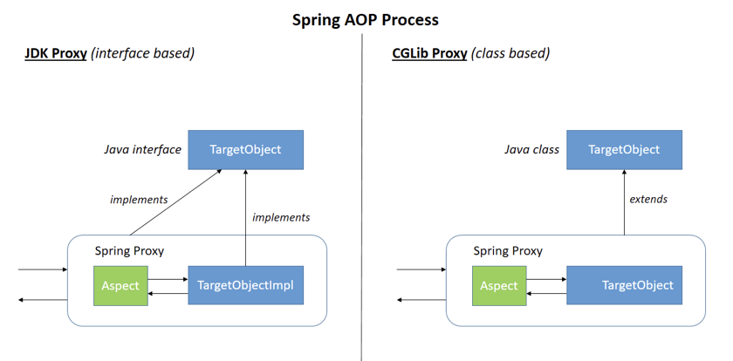
Spring AOP

Slide 9
Spring AOP vs AspectJ Abilities
Joinpoint | Spring AOP Supported | AspectJ Supported
Method Call | No | Yes
Method Execution | Yes | Yes
Constructor Call | No | Yes
Constructor Execution | No | Yes
Static initializer execution | No | Yes
Object initialization | No | Yes
Field reference | No | Yes
Field assignment | No | Yes
Handler execution | No | Yes
Advice execution | No | Yes

Slide 10
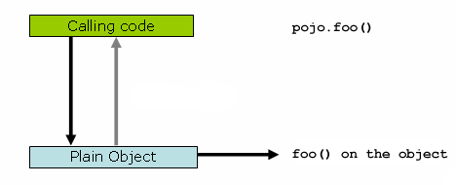
Spring AOP proxies
public class SimplePojo implements Pojo { @Override public void foo() { // this next method invocation is a direct call on the 'this’ reference this.bar(); } @Override public void bar() { // some logic... } }
public class Main { public static void main(String[] args) { Pojo pojo = new SimplePojo(); // this is a direct method call on the 'pojo' reference pojo.foo(); } }
a plain-vanilla, un-proxied, nothing-special-about-it, straight object reference

Slide 11
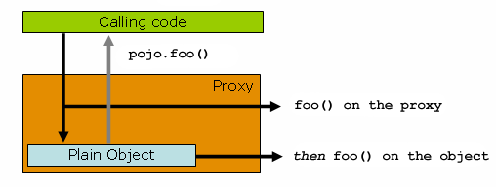
Spring AOP proxies
public class Main { public static void main(String[] args) { ProxyFactory factory = new ProxyFactory(new SimplePojo()); factory.addInterface(Pojo.class); factory.addAdvice(new RetryAdvice()); Pojo pojo = (Pojo) factory.getProxy(); // this is a method call on the proxy! pojo.foo(); } }

Slide 12
@Transactional @EnableTransactionManagement
InfrastructureAdvisorAutoProxyCreator - По умолчанию
/** * Find all candidate Advisors to use in auto-proxying. * @return the List of candidate Advisors */ protected List<Advisor> findCandidateAdvisors() { Assert.state(this.advisorRetrievalHelper != null, "No BeanFactoryAdvisorRetrievalHelper available"); return this.advisorRetrievalHelper.findAdvisorBeans(); }

Slide 13
@EnableAspectJAutoProxy
InfrastructureAdvisorAutoProxyCreator -
AnnotationAwareAspectJAutoProxyCreator
@Override protected List<Advisor> findCandidateAdvisors() { // Add all the Spring advisors found according to superclass rules. List<Advisor> advisors = super.findCandidateAdvisors(); // Build Advisors for all AspectJ aspects in the bean factory. if (this.aspectJAdvisorsBuilder != null) { advisors.addAll(this.aspectJAdvisorsBuilder.buildAspectJAdvisors()); } return advisors; }

Slide 14
AbstractAspectJAdvisorFactory
@Override
public boolean isAspect(Class<?> clazz) {
return (hasAspectAnnotation(clazz) && !compiledByAjc(clazz));
}
/**
* We need to detect this as "code-style" AspectJ aspects should not be
* interpreted by Spring AOP.
*/
private boolean compiledByAjc(Class<?> clazz) {
for (Field field : clazz.getDeclaredFields()) {
if (field.getName().startsWith(AJC_MAGIC)) {
return true;
}
}
return false;
}

Slide 15
The proxy is essentially just invoking the chain of advice needs to be applied. That advice isn't implemented in the proxy itself. For example, the advice for @Transactional lives in TransactionAspectSupport. Take a look at the source to JdkDynamicAopProxy.

