Slide 1
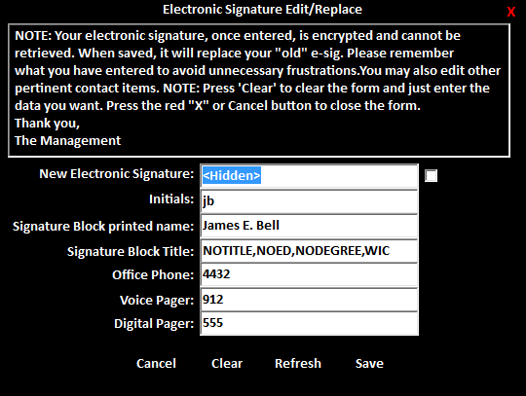
Close the app
Disclaimer
Show/Hide Text
Data/Edit Fields
Close app w/o saving
Clear Fields
Refresh Fields
Save Fields

