Slide 1
TCK

Slide 2
0x160F and 0x1612 are the same
L0:
MuonPT > 900MeV
SPD < 900

Slide 3
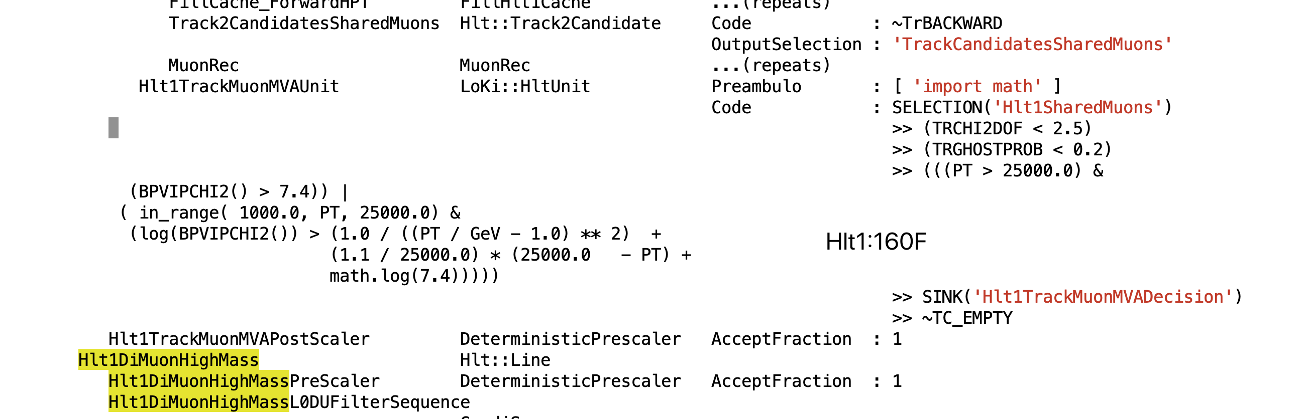
Hlt1(160F)

Slide 4
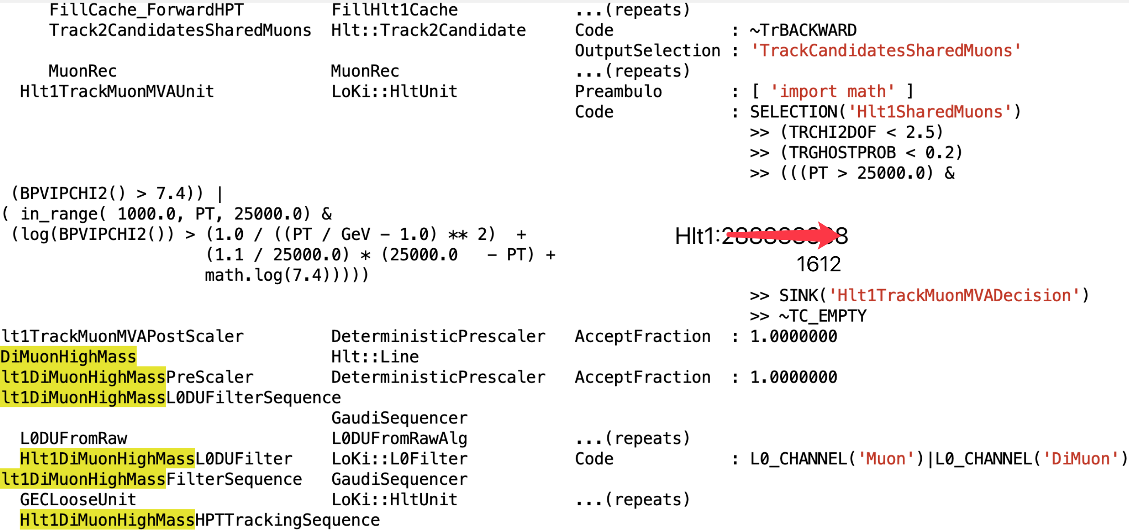
Hlt1(1612)

Slide 5
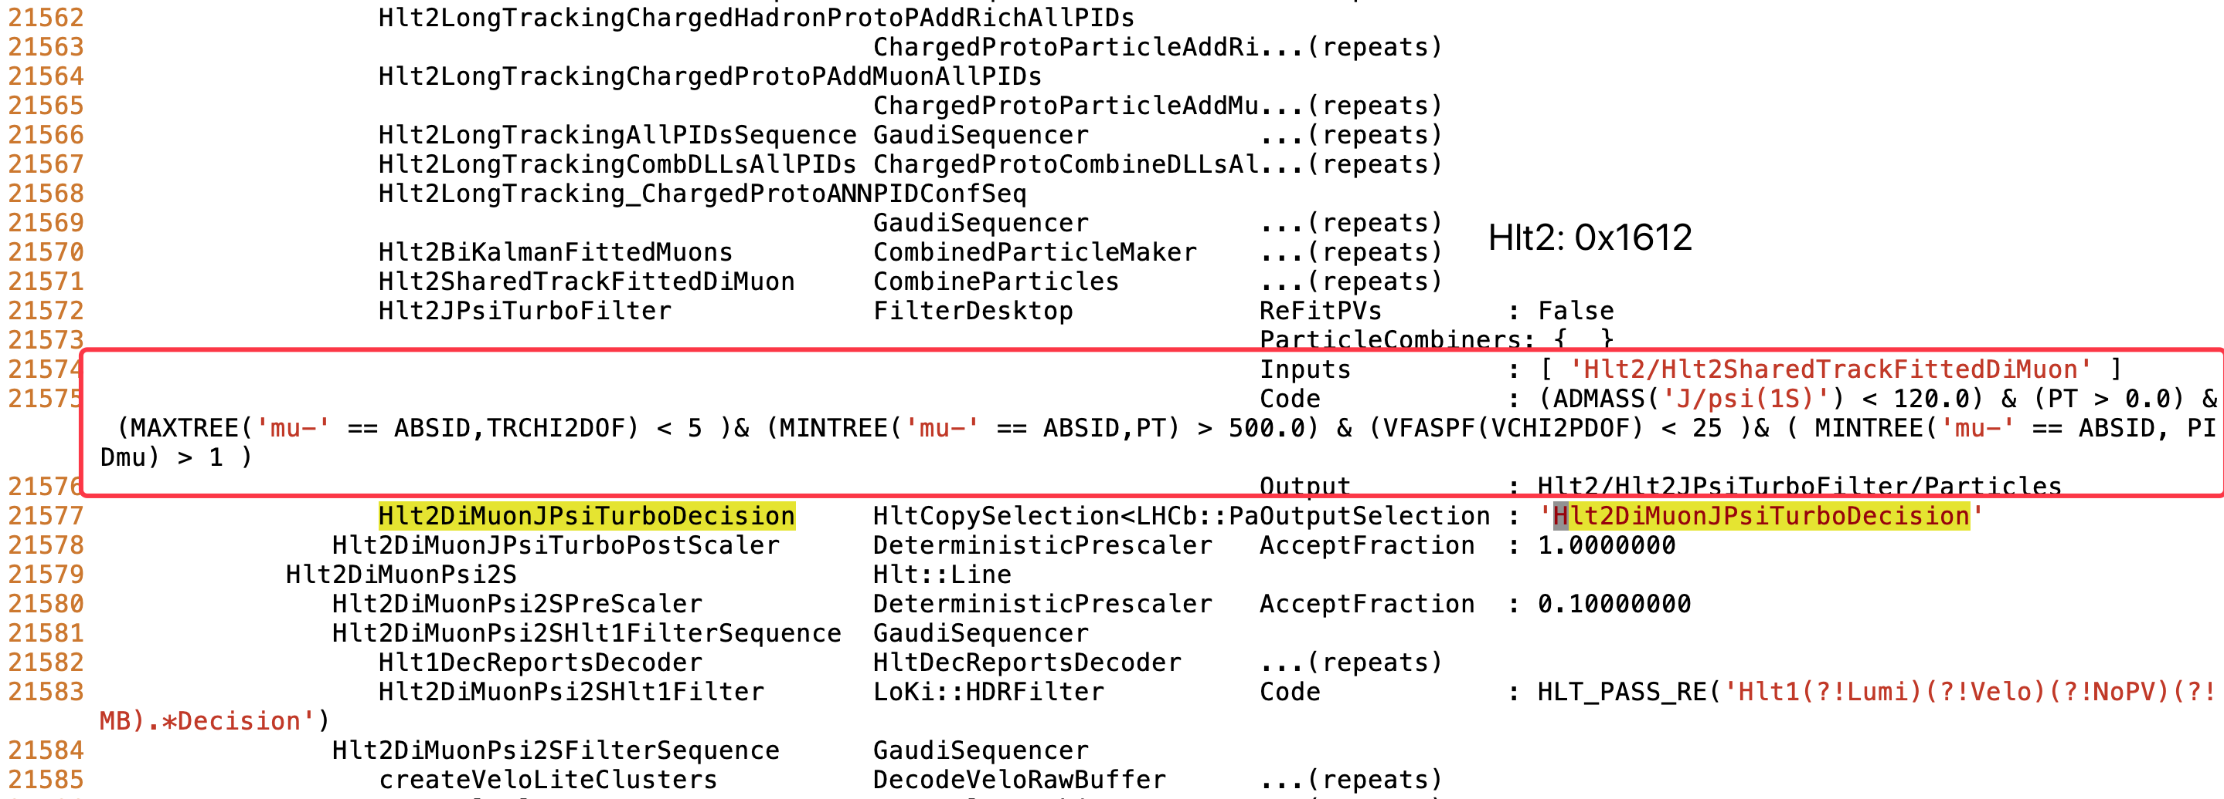
Hlt2(1612)

Slide 6
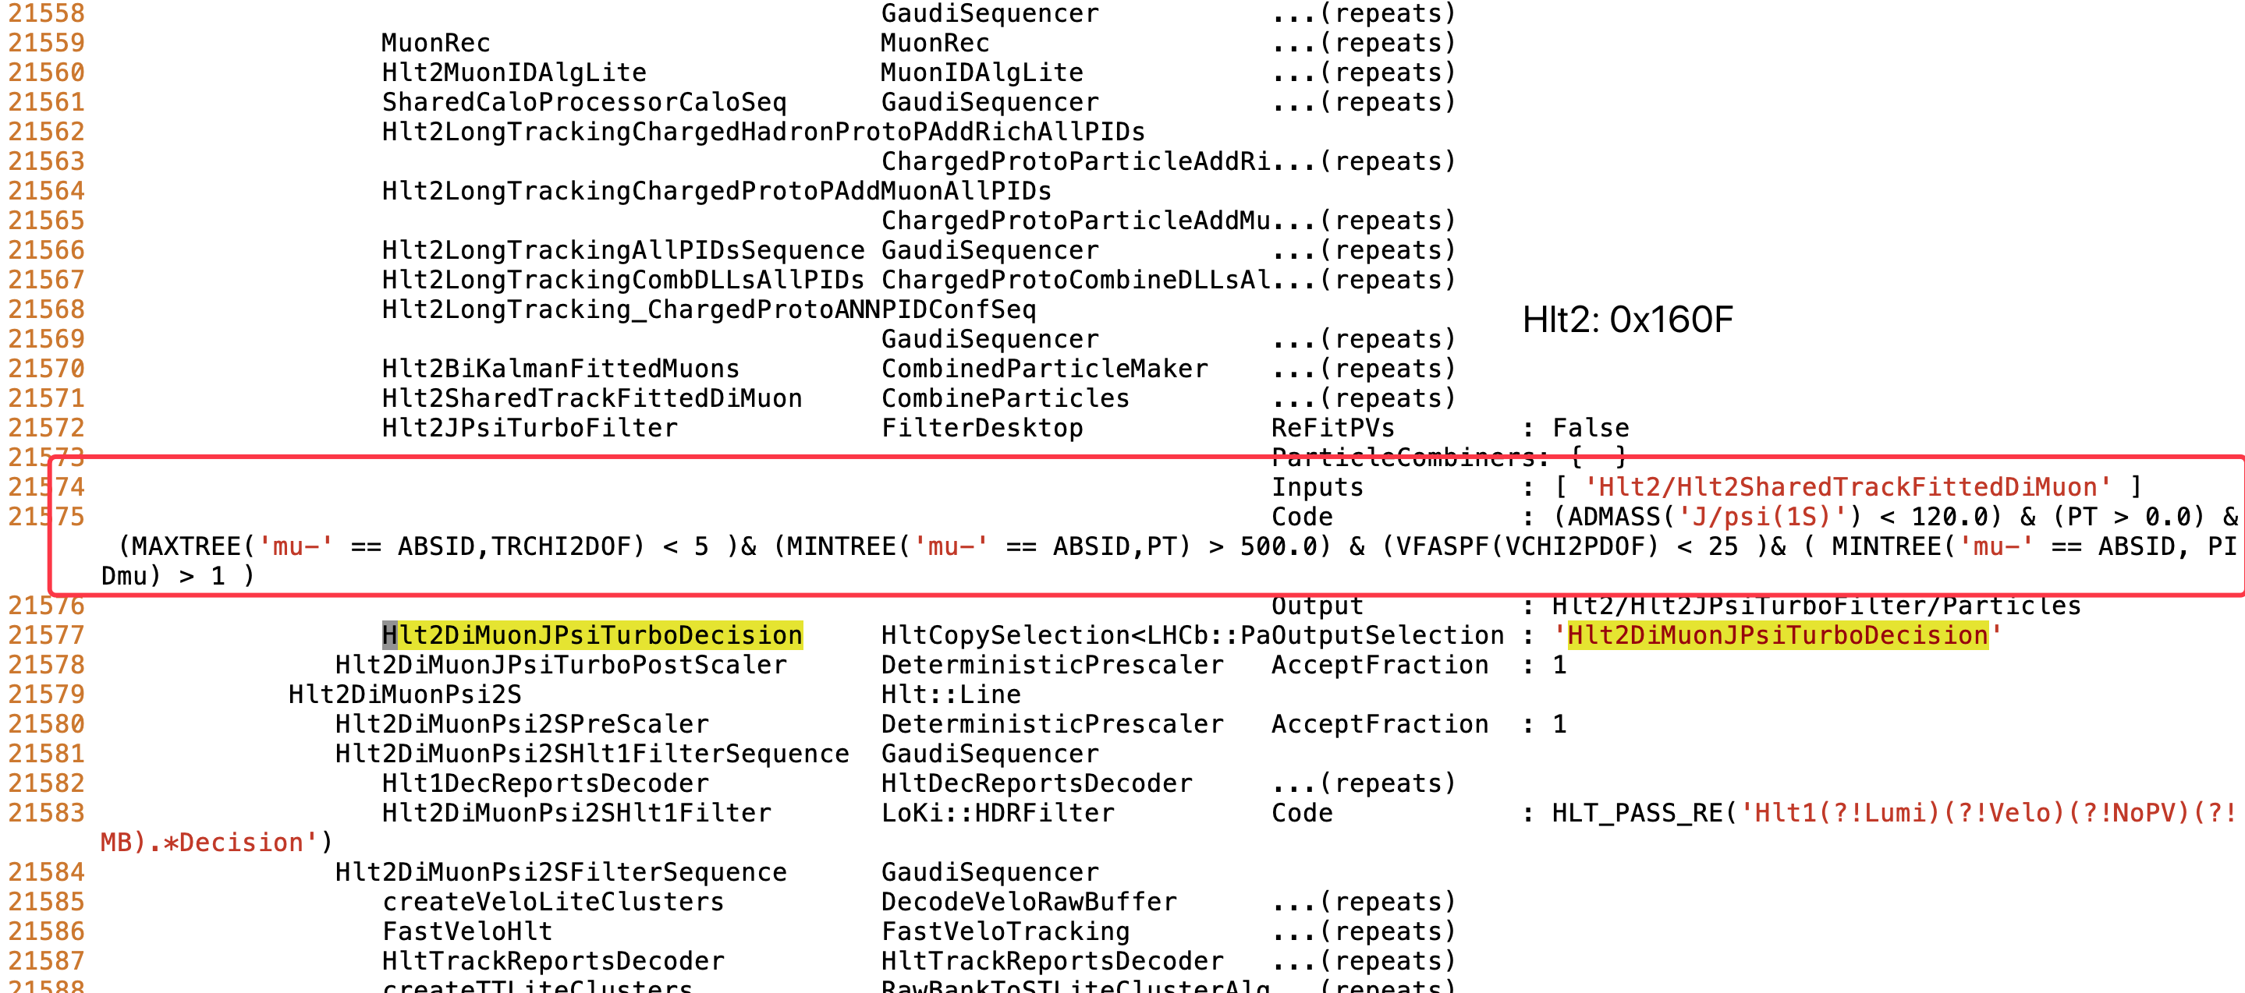
Hlt2(160F)

Slide 7
总结一下我用的TCK
Jpsi Data
L0:
5647 (0x160F)
5650 (0x1612)
L1:
288888335 (0x1138160F)
288888338 (0x11381612)
L2:
557323791(0x2138160F) 557258255(0x2137160F) 557389327(0x2139160F)
557389330(0x21391612)

