Slide 1
Opening a new Shopping Mall
In Singapore
Sissi Lin
Aug 13, 2020

Slide 2
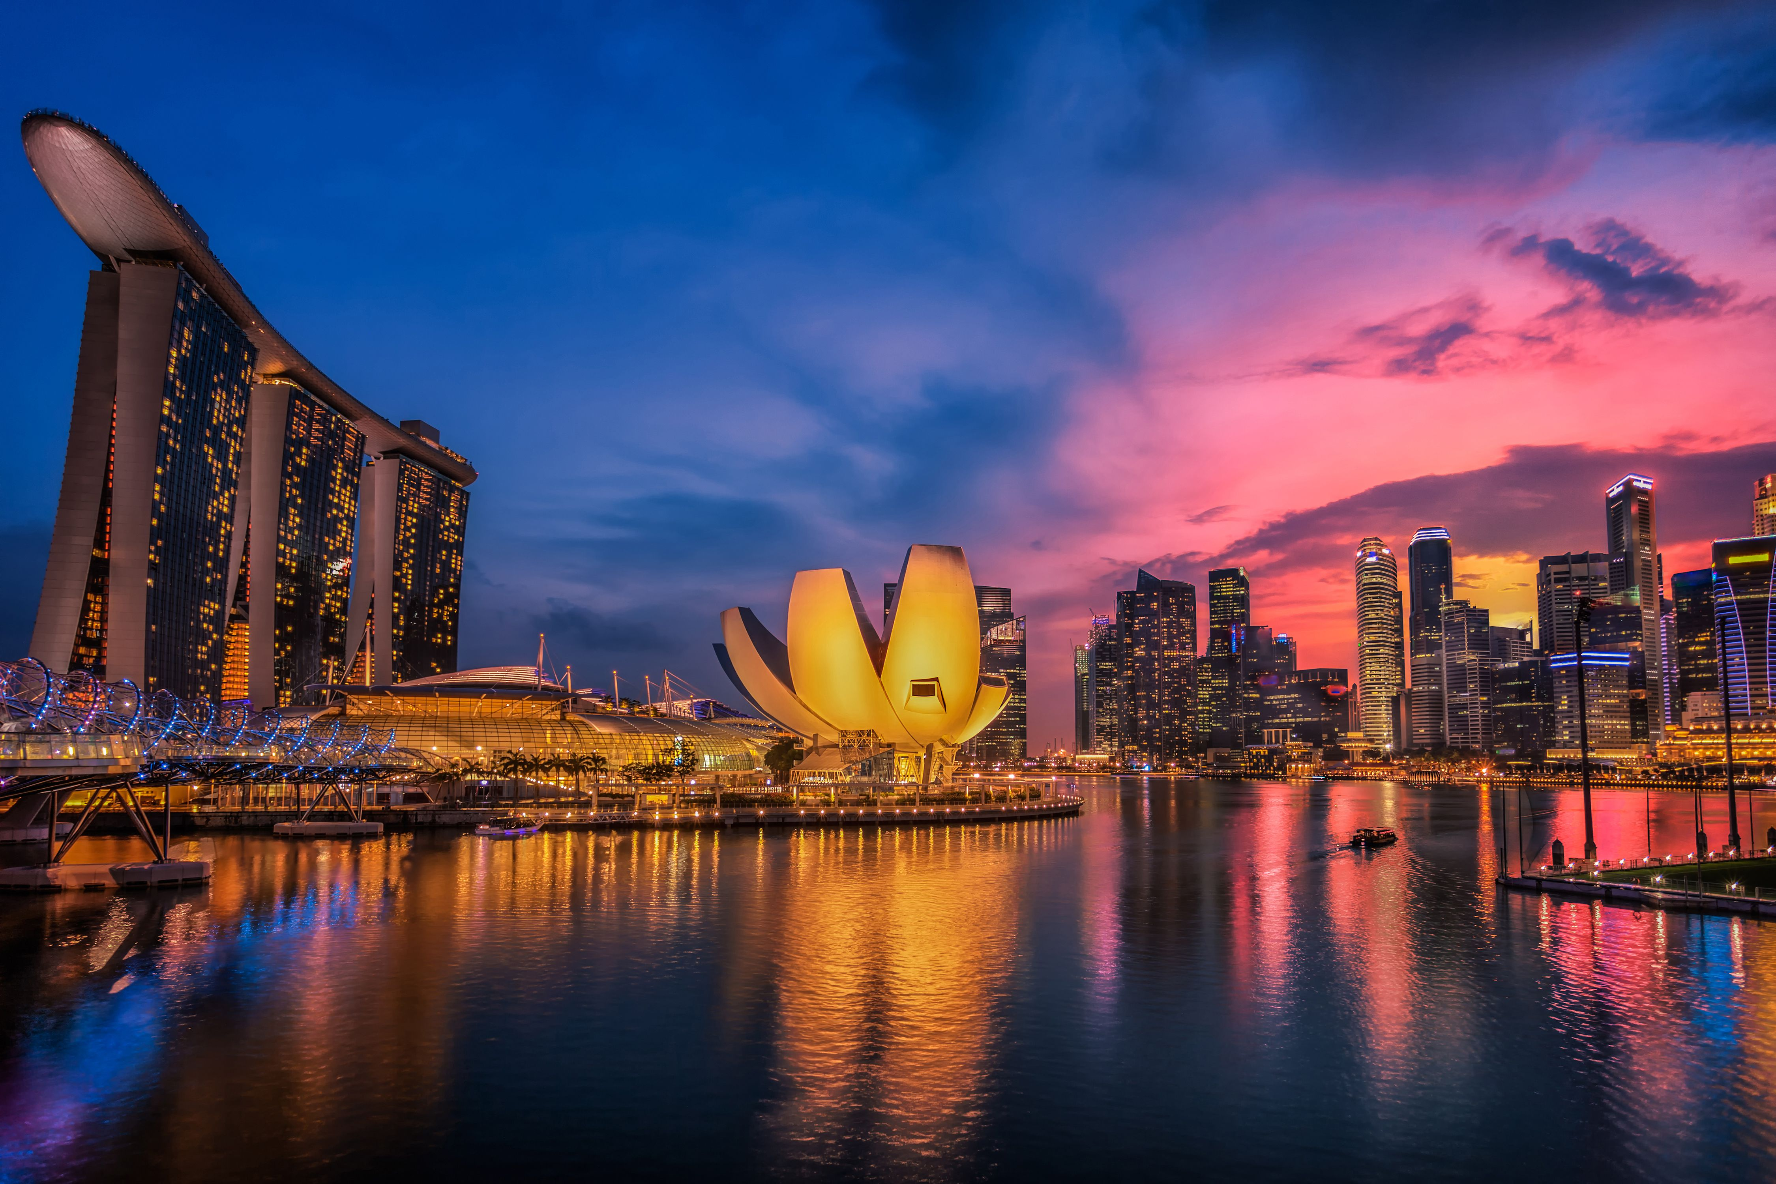
Singapore

Slide 3
Background
Background: this project is based on a hypothetical scenario. I chose Singapore as the study object for this project. Singapore,famously known as the "the red dot" on the world map, is one of the most important financial and transport hubs in Asia. Due to its geographical advantages, Singapore welcomes tourists from all around the world. Each year, Singapore attracts a lot of foreign investment as a result of its location, skilled workforce, low tax rates, and advanced infrastructure.
Singapore has a decent amount of shopping malls, because Singaporeans of all ages like to go to shopping malls for different purposes, some for shopping, some for dining out, some for watching movies... Not only the locals love going to shopping mall, but also the millions of tourists who visit Singapore each year.

Slide 4
Business Problem
Suppose a shopping mall chain is willing to open a new shopping mall outlet in Singapore to expand their business in South East Asia, however, the stakeholders are not familiar with Singapore. They want to know which location would be the best to suit their needs.

Slide 5
Target Audience
The stakeholders who want to invest in the shopping mall.
Tourists who visit Singapore. Singapore attracted approximately 19.1 million visitors in 2019 with receipts at S$27.1 billion, according to preliminary figures by the Singapore Tourism Board. The top three countries where the tourists are from are China, India and Indonesia.
Local Singaporean residents. As of June 2019, Singapore's population stood at 5.70 million.

Slide 6
Data acquisition and Cleaning
2019 Singapore Planning area (Neighborhoods) dataset downloaded from data.gov.sg
Venues of each planning areas dataset with the help of Foursquare API
Clean the dataset and remove all irrelevant columns, and only keep four useful features, including neighborhood, region, and its latitude and longitude values.

Slide 7
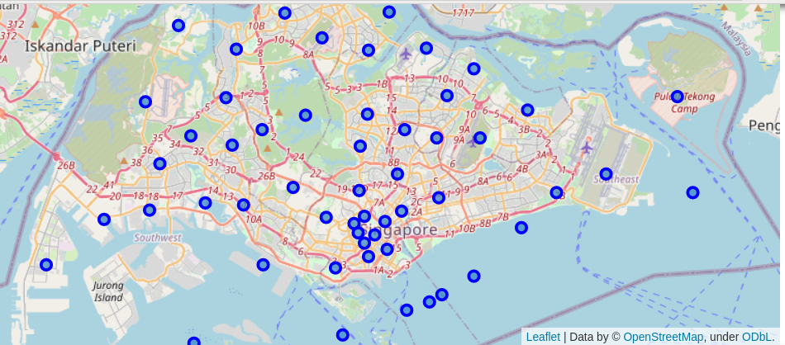
Visualize neighborhoods in Singapore on Map

Slide 8
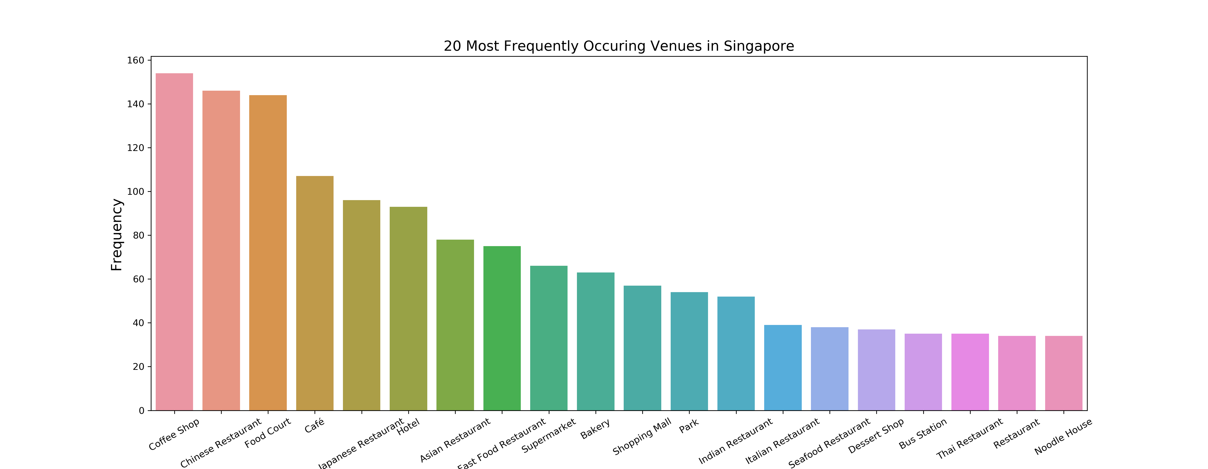
The most frequently occurring venues
By using Foursquare API, we found out the top 20 popular venue categories and visualize them by using seaborn and matplotlib libraries. Shopping mall is ranked as 11th most frequent one.
Shopping mall

Slide 9
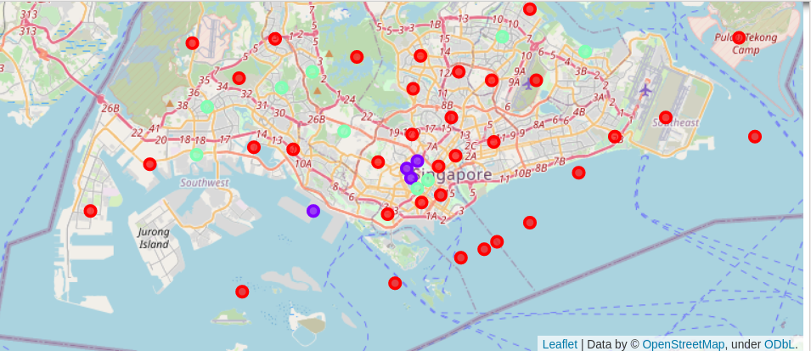
Cluster the similar neighborhoods by K-Means clustering
We cluster the data into three clusters, the red dots representing the first cluster, while the cyan ones are for second cluster and the purple ones are for the third cluster

Slide 10
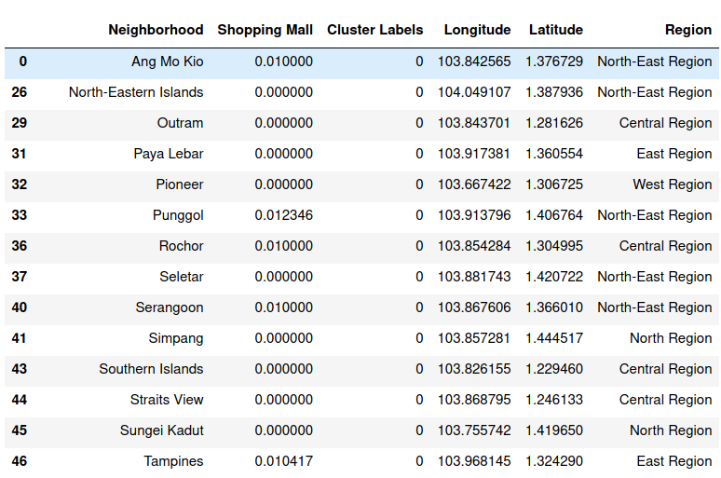
First Cluster

Slide 11
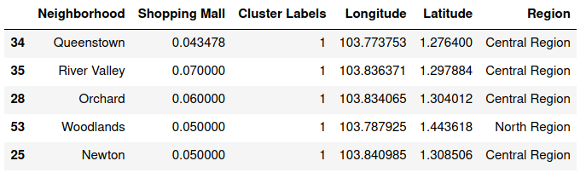
Second Cluster

Slide 12
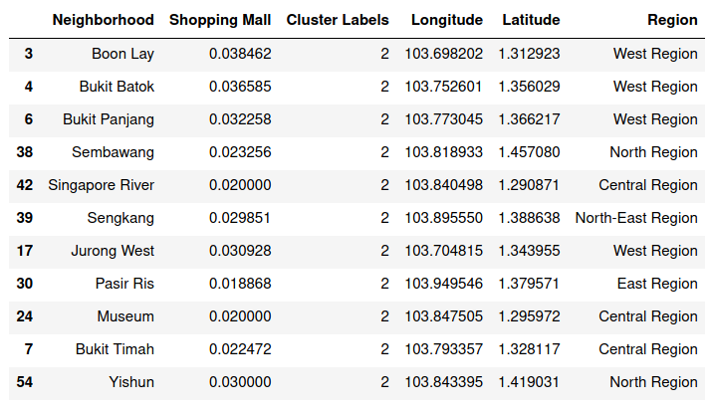
Third Cluster

Slide 13
Observation
1. First cluster has zero to very low numbers of shopping malls, as we can see, the neighborhoods in the first clusters are mostly in North/East/West Region. The density of population of most of these neighborhoods are not high.
2. Second cluster has the highest rate of shopping malls. It's easy to identify most places are in central region. For example, Orchard is a well-known shopping center in Singapore. While Woodlands, even in North Region, but it's the regional center of the North Region and being located immediately across from Johor Bahru, Malaysia, Woodlands is highly accessible, connected as the border between two countries, which brings a certain amount of business including shopping malls.
3. Third cluster shows a moderate amount of shopping malls, located mostly in West Region and Central Region.

Slide 14
Recommendations
I would strongly recommend the stakeholders invest in the third cluster.
It’s too competitive for a new shopping mall in the second cluster since it already has a high amount of shopping malls in such areas.
Investing in the first cluster could be relatively risky, since most locations are in suburb area, which are less populated and are of industrial zones instead of residential areas.
In the third cluster, most neighborhoods are well-located in the central and west region, and currently there are a moderate amount of shopping malls, but not too competitive as the second cluster, which creates great potential for shopping mall investments.

Slide 15
Conclusion and future directions
Accuracy of the models still has room to improve.
Need to gather more datasets to have a better understanding the potential of different planning areas in Singapore, which includes:
1. The population density of each neighborhoods
2. Annual household income of each neighborhoods
3. The amount of hotels in each neighborhoods etc.

