Slide 1



Tomcat Session Replication in the Cloud
Final presentation
R&D Workshop @ Red Hat
Supervisor: Jean-Frederic Clere
Ismaïl Senhaji, Guillaume Pythoud
Notes:
Present Red Hat
International Open source software company
Involved in many products
Provides commercial support

Slide 2
Outline
Project's reminder
What has been done
Solution
Demo
Issues
Future work

Slide 3
Reminder: Goal
Extend Tomcat’s session replication to work in a cloud environment
  Create a simple test application
    The app will be distributed and be able to keep session data between
    nodes.
  Provide documentation (Quick Start Guide)
  Use OpenShift as cloud platform
Notes:
Explore existing solutions AND/OR extend…
Easiest solution with minimal dependencies and configuration
Explain functionality of app
Show which node served the request
Show session ID
Simple counter that increments on each request
Documentation = most important!

Slide 4

Reminder: Technology
Tomcat
  Open-source Java Servlet Container
  Has built-in session replication
    But is not cloud-ready
OpenShift
  Open source cloud/PaaS suite
  Built on Docker containers and with Kubernetes as cluster manager.
  Built by Red Hat.

Slide 5
Reminder: Cloud Architecture
Internet
Load Balancer
Internet
Session
Data
Session
Data
Session
Data
Notes:
Similar to before
Distributed over the world
Easy to add/remove nodes (animation)
Drawback: harder

Slide 6
What has been done
Many new technologies
  OpenShift
  Kubernetes
  Docker
  Fabric8
  Tomcat
Best way to learn is to experiment, we explored a lot of different paths
We tried the tools out, got familiar with them

Slide 7
Experiments
Tomcat + jsp
SpringBoot
Embedded Tomcat
SpringBoot + SpringSession
Embedded Tomcat + Infinispan
Embedded Tomcat + custom membershipservice
  Our solution

Slide 8
Solution
Tomcat built-in solution
does not work in a cloud environment
Our solution
Openshift ready
Get cluster
members from
the API
Session
Data
Session
Data
Multicast
or
Static Peer List
Session
Data
Session
Data

Slide 9
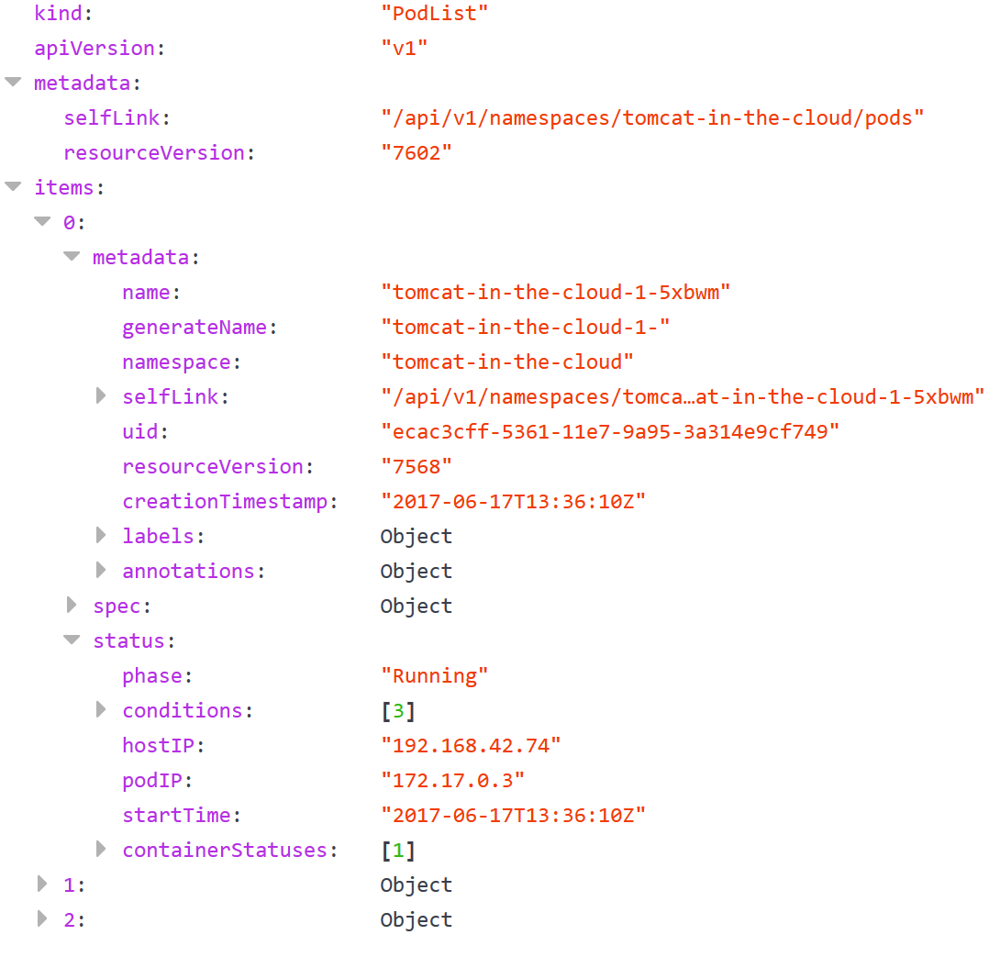
Openshift API
Tools for managing a Kubernetes cluster
Accessible from the pods of the cluster
GET /api/v1/namespaces/tomcat-in-the-cloud/pods
Return a JSON file containing the list of all the pods of the cluster

Slide 10
Implementation
Inspired by Kube_PING from JGroup and McastService (multicast service) from Tomcat :
  DynamicMemberShipService: manage the member of the cluster
  KubernetesMemberProvider: call the API and filter the pods

Slide 11
DynamicMembershipService
DynamicMembershipService
MemberProvider
init(Properties)
getMembers(): List<Member>
KubernetesMemberProvider
init():
  Get URL, cert, ... from
  environment variables
  Set startTime
RefreshThread
Call memberProvider.getMembers()
Filter out already known Member
Inform listeners of
new/dead members
Collect Members in
Membership
getMembers():
  Call api to get pods
  Filter active pods
  Set alive time
  Compute aliveTime

Slide 12
DEMO

Slide 13
Issues
Session data is shared within all the applications of a project/namespaces
Functional in Openshift, but not 100% sure within a pure Kubernetes cluster
Light errors handling in the implementation

Slide 14
Future works
Fix previous issues
Implement a testing suite

Slide 15
Planning
Until midterm
  Read about Tomcat, clustering, Openshift,...
  Write the testing app
  Run the app on a local Tomcat Cluster
  Install and configure Minishift
  Implement Plan A
Midterm to final
  If Plan A works:
    Install Raspberry Pi Cluster
    Deploy app
  Else:
    Plan B
  Write documentation & report

Slide 16
Thank you for your attention!
Ismaïl Senhaji, Guillaume Pythoud

