Slide 1

ENLIFE
Life is a gift- we help you take care of it

Slide 2
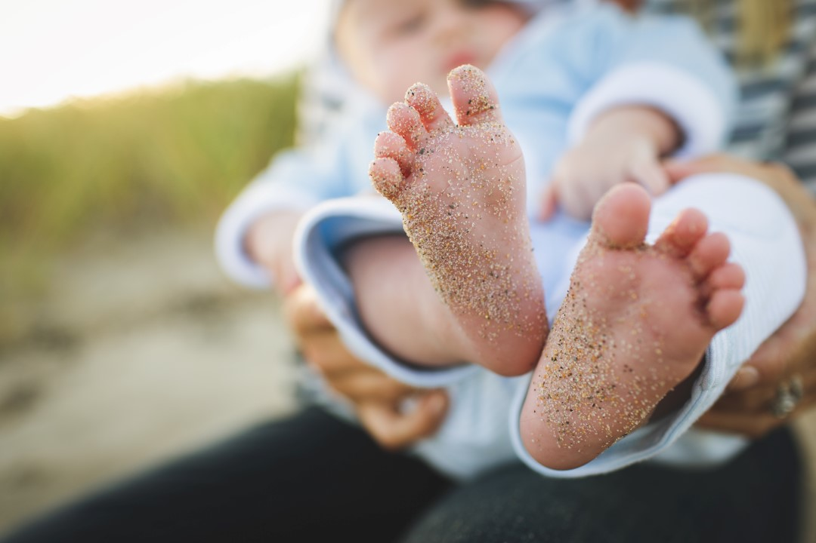
We believe that people should live a healthy live.

Slide 3

Do you know the every 4th person suffers from allergies?

Slide 4
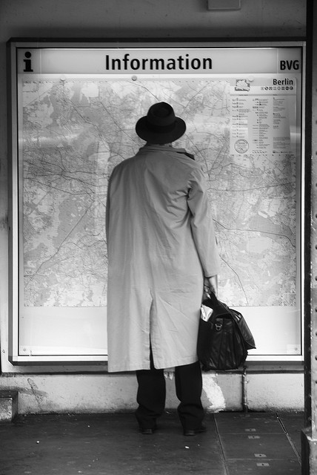
We help people to obtain information concerning their health.

Slide 5

Everything starts when the user inputs their symptoms

Slide 6
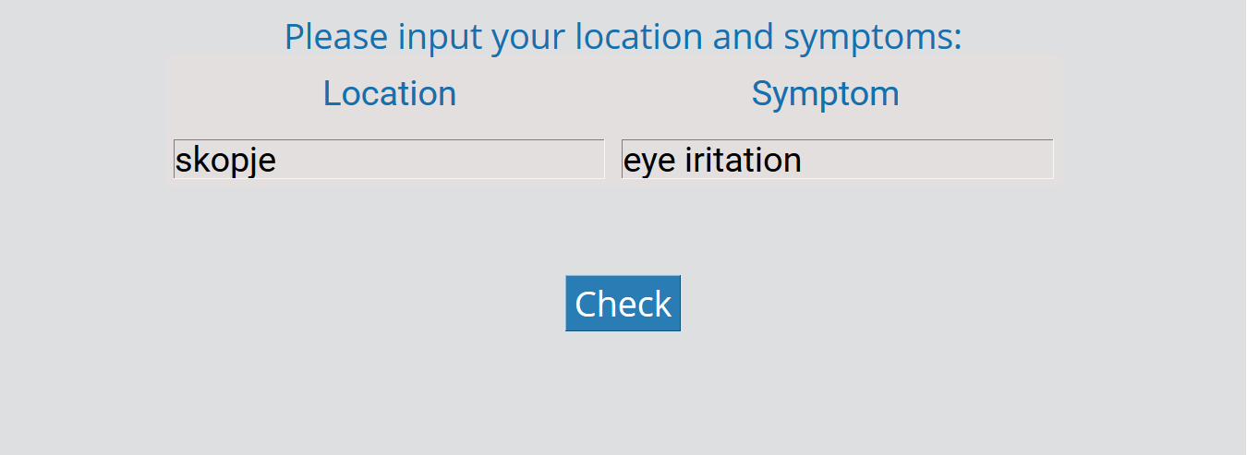

Slide 7

Our platform utilizes data analytics to match user's symptoms against NASA's data.

Slide 8
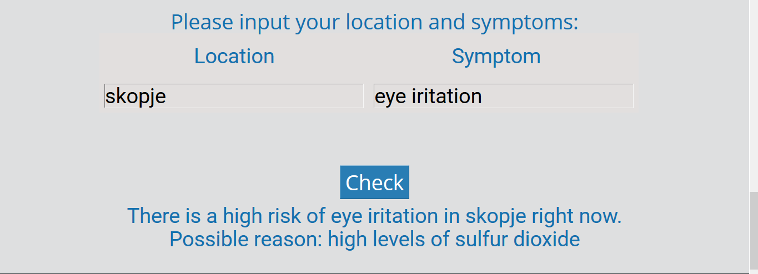

Slide 9
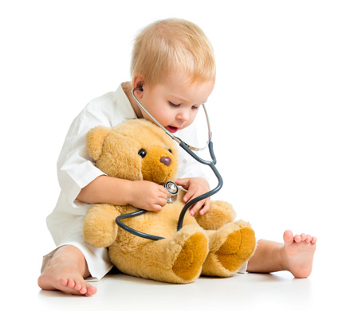
As a result, the user gets a detailed diagnosis.

Slide 10
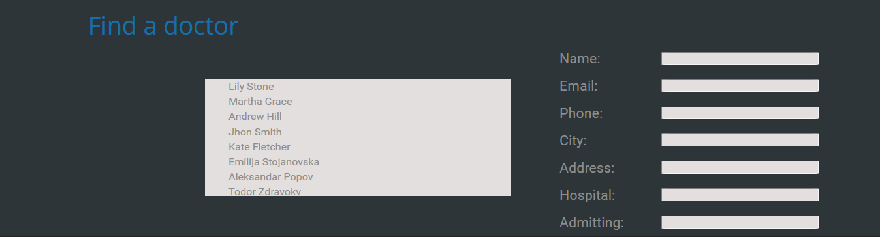

Slide 11


