Slide 1
EVALUATION OF BLACK HOLE ATTACK IN MANET
PROJECT GUIDE: TEAM MEMBERS:
Ms P.Vimala Manohara Ruth P.Sumanth (160114733115)
G.Vamshi Krishna (160114733116)
PROJECT ID: BE1702-32

Slide 2
Contents
Problem statement
Introduction
Existing system
Proposed system
Literature survey
Analysis
Design
Result
Conclusion
References

Slide 3
PROBLEM STATEMENT
Aim to evaluate the performance of the network when there is a blackhole attack in the network, in terms of packet delivery ratio, throughput and packets dropped.
Aim to compare the performance of MANET under single/multiple blackhole attack(s) and from prevention of blackhole attack in a MANET.
Aim to prevent blackhole attack and mitigate its effect on MANET.

Slide 4
INTRODUCTION
Network security is a crucial issue in the present generation networks. Most network security solutions focus on vulnerabilities in the end systems, but not on vulnerabilities in the network.
As a result, the focus of attacker has shifted to attacking the network infrastructure(e.g. router , switch,etc) itself.
Therefore protecting the network from internal or external attacks improves in performance of the network.

Slide 5
EXISTING SYSTEM
In existing system the intermediate node behaves as black hole which drops the packets in the network, so the throughput is decreased and affects network performance. Due to the light weight detection mechanism, the black hole node is not eliminated from routing and its presence degrades the network performance.

Slide 6
PROPOSED SYSTEM
The performance metrics of a MANET such as Throughput, Packet delivery ratio, PacketLoss are evaluated when there is no malicious node, single malicious node which leads to a single blackhole attack and multiple malicious nodes which leads to multiple blackhole attacks, compare the metrics of no blackhole, single black hole and multiple blackholes attacks.
Proposed system uses fake routing protocol to prevent black hole attacks imposed by both single and multiple black hole nodes.

Slide 7
LITERATURE SURVEY
S.No | TITLE | AUTHOR | YEAR | OBJECTIVE
1 | A survey of black hole attacks in wireless mobile ad hoc networks | Fan-Hsun Tseng, Li-Der Chou | 2011 | This paper recommends that a hybrid detection method which combined the advantages of proactive routing with reactive routing.
2 | Routing protocols in MANET | K. Madhuri | 2011 | This papers explains 2 protocols, Table-driven and on-demand routing protocols
3 | Study of MANET | S. S. Tyagi Aarti | 2013 | In this paper, tells MANET and its characteristics, challenges, advantages, application, security goals,
4 | Performance analysis of AODV & DSR Routing protocols for MANET | Uma Rathore Bhatt, Abhishek Dangarh | 2014 | The higher traffics updates we get slower communication. As AODV makes more updates than DSR, it consumes more energy and this is a real handicap for this protocol.

Slide 8
MANET(Mobile Adhoc Network)
MANET consists of group of wireless mobile nodes
Dynamically constructs network, no infrastructure is used
Fast setup
Mobile nodes may be cellphones, laptops, etc.,
Categories
Proactive
Reactive
Hybrid

Slide 9
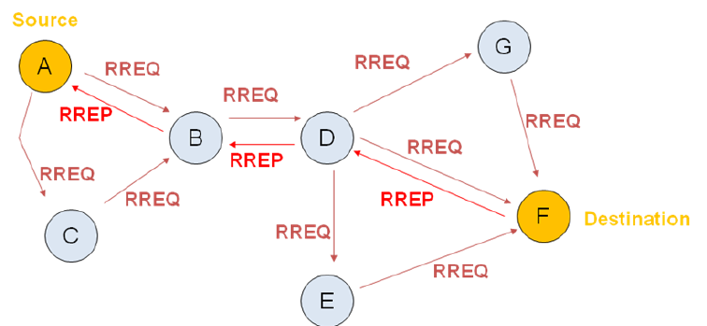
AODV(Ad hoc On-Demand Distance Vector Routing) Routing Protocol
AODV is a Reactive routing protocol
Route discovery process in AODV
Route request from source passes on to all the neighbors and there by passes on till it reach the destination.
Then destination gives route reply and the route is discovered.

Slide 10
Network Simulator(NS tool)
Network simulation tool is useful in studying the dynamic nature of communication networks

Slide 11
Performance Evaluation Metrics
PACKET DELIVERY RATIO (PDR)
PACKET LOSS
THROUGHPUT

Slide 12
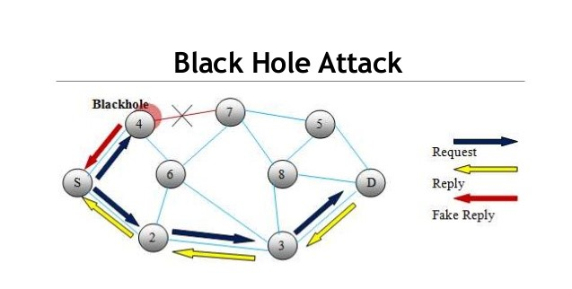
Blackhole attack
It gives fake route reply as it has the shortest path to reach destination.

Slide 13
ANALYSIS
Creating a MANET
Implementing AODV routing protocol
Introducing malicious node and creating blackhole attack
Evaluating performance metrics(under blackhole attack)
Implementing modified AODV routing protocol(Prevention under blackhole attack)
Display moment of nodes using NAM and graphs using Xgraph tools
Comparision of MANET performance in both scenarios and drawing conclusions from results

Slide 14
Modified AODV mechanism
Create MANET
Insert mobile nodes and malicious nodes into the network
Source broadcasts RREQ(Route Request message) with its own ID(SSN(Source Sequence number)) in place of DSN(Destination Sequence Number)
Intermediate Nodes sends RREP(Route Reply message) packet having highest SSN
If (RREP(SSN)>RREQ(SSN)) is true then node is blacklisted and other nodes are notified, Otherwise normal routing process of AODV is involved
Display results in NAM and terminal and using Xgraphs

Slide 15
DESIGN
Data flow diagram:
DFD level 0
DFD level 1
UML diagrams:
Usecase diagram
Activity diagram

Slide 16
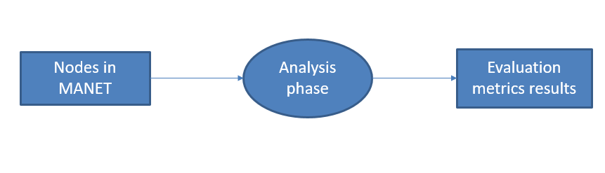
DFD level-0

Slide 17
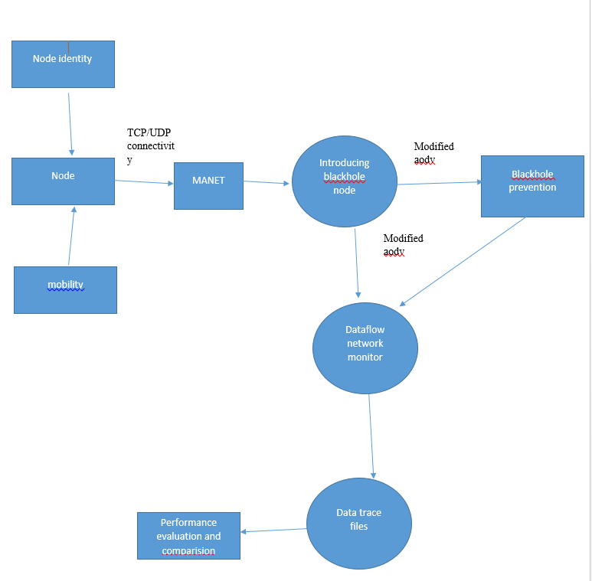
DFD level-1

Slide 18
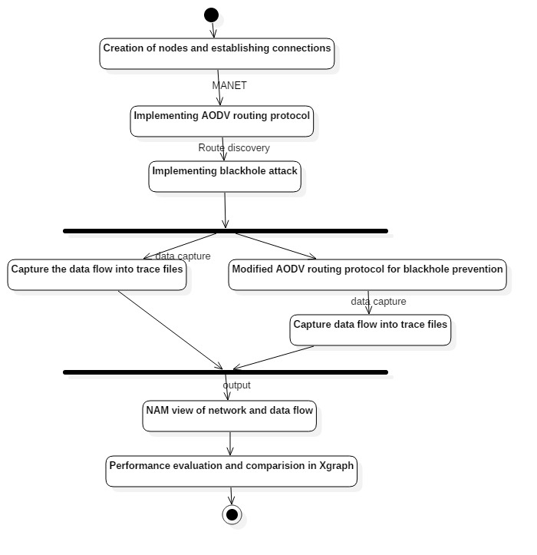
Activity diagram

Slide 19
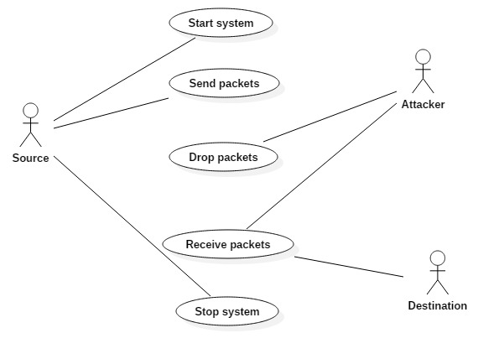
Usecase diagram

Slide 20
RESULT
Performance evaluation of AODV routing protocol under 0,1,2,3,4 blackhole attackers in MANET.
Implemented modified AODV for prevention of blackhole attack in MANET.
Comparison of performance of AODV(under blackhole attack) vs modified AODV (from prevention of blackhole attack) routing protocol in MANET.

Slide 21
CONCLUSION
Under blackhole attack in AODV:
Throughput and packet delivery ratio decreases as the no.of blackholes in MANET increases.
Packet loss increases as the no.of blackholes in MANET increases.
Under blackhole attack in Modified AODV :
Effect of blackhole over MANET is reduced.
Shows normal throughput , packet delivery ratio and packet loss.

Slide 22
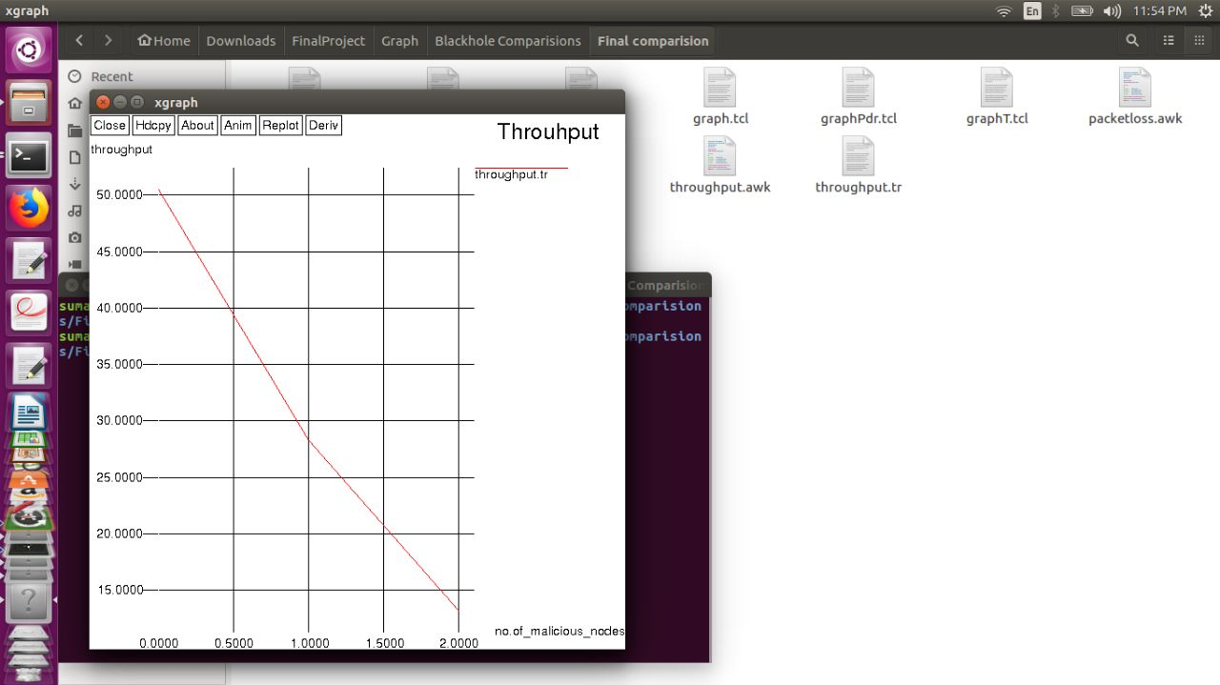
Throughput graph when no. of malicious nodes in MANET increases

Slide 23
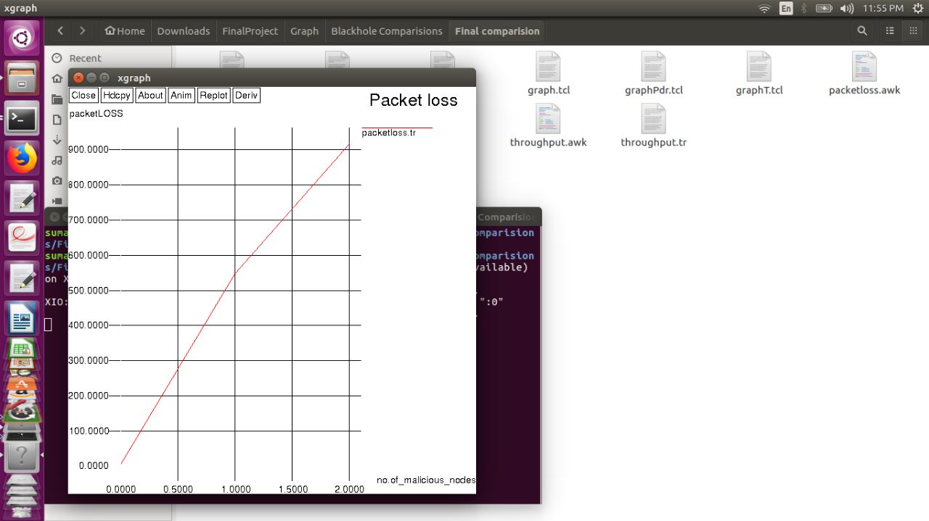
Packet loss graph as no. of malicious nodes in MANET increases

Slide 24
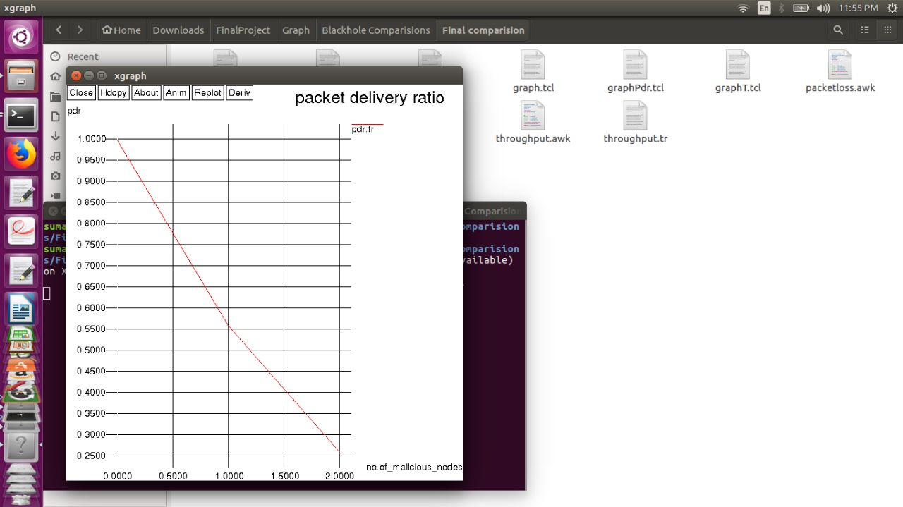
Packet delivery ratio graph as no. of malicious nodes increases in MANET

Slide 25
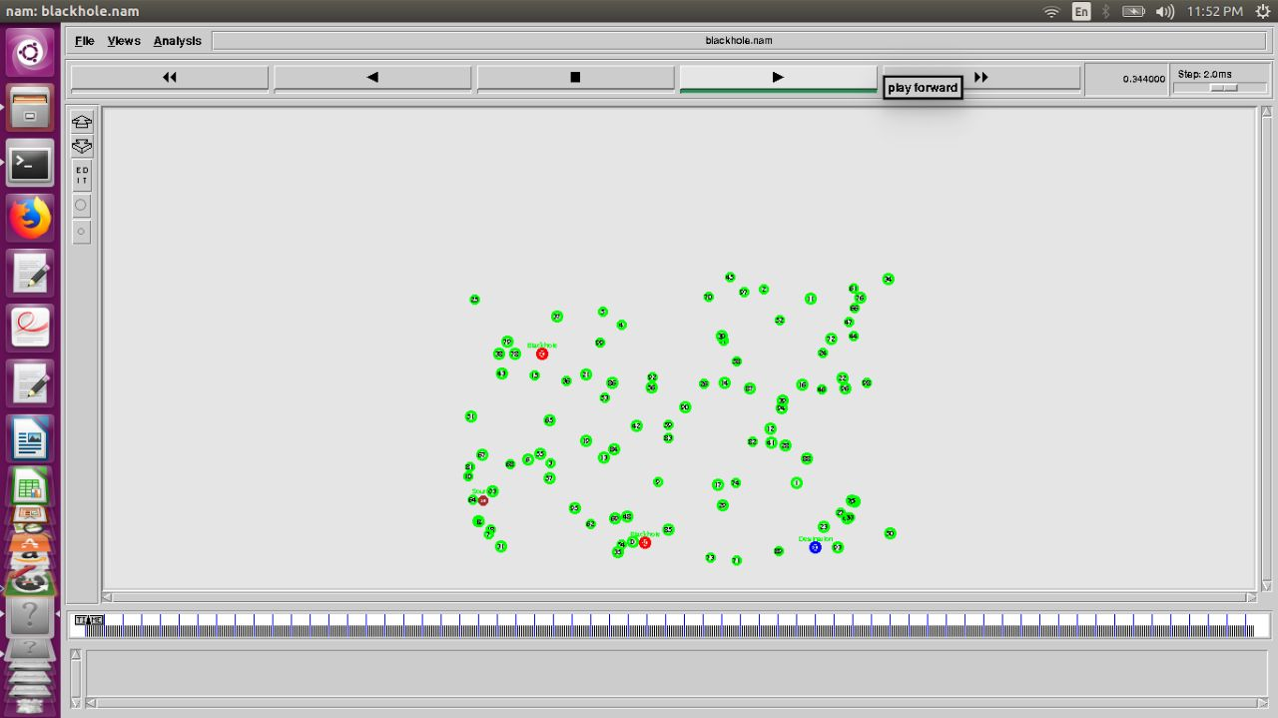
100 Nodes in MANET with source, destination and malicious nodes

Slide 26
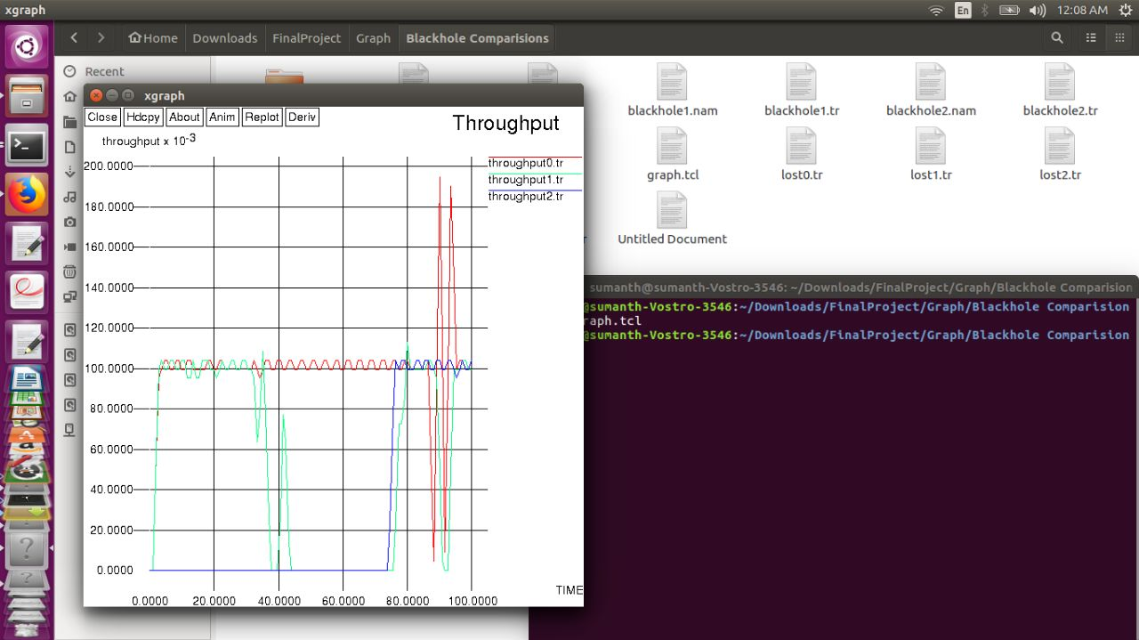
Time vs Throughputdelay(when no blackhole, single blackhole and multiple blackhole attack)

Slide 27
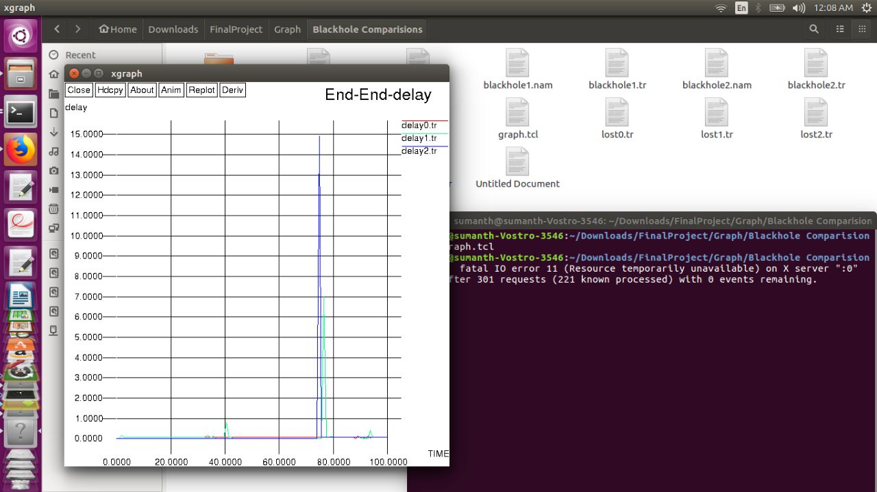
Time vs delay(when no blackhole, single blackhole and multiple blackhole attack)

Slide 28
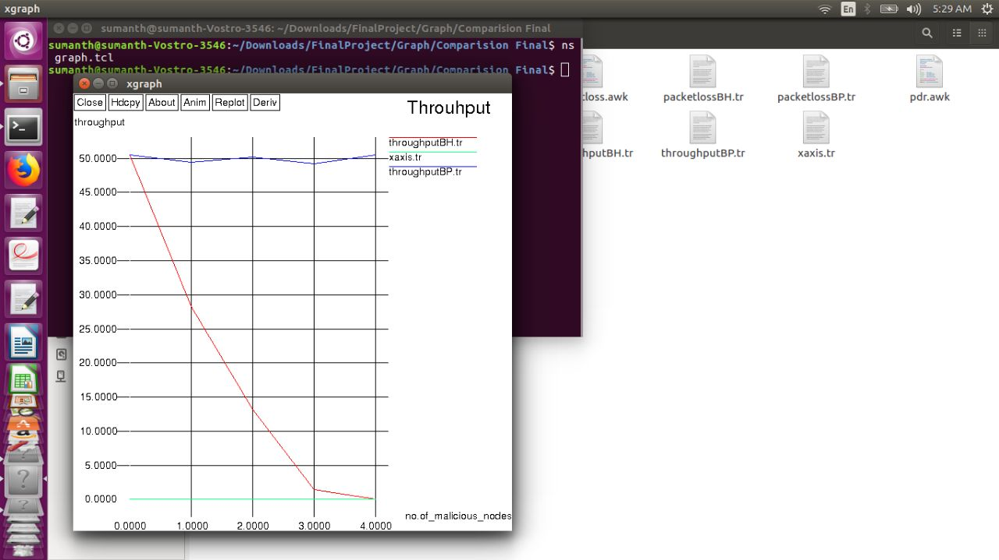
No. of malicious nodes vs throughput (under blackhole attack and prevention of blackhole attack)

Slide 29
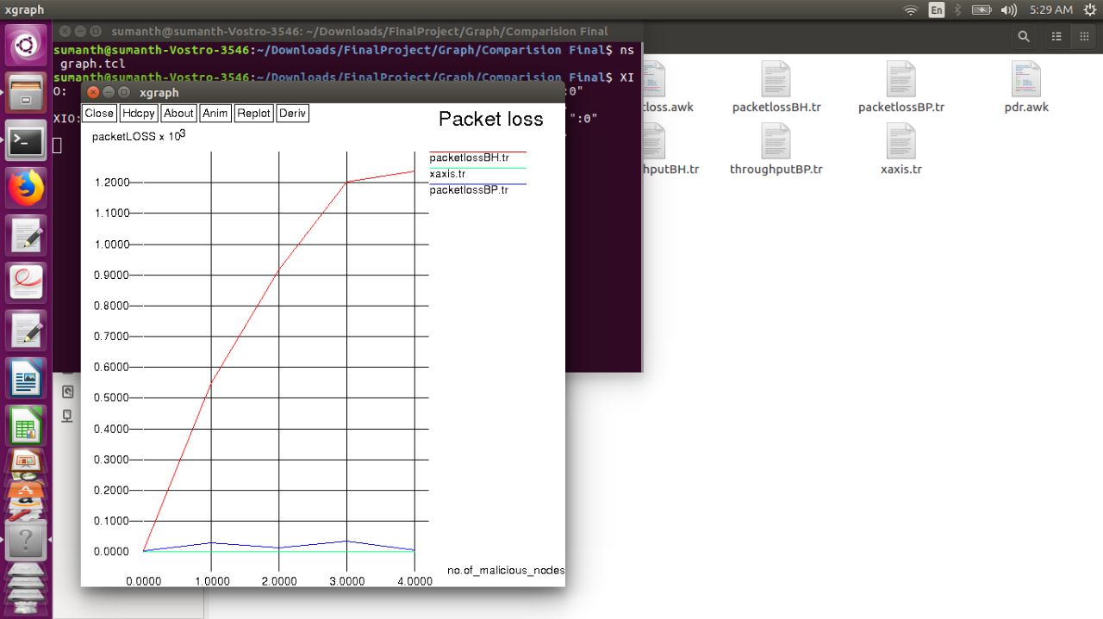
No. of malicious nodes vs packetloss(under blackhole attack and prevention of blackhole attack)

Slide 30
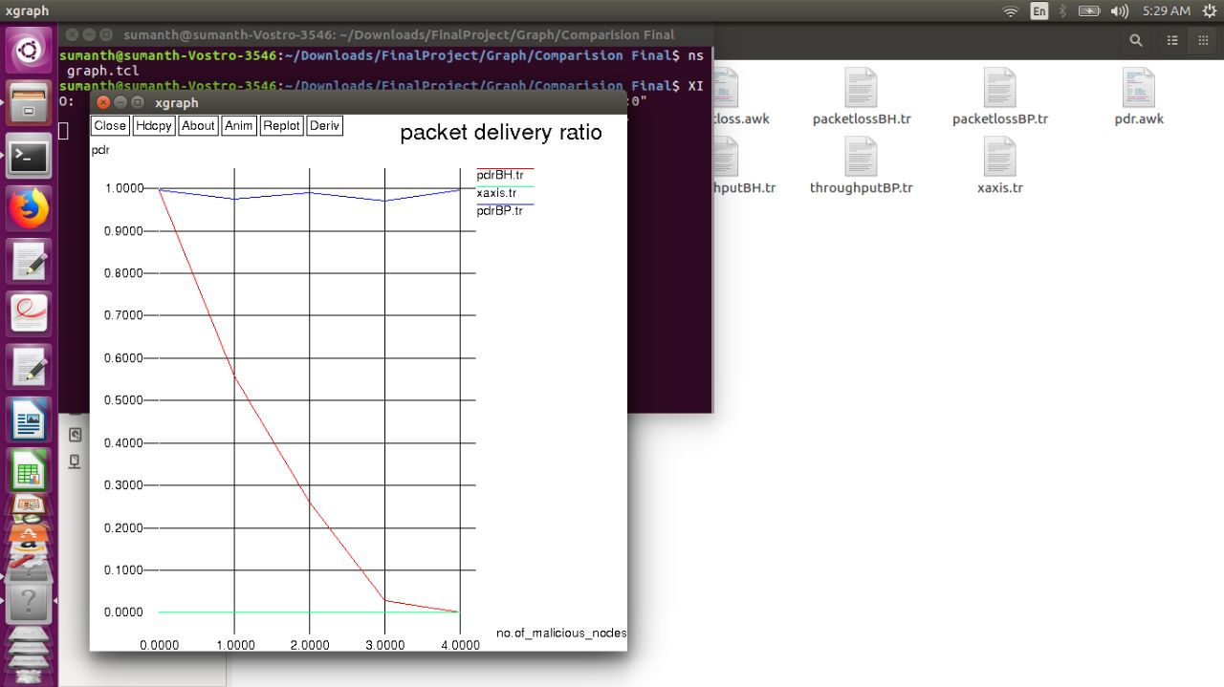
No. of malicious nodes vs PDR(under blackhole attack and prevention of blackhole attack)

Slide 31
REFERENCES
[1] S. S. Tyagi Aarti, "Study of MAN E T: Characteristics", Challenges Application and Security Attacks, vol. 3, no. 5, May 2013
[2] Nishu Kalia, Harpreet Sharma, “Detection of Multiple Black hole nodes attack in MANET by modifying AODV protocol”, 2016
[3] Uma Rathore Bhatt, Abhishek Dangarh, Akanksha Kashyap, Aishwarya Vyas “Performance analysis of AODV & DSR Routing protocols for MANET”,.Fourth International Conference on Communication Systems and Network Technologies, 2014
[4] S. Li, A. Ephremides, “Covert Channels in Ad-Hoc Wireless Networks,” Elsevier Ad Hoc Networks, 2009
[5] Umang, Dr. B V. R. Reddy, Dr. M .N. Hoda “MNI AODV Analytical model for Attack mitigation using AODV routing in ad hoc networks”,.2014 International Conference on Computing for Sustainable Global Development (INDIACom)

