Slide 1


India's 1st EV Battery Financing
& Lifecycle Management
Ecosystem
Turning batteries into programmable financial assets through smart telemetry, behavioral risk scoring, and lifecycle intelligence.
PRE-SEED ROUND | RAISING ₹8 CRORE
March 2026

Slide 2



The Hook — Why Now
A confluence of market growth, financial risk, and regulatory mandates creates the perfect storm for battery intelligence.
1.2 Million
~90%
New Electric 3-Wheelers by FY'27
Informal Battery Financing
Every single vehicle needs a financed battery, creating massive demand for structured capital.
Current lending is broken, leading to high NPAs and thin margins due to "blind asset" risk.
+10% YoY
Mandatory
Lithium Pricing Volatility
Battery Waste Management Rules (2022)
Rising costs in FY'26 make ownership harder and financing essential for drivers.
New EPR compliance laws force OEMs to track lifecycle, creating a regulatory moat.
The iTarang Thesis
To unlock capital at scale, the battery must evolve from a "consumable part" into a transparent, data-rich, and programmable financial asset.

Slide 3





The Problem: Three Systemic Gaps
Why the EV battery financing ecosystem is currently broken
Lenders Fly Blind
Drivers Locked Out
Lifecycle Unmanaged
No Real-Time Data: Lenders lack visibility into battery health (SOH) or driver usage patterns.
Thin Credit Files: Most drivers lack formal credit history, making them invisible to banks.
No Structured End-of-Life: Assets often vanish or are scrapped informally, losing residual value.
High Risk Perception: Without data, batteries are treated as "blind assets" with unpredictable depreciation.
Informal Traps: Forced to rely on informal lenders with punitive interest rates (30-60%).
Compliance Risk: Rising EPR mandates create liability for OEMs without track-and-trace systems.
Weak Recovery: No mechanism to remotely secure or recover assets in default scenarios.
Slow Approvals: Manual verification takes days, costing daily wage earners crucial income.
Missed Value: Potential revenue from second-life applications is lost due to lack of health data.
CONSEQUENCE
CONSEQUENCE
CONSEQUENCE
High NPAs & Reluctance to Lend
Financial Exclusion & High Costs
Lost Value & Regulatory Exposure
Source: Market Analysis, Primary Research
03

Slide 4

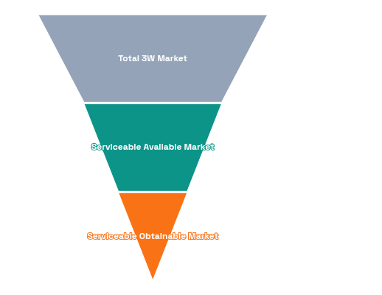




Market Opportunity: Recurring & Growing
Targeting the high-velocity replacement market in India's EV 3W sector
30 Lakh+
Current E-Auto Installed Base
₹11,250 Cr
Replacement TAM (Annual)
2-3 Years
Battery Replacement Cycle (Recurring Demand)
~1.2 Million
New 3W Additions by FY'27
UP, WB, Bihar, NCR
Focus Geography (High Density)
2.5 - 3 Lakh
Growth Drivers
Batteries for Recycling/Year
Commercial Usage: Lowest TCO/km vs ICE vehicles drives rapid adoption.
Policy Push: FAME subsidies & PLI schemes accelerating manufacturing.
Financing Gap: 90% informal lending creates massive structured credit opportunity.
Source: Vahan Dashboard, Industry Reports, Chargeup Estimates
04

Slide 5







The Solution: iTarang Platform
Three integrated pillars turning batteries into programmable financial assets
Smart Battery
Telemetry
Intelligent Risk
Evaluation Engine
Lifecycle Asset
Management
IoT-Enabled: Real-time tracking of State of Health (SOH) & Charge (SOC).
Behavioral Scoring: Underwriting based on usage behavior, not just credit history.
Remote Control: Immobilization capabilities for secure asset recovery.
Usage Patterns: Granular data on distance, charging cycles, and temperature.
Fast Decisions: API-first integration for near-instant loan approvals.
Second Life: Automated routing for repurposing based on health data.
Financial Inclusion: Unlocks credit for thin-file drivers via alternative data.
Compliance: Built-in EPR reporting tools for OEMs and partners.
Asset Visibility: GPS tracking ensures the asset never "goes dark".
KEY BENEFIT
KEY BENEFIT
KEY BENEFIT
Eliminates "Blind Asset" Risk
Unlocks Institutional Capital
Maximizes Residual Value
The Core Technology Stack
05

Slide 6






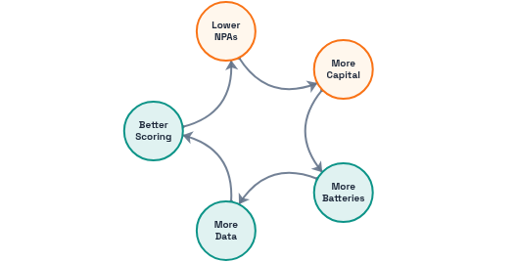


How It Works: Asset-Centric Financing
End-to-end lifecycle management powered by a compounding data engine
Operational Workflow
Driver & Dealer
iTarang Platform
NBFC Partner
Monitoring
Lifecycle Ops
Origination at POS
Telemetry + Risk Score
Decision & Disbursement
Health & Repayment
Recovery & Second Life
AI as Efficiency Layer
The Data Flywheel Effect
1
More Batteries Onboarded
Expanding the install base generates richer, more diverse telemetry data.
2
Smarter Risk Engine
Granular data improves behavioral scoring and default prediction accuracy.
3
Lower NPAs & Higher Trust
Predictable outcomes attract more institutional capital to deploy.
iTarang Ecosystem Architecture
06

Slide 7





Business Model: Clear Revenue Focus
Structured for early cash flow and long-term recurring value
Revenue Stream
Phase / Timing
Unit Economics
Nature of Revenue
Phase 1 (Day 1)
Underwriting Enablement Fee
₹1,500 – ₹2,500
Per approved loan (Upfront)
Cash Flow Engine
Charged to NBFC per loan approved
Phase 1 (Day 1)
Telemetry SaaS Subscription
₹200 – ₹300
Per battery / month
High Margin ARR
Recurring fee for data & monitoring
Phase 2+
Collection Infrastructure Fee
~1% – 2%
Of AUM collected
Volume Upside
Platform-facilitated repayment
Phase 2+ (Year 3)
Lifecycle Recovery Margin
₹3,000 – ₹8,000
Per asset (Resale/Recycle)
Regulatory Moat
End-of-life value capture
Strategic Sequencing Rationale
We prioritize Underwriting Fees + SaaS to generate immediate cash flow and high-margin recurring revenue. Lifecycle revenue builds a long-term "regulatory moat" as EPR compliance tightens, creating back-ended upside without front-loaded CAPEX.
QUERY #1 ADDRESSED
Asset-Light Fee & SaaS Model
07

Slide 8






Unit Economics: Per Battery
Profitable unit metrics from Day 1 with compounding lifecycle value
Query #2 Addressed
Gross Margin
Lifetime Revenue (3 Years)
Direct Costs (Per Unit)
~65-70%
₹2,000
₹1,000
Excluding Lifecycle Upside
Underwriting Fee (Year 1)
Upfront per loan
IoT Hardware
Amortized cost
Telemetry SaaS (18 Mo.)
₹4,500
Dealer Origination
₹650
₹250/mo × 18 months
Partner incentive
Market Context
~₹1,100
₹300
Typical e-rickshaw battery loan is ~₹49,000 @ 17.5% p.a. for 18 months. Without iTarang's intelligence, lenders face thin margins due to high NPAs. Our platform improves risk-adjusted returns by 30-40%.
Collection Fee (1.5%)
% of AUM collected
Platform Ops (Cloud)
Data storage/compute
Lifecycle Margin (Year 3)
₹4,000 - ₹8,000
Support & Maintenance
₹500
Resale / Recycling
Service allocation
~₹11,600 - ₹15,600
~₹2,450
Total LTV
Total CAC + COGS
Estimates based on current pilot data & market rates
08

Slide 9












Competitive Landscape
Unique positioning at the intersection of asset intelligence & lifecycle compliance
Player
Asset Focus
IoT & Risk Tech
Lifecycle / EPR
Business Model
Query #5 Addressed
iTarang's Whitespace
iTarangUnified Platform
Battery-First
Behavioral Score
Full EPR Suite
Fee-Based Tech
Lifecycle Integration: Only player connecting origination with EPR compliance & second-life routing.
ChargeupDriver Platform
Driver-First
Digital Twin
Not Core
B2C Financing
Fee-Based Model: Tech enabler for NBFCs, not a balance-sheet heavy lender like Revfin.
RevfinEV Lender
Vehicle-First
Psychometric
Lending Book
Asset-Centricity: Focus on the battery as a programmable financial asset vs. driver profiling.
Battery SmartSwapping Infra
Network-First
Asset Tracking
Swapping Fees
Market Validation
Attero / LohumRecyclers
Material-First
Processing
Material Recovery
Chargeup's Success: ₹20 Cr ARR & 7k+ drivers proves the segment pays for tech-enabled financing.
Unit Economics Advantage: iTarang's asset-light model targets ~65% gross margins vs. OpEx-heavy B2C models.
Strategic Positioning Analysis
09

Slide 10




Regulatory Landscape
Query #6 Addressed
Navigating compliance with built-in mitigation strategies
Battery Waste Management Rules (2022)
Strong Tailwind
RBI & Lending Framework
Operational Risk
EPR Mandate: OEMs must ensure collection & recycling of end-of-life batteries.
FLDG Cap: First Loss Default Guarantee capped at 5% (RBI 2023 guidelines).
Recycling Targets: 70% recovery (FY24-25) ramping to 90% (FY26+).
Lending License: Operating as a lender requires NBFC registration and capital adequacy.
Recycled Content: Mandatory ~20% recycled material in new batteries by FY30.
Strategic Pivot
iTarang operates as a Technology Service Provider (TSP), earning fees rather than taking balance sheet risk. We enable NBFCs, we don't compete with them.
iTarang Advantage
Our lifecycle tracking module becomes essential compliance tooling for OEMs, creating a "regulatory moat."
Data Privacy & Devices
Compliance
DPDP Act (2023): Strict consent requirements for personal data processing.
BIS Certification: Mandatory safety standards for all IoT hardware.
Mitigation Strategy
Consent-first onboarding flow + Exclusive procurement of BIS-certified hardware partners.
FY24
FY25
FY26+
FY30
Compliance Roadmap
70% Recovery
80% Recovery
90% Recovery
20% Recycled Content
Regulatory environment creates net-positive demand for lifecycle data
10

Slide 11






GTM Strategy: 3-Layer Execution
Query #3 & #7 Addressed
Phased rollout focused on Batteries Under Management (BUM) vs. vanity metrics
01
Dealer Network
Target
Offer
Goal
Months 1-6
20-30 Key EV Dealers in UP/NCR
POS Integration + Referral Fees
Origination Pipeline
02
NBFC Integrations
Target
Offer
Goal
Months 3-9
2-3 EV-focused NBFCs
API Risk Score + Real-time Monitoring
Capital Throughput
03
Data Flywheel
Target
Mechanism
Goal
Network Effects
Telemetry → Better Risk Score → Lower NPA
Defensible Moat
Month 6+
Execution Milestones
Metric: Batteries Under Management (BUM)
Phase 1 (0-12 Months)
Phase 2 (12-24 Months)
Phase 3 (24-36 Months)
~3,000 BUM
~25,000 BUM
90 Cities
Foundation
Scale
National
3 Cities • 20 Dealers • 2 NBFCs
15 Cities • 100 Dealers • 5 NBFCs
Private Labels • >1M Data Points
Focus on unit economics and operational density over aggressive market share claims
11

Slide 12









Traction & Validation
Early execution signals backed by clear category validation
Current Status
Category Validation
NBFC Partners
Dealer Network
2 LOIs
20+ Active
Competitor Benchmark: Chargeup
₹20 Cr
7,000+
EBITDA+
In Pipeline
Onboarded
ARR
Drivers
Profitability
Pilot Battery Assets
Recovery Rate
Market Signal: Mufin Green Finance
~150 Units
98%
Rapidly growing battery-only loan book confirms strong demand for unbundled asset financing.
Live Monitoring
Early Data
"The market is proven. The next winner will be the one who owns the asset lifecycle data, not just the customer interface."
Tech Readiness (MVP)
Telemetry Module
Dealer Portal
Loan Processing
Risk Engine v1
Post-Raise Objective
Convert LOIs into 3,000 Batteries Under Management within 12 months
Early traction signals de-risk the execution path
12

Slide 13





Roadmap: 36-Month Plan
Clear path from foundation to national scale & product depth
Phase 01
Phase 02
Phase 03
Foundation
Scale
Product Depth
0 - 12 Months
12 - 24 Months
24 - 36 Months
MVP Platform Live
15 Cities Operational
National Footprint (90 Cities)
2 NBFC API Integrations
100 Dealer Network
Private Label Launch
3 Cities Launched
Launch i-Distribution
Deep EPR Tooling
Core Team Hired
Lifecycle Ops Active
Second-Life Partnerships
Key Metric
Key Metric
Key Metric
~3,000 BUM
~25,000 BUM
>1M Data Points
Expected Outcomes
De-risked Unit Economics
Repeatable GTM Playbook
Compounding Data Moat
Systematic scaling from pilot to platform dominance
13

Slide 14











Team & Organization
Query #9 Addressed
Structured for execution velocity and risk management
CEO / Co-founder
CTO / Co-founder
{Founder Name}
{Founder Name}
Vision & Fundraising Strategy
IoT Platform Architecture
NBFC & Dealer Partnerships
Risk Engine & Data Pipeline
Regulatory Compliance Lead
Security & Privacy (DPDP)
Head of Partnerships
Credit & Risk Head
City Ops Leads (x2)
Advisory Board
Driving NBFC integrations and expanding dealer/OEM alliances network.
Designing underwriting models, scorecards, and managing portfolio NPA.
Executing ground operations: dealer onboarding, device installs, and logistics.
NBFC Veteran
Lending Strategy
EV Industry Expert
Market Dynamics
Fintech Investor
Key Hire
Key Hire
Key Hire
Growth & Scale
Building deep domain expertise across finance, tech, and operations
14

Slide 15

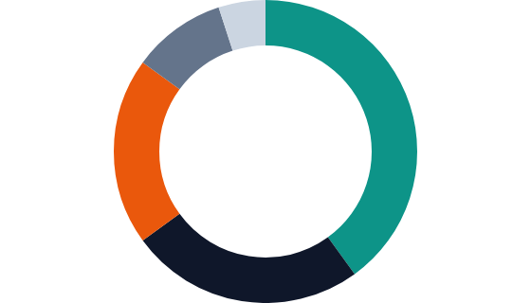



Use of Funds & Milestones
Query #8 Addressed
Deploying capital to achieve Series Seed readiness within 12 months
Milestones Unlocked (≤12 Months)
3,000 Batteries Under Management
Achieving critical mass of data points to validate risk models.
₹8 Cr
Primary KPI
Total Raise
2 NBFC API Integrations
Live data pipe with lending partners for automated underwriting.
Product Validation
3 Cities Live Operations
₹3.2 Cr
Proving the GTM playbook works across different geographies.
Tech / MVP
Market Proof
IoT platform, risk engine, apps
40%
Team
₹2.0 Cr
CTO, BD, Risk, Ops leads
25%
Working Capital
₹1.6 Cr
IoT hardware, dealer activation
20%
GTM & Expansion
₹0.8 Cr
3 cities, 20 dealers
10%
Regulatory/Ops
₹0.4 Cr
Outcome: Series Seed Ready
Investable Asset
BIS, DPDP compliance
5%
De-risked unit economics + Proven scalability
Clear capital allocation strategy focused on metric validation
15

Slide 16











"
The Ask & Vision
Building the credit rails for India's EV economy
Funding Ask
"iTarang isn't just financing batteries. We are building the **Battery Passport** and intelligence layer that makes the entire EV circular economy bankable."
₹8 Crore
Pre-Seed Round (Equity)
10M+
National
₹10Bn+
12-Month Post-Raise Proof Points
Batteries Monitored
EPR Data Backbone
AUM Facilitated
Batteries Under Management
3,000+
NBFC Integrations
2 Partners
Why Now?
Battery Waste Management Rules (2022) mandate recycling just as 1.2M new e-rickshaws hit the road. The regulatory and market timelines have converged perfectly.
AUM Facilitated
₹15 Cr+
Portfolio NPA
< 2%
founders@itarang.in
www.itarang.in
Let's Build This.
Confidential & Proprietary
16

