Slide 1

Tesla Header Component

Slide 2
How to create a tesla.header.component?
App.vue
props: :greeting
TeslaHeader
TeslaBattery
props
props
props
props
props
TeslaCar
TeslaStats
TeslaCounter
TeslaClimate
TeslaWheels
Notes:
To create a tesla.header.component we will pass a ‘greeting’ property from the App.vue to the tesla.header.component

Slide 3
tesla-header.component
Step1 Create tesla-header.component.vue
Step 2 Import tesla-header.component in App.vue

Slide 4
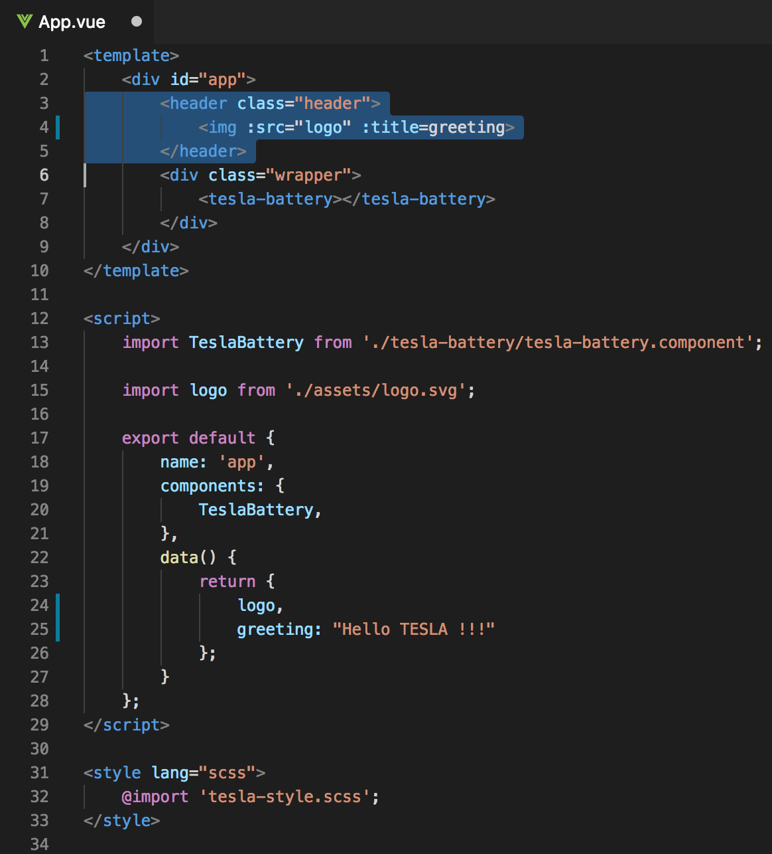
Current App.vue
<img v-bind:src=“logo” v-bind:title=“greeting”>
Notes:
We will store the img src in the data object
To assign the ’logo’ and ‘greeting’ attribute to HMTL tag, we need to use v-bind directive or colon.

Slide 5
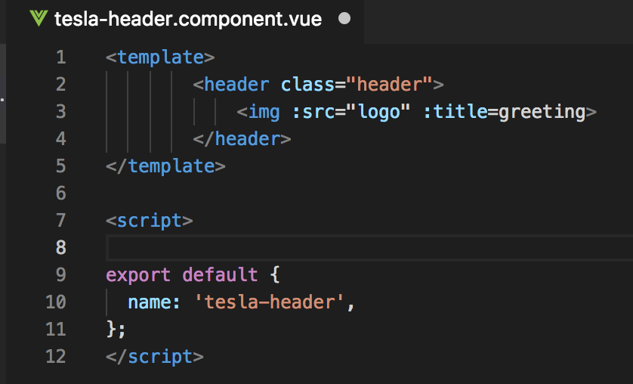
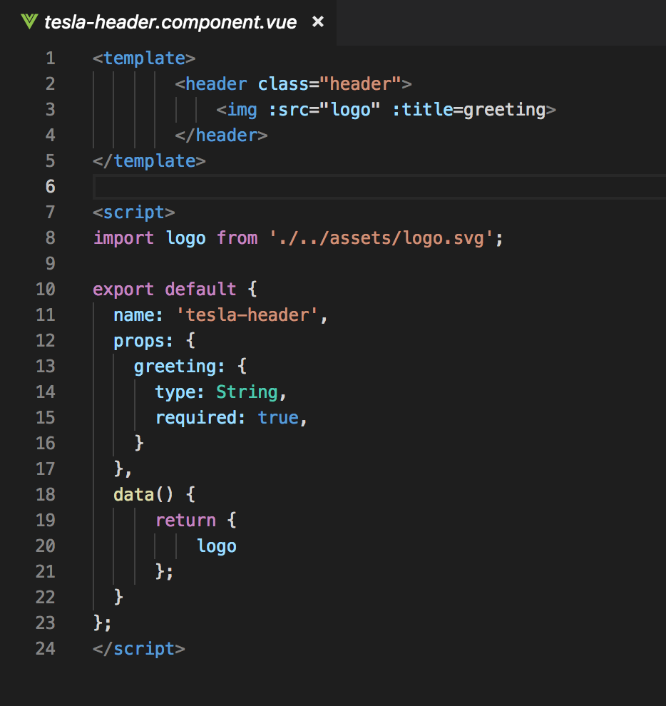
Step1 Create: tesla-header.component.vue
Notes:
Name
Props → logo

Slide 6
Components tree
App.vue
props: :greeting
TeslaHeader
TeslaBattery
props
props
props
props
props
TeslaCar
TeslaStats
TeslaCounter
TeslaClimate
TeslaWheels

Slide 7
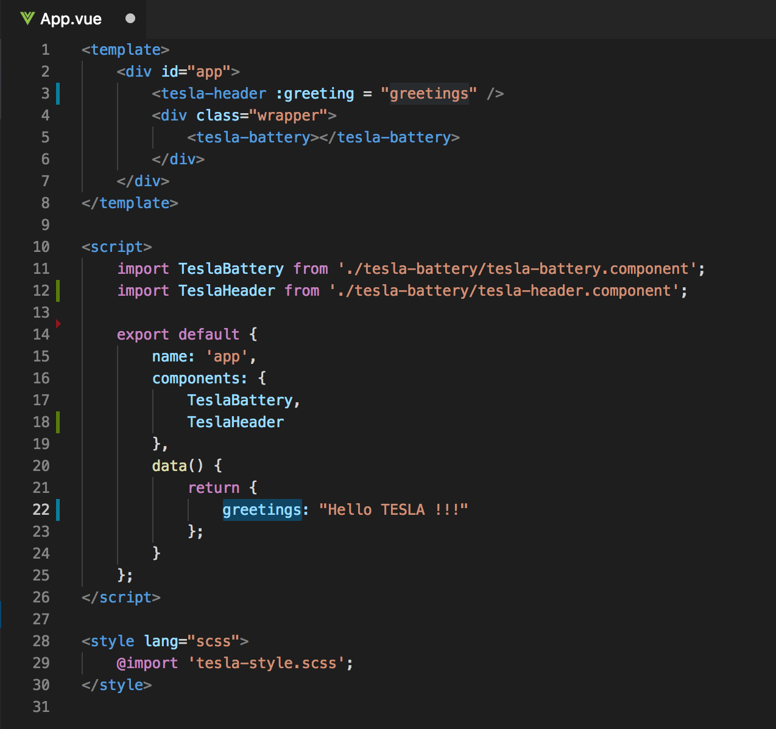
Step 2 Import tesla-header.component in App.vue
Old
New

Slide 8
Getting started
Clone or download:
https://github.com/petereijgermans11/workshop-reactjs-vuejs

