Slide 1
Deep Learning in Physical Layer

Slide 2
Traditional Communication Systems
Complex field with no room for significant performance improvement
Only few ML application adopted in commercial area
Considering communication process individual tasks (Blocks)
There are some challenges :-
Practical imperfections make it difficult to express each block mathematically.
Block structure doesn’t guarantee global optimality.
Robust models and environment change.

Slide 3
Deep Learning Basics
DNN is a layered architecture model taking labelled data (I/O vector pair).
The model is trained to minimize the loss function.
It has two types :-
FNN : each neuron is connected to other neuron in adjacent layers but not in same layer.
DCN is a special case of FNN where only some of the connection are kept to reduce training parameters.
RNN : same FNN structure but layers take their hidden states as additional input.
GAN and conditional GAN to solve lack of data problem (especially in communication)

Slide 4
DL Based Communication
Model-Driven :-
Exploit prior knowledge to reduce the parameters to be learnt (reduced complexity)
Data-Driven (Black Box) :-
General structure with unknown parameters to be trained using large data sets (more general-flexible)
------------------------------------------------------------------------------------------------------------------------------
Block-Structured (traditional):-
Work on a specific part (e.g. receiver)or task (e.g. decoding , demodulation)
End-to-End :-
Learn to encode and transmit over channel and recover signals (treat whole system as single task)
Use especially data-driven methods

Slide 5
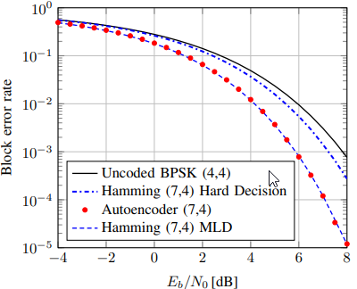
End-to-End Communications
Auto Encoders :
While the goal of most autoencoders is to remove redundancy bits for compression, this autoencoder will often add redundancy to learn a representation robust to channel impairments.
The input is 1-hot vector pass by (FNN with Multi Dense L → normalization L → channel with Additive noise L → FNN with Multi Dense L at receiver → SoftMax activated Dense L) it outputs vector, the received message is highest probability index.
Using SGD on set of all possible messages to train on the loss function (cross entropy).
It could achieve the same BLER of Hamming with MLD.
Auto Encoders for Multiple Transmitters and receivers :
Same as the above but with multi users it starts with dynamic α=0.5.
Using the weighted sum for loss functions of each connection (L= αL₁ + (1- α)L₂).
Throughout training α is proportional with L₁ that will lead to identical BLER for pairs.
It outperforms the time sharing for higher QAM values.

Slide 6
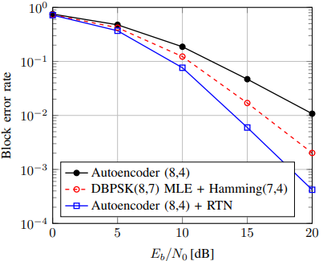
End-to-End Communications
RTN (Block-Structured on End-to-End System) receiver example:-
Augmentation between DL and expert propagation knowledge.
A learned parameter estimator will calculate a parameter vector based on its input.
Using the parameter vector to transform the input then a learned
discriminative network outputs estimated message.
Parameter estimator can be trained on a specific loss function.
Autoencoders + RTN outperforms plain autoencoders and DBPSK MLE + Hamming
CNN for Classification :-
Like Image Classification, A classifier with narrowing convolutional layers followed by dense layers then SoftMax dense layer.
A dataset of 1.2M sequence of baseband signals corresponding to different digital and analog single-carrier modulation schemes over a wireless channel with harsh impairments.
CNN outperforms boosted and single tree but performs the same as boosted tree in high SNR.

Slide 7
Block-Structured Communications
Model-Driven CSI Feedback Compression and Reconstruction :-
Massive MIMO relies on CSI feedback to get high performance from multiple antennas that led to excessive feedback overhead which Compressive Sensing (CS) at user side can reduce it.
However, it was not practical as real-life data are not sparse and it has slow convergence.
Using DCN to learn the inverse transformation to speed-up vector recovery.
CSINet has been made to simulate compression and recovery processes.
It has an encoder that collects compression measurements then pass by convolutional layer followed by dense layer to generate compressed CSI which fed back to the base station.
The decoder learns the inverse transform of compression feedback at the base station.
It outperform the traditional CS-based method in compression ratio and recovery speed.

Slide 8
Open Research Challenges
Lack of Benchmark datasets as it is man-made
Make standard generating methods, set of problems and set of channel impairments.
Data Representation, loss function and training SNR
No optimal data representation so No optimal loss function.
One can train the model at high SNR and reduce it every epoch.
No libraries support complex-valued NN
Represent complex-value as real vector twice the size.
Massive number of message types
Using DL in subtasks not the whole system – Using RTN.
Unknown transfer function preventing backpropagation
We need to find general models for wide range of communications.

