Slide 1
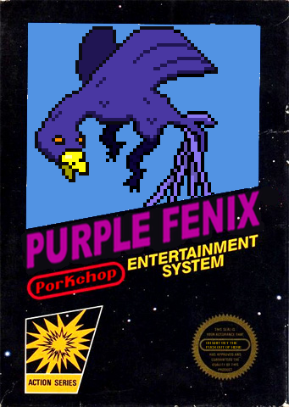
Roberto Caputo Salvatore D’ Agostino
Bronson Zgeb

Slide 2
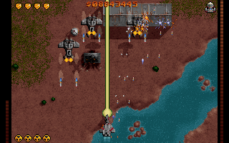
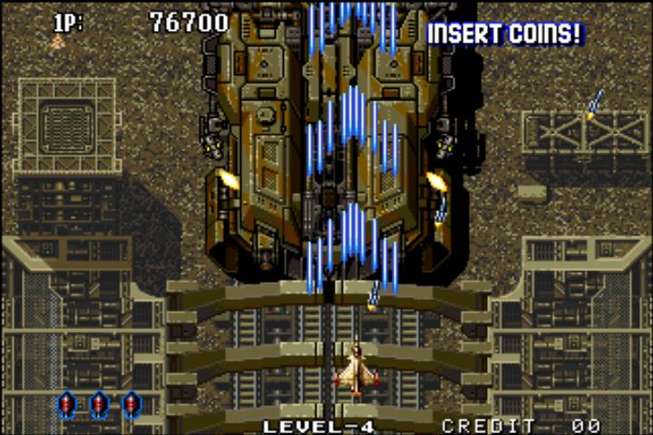
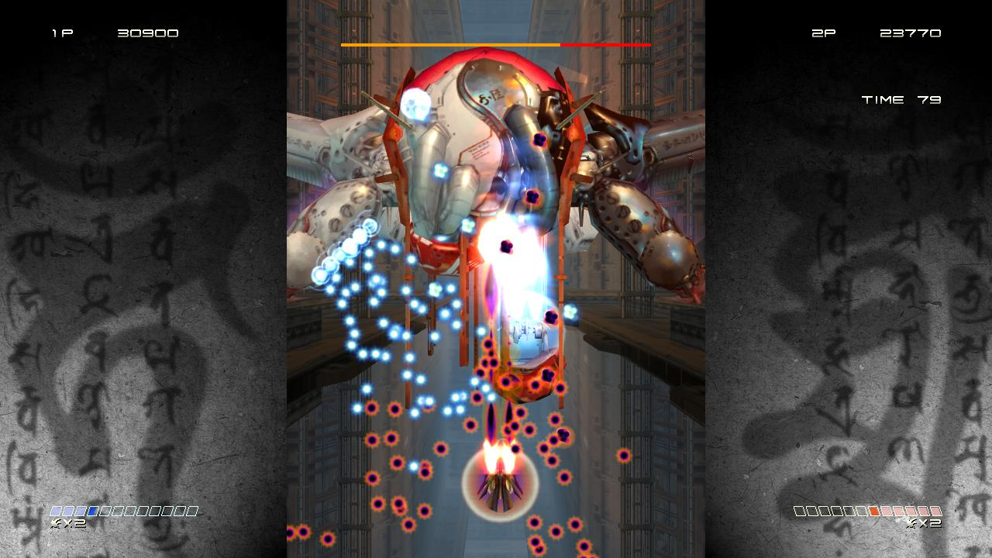

Slide 3
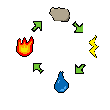
Mechanics
Elemental strengths and weaknesses
Power-ups
Purchasing of upgrades via item shop
4 Player cooperative play
Non-stop Action!!!!

Slide 4
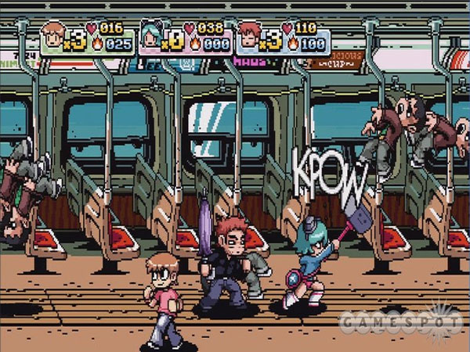
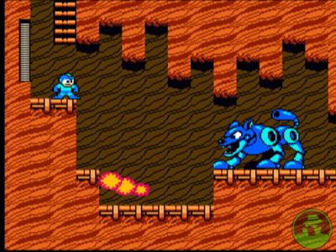
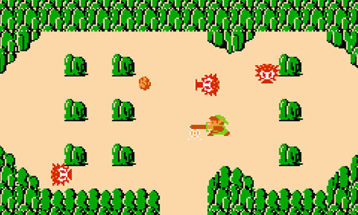
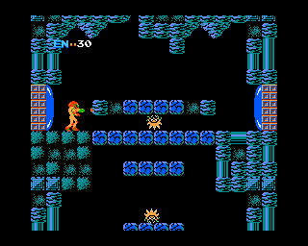
Reference Art

Slide 5

Music
Retro Chiptunes
Music by Anamanaguchi

Slide 6


Future?

Slide 7
Thank you!

