Slide 1
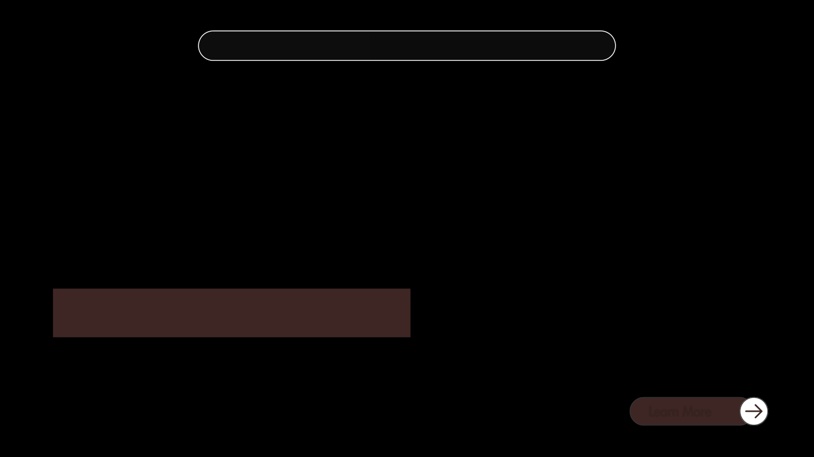

SECURE-RAG
Abstract Introduction Problem Objective Methodology
IMDAI Research
SECURE-RAG
Cybersecurity claim verification
Qwen2.5 3B on the SECURE benchmark
Tulsi Sanskrati Tomar · S24CSEU0084
Twinkle Sahu · S24CSEU0090
Satyajeet Singh · S24CSEU2429
Bennett University
01 / 11
Notes:
I wanted to see whether a small model could read a vulnerability advisory and reach the right verdict. I tested prompts, retrieval and a lightweight training update.

Slide 2
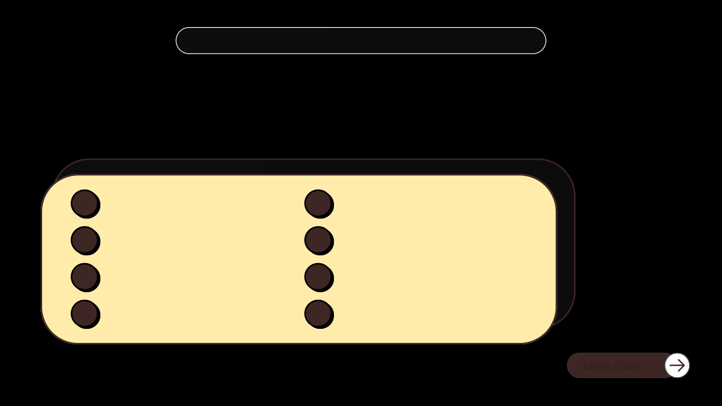
SECURE-RAG
Abstract Introduction Problem Objective Methodology
IMDAI Research
Overview
I tested how a small local model verifies cybersecurity claims and looked at the mistakes it made even when it had the relevant evidence.
01
Abstract
05
Methodology
02
Introduction
06
Results
03
Problem
07
Conclusions
04
Objectives
08
References
02 / 11
Notes:
The presentation moves from the research problem to three experiments, the results and their limits.

Slide 3


SECURE-RAG
Abstract Introduction Problem Objective Methodology
IMDAI Research
Abstract
I evaluated Qwen2.5 3B with different prompts, retrieved evidence and a LoRA adapter. Each experiment had its own dataset and comparison.
Evidence-first prompting helped on vulnerability knowledge questions. Retrieved quotes could still accompany wrong verdicts. The LoRA adapter improved KCV accuracy on validation.
03 / 11
Notes:
The three experiments answer separate questions. The benchmark measures prompting, the 160 claims compare retrieval setups, and matched validation measures the adapter.

Slide 4



SECURE-RAG
Abstract Introduction Problem Objective Methodology
IMDAI Research
Introduction
A cybersecurity advisory describes a vulnerability and how it can be exploited. A claim might say that exploitation requires a user to click a link.
I used SECURE to test whether the model could read the evidence and return the right verdict: true, false, or insufficient evidence.
04 / 11
Notes:
A CVE record describes a known vulnerability. Given a claim about it, the model must decide whether the evidence supports it, contradicts it, or leaves it unresolved.

Slide 5
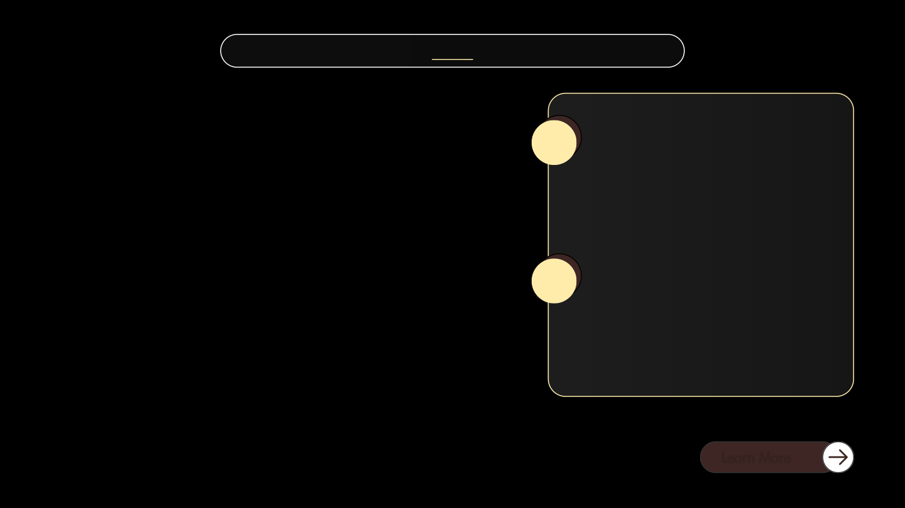

SECURE-RAG
Abstract Introduction Problem Objective Methodology
IMDAI Research
For CVE-2025-41244, the model quoted userInteraction = NONE, then marked “User interaction is not required” as false.
Finding the evidence
01
Retrieval gives the model selected passages. Those passages can omit details available in the full record.
Reading the evidence
02
A quote can match the source even when the verdict contradicts what the source says.
Problem
05 / 11
Notes:
For CVE-2025-41244, NONE means no user action is required. The model quoted that field and still rejected the claim.

Slide 6
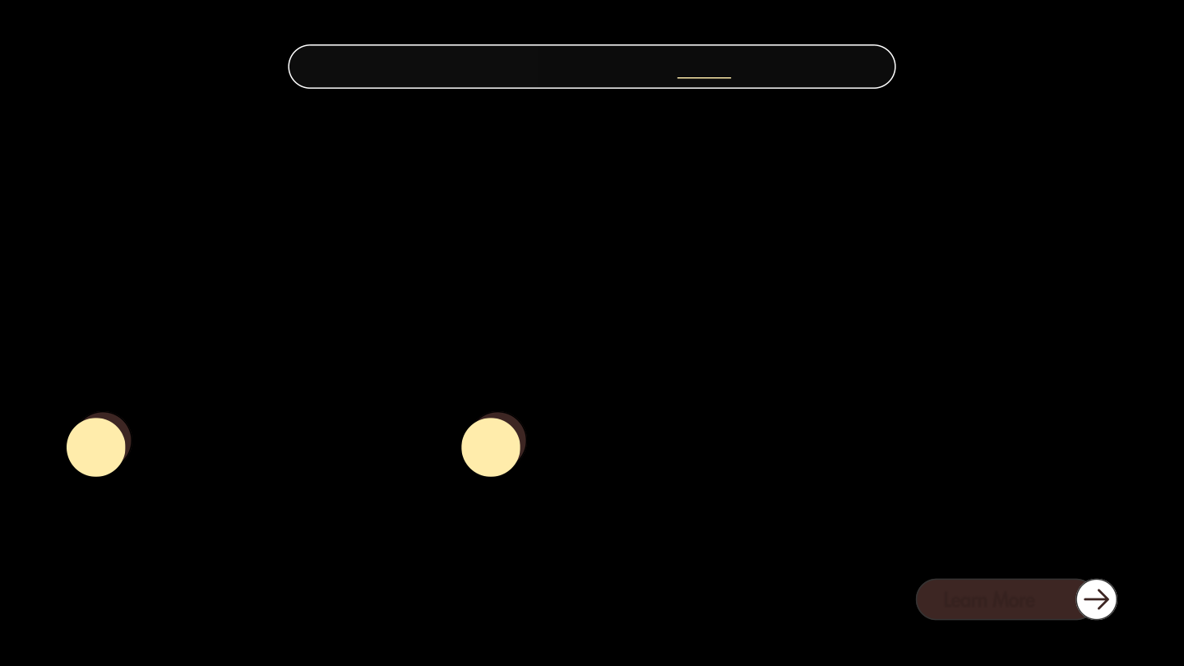

SECURE-RAG
Abstract Introduction Problem Objective Methodology
IMDAI Research
Objectives
I wanted to see which changes helped the model make better decisions about vulnerability claims.
Test prompts and retrieval
Test lightweight fine-tuning
01
02
Measure how prompt changes affect SECURE tasks. Compare full records with retrieved passages and check whether citations agree with verdicts.
Train a small LoRA adapter, then compare it with the same base model on a shared validation split.
06 / 11
Notes:
I tested two ideas: what the model sees or is asked to do, and whether a small amount of training improves its decisions.

Slide 7
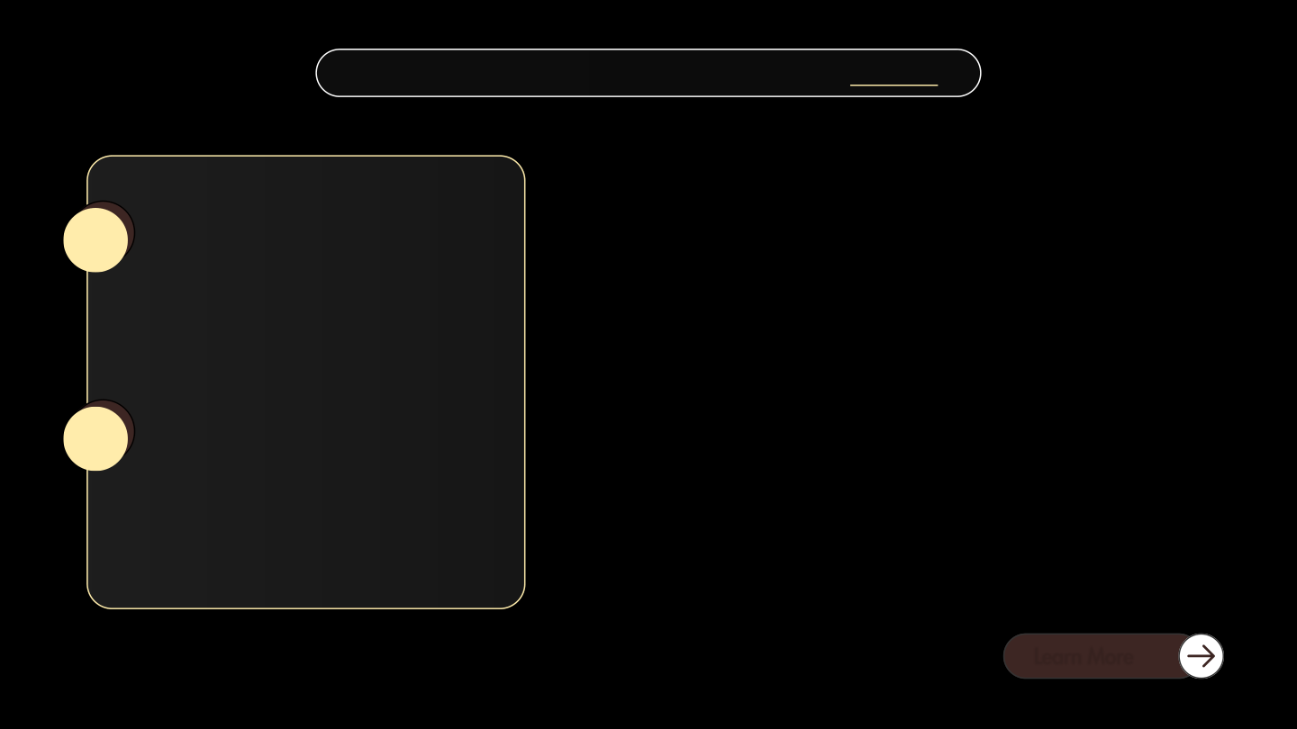

SECURE-RAG
Abstract Introduction Problem Objective Methodology
IMDAI Research
Prompt comparison
01
2,367 examples across six SECURE tasks. I compared the original prompt, evidence-first prompting and self-review.
Retrieval comparison
Methodology
02
160 claims from 40 CVEs. I tested the full record, three retrieved passages, and the same passages with citations requested.
For LoRA, I ran 100 updates using a pool of 262 development examples. I evaluated the same base checkpoint with and without the adapter.
07 / 11
Notes:
I compared the original prompt, evidence-first prompting and self-review. The retrieval comparison used three passages in both retrieval conditions. For LoRA, the base checkpoint, prompts and decoding stayed fixed.

Slide 8
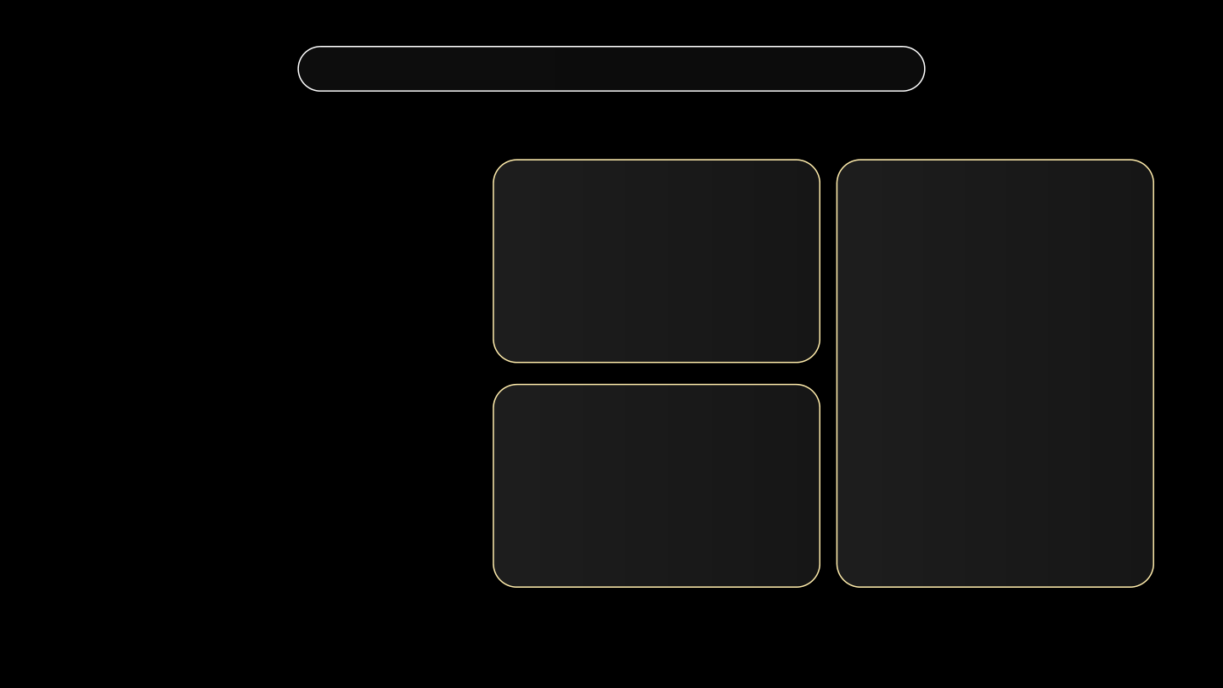
SECURE-RAG
Abstract Introduction Problem Objective Methodology
IMDAI Research
Results
KCV prompt comparison
KCV validation
Original prompt 46.10%
Evidence-first 63.12%
Same 53 examples
47 of 142
Base model
64.15%
answers with matching quotes still gave the wrong verdict.
CVE claim accuracy
Base model + LoRA
Full record 91.25%
Retrieval only 48.75%
Cited retrieval 68.13%
79.25%
A citation check and a verdict check measure different things.
Notes:
The three comparisons use different data. Prompting improved KCV on the benchmark, the full record beat the two retrieval setups, and the adapter gained eight correct answers on matched KCV validation.

Slide 9
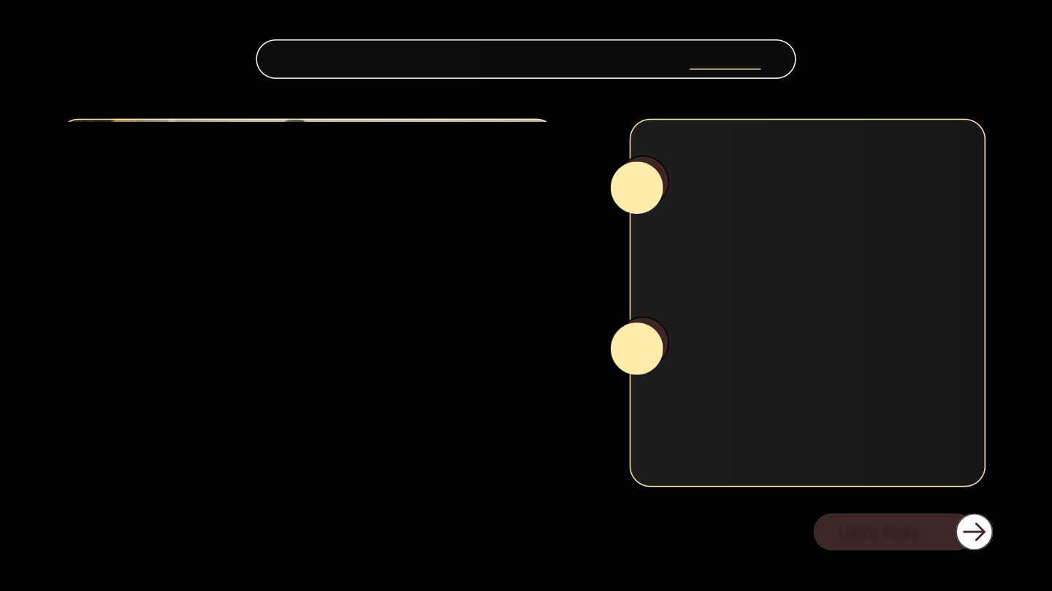

SECURE-RAG
Abstract Introduction Problem Objective Methodology
IMDAI Research
Evidence and verdicts
01
A model can quote the right passage and still misread it. I scored citations and verdicts separately.
Conclusions
Validation and next steps
02
LoRA improved KCV from 34 to 42 correct answers out of 53. An untouched CVE test and repeat runs are still needed.
My contribution was to compare the three changes on a small local model and inspect the errors behind the scores.
09 / 11
Notes:
A matching quote did not establish that the model understood it. The LoRA result comes from a single matched validation run, so generalization remains open.

Slide 10
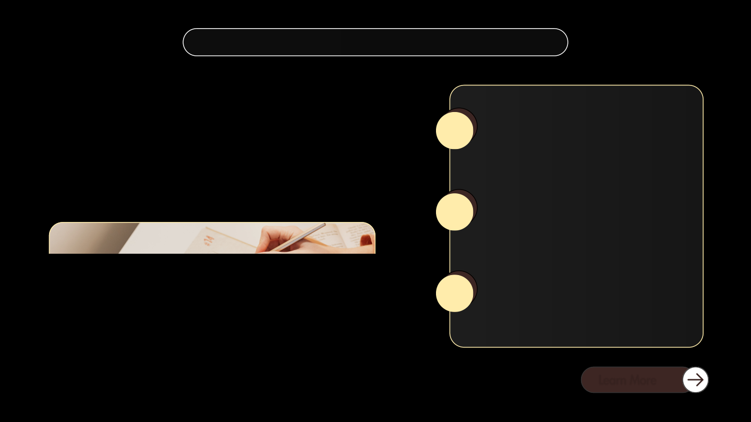

SECURE-RAG
Abstract Introduction Problem Objective Methodology
IMDAI Research
References
Bhusal et al.
SECURE: Benchmarking Large Language Models for Cybersecurity
ACSAC 2024
01
Benchmark and methods used in the study
Lewis et al.
Retrieval-Augmented Generation for Knowledge-Intensive NLP Tasks
NeurIPS 2020
02
Hu et al.
LoRA: Low-Rank Adaptation of Large Language Models
ICLR 2022
03
10 / 11
Notes:
The SECURE paper provides the benchmark. The RAG and LoRA papers describe the underlying methods used in the project.

Slide 11


SECURE-RAG
Abstract Introduction Problem Objective Methodology
IMDAI Research
Thank you
Questions?
Tulsi Sanskrati Tomar · S24CSEU0084
Bennett University
11 / 11
Notes:
I’m happy to explain how I compared the runs, why the citation error matters, or what I would test next.

