Slide 1
💰
Expense
Tracker
Android & Desktop Expense Management Application
Presented by
Najm Yaslam · Ibrahim Aldolaaee · Khalid Alghanemi · Ahmed Alhashedi
Software Project Management · Presentation

Slide 2
OVERVIEW
The Problem & Our Solution
Why this app exists and what it delivers
❌ The Problem
✅ Our Solution
No centralised way to track personal spending
Manual records are error-prone and hard to review
No budget alerts — users overspend without knowing
No role separation — anyone can see everything
No secure login or user account management
Python + Kivy app for Android and desktop
MySQL database — real relational storage
Per-category monthly budget limits with alerts
Role-based access: User vs Admin roles
Secure login with PBKDF2 hashing & lockout
Expense Tracker — Project Presentation
2 / 16

Slide 3
TARGET USERS
Who Uses the System
Two roles with distinct capabilities
👤 Regular User
👑 Admin
Registers and logs in securely
Adds, edits, and deletes expenses
Filters expenses by category
Sets monthly budget limits
Views dashboard with totals & charts
Exports expenses to CSV
Changes their own password
Everything a regular user can do
Views ALL users' expenses
Creates and deletes user accounts
Promotes users to admin role
Unlocks locked accounts
Views full audit log
Sees global spending statistics
Expense Tracker — Project Presentation
3 / 16

Slide 4
WHO WE ARE
The Team
Four developers, one shared vision
NY
IA
KA
AH
Najm Yaslam
Ibrahim Aldolaaee
Khalid Alghanemi
Ahmed Alhashedi
Team Leader
Backend Dev
Frontend / UI
QA / DevOps
Architecture · Database · Coordination
Logic layer · Auth · Security
Kivy screens · Theme · UX
Test suite · CI/CD · Documentation
Expense Tracker — Project Presentation
4 / 16

Slide 5
5 PHASES · ROADMAP
Project Roadmap
Development milestones from MVP to release
# | Phase | Key Deliverables | Owner | Status
1 | Core MVP | SQLite schema, 5 Kivy screens, NavBar, budgets | Full team | Done
2 | Auth & Roles | Login/Register, PBKDF2 hashing, RBAC, Admin Panel | Full team | Done
3 | Security Hardening | Brute-force lockout, audit log, MySQL, DB indexes | Full team | Done
4 | Data Management | CSV export, colourful UI theme, Settings screen | Full team | Done
5 | Polish & Release | Full test suite, CI/CD pipeline, documentation | Full team | In Progress
Expense Tracker — Project Presentation
5 / 16

Slide 6
WHAT WE BUILT
By the Numbers
Measured directly from the project repository
3
2,000+
8
6
Python source files
Lines of Python code
Expense categories
Database tables
60+
2
5
100%
Automated tests passing
User roles (User & Admin)
Kivy screens
Tests passing
Expense Tracker — Project Presentation
6 / 16

Slide 7
HOW IT IS BUILT
Tech Stack
Languages, frameworks, and tools used
📱 Application Layer
Python 3.11 · Kivy 2.3 · Role-based screens · FontAwesome icons
Cross-platform: runs on Android and Windows/Linux desktop
⚙️ Business Logic
logic.py · PBKDF2-SHA256 auth · RBAC · CSV export · Brute-force lockout
Fully separated from UI — testable without Kivy
🗄️ Database
MySQL 8 · mysql-connector-python · 6 tables · InnoDB FK constraints
Parameterised queries throughout — SQL injection impossible
🔧 Tooling & Process
GitHub · GitHub Actions CI/CD · pytest 60+ tests · PlantUML diagrams
Automated test + lint + security scan on every push
Expense Tracker — Project Presentation
7 / 16

Slide 8
THE CORE FLOW
Expense Tracking in 4 Steps
From login to insights — simple and secure
1
2
3
4
Login / Register
Add an Expense
Track & Budget
Analyse & Export
Secure login with PBKDF2 hashing. New users register in seconds. Admins are seeded automatically on first run.
Title, amount, category, date, and optional note. Input is sanitised and validated before writing to MySQL.
Dashboard shows monthly total, per-category bars, and budget progress. Red bar = over budget alert.
Stats screen shows daily breakdown and category charts. Export all data to CSV with one tap in Settings.
Expense Tracker — Project Presentation
8 / 16

Slide 9
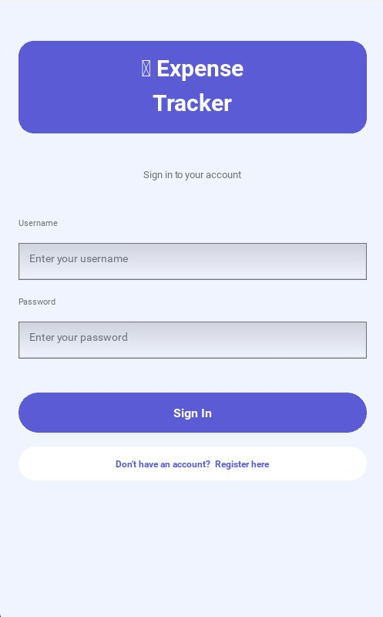
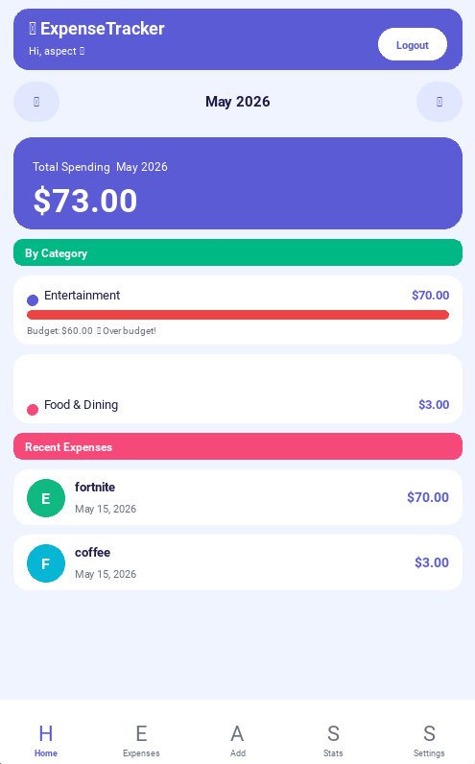
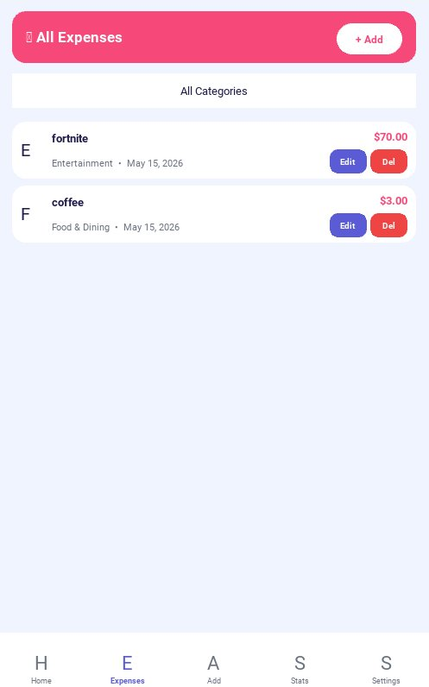
LIVE SCREENS
User Experience
Login · Dashboard · All Expenses
Login — secure sign in
Dashboard — totals & budgets
Expenses — full list
Expense Tracker — Project Presentation
9 / 16

Slide 10
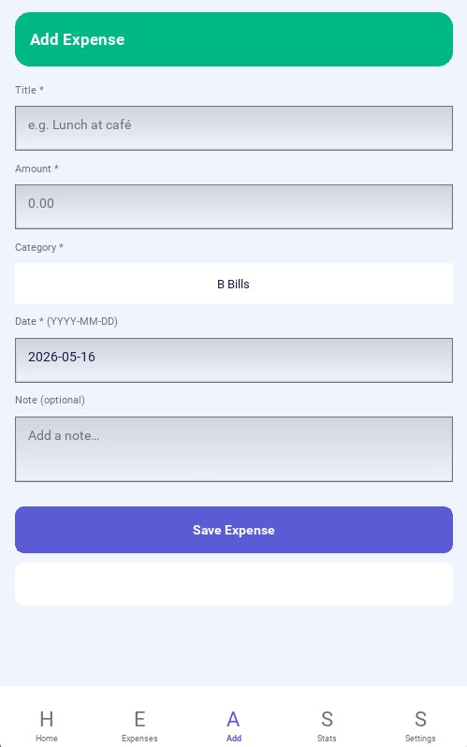
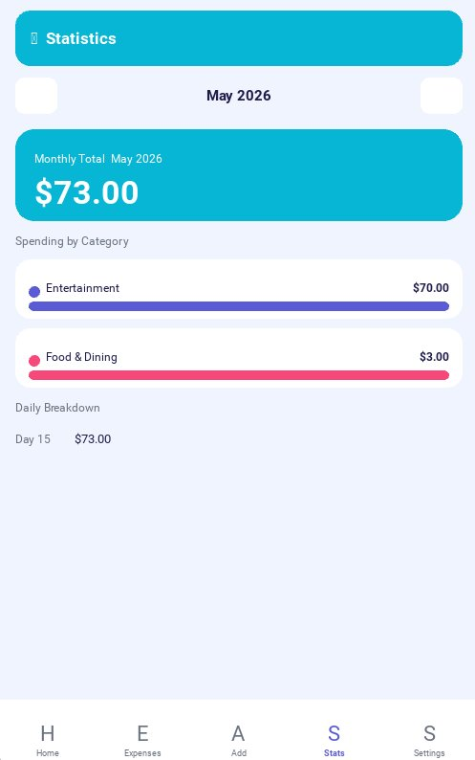
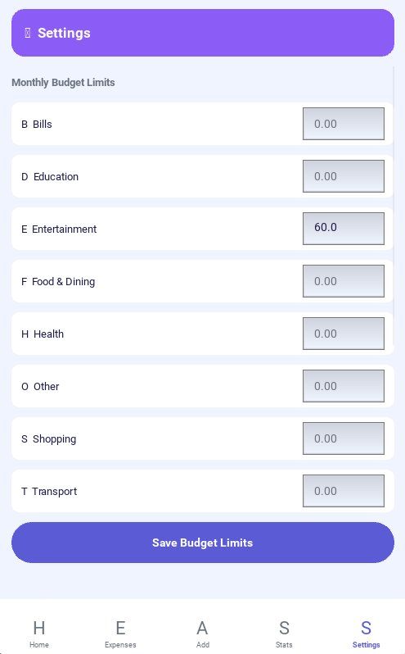
LIVE SCREENS
User Experience
Add Expense · Statistics · Settings
Add Expense — quick entry
Statistics — monthly charts
Settings — budget limits
Expense Tracker — Project Presentation
10 / 16

Slide 11
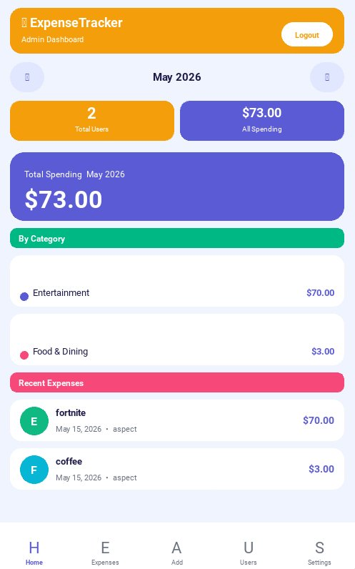
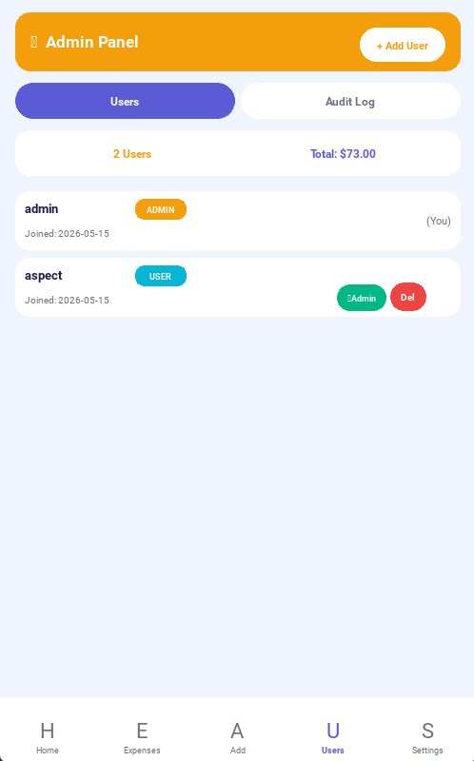
LIVE SCREENS
Administrator Experience
Exclusive screens only admins can access
Admin Dashboard
Admin Panel
Expense Tracker — Project Presentation
11 / 16
Total users, all spending, category breakdown
Manage users, roles, unlock accounts, audit log

Slide 12
SIX CONTROLS IN PLACE
Security in Depth
Every layer is protected
1
Password Hashing
2
Brute-Force Lockout
3
Role-Based Access
PBKDF2-HMAC-SHA256, 260,000 iterations, random 16-byte salt per password. Never stored in plain text.
5 failed logins → account locked for 30 minutes. Remaining attempts shown. Admin can unlock manually.
Every admin function checks is_admin() first. Users see only their own data via _uid() scoping.
4
SQL Injection Block
5
Ownership Checks
6
Audit Log
All queries use %s parameterised statements. User input is also sanitised via sanitise() before DB write.
update_expense() and delete_expense() verify ownership. Users cannot modify another user's records.
Every admin action is recorded: LOGIN, LOCKOUT, CHANGE_ROLE, DELETE_USER, EXPORT_CSV, and more.
Expense Tracker — Project Presentation
12 / 16

Slide 13
IDENTIFIED & MITIGATED
Risk Management
Risks identified, assessed, and resolved
Risk | Level | Mitigation
Weak Password Storage | High | PBKDF2-SHA256 hashing with 260k iterations + unique salt. Password never stored in plain text (logic.py lines 40–55).
SQL Injection | High | All queries use parameterised %s placeholders. sanitise() strips control characters from all inputs (database.py).
Privilege Escalation | High | is_admin() guard on every admin function. Last-admin protection prevents the system losing all admin access.
Brute-Force Attacks | High | Lockout after 5 failures within 30 min. login_attempts table tracks failures. Auto-unlock on expiry.
No Data Backup | Critical | CSV export feature (logic.py lines 350–384). One-tap export from Settings. Audit-logged every time.
Unencrypted Database | High | Migrated from SQLite to MySQL. Data in managed directory. SQLCipher planned for production deployment.
Expense Tracker — Project Presentation
13 / 16

Slide 14
OUR PROMISES
Success Criteria — Achieved
Every goal we set for this project
✓
Register, login, and logout work correctly — session persists in memory for app lifetime.
✓
Expenses are added, edited, and deleted. All data validates before MySQL write.
✓
Budget limits trigger visible over-budget alerts on the dashboard.
✓
Regular users see only their own data. Admins see all — enforced at SQL level via user_id scoping.
✓
Role permissions enforced by is_admin() on every admin function — GUI cannot bypass it.
✓
Password hashing is secure (PBKDF2, 260k iterations). Brute-force lockout protects all accounts.
✓
CSV export produces a correct, downloadable file with all expense data.
✓
60+ pytest tests pass. GitHub Actions CI runs on every push.
Expense Tracker — Project Presentation
14 / 16

Slide 15
WHAT IS NEXT
Future Plans
Enhancements planned for the next version
🔒
📧
📱
SQLCipher Encryption
Email Notifications
Android APK Release
Full AES-256 database encryption at rest for production Android deployment.
Over-budget alerts and monthly summaries delivered via SMTP to the user's registered email.
Buildozer packaging for Google Play distribution with proper signing and permissions.
💱
📊
🌙
Multi-Currency Support
Advanced Analytics
Dark / Light Theme Toggle
Currency selector in Settings — amounts stored in base currency and converted on display.
Year-over-year comparisons, spending trends, and predictive budget recommendations.
User-selectable theme stored in preferences and applied across all screens instantly.
Expense Tracker — Project Presentation
15 / 16

Slide 16
Thank You
We welcome your questions.
Najm Yaslam · Ibrahim Aldolaaee · Khalid Alghanemi · Ahmed Alhashedi
Expense Tracker · Python + Kivy + MySQL · Software Project Management
🔗 github.com/iTxAspect/Expense-Tracker-Project

