Slide 1
Statistical Analysis of IMDB Movie Dataset
Key Findings, Insights, and Implications
Prepared by Arnab Das Utsa

Slide 2
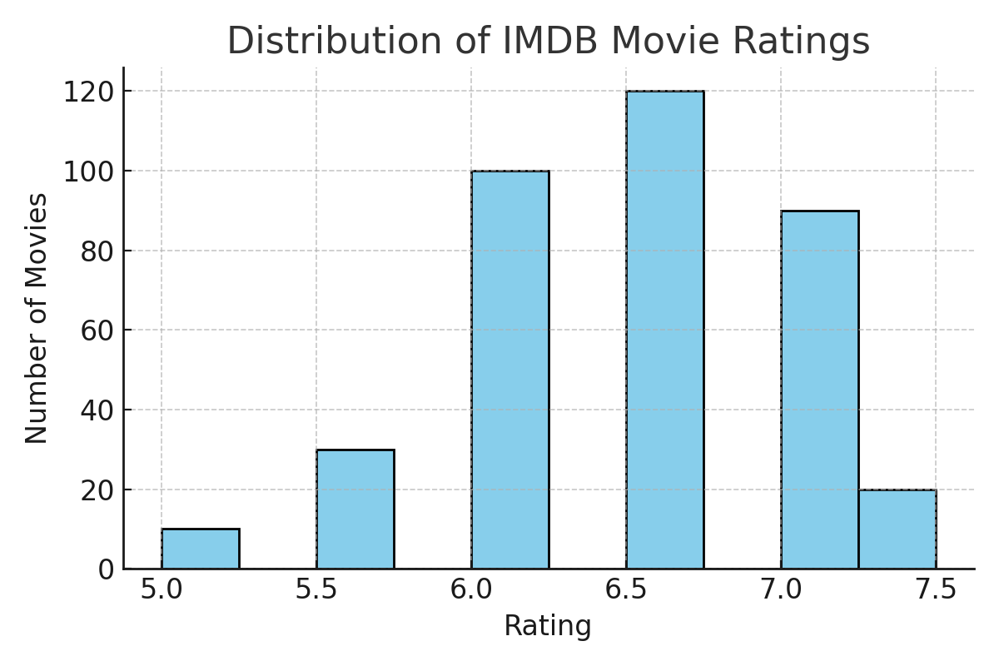
4.1 Distribution of Movie Ratings
• Mean rating: 6.72
• Standard deviation: 0.95
• Rating range: 4.2 to 9.0
Most movies are rated between
6.0 and 7.0.
Over 75% of ratings fall within two
standard deviations of the mean.
Extremely high or low ratings are rare (Tchebysheff's Theorem).

Slide 3
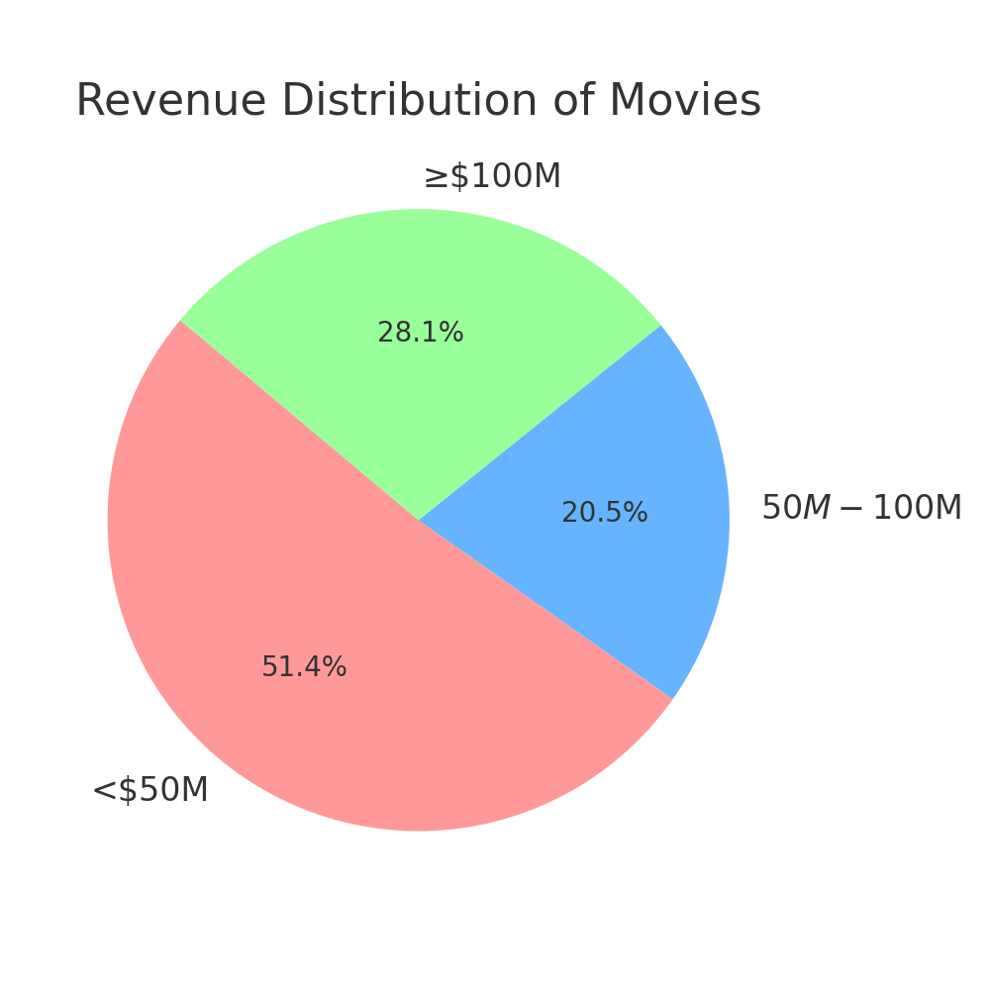
4.2 Revenue Performance and Success Rate
• <$50M: 190 movies (51.35%)
• $50M-$100M: 76 movies (20.54%)
• ≥$100M: 104 movies (28.11%)
Only ~28% of movies surpass
the $100M revenue mark.
Most movies do not achieve
blockbuster-level earnings.

Slide 4
4.3 Genre and Success Probability
Action movies are more likely to succeed.
Action + Drama combinations have the highest success probability.
Set theory and Venn diagrams help visualize overlapping successful genres.

Slide 5

4.4 Probability Models and Financial Success
• Binomial: 30.15% chance of 3 hits in 10 tries.
• Geometric: 10.45% chance of 1st hit on 4th try.
• Hypergeometric: Very low chance of 4 hits in 10 draws.
• Poisson: 13.38% chance of exactly 4 hits/year (avg=6).
Conclusion: Random success is rare. Targeted strategy needed.

Slide 6
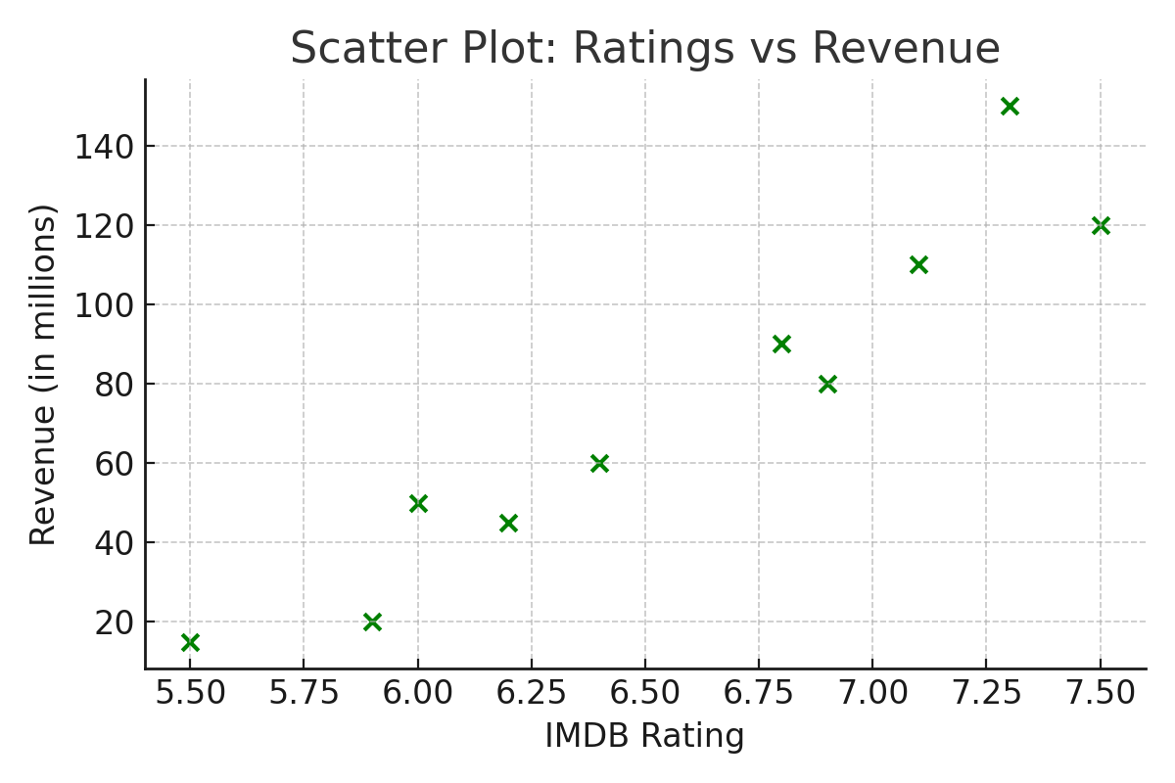
4.5 Rating vs Revenue Correlation
Scatter plot reveals weak positive correlation.
High-rated movies are not always high earners.
Low-rated action
films may still earn big
due to popularity,
marketing, or genre effects.

Slide 7
4.6 Summary of Key Findings
• Majority of ratings fall between 6.0–7.0
• Only ~28% of films earn over $100M
• Action and Action-Drama films most likely to succeed
• High-revenue films rarely occur randomly
• Ratings weakly predict revenue

Slide 8
5.1 Interpretation of Findings
• Strong central tendency in ratings (mean = 6.72)
• Financial success highly selective (28.11% blockbusters)
• Action and Action-Drama best predictors of revenue
• Ratings and revenue not strongly correlated
• Random selection rarely yields multiple successes

Slide 9
5.2 Implications for the Industry
• Focus on Action and Action-Drama films for ROI
• Ratings not sufficient for green-lighting projects
• Use data-driven methods to reduce risk
• Streaming services can refine recommendations using genre + rating combo

Slide 10
5.3 Limitations
• Only ~370 movies studied, no TV shows or global scope
• No data on budget, marketing, or release timing
• Genre tagging on IMDB is inconsistent

Slide 11

5.4 Conclusion
Action-heavy films are the best bet for success.
Moderate ratings are the norm; extreme ratings are rare.
Probability models confirm randomness of success.
Future studies can use ML models for deeper predictions.

