Slide 1



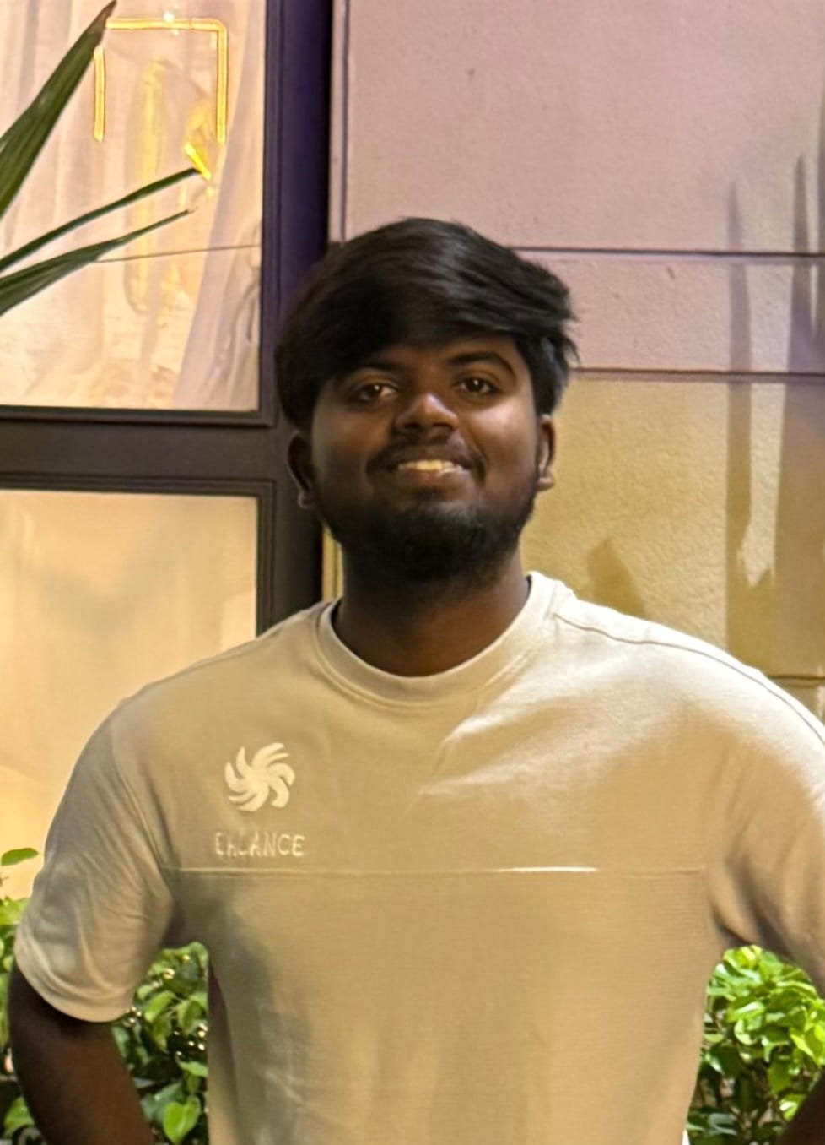
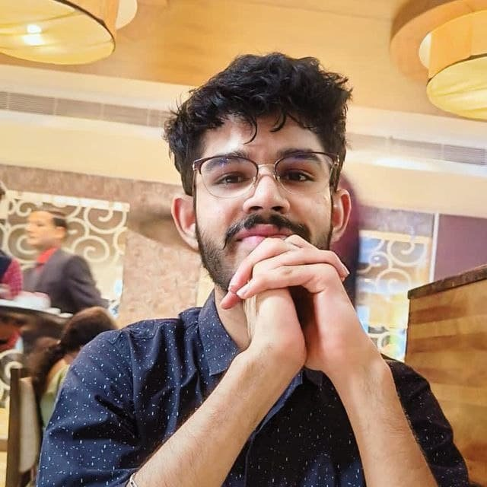


Elevating Indian Football
The Road to FIFA Mission 2047
Proposed by: Catalyst
Jones G
Varun Singhal
Yasmin Almumtazah
Amira SuhaylaPurba
180 DC BIT MESRA
180 DC BIT MESRA
180 DC Univ. Brawijaya
180 DC Univ. Brawijaya

Slide 2



Executive Summary
Situation
India has never qualified for a FIFA World Cup and ranks 127th globally in 2026, worse than its own 1995 ranking of 94th, despite three decades of federation roadmaps.
THE 2046 CONVERGENCE THESIS
Hosting eligibility reopens
Complication
Political Distraction
Fiscal Capital Dilution
AFC's earliest plausible World Cup hosting turn, after Saudi Arabia's 2034 edition, is 2042 at best, more likely 2046 given FIFA's multi-cycle continental rotation.
The government is splitting its strategic focus by actively pushing a 2036 Olympic bid in Ahmedabad, which has already entered the IOC’s "continuous dialogue" phase
Instead of prioritizing the 2030 objectives, national resources are being heavily diverted toward targeting a top-5 medal finish for the Olympics
Qualification becomes realistic
Benchmarked against Morocco, Japan, and South Korea's transformation rates, India's grassroots-to-senior-team pipeline makes 2046 the earliest credible qualification window.
Question
Which single objective should India commit to by 2030, qualification, hosting, or Olympic success, and how should it be funded, sequenced, and hosted?
AIFF's own centenary
Answer
Commit to World Cup qualification via a grassroots–first, data-driven pipeline, fund it in four gated ₹100,000 Cr tranches (2026–2046), pursue hosting only as a
multi-country bid once credibility is proven, and gate every phase with go/no-go milestones.
2047 is Vision 2047's own target horizon. A 2046 qualification push lands exactly one year ahead of it, legacy and delivery arrive together, not staggered.
4
Registered Players Per 1,000 population ∼ Today
2046
Earliest Realistic Qualification Year ∼ Our Target

Slide 3
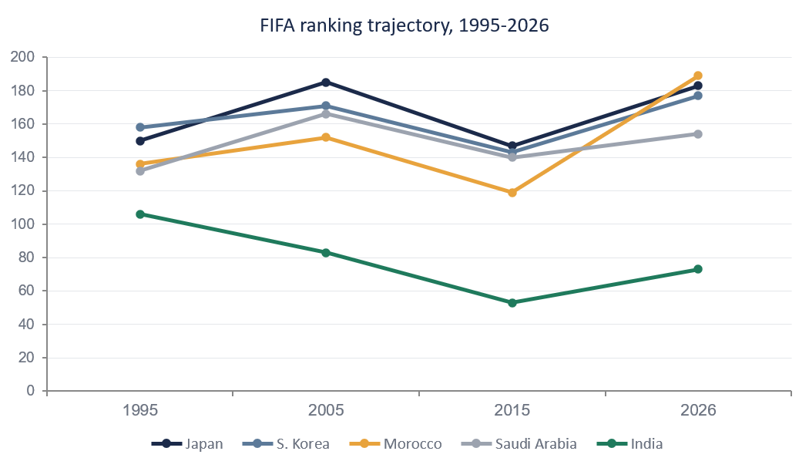





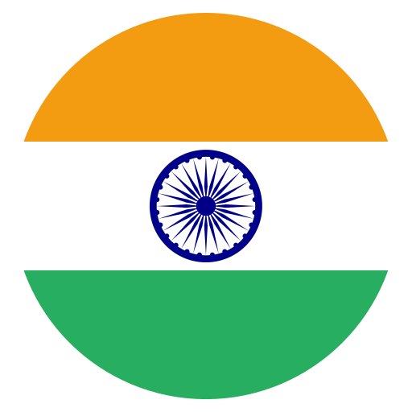
CONTEXT
DIAGNOSIS
ECONOMICS
OPERATIONS
IMPROVEMENTS
QUANTIFYING THE GAP
FIFA Ranking Trajectory (1995-2026)
Country
Players
Root Causes
83
Fragmented administration across AIFF and state associations, with a history of governance breakdowns
No data-driven talent identification pipeline, scouting relies on informal, hyper-local networks
Inconsistent grassroots coaching standards nationwide
Lack of a competitive youth fixture calendar to season young players before senior level
46
38
127
FIFA Ranking (127th,higher=worse)
4
Registered Players Per 1,000 (vs 18-83 abroad)
31
18
7
Suitable Stadiums
(of 12-16 needed)
9
Sponsorship Share%
(vs cricket 80-85%)
4

Slide 4
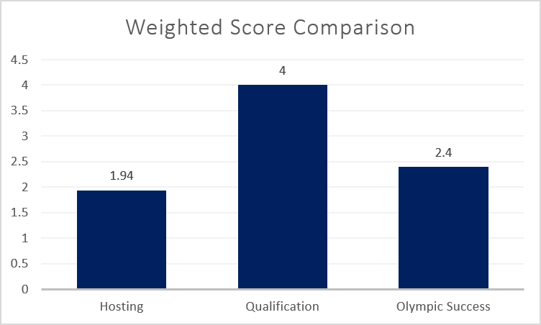
CONTEXT
DIAGNOSIS
ECONOMICS
OPERATIONS
IMPROVEMENTS
CHOOSING THE 2030 PRIORITY
Qualification wins on a weighted scoring basis, not by elimination alone
Criterion (weight) | Hosting | Qualification | Olympic Success
Feasibility by 2030 (30%) | 1 | 3 | 4
Compounding value to 2046 (25%) | 2 | 5 | 1
Capital efficiency (20%) | 1 | 4 | 2
FIFA mandate fit (15%) | 5 | 5 | 1
Institutional readiness (10%) | 2 | 3 | 4
Weighted total | 1.95 | 4.00 | 2.40
THE TRADE-OFF JUDGES WILL LOOK FOR
Olympic success scores respectably on feasibility and institutional readiness, India is already in the IOC's "continuous dialogue" phase for Ahmedabad 2036, with a final decision due by mid 2029 and a stated top-5 medal-table ambition (vs. 71st-place, six-medal finish at Paris 2024). It loses on compounding value and FIFA-mandate fit, but it will keep competing for the same sponsorship pool and political bandwidth football needs.
KEY TAKEAWAY
Qualification isn't the "safe" or "obvious" choice — it wins because it's the only objective whose investment compounds toward every later milestone (hosting credibility, sponsorship share, the 2047 legacy), even though Olympic success is currently more politically funded.

Slide 5
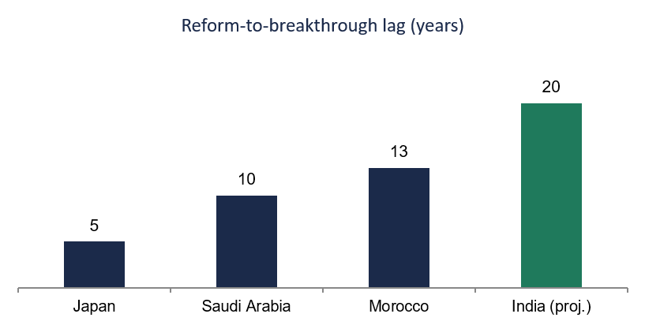
CONTEXT
DIAGNOSIS
ECONOMICS
OPERATIONS
IMPROVEMENTS
WHEN CAN INDIA REALISTICALLY QUALIFY
Country | Reform Trigger | Breakthrough | Lag
Japan | J-League professionalized, 1993 | First World Cup,1998 | 5 yrs
Saudi Arabia | Vision 2030 launched, 2016 | Qualified for 2026 | 10 yrs
Morocco | Academy founded, 2009 | WC Semi-Final, 2022 | 13 yrs
India | Proposed Start, 2026 | Projected | ∼ 20 yrs
India's starting gap (4 players/1,000) is larger than any comparator's starting point — averaging their lags would understate the timeline
Scenario | Logic | Year
Bull | Japan's pace, adjusted for India's larger gap | 2042
Base (recommended) | Two full cycles: density building, then competitive conversion | 2046
Bear | India repeats its 2014-2026 pattern: no grassroots reform | Beyond 2050
Earliest realistic qualification year: 2046
A straight average of Japan, Saudi Arabia, and Morocco puts India at ~2036 — we reject that number because none of them started 4x below the next-lowest comparator's density.

Slide 6
CONTEXT
DIAGNOSIS
ECONOMICS
OPERATIONS
IMPROVEMENTS
FIFA WORLD CUP HOSTING STRATEGY
A multi-country hosting model enables India to close its infrastructure gap while accelerating long-term football development.
Current Condition (India)
World Cup Hosting Cost
FIFA Requirement
Current Condition (India)
12–16 host stadiums
4-5 FIFA-ready stadiums
≥80,000-seat final venue
Na-Mo Stadium, India's largest, is cricket-centric and not football-eligible
60+ training facilities
Significant infrastructure gap
Why Multi-Country Hosting?
Key Takeaway
Reduce the need for 7–11 new stadiums.
Share infrastructure costs and invest more in football development.
Replicate the successful 2026 and 2030 co-hosting model.
A multi-country bid is India's most realistic pathway to host the FIFA World Cup while preserving financial resources to build a stronger football ecosystem for the future.

Slide 7
CONTEXT
DIAGNOSIS
ECONOMICS
OPERATIONS
IMPROVEMENTS
FUNDING THE PLAN​
Category | Wave 1 | Wave 2 | Total
Grassroots and Talent ID Closes the widest gap in the diagnosis (4 vs 18-83 players/1000). | 28,000 | 6,000 | 34,000
Coaching and Elite Performance Converts grassroots volume into senior-team quality. | 16,000 | 6,000 | 22,000
Infrastructure 81% backloaded to Wave 2- scales only once the pipeline is proven. | 3,000 | 13,000 | 16,000
Sports Data and Analytics Split evenly—fixes the 'no data-driven scouting' root cause. | 8,000 | 8,000 | 16,000
Governance and Sponsorship Smallest share, but –--Rs. 4-5cr lands first--- everything else is gated on it. | 8,000 | 4,000 | 12,000
Wave Total ( ₹ Crore) | 63,000 (63%) | 37,000 (37%) | 100,000
₹100,000 crore · 20-year horizon · 2026 – 2046
Sequencing: front-load ~₹4,000-5,000 cr of governance reform into 2026-2029, ahead of the rest of Wave 1 — an institution that can't manage ₹50 crore without a deficit can't absorb ₹34,000 crore without administrative reform first.
100×
₹35/person
AIFF's current annual budget (~₹50–60 cr/yr)
per Indian · per year · over the full 20-yr program
Govt 50
Illustrative funding mix (suggested, not sourced)
Govt 50%
CSR 30%
Grants 20%
Government (Sports Ministry + states) · Corporate CSR / sponsorship · FIFA/AFC development grants
Governing thought: under ₹35/person/year — the constraint is absorption capacity, not money.

Slide 8
CONTEXT
DIAGNOSIS
ECONOMICS
OPERATIONS
IMPROVEMENTS
THE ROADMAP TO 2046
Two waves · five checkpoints · qualification-first strategy
2046
2046 · Target milestone
Qualification & hosting bid readiness
2040 · Checkpoint two
2040
Players 20+/1,000 · Ranking top 60–70
⚠ Not competitive at 3rd-round level → retarget as infrastructure legacy
2036
2036 · Wave 2 begins
Infrastructure scale-up starts
2030
2035 · Interim checkpoint
Players 15+/1,000 · Ranking top 90–100
⚠ No continental competitiveness → shift to legacy narrative
2026
2030 · Checkpoint one
Players 4→8–10/1,000 · Ranking sub-115
⚠ Miss both → re-scope the whole timeline
2026 · Mission launch
Wave 1 grassroots begins · Baseline: 4 players/1,000

Slide 9





CONTEXT
DIAGNOSIS
ECONOMICS
OPERATIONS
IMPROVEMENTS
WHAT COULD BREAK THIS
India's actual track record is stop-start — ISL launched 2014, ranking still fell.
The 2036 Olympic bid absorbs political attention and sponsorship capital.
AFC's hosting rotation could shift the 2042/2046 window.
A 20-year plan spans ~4 election cycles — priorities can shift with each government
Likelihood: High
Impact: High
Likelihood: Medium
Impact: High
Likelihood: Medium
Impact: Medium
Likelihood: High
Impact: High
Ring-fence the ₹100,000 crore as a separate mandate from Olympic-bid budget lines.
The qualification-first strategy still pays off even if hosting timing slips.
Structure funding through an independent statutory trust, insulated from political turnover.
Tie each funding tranche to the roadmap's checkpoints, not a blank multi-decade cheque.

Slide 10
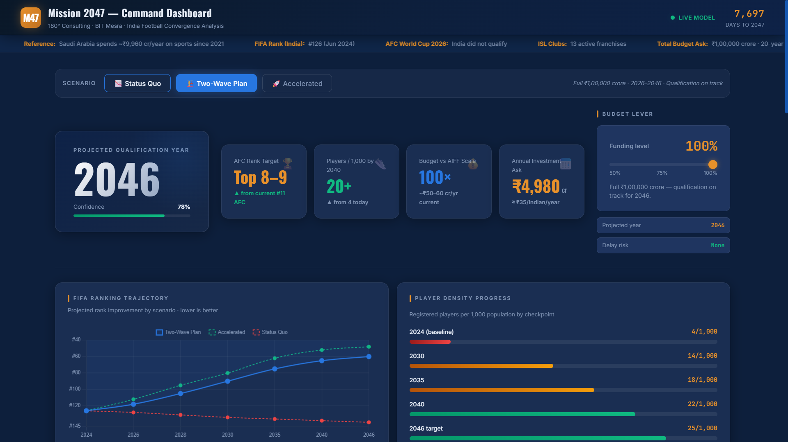

Slide 11
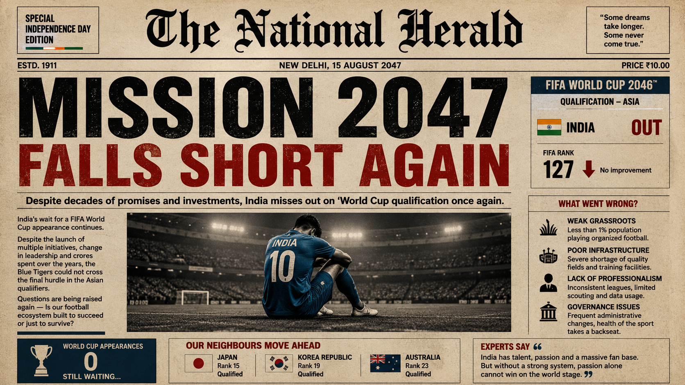

Slide 12
