Slide 1
Sustainability Capstone:
Decarbonising Travel
A data-driven roadmap to cut business travel emissions using Celonis Process Intelligence
Speaker name: Varun Singhal
Institute: Birla Institute of Technology, Mesra
Branch & Year of Study: 2 Year
Email ID: varunsinghal2006@gmail.com ied10021.24@bitmesra.ac.in

Slide 2
Executive Summary
Celonis' fictional travel program generated 178,090 tonnes of CO2e across 65,289 trips last year, at a total spend of $140.5M — with 18% of trips booked out of policy.
Results at a Glance
Top 3 Recommendations
Why this matters for 2030:
Business travel is Celonis' largest source of Scope 3 emissions and one of the hardest categories to decarbonize, since it's driven by individual booking decisions rather than fixed infrastructure. Closing the gap between "policy" and "practice" — visible directly in our 18% out-of-policy rate and the 54% process deviation rate — is the fastest lever available before 2030.
Oceania is your single highest-emitting region despite being one country — a concentration risk, not a spread-out problem
Sales and Value Engineering drive the most emissions by Business Unit
Only 46% of trips go straight from confirmation to departure — 54% deviate through rebookings/delays, adding a median ~19 extra days per trip
Shift short-haul Air travel to Rail — an 87% emissions cut per trip, primarily targeting domestic flight routes.
Tighten approval-to-booking lead time to close the 43.5% emissions premium on out-of-policy trips (~12,000 trips/year).
Introduce a virtual-first policy for Oceania-based Sales customer visits, avoiding an estimated 3,261 tonnes CO2e annually.

Slide 3
Emissions Profile and Benchmarking
Industry Context:
Business travel is classified as Scope 3, Category 6 under the GHG Protocol Corporate Value Chain Standard — the same framework used across the industry for corporate carbon accounting, meaning our findings are directly comparable to peer benchmarks.
Separately, business-class seating is commonly cited as carrying a carbon footprint up to 3x larger than economy for the same route (World Bank analysis). Our own data shows Business Class trips average 4,865 kg CO2e versus 2,555 kg CO2e for Economy — a 1.9x ratio, directionally consistent with, though somewhat lower than, the World Bank benchmark.
Current Footprint: 178,090 tonnes CO2e across 65,289 trips ($140.5M total spend)
By Travel Mode: Air travel is the dominant emissions source, far exceeding Road/Car and Rail combined.
By Region: Oceania > South America > Asia > North America > Europe > Africa

Slide 4
Hotspot Analysis
Regional Hotspot:
Oceania trips account for
89,424 tonnes (50.2% of total)
emissions — disproportionate relative to trip volume, since it represents
only 32.5% of total trips.
This points to long-haul flights from Sydney-based teams as a specific, addressable pattern rather than a general "flights are bad" problem.
Business Unit Hotspot:
Sales and Value Engineering are the top two emitting business units, together accounting for 43.5% of
total emissions — closely matching their 43.5% share
of total trips, indicating volume-driven rather than intensity-driven emissions: these units simply travel more often, not more carbon-intensively per trip.
Purpose Hotspot:
Customer Visit and Conference/Exhibition trips
are the largest emitting purpose categories, reflecting client-facing and event-driven travel as the core cost
of doing business.

Slide 5
Inefficiencies Identified
Efficient Stages:
Travel request approval is fast — 96% of trips move from approval to confirmation within hours.
Expense reimbursement is even faster, with a median approval time of ~30 minutes. These stages are not where the process breaks down.
The Core Inefficiency:
Only 46% of trips (30,191 of 65,289) proceed directly from Receive Confirmation to Take Departure Flight.
The remaining 54% (35,098 trips) deviate from this path — typically through rebookings, schedule conflicts, or hotel changes — adding a median of 19 days between confirmation and departure versus a same-day/next-day pattern for the direct-path cohort.
Root causes:
Rebooking reasons cluster around
Cost Optimization (1,905 cases), Client Preference (1,889 cases), Time Constraints (1,867 cases), and Safety Concerns (1,861 cases) — a near-even split across four distinct drivers among the ~7,522 trips (11.5% of all trips) with a recorded change reason, suggesting no single dominant cause but a systemic pattern of last-minute change requests.

Slide 6
Low Carbon Strategic Recommendations (Quantified)
Shift short-haul Air to Rail:
Redirecting short-haul flights currently booked as Air to Rail alternatives would reduce average per-trip emissions from 3,450 kg to 445 kg CO2e — an 87.1% reduction.
Applied across an estimated [INSERT: domestic-flight trip count] eligible short-haul trips annually, this represents a potential saving of [INSERT: trip count x 3,005kg / 1000] tonnes CO2e and $[INSERT: avg NetCosts delta x trip count] in costs — see speaker notes for the exact Celonis formulas.
Reduce out-of-policy / rushed bookings:
Out-of-policy trips average 3,625 kg CO2e per trip versus 2,525 kg CO2e for in-policy trips — a 43.5% premium.
Tightening approval-to-booking lead time (currently a median 19 days from confirmation to departure across the 54% of trips that deviate from the standard path) could bring out-of-policy trips (an estimated 12,013 trips, 18.4% of volume) in line with standard trips, saving an estimated 13,212 tonnes CO2e annually.
Address the Oceania/Sales hotspot specifically:
Given Oceania's disproportionate share of emissions relative to trip volume (50.2% of emissions from just 32.5% of trips), and Sales' position as the top emitting business unit, introducing a virtual-first policy for Oceania-based Sales customer visits — replacing an estimated 25% of these trips with video conferencing — with video conferencing as the default for initial check-ins and status reviews — could avoid an estimated 3,261 tonnes CO2e annually, based on the average per-trip emissions for this specific route/BU/purpose combination (3,059 trips averaging 4,264 kg CO2e each) — with proportional cost savings expected given Oceania long-haul trips also carry above-average per-trip spend.
Notes:
STILL NEEDED before final submission:
1) Rec 1 (Air->Rail) - eligible trip count Y:
COUNT(CASE WHEN "Public Trip Data"."ShippingTypeDescription" LIKE '%Flight%' AND "Public Trip Data"."DepartureLocationCountry" = "Public Trip Data"."ArrivalLocationCountry" THEN "Public Trip Data"."TRIPID" END)
Then: Z (tonnes) = Y * 3.005 / 1000 (i.e. Y trips x 3005 kg saved per trip, /1000 for tonnes)
2) Rec 1 - dollar savings W:
Build AVG(NetCosts) filtered Air vs Rail (same CASE pattern as CO2e), find the delta, multiply by Y.
3) Rec 3 (Oceania/Sales) - dollar savings Z:
AVG(CASE WHEN DepartureLocationCountry='AU' AND BusinessUnit='Sales' AND Purpose='Customer Visit' THEN NetCosts END) x 0.25 x 3059 trips
Once you have these 3 numbers, replace the [INSERT: ...] placeholders on this slide.

Slide 7
Strategic Integration Roadmap
Phase 1 (0–6 months) — Visibility:
Embed real-time carbon metrics directly into the booking and approval workflow (per Celonis' own stated strategic objective).
Deploy the confirmation-to-departure tracking built in this dashboard as a standing operational KPI, targeting a reduction in the current 54% deviation rate.
Phase 2 (6–18 months) — Policy:
Introduce a rail-first mandate for short-haul intra-regional routes under a defined distance threshold.
Set carbon budgets specifically for Sales and Value Engineering, Celonis' two highest-emitting business units.
Tighten approval-to-booking lead time requirements to reduce rushed, high-emission bookings.
Phase 3 (18–36 months, through 2030) — Automation & Structural Change:
Automate carbon-based approval routing so high-emission bookings trigger mandatory review. Pursue Sustainable Aviation Fuel (SAF) procurement for unavoidable long-haul routes.
Evaluate regional hub consolidation to reduce Oceania-origin long-haul dependency.

Slide 8
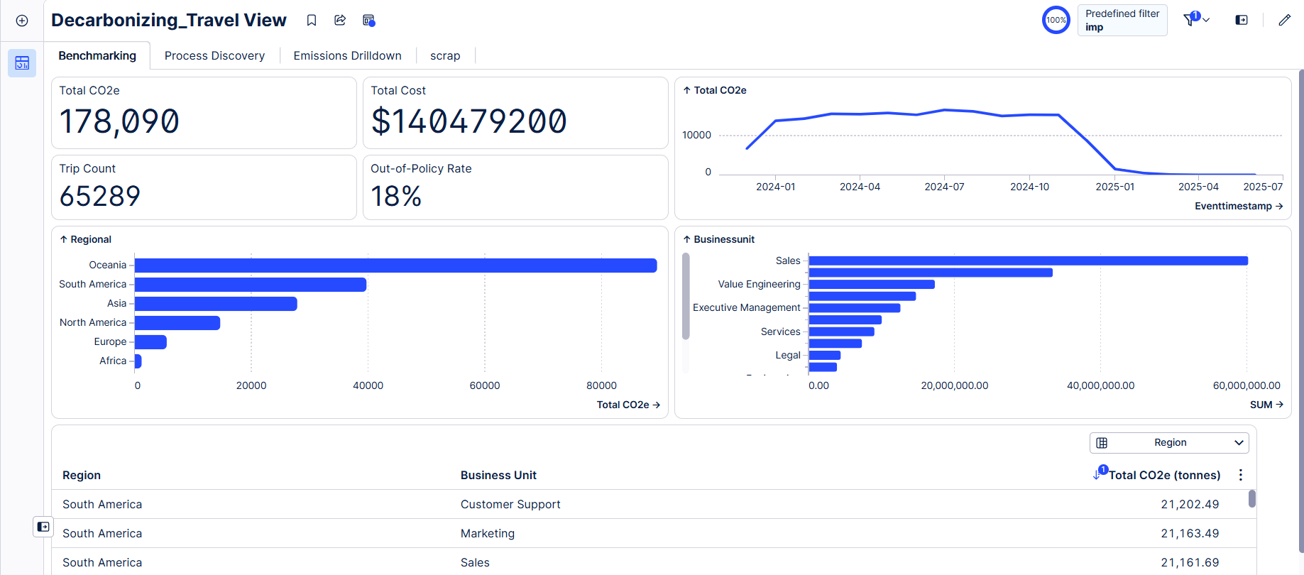
178,090 tonnes CO2e across 65,289 trips, 18% out-of-policy

Slide 9
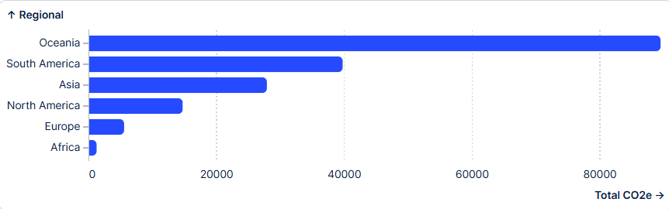
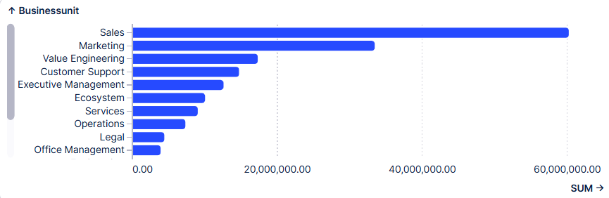
Oceania and Sales identified as primary emissions hotspots

Slide 10
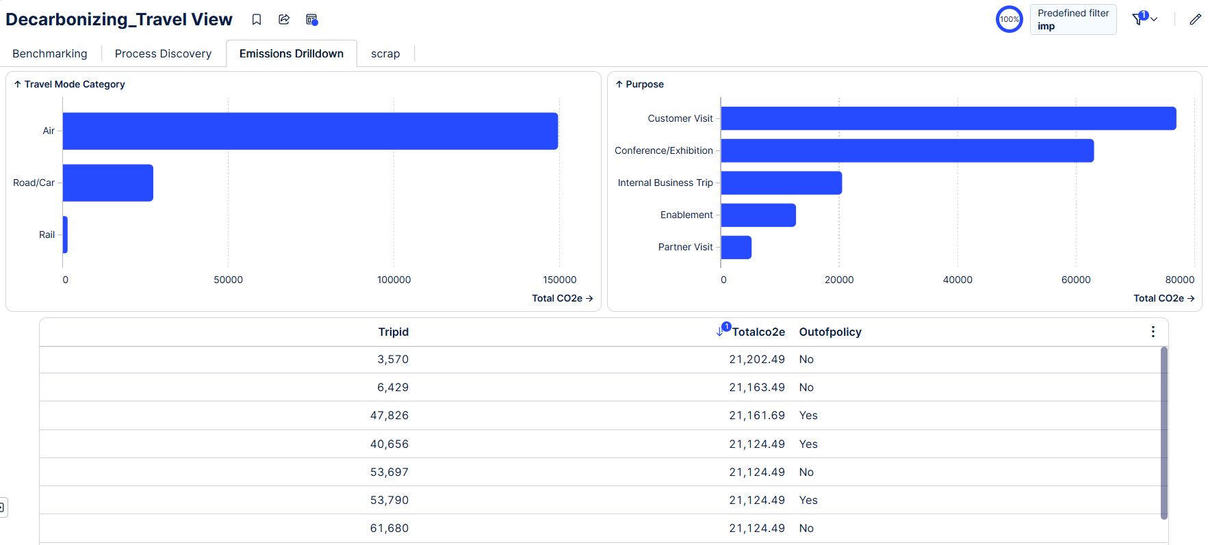
Air travel dominates emissions; top individual trips flagged for review

