Slide 1
Clustering Contd

Slide 2
Clustering
Clustering:
Unsupervised learning
Requires data, but no labels
Detect patterns e.g. in
Group emails or search results
Customer shopping patterns
Regions of images
Useful when don’t know what you’re looking for
But: can get gibberish

Slide 3




Clustering
Basic idea: group together similar instances
Example: 2D point patterns

Slide 4


Clustering
Basic idea: group together similar instances
Example: 2D point patterns

Slide 5





Clustering
Basic idea: group together similar instances
Example: 2D point patterns
What could “similar” mean?
– One option: small Euclidean distance (squared)
– Clustering results are crucially dependent on the measure of similarity (or distance) between “points” to be clustered

Slide 6
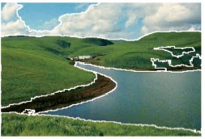
Clustering examples
Image segmentation
Goal: Break up the image into meaningful or perceptually similar regions
[Slide from James Hayes]

Slide 7
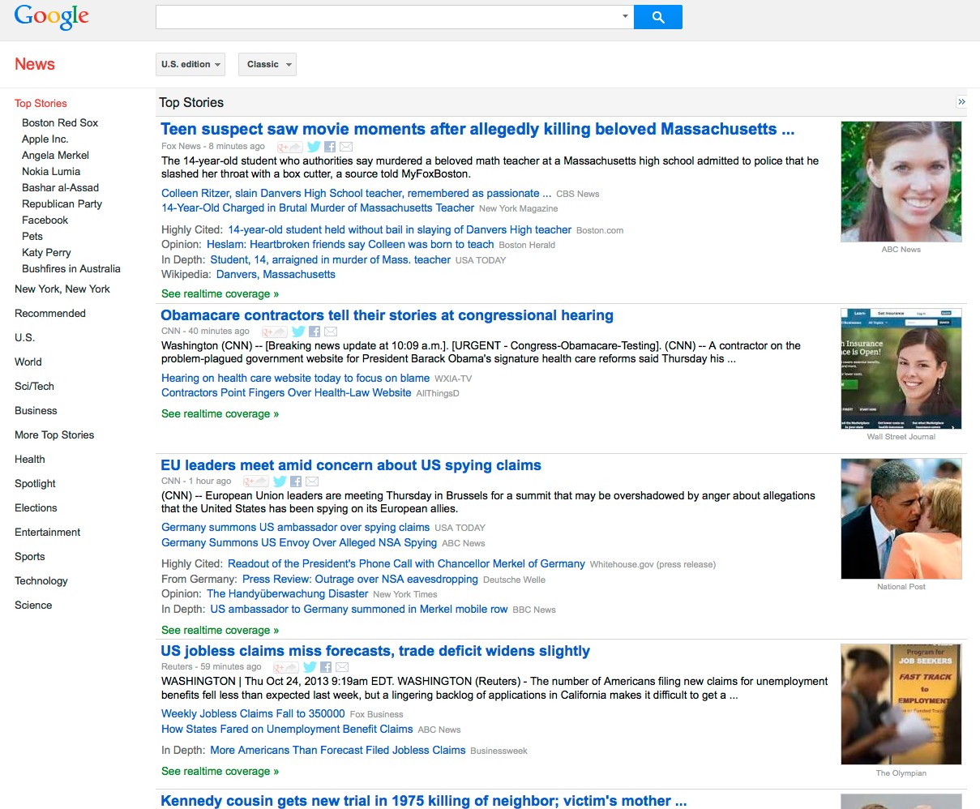
Clustering examples
Cluster news articles

Slide 8
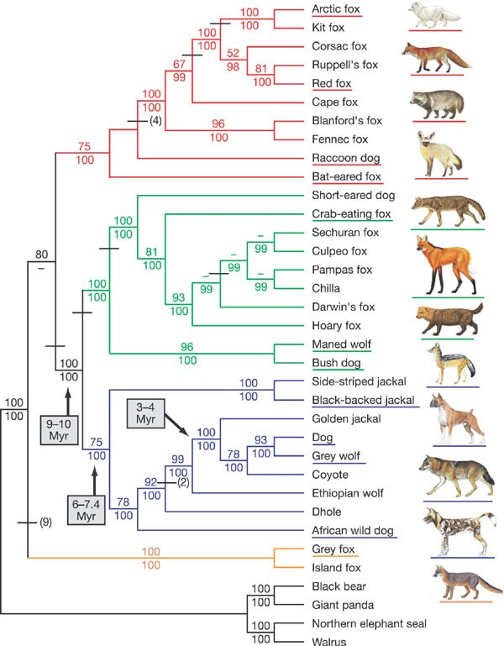
Clustering examples
Clustering species (“phylogeny”)
[Lindblad-Toh et al., Nature 2005]

Slide 9
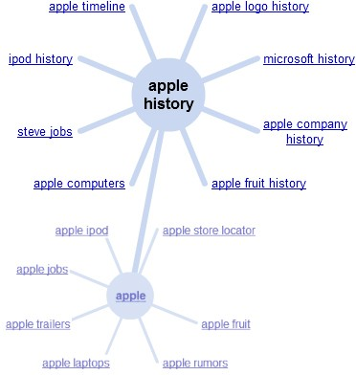
Clustering examples
Clustering search queries

Slide 10
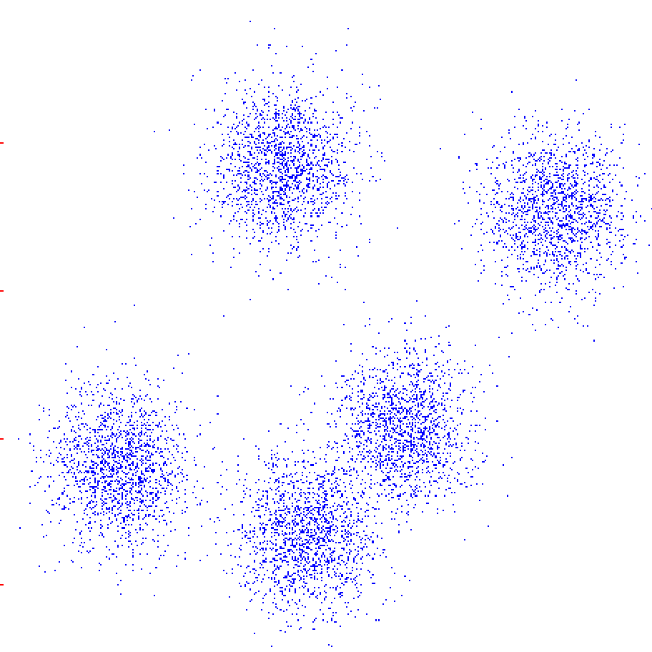
K-Means
An iterative clustering algorithm
Initialize: Pick K random points as cluster centers
Alternate:
Assign data points to closest cluster center
Change the cluster center to the average of its assigned points
Stop when no points’ assignments change

Slide 11
K-Means
An iterative clustering algorithm
Initialize: Pick K random points as cluster centers
Alternate:
Assign data points to closest cluster center
Change the cluster center to the average of its assigned points
Stop when no points’ assignments change

Slide 12
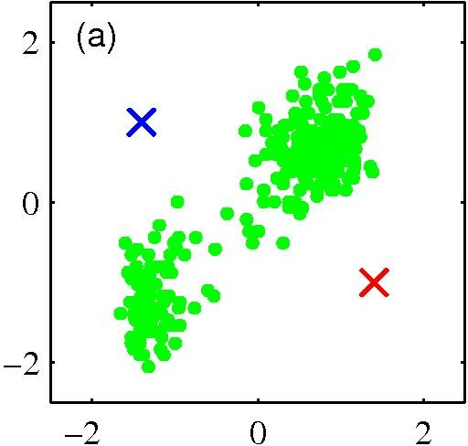
K-­‐means clustering: Example
Pick K random points as cluster centers (means)
Shown here for K=2
17

Slide 13
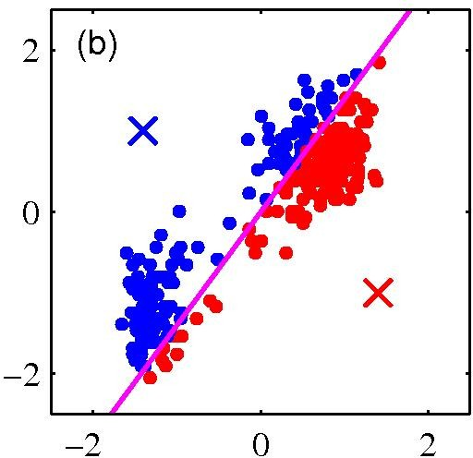
K-­‐means clustering: Example
Iterative Step 1
Assign data points to closest cluster center
18

Slide 14
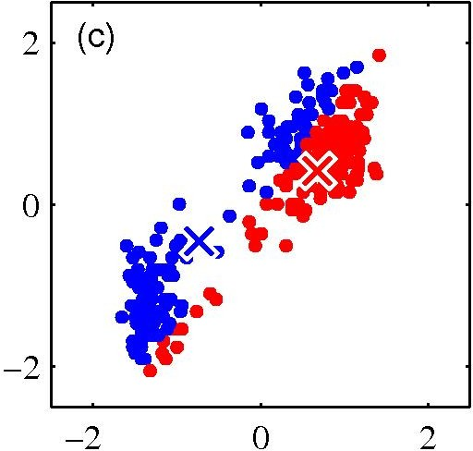
K-­‐means clustering: Example
Iterative Step 2
Change the cluster center to the average of the assigned points
19

Slide 15
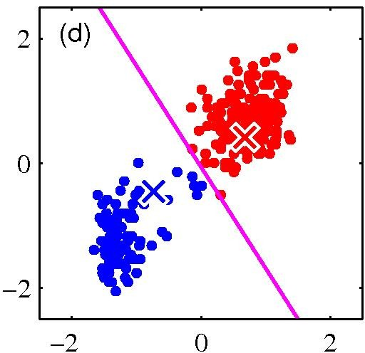
K-­‐means clustering: Example
Repeat until convergence
20

Slide 16
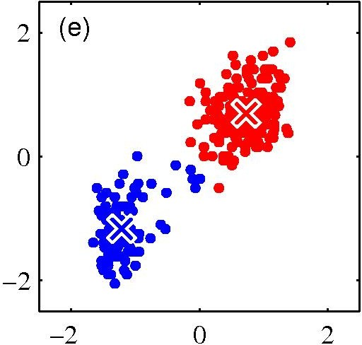
K-­‐means clustering: Example
21

Slide 17
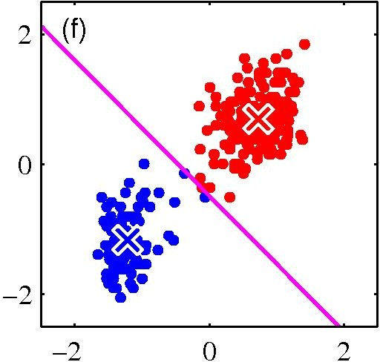
K-­‐means clustering: Example
22

Slide 18

K-­‐means clustering: Example
23

Slide 19
Properties of K-­‐means algorithm
Guaranteed to converge in a ﬁnite number of iterations
Running time per iteration:
Assign data points to closest cluster center
O(KN) time
Change the cluster center to the average of its assigned points
O(N)

Slide 20
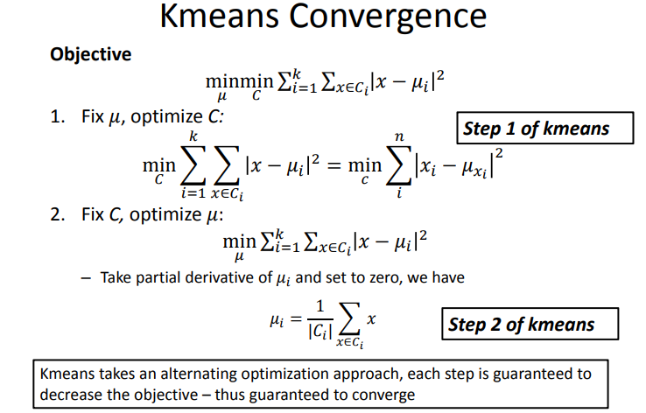

Slide 21
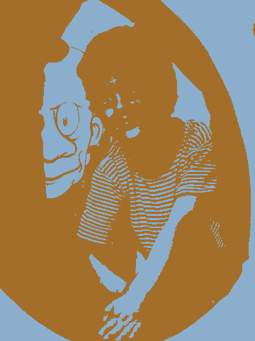
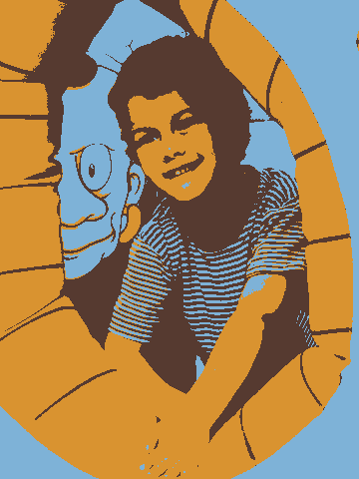
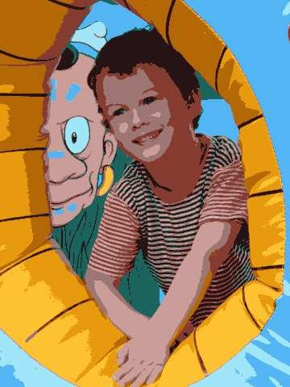
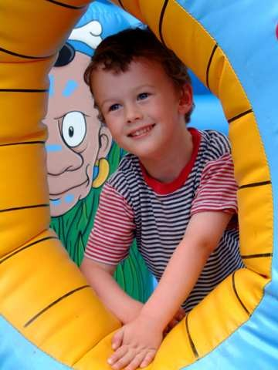
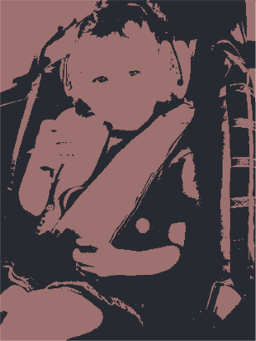
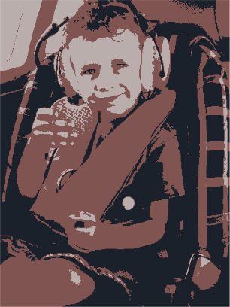
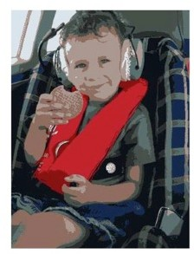
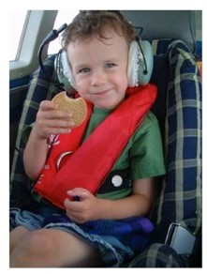
Example: K-Means for Segmentation
K=2
Goal of Segmentation is
Original
K =2
K =3 K = 10
Original image
to partition an image into regions each of which has reasonably homogenous visual appearance.

Slide 22
Example: K-Means for Segmentation
K=2
K=3
K=10
Original
K =2
K =3
K = 10
Original image

Slide 23
Example: K-Means for Segmentation
K=2
K=3
K=10
Original
K =2
K =3
K = 10
Original image

Slide 24

Initialization
K-means algorithm is a heuristic
Requires initial means
It does matter what you pick!
What can go wrong?
Various schemes for preventing this kind of thing: variance-based split / merge, initialization heuristics

Slide 25

K-Means Getting Stuck
A local optimum:
Would be better to have one cluster here
… and two clusters here

Slide 26









K-means not able to properly cluster
Y
X

Slide 27








Changing the features (distance function) can help
R
θ

