Slide 1
Singular Value Decomposition

Slide 2

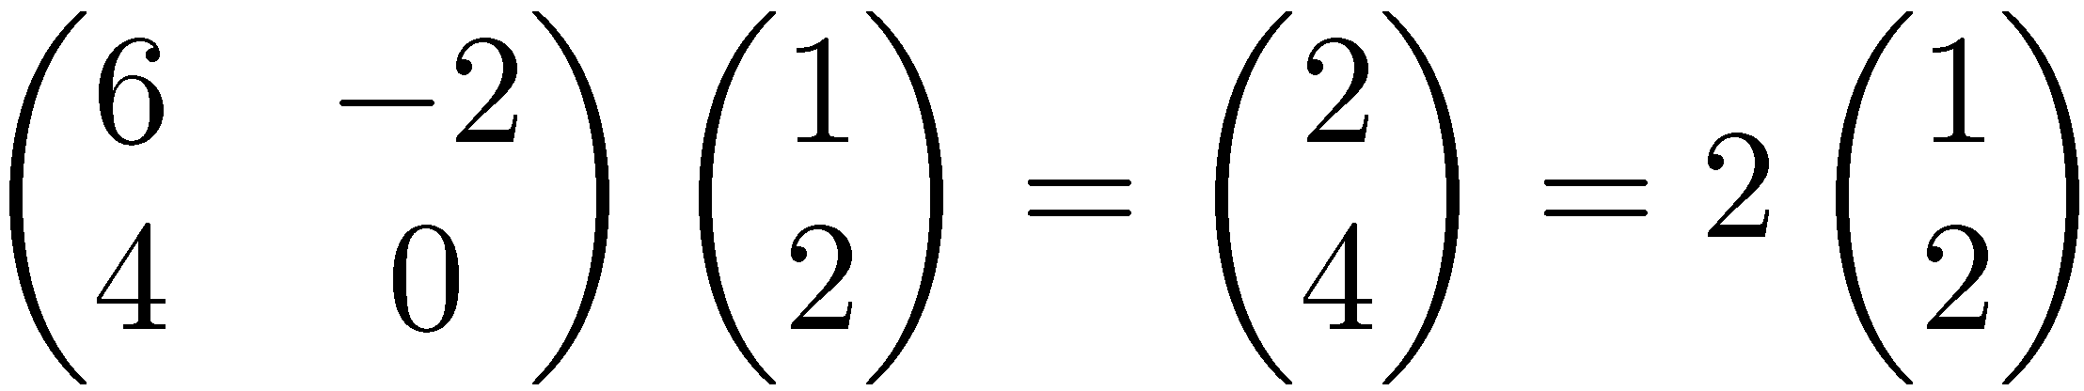
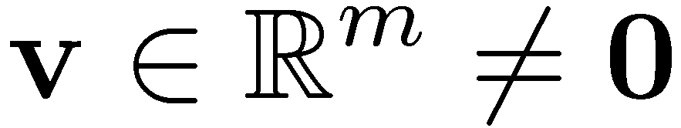
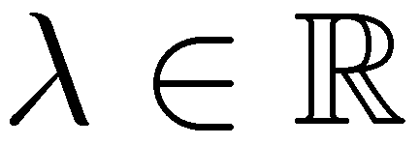
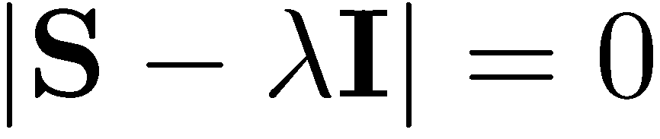
Eigenvalues & Eigenvectors
Eigenvectors (for a square m×m matrix S)
How many eigenvalues are there at most?
Example
(right) eigenvector
eigenvalue
only has a non-zero solution if
this is a m-th order equation in λ which can have at most m distinct solutions (roots of the characteristic polynomial) – can be complex even though S is real.

Slide 3
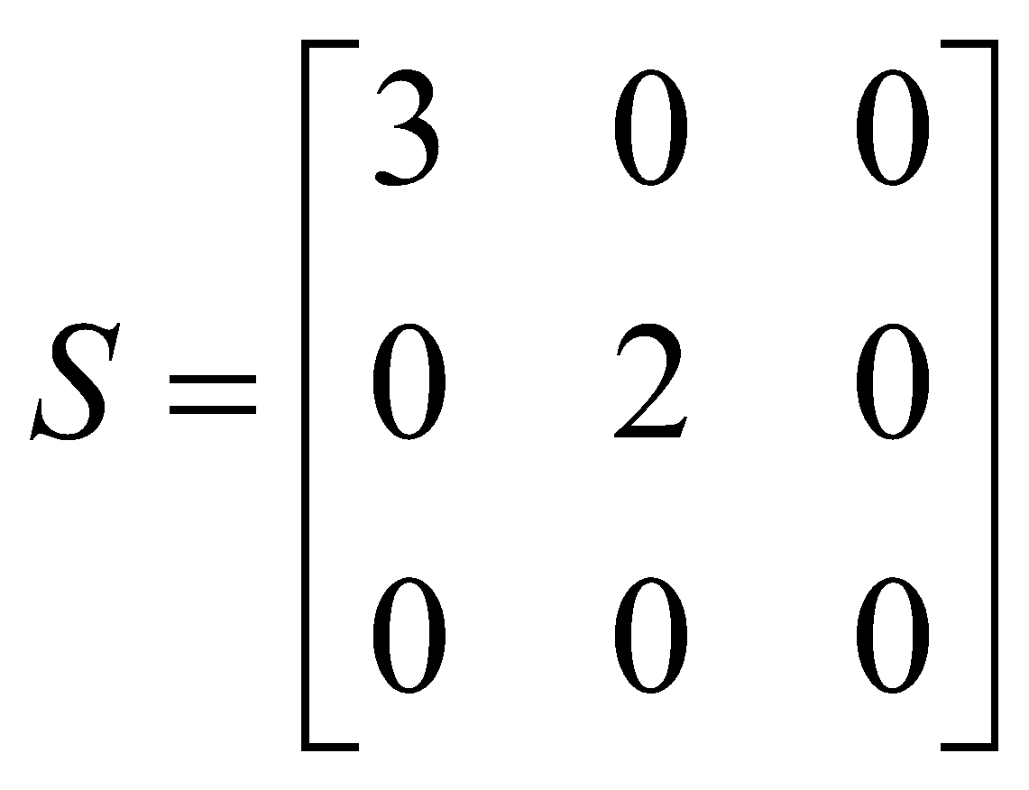
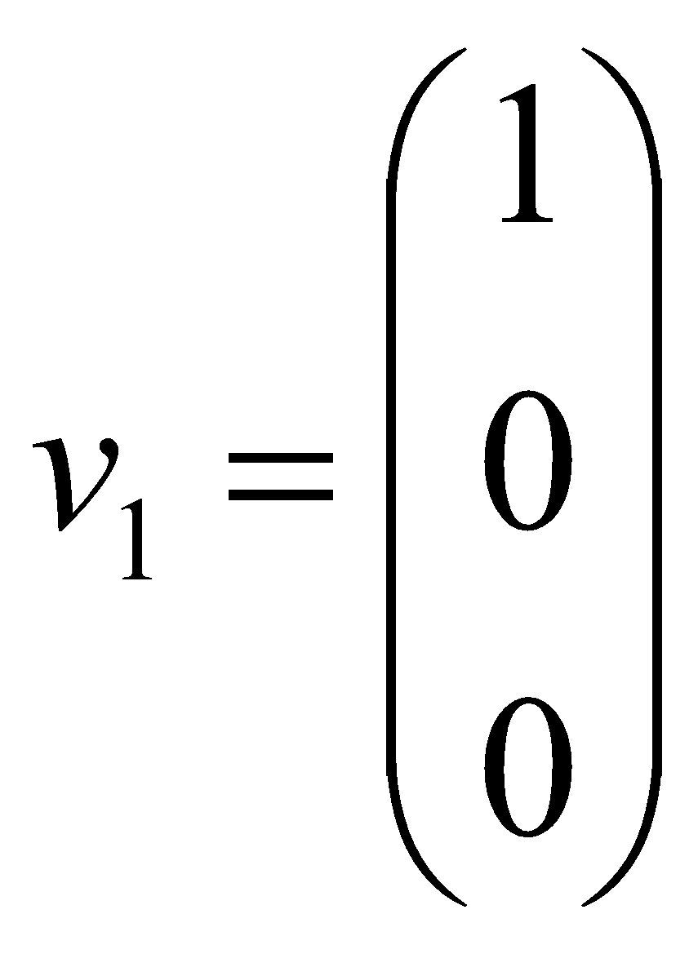
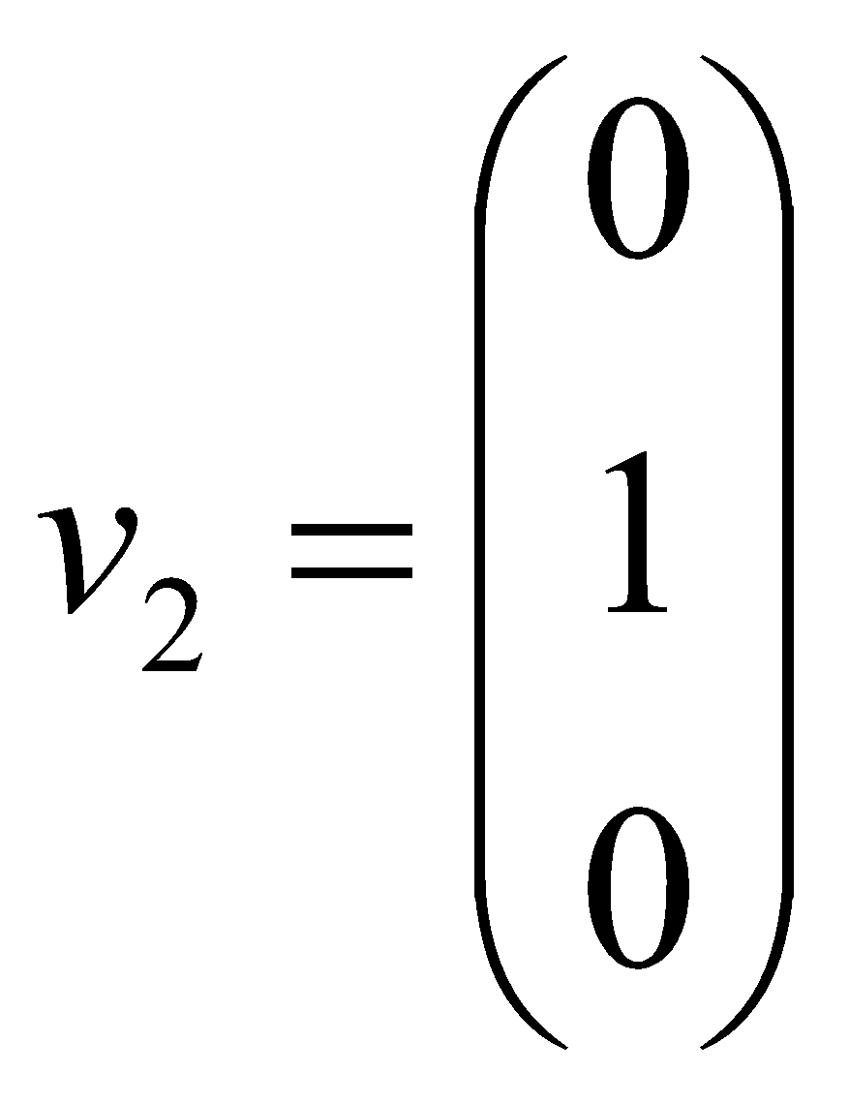
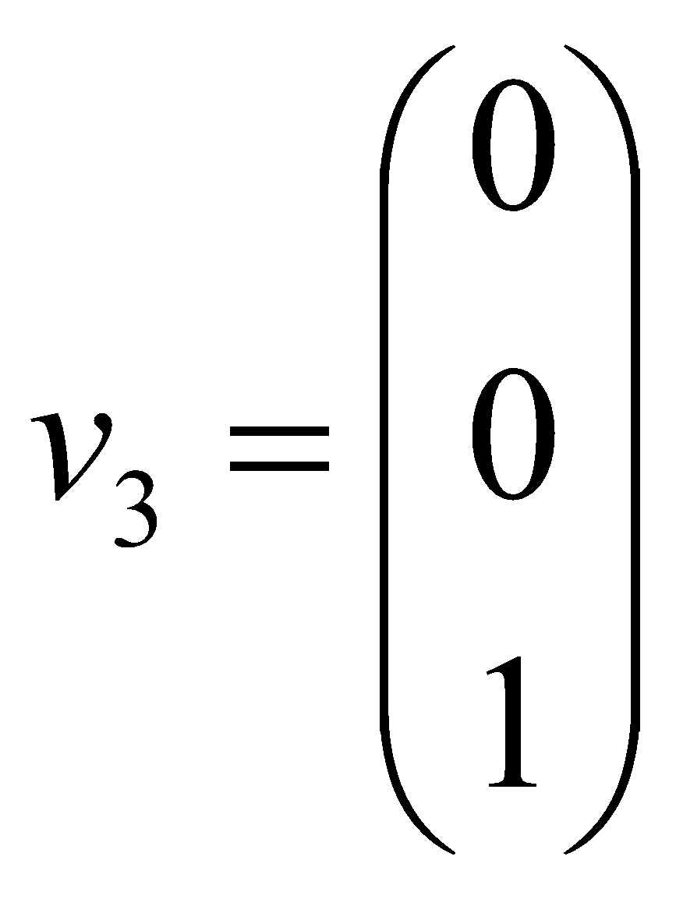
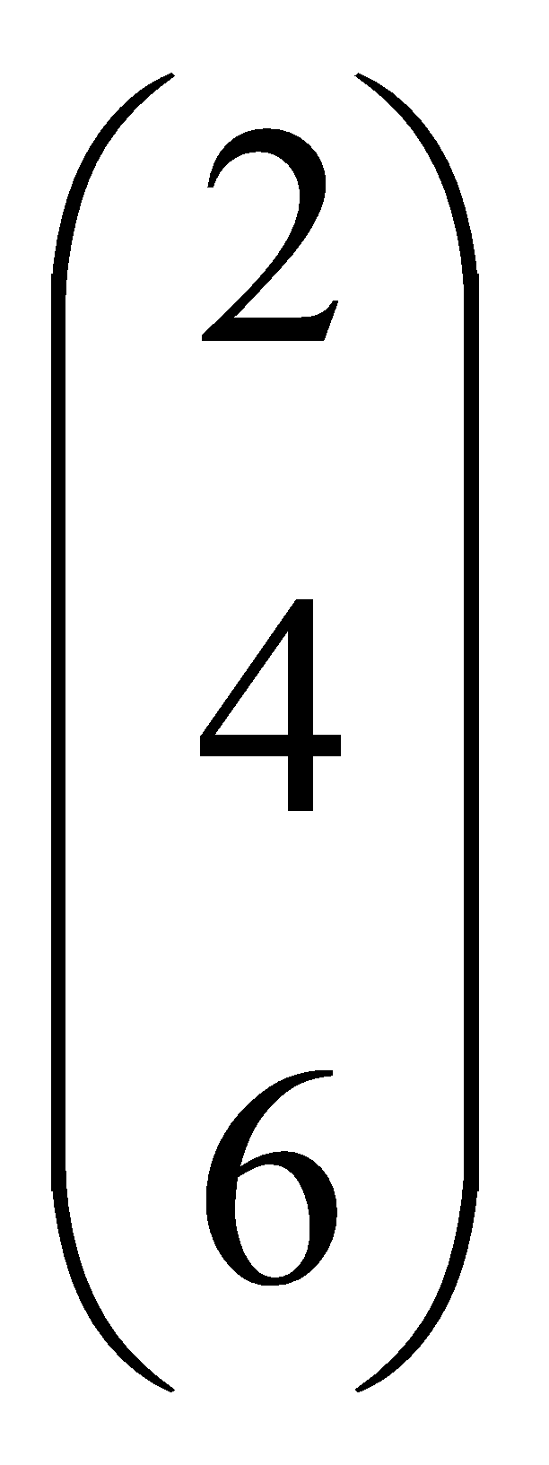
Matrix-vector multiplication
has eigenvalues 3, 2, 0 with
corresponding eigenvectors
On each eigenvector, S acts as a multiple of the identity
matrix: but as a different multiple on each.
Any vector (say x= ) can be viewed as a combination of
the eigenvectors: x = 2v₁ + 4v₂ + 6v₃

Slide 4
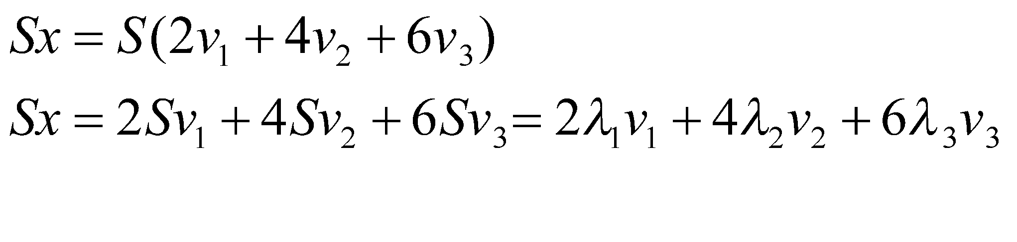
Matrix vector multiplication
Thus a matrix-vector multiplication such as Sx (S, x as in the previous slide) can be rewritten in terms of the eigenvalues/vectors:
Even though x is an arbitrary vector, the action of S on x is determined by the eigenvalues/vectors.
Suggestion: the effect of “small” eigenvalues is small.

Slide 5
Eigenvalues & Eigenvectors
For symmetric matrices, eigenvectors for distinct
eigenvalues are orthogonal
All eigenvalues of a real symmetric matrix are real.
All eigenvalues of a positive semidefinite matrix
are non-negative

Slide 6
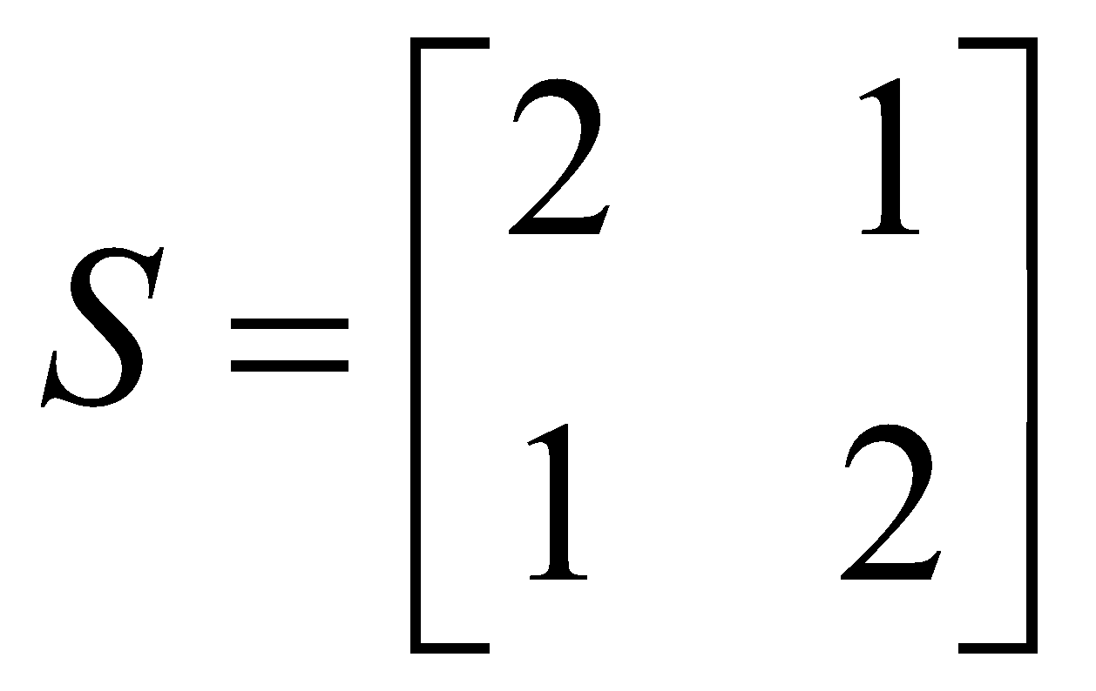
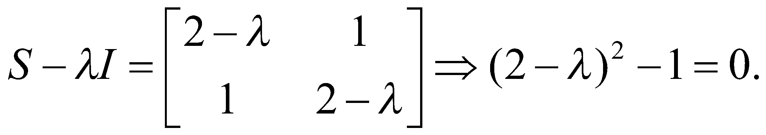
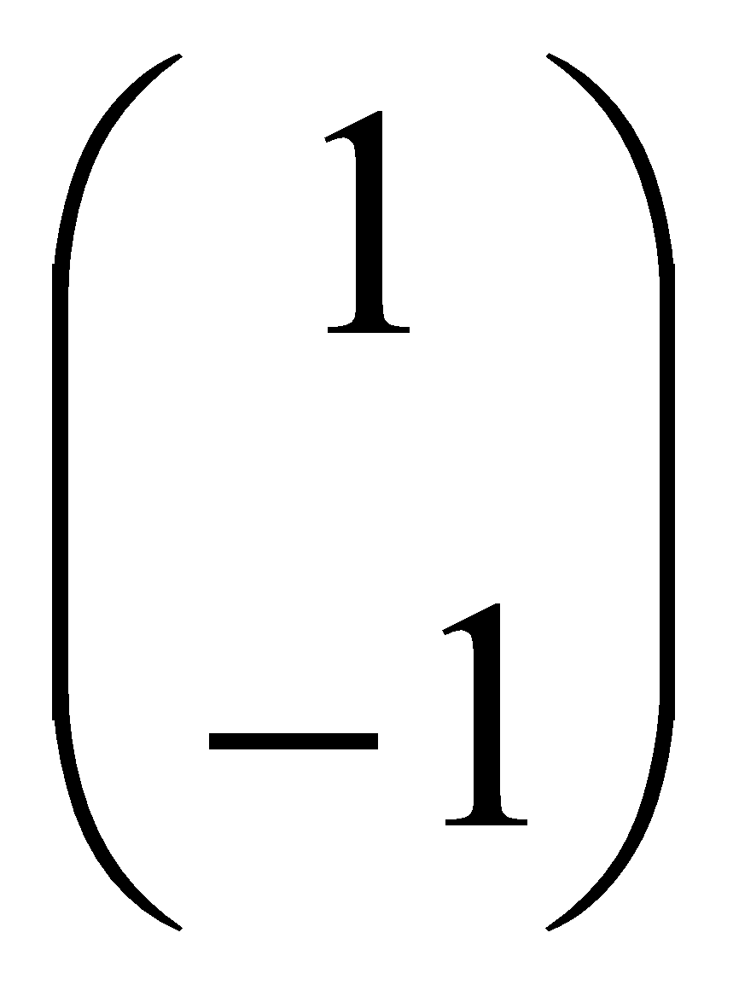
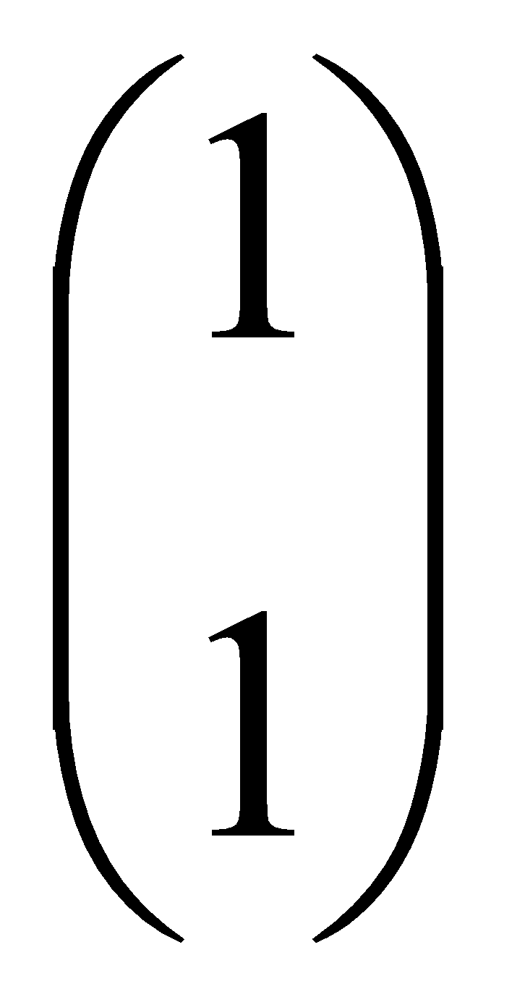
Example
Let
Then
The eigenvalues are 1 and 3 (nonnegative, real).
The eigenvectors are orthogonal (and real):
Real, symmetric.
Plug in these values and solve for eigenvectors.

Slide 7
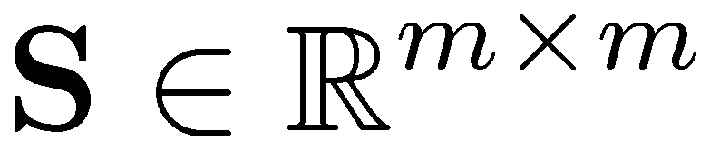
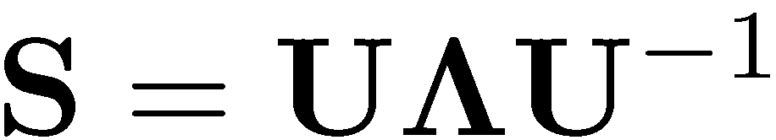
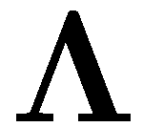

Eigen/diagonal Decomposition
Let be a square matrix with m linearly independent eigenvectors (a “non-defective” matrix)
Theorem: Exists an eigen decomposition
(cf. matrix diagonalization theorem)
Columns of U are eigenvectors of S
Diagonal elements of are eigenvalues of
Unique for distinct eigen-values
diagonal

Slide 8
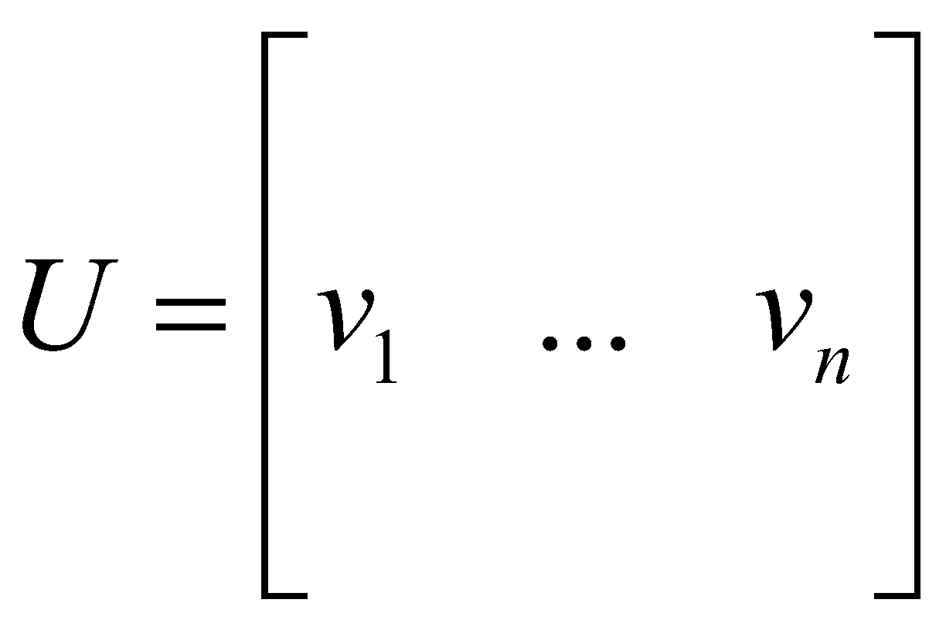
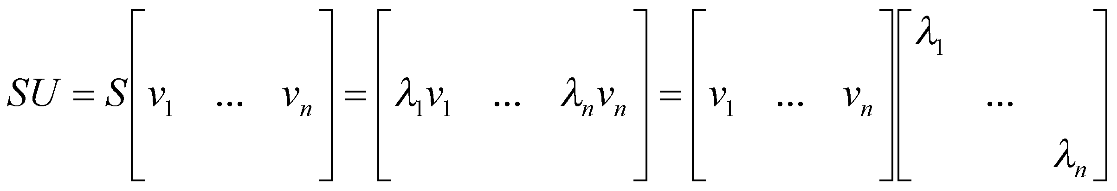
Diagonal decomposition: why/how
Let U have the eigenvectors as columns:
Then, SU can be written
Thus SU=UΛ, or U^{–1}SU=Λ
And S=UΛU^{–1}.

Slide 9
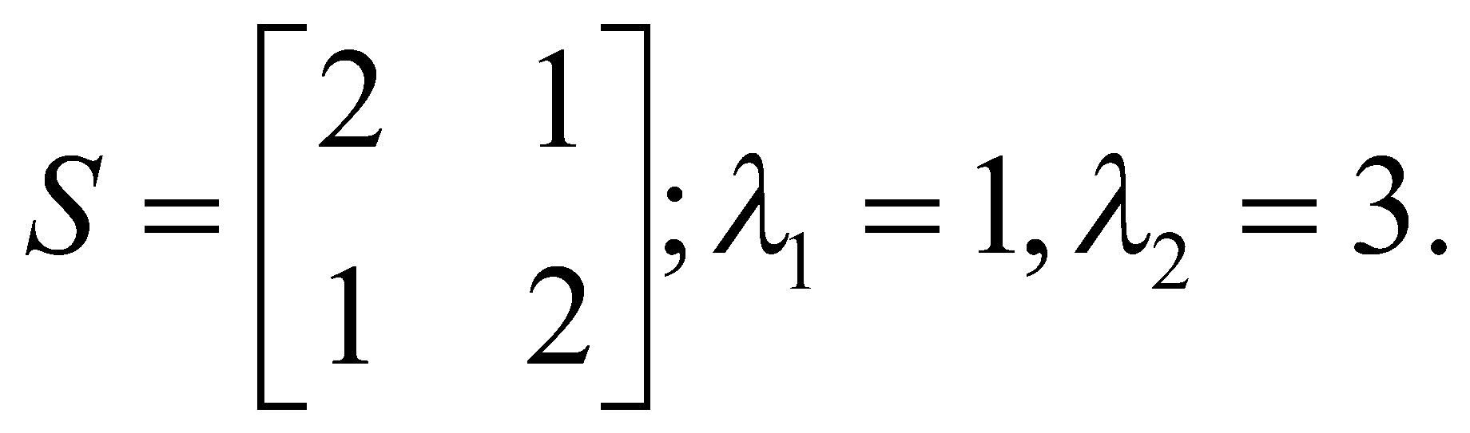
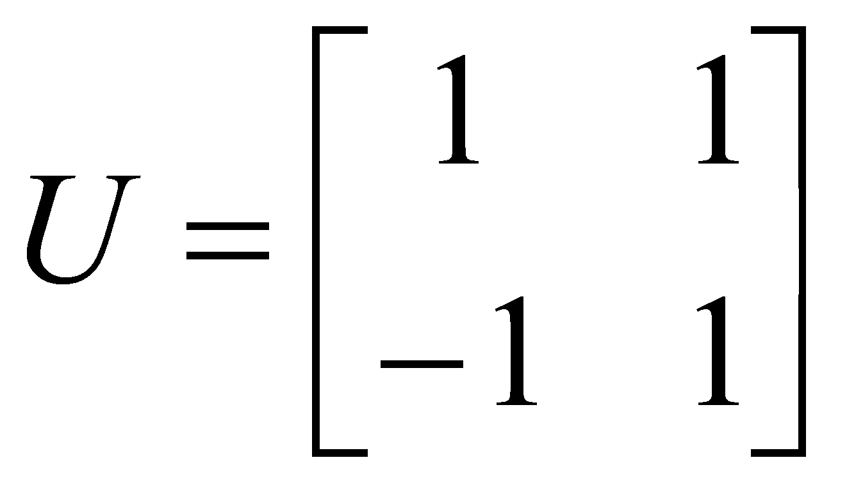
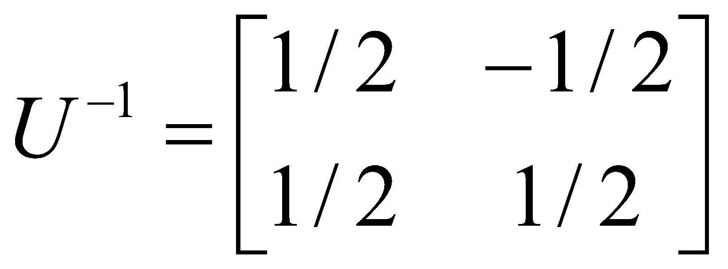
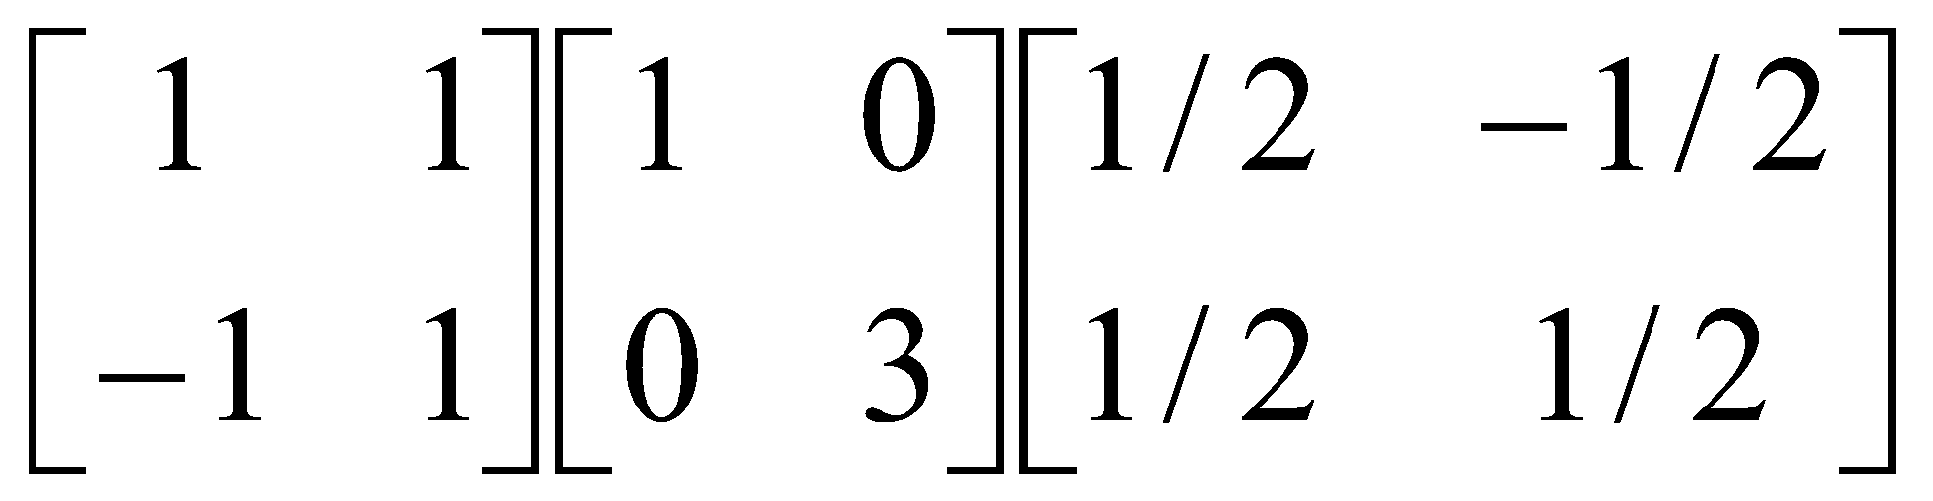
Diagonal decomposition - example
Recall
The eigenvectors and form
Recall
UU^{–1} =1.
Inverting, we have
Then, S=UΛU^{–1} =

Slide 10
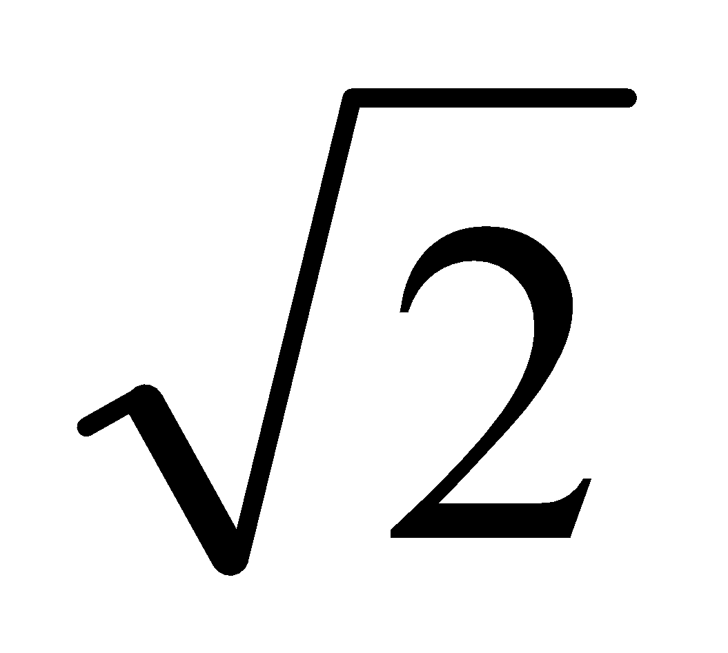
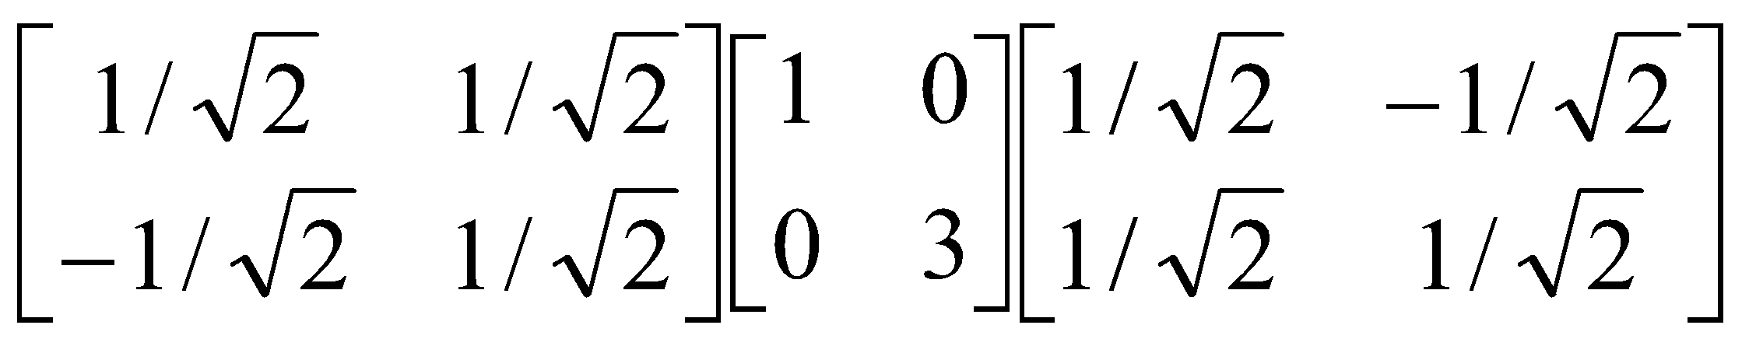
Example continued
Let’s divide U (and multiply U^{–1}) by
Then, S=
Q
Λ
(Q⁻¹= Q^{T} )
Why? Stay tuned …

Slide 11
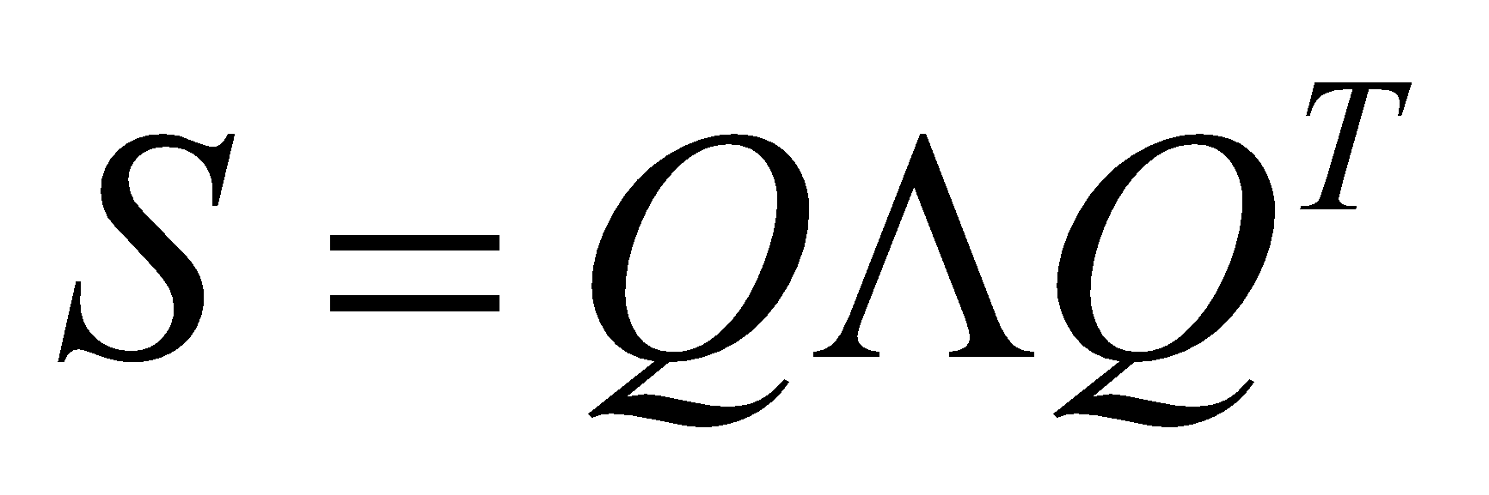
Symmetric Eigen Decomposition
If is a symmetric matrix:
Theorem: Exists a (unique) eigen decomposition
where Q is orthogonal:
Q⁻¹= Q^{T}
Columns of Q are normalized eigenvectors
Columns are orthogonal.
(everything is real)

Slide 12
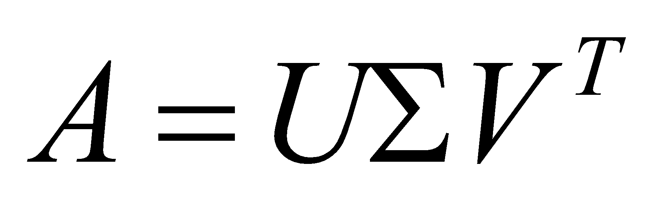
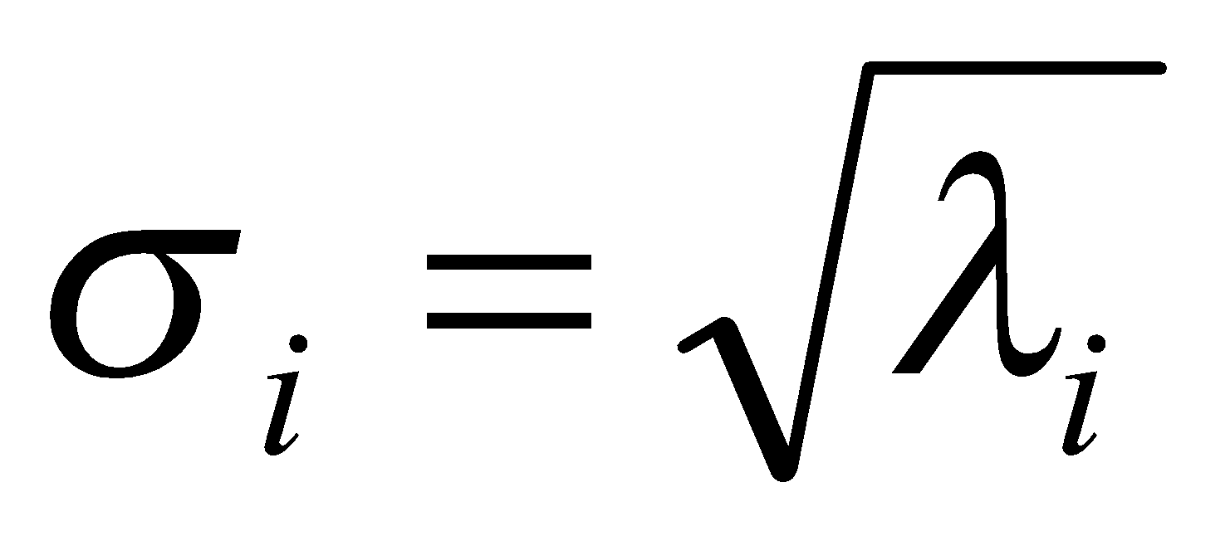
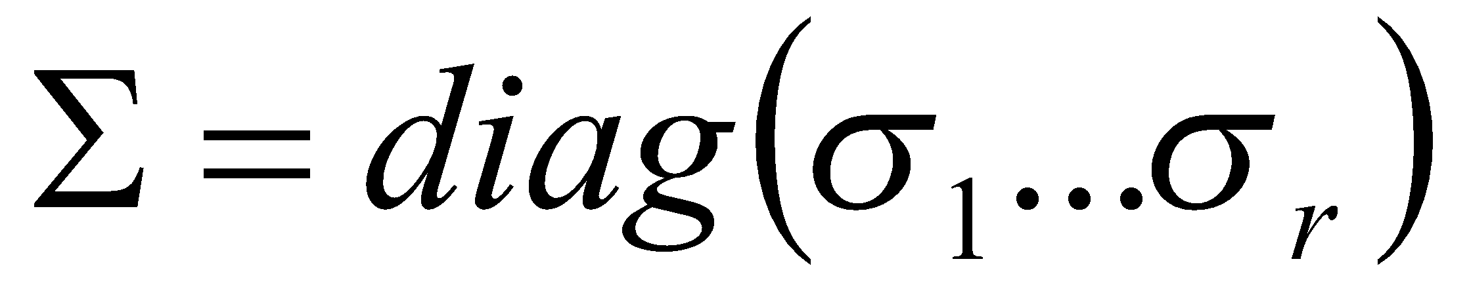
Singular Value Decomposition
For an m× n matrix A of rank r there exists a factorization(Singular Value Decomposition = SVD) as follows:
m×m
m×n
V is n×n
The columns of U are orthogonal eigenvectors of AA^{T}.
The columns of V are orthogonal eigenvectors of A^{T}A.
Eigenvalues λ₁ … λ_{r} of AA^{T} are the eigenvalues of A^{T}A.
Singular values.

Slide 13
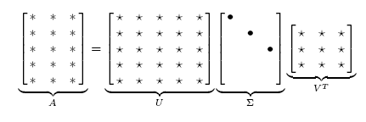
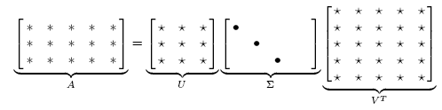
Singular Value Decomposition
Illustration of SVD dimensions and sparseness

Slide 14
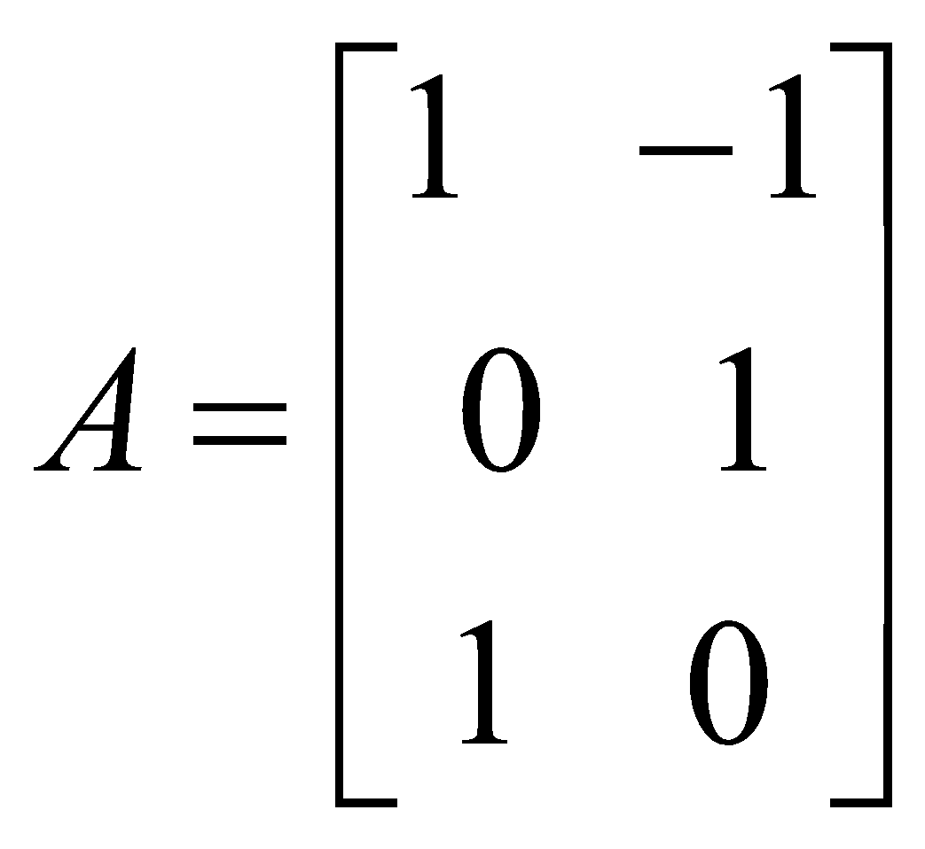
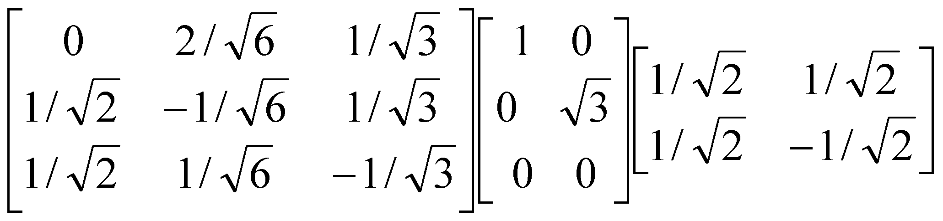
SVD example
Let
Thus m=3, n=2. Its SVD is
Typically, the singular values arranged in decreasing order.

Slide 15
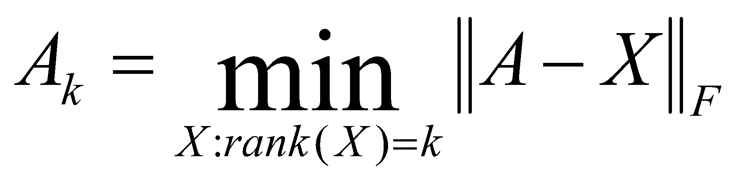

Low-rank Approximation
SVD can be used to compute optimal low-rank approximations.
Approximation problem: Find A_{k} of rank k such that
A_{k} and X are both m×n matrices.
Typically, want k << r.
Frobenius norm

Slide 16
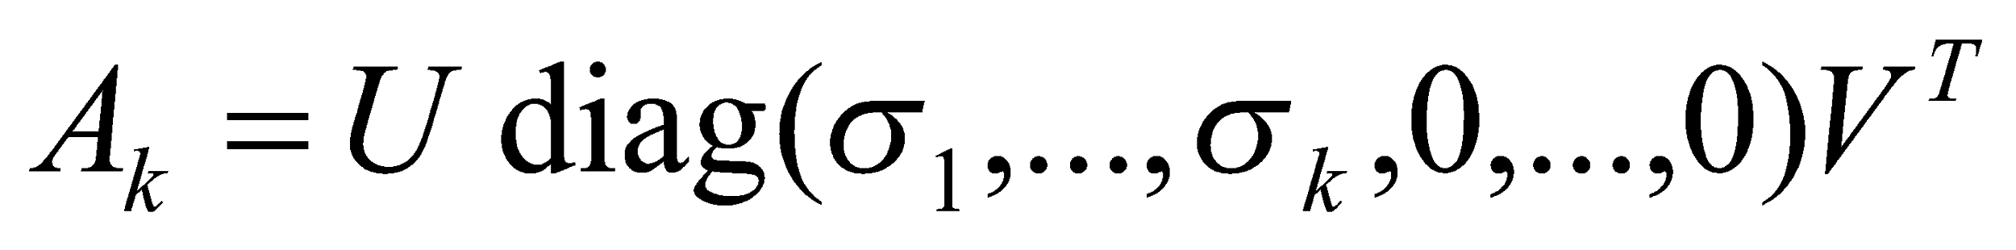
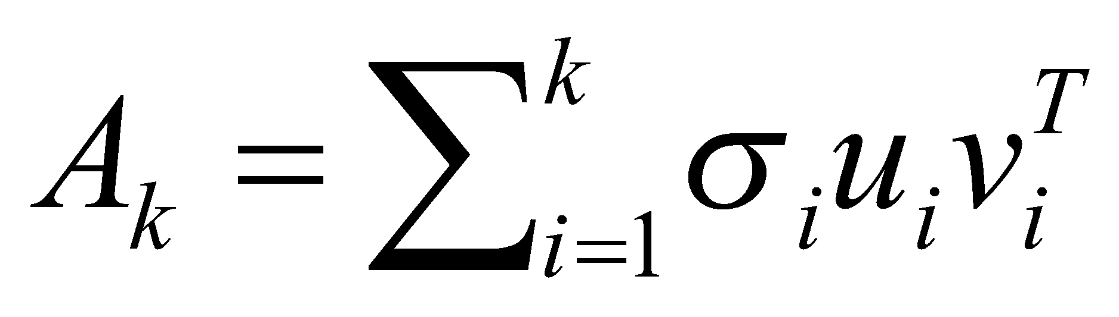
Low-rank Approximation
Solution via SVD
set smallest r-k
singular values to zero
k
column notation: sum
of rank 1 matrices

Slide 17
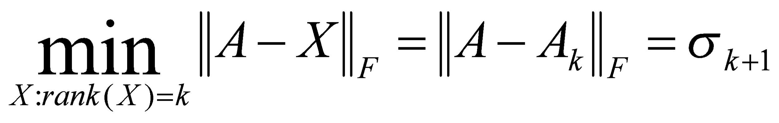
Approximation error
How good (bad) is this approximation?
It’s the best possible, measured by the Frobenius norm of the error:
where the σ_{i} are ordered such that σ_{i} ≥ σ_{i+1}.
Suggests why Frobenius error drops as k increased.

Slide 18
Recall random projection
Completely different method for low-rank approximation
Was data-oblivious
SVD-based approximation is data-dependent
Error for random projection depended only on start/finish dimensionality
For every distance
Error for SVD-based approximation is for the Frobenius norm, not for individual distances

Slide 19
SVD Low-rank approximation
Whereas the term-doc matrix A may have m=50000, n=10 million (and rank close to 50000)
We can construct an approximation A₁₀₀ with rank 100.
Of all rank 100 matrices, it would have the lowest Frobenius error.
Great … but why would we??
Answer: Latent Semantic Indexing
C. Eckart, G. Young, The approximation of a matrix by another of lower rank. Psychometrika, 1, 211-218, 1936.

Slide 20
Latent Semantic Analysis via SVD

Slide 21
What it is
From term-doc matrix A, we compute the approximation A_{k.}
There is a row for each term and a column for each doc in A_{k}
Thus docs live in a space of k<<r dimensions
These dimensions are not the original axes
But why?

Slide 22
Vector Space Model: Pros
Automatic selection of index terms
Partial matching of queries and documents (dealing with the case where no document contains all search terms)
Ranking according to similarity score (dealing with large result sets)
Term weighting schemes (improves retrieval performance)
Various extensions
Document clustering
Relevance feedback (modifying query vector)
Geometric foundation

Slide 23
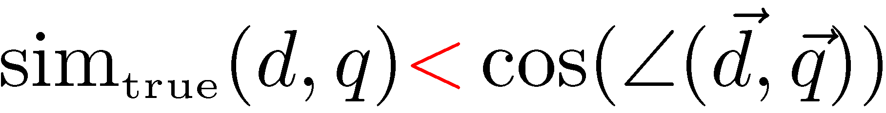
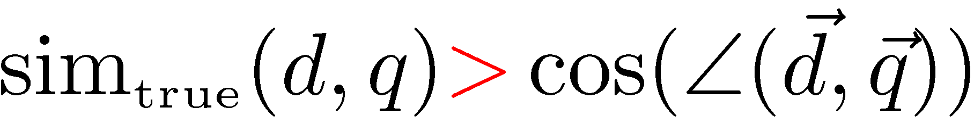
Problems with Lexical Semantics
Ambiguity and association in natural language
Polysemy: Words often have a multitude of meanings and different types of usage (more urgent for very heterogeneous collections).
The vector space model is unable to discriminate between different meanings of the same word.
Synonymy: Different terms may have an identical or a similar meaning (weaker: words indicating the same topic).
No associations between words are made in the vector space representation.

Slide 24
Polysemy and Context
Document similarity on single word level: polysemy and context
ring
jupiter
•••
space
voyager
meaning 1
…
planet
...
…
saturn
...
meaning 2
car
company
•••
dodge
ford
contribution to similarity, if used in 1st meaning, but not if in 2nd

Slide 25
Latent Semantic Analysis
Perform a low-rank approximation of document-term matrix (typical rank 100-300)
General idea
Map documents (and terms) to a low-dimensional representation.
Design a mapping such that the low-dimensional space reflects semantic associations (latent semantic space).
Compute document similarity based on the inner product in this latent semantic space
Goals
Similar terms map to similar location in low dimensional space
Noise reduction by dimension reduction

Slide 26
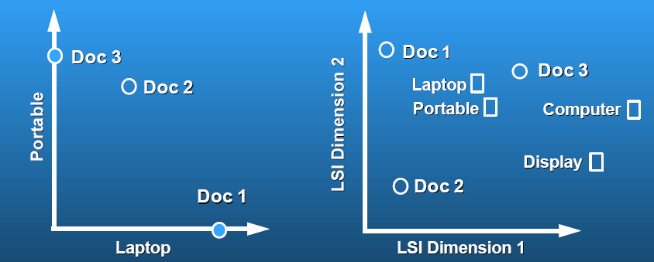
Latent Semantic Analysis
Latent semantic space: illustrating example
courtesy of Susan Dumais

Slide 27
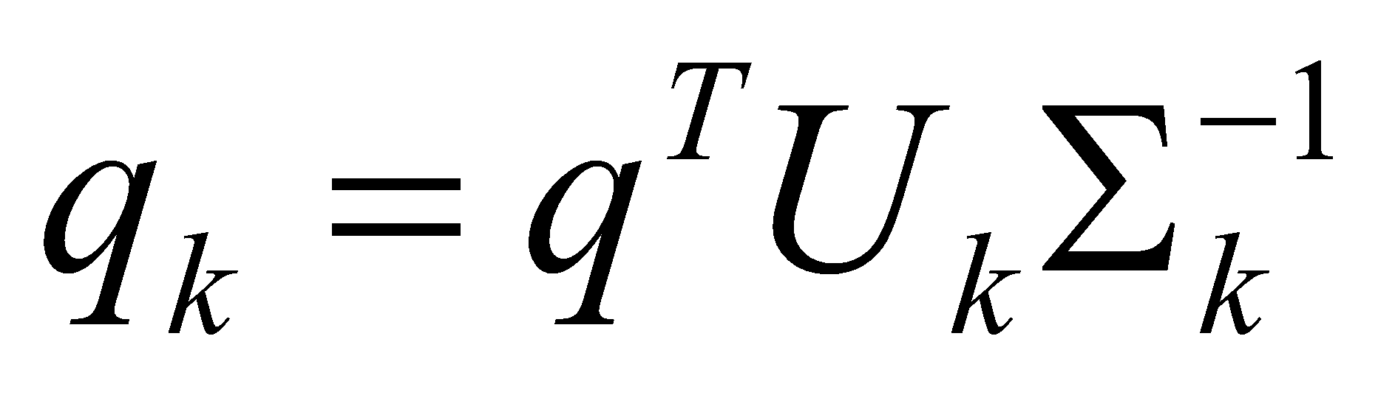
Performing the maps
Each row and column of A gets mapped into the k-dimensional LSI space, by the SVD.
Claim – this is not only the mapping with the best (Frobenius error) approximation to A, but in fact improves retrieval.
A query q is also mapped into this space, by
Query NOT a sparse vector.

Slide 28
Empirical evidence
Experiments on TREC 1/2/3 – Dumais
Lanczos SVD code (available on netlib) due to Berry used in these expts
Running times of ~ one day on tens of thousands of docs
Dimensions – various values 250-350 reported
(Under 200 reported unsatisfactory)
Generally expect recall to improve – what about precision?

Slide 29
Empirical evidence
Precision at or above median TREC precision
Top scorer on almost 20% of TREC topics
Slightly better on average than straight vector spaces
Effect of dimensionality:
Dimensions | Precision
250 | 0.367
300 | 0.371
346 | 0.374

Slide 30
Failure modes
Negated phrases
TREC topics sometimes negate certain query/terms phrases – automatic conversion of topics to
Boolean queries
As usual, freetext/vector space syntax of LSI queries precludes (say) “Find any doc having to do with the following 5 companies”
See Dumais for more.

Slide 31
But why is this clustering?
We’ve talked about docs, queries, retrieval and precision here.
What does this have to do with clustering?
Intuition: Dimension reduction through LSI brings together “related” axes in the vector space.

Slide 32
Intuition from block matrices
n documents
Block 1
What’s the rank of this matrix?
Block 2
0’s
m
terms
…
0’s
Block k
= non-zero entries.

Slide 33
Intuition from block matrices
n documents
Block 1
Block 2
0’s
m
terms
…
0’s
Block k
Vocabulary partitioned into k topics (clusters); each doc discusses only one topic.

Slide 34
Intuition from block matrices
n documents
Block 1
What’s the best rank-k
approximation to this matrix?
Block 2
0’s
m
terms
…
0’s
Block k
= non-zero entries.

Slide 35
Intuition from block matrices
Likely there’s a good rank-k
approximation to this matrix.
wiper
Block 1
tire
V6
Block 2
Few nonzero entries
…
Few nonzero entries
Block k
car
1
0
automobile
0
1

Slide 36
Simplistic picture
Topic 1
Topic 2
Topic 3

Slide 37
Some wild extrapolation
The “dimensionality” of a corpus is the number of distinct topics represented in it.
More mathematical wild extrapolation:
if A has a rank k approximation of low Frobenius error, then there are no more than k distinct topics in the corpus.

Slide 38
LSI has many other applications
In many settings in pattern recognition and retrieval, we have a feature-object matrix.
For text, the terms are features and the docs are objects.
Could be opinions and users … more in 276B.
This matrix may be redundant in dimensionality.
Can work with low-rank approximation.
If entries are missing (e.g., users’ opinions), can recover if dimensionality is low.
Powerful general analytical technique
Close, principled analog to clustering methods.

