Slide 1
Matrices
Introduction

Slide 2
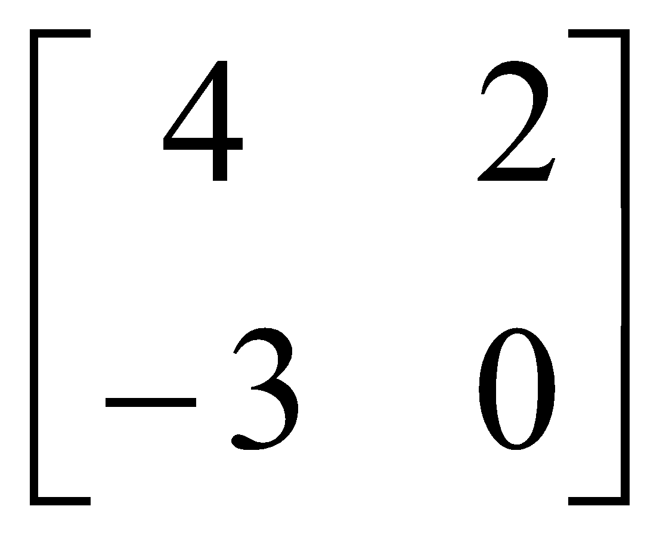

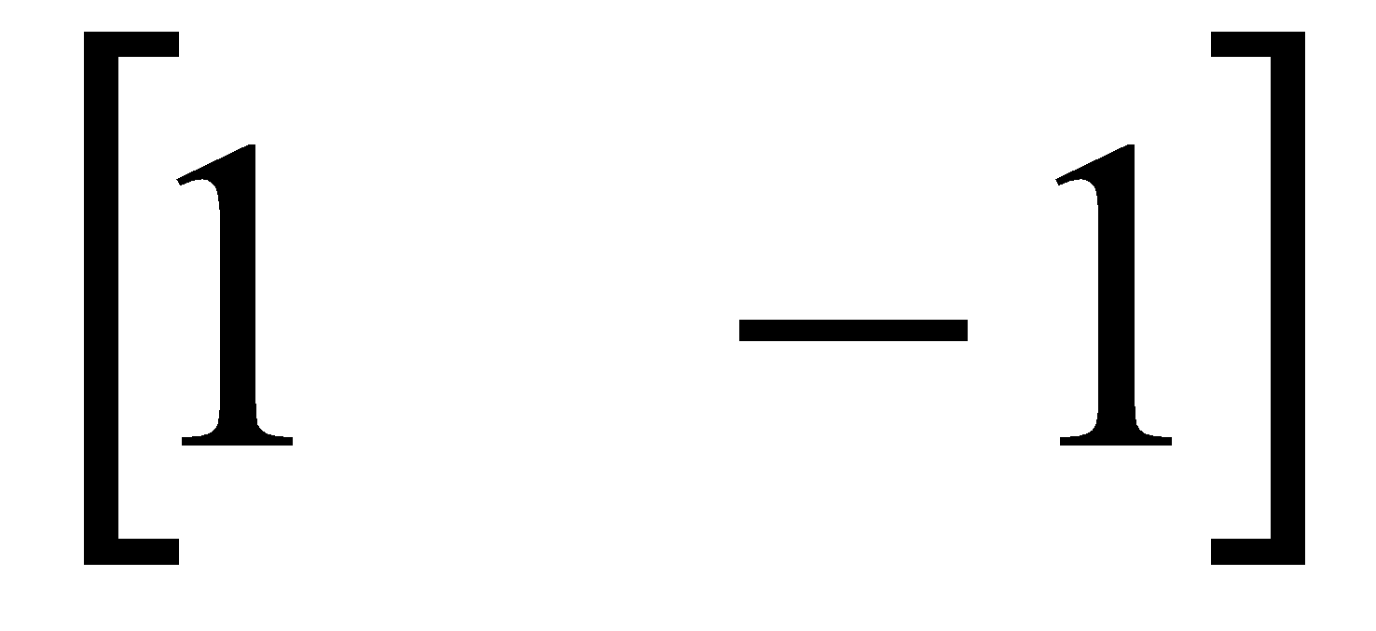
Matrices - Introduction
Matrix algebra has at least two advantages:
Reduces complicated systems of equations to simple expressions
Adaptable to systematic method of mathematical treatment and well suited to computers
Definition:
A matrix is a set or group of numbers arranged in a square or rectangular array enclosed by two brackets

Slide 3
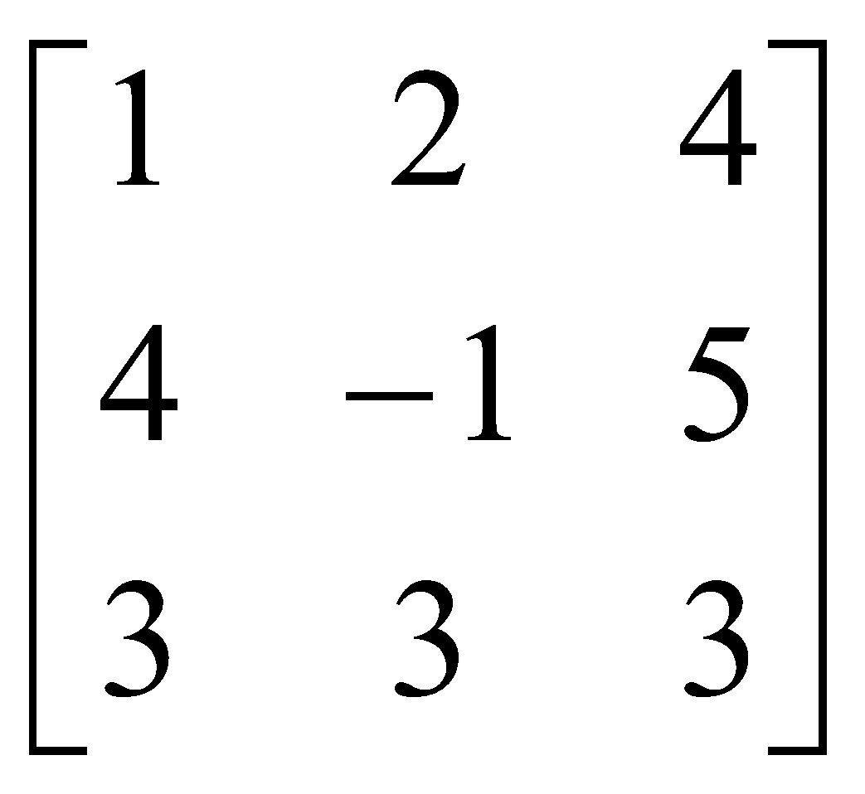
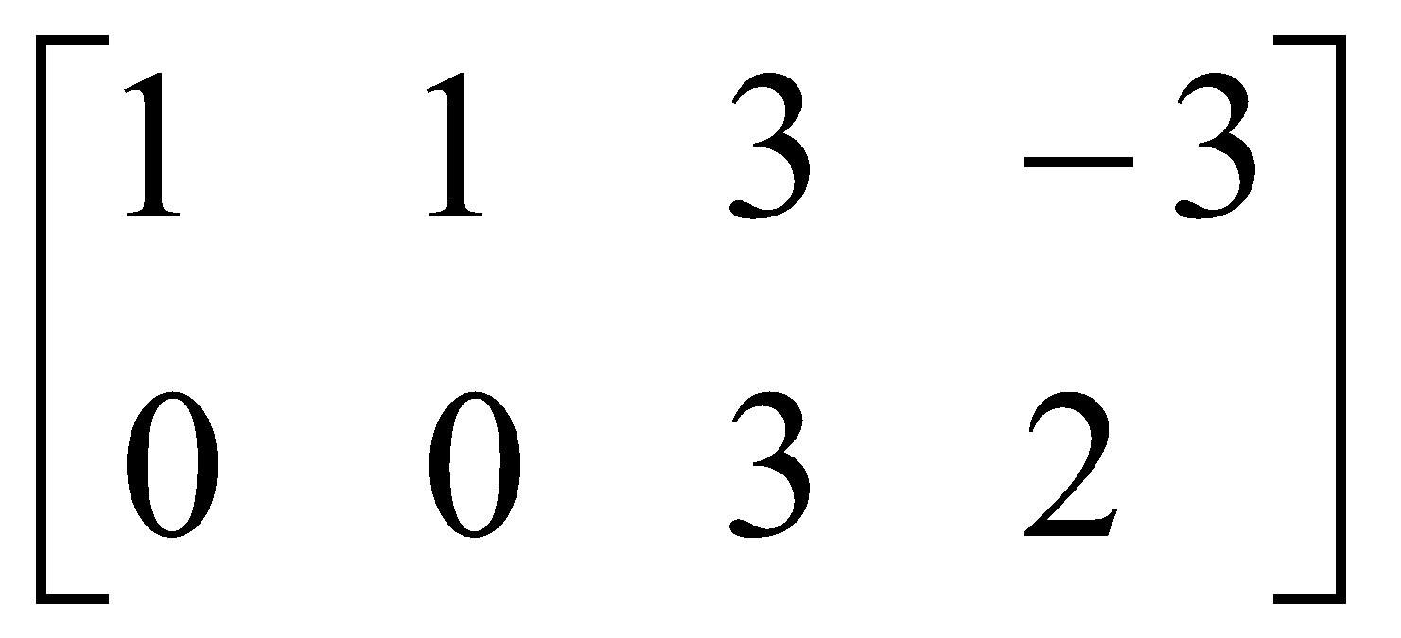
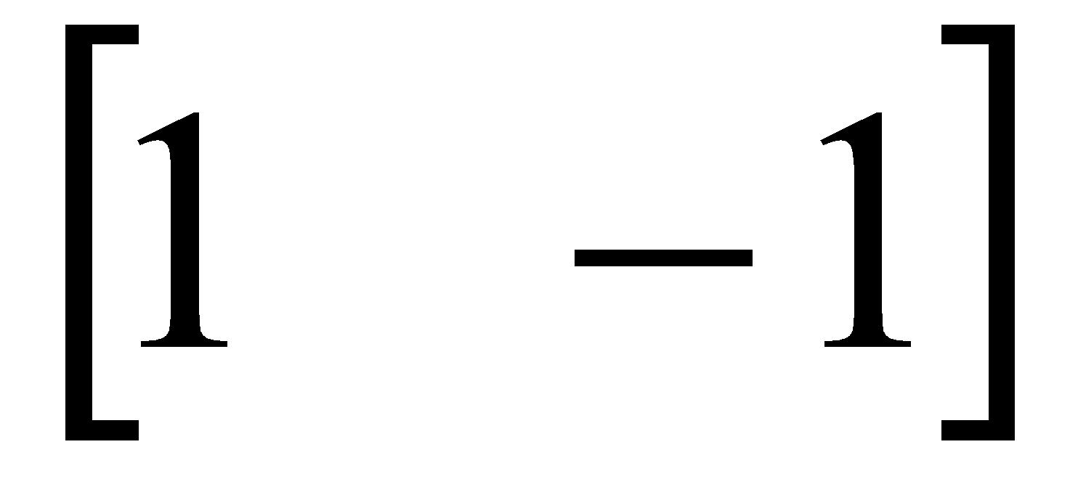
Matrices - Introduction
Properties:
A specified number of rows and a specified number of columns
Two numbers (rows x columns) describe the dimensions or size of the matrix.
Examples:
3x3 matrix
2x4 matrix
1x2 matrix

Slide 4
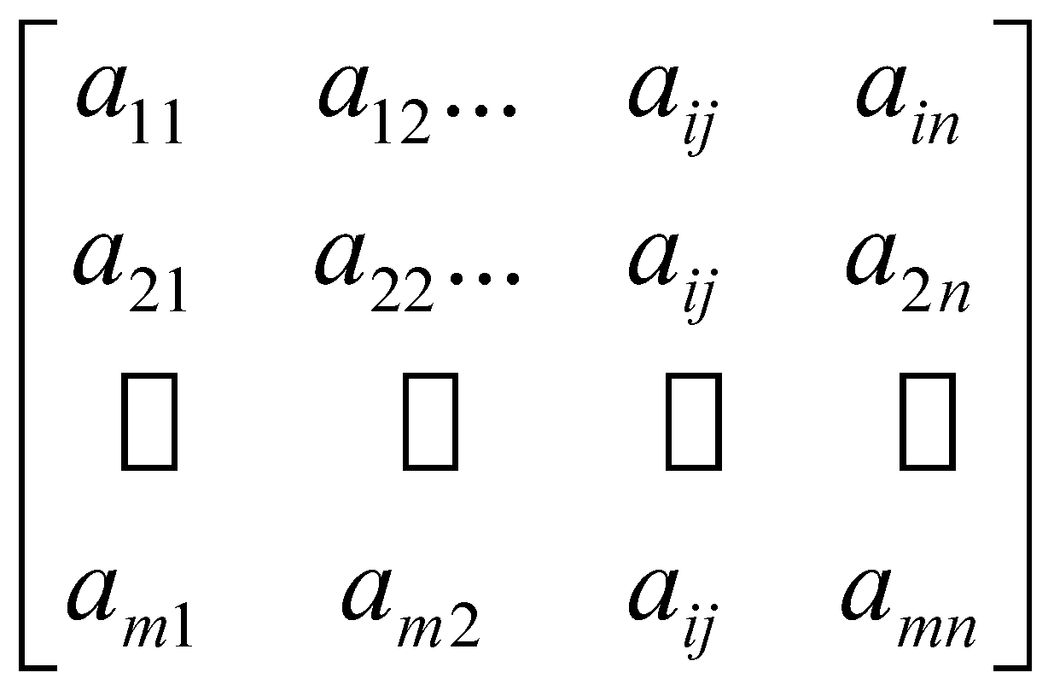
Matrices - Introduction
A matrix is denoted by a bold capital letter and the elements within the matrix are denoted by lower case letters
e.g. matrix [A] with elements a_{ij}
A_{mxn}=
_{m}A^{n}
i goes from 1 to m
j goes from 1 to n

Slide 5

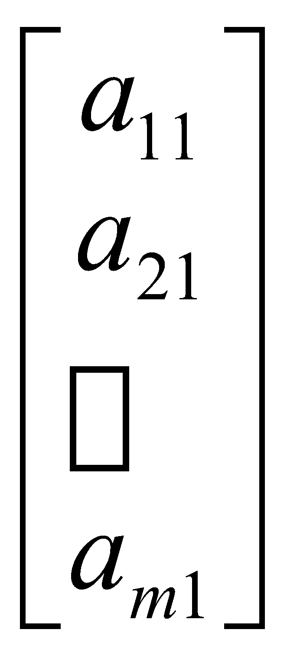
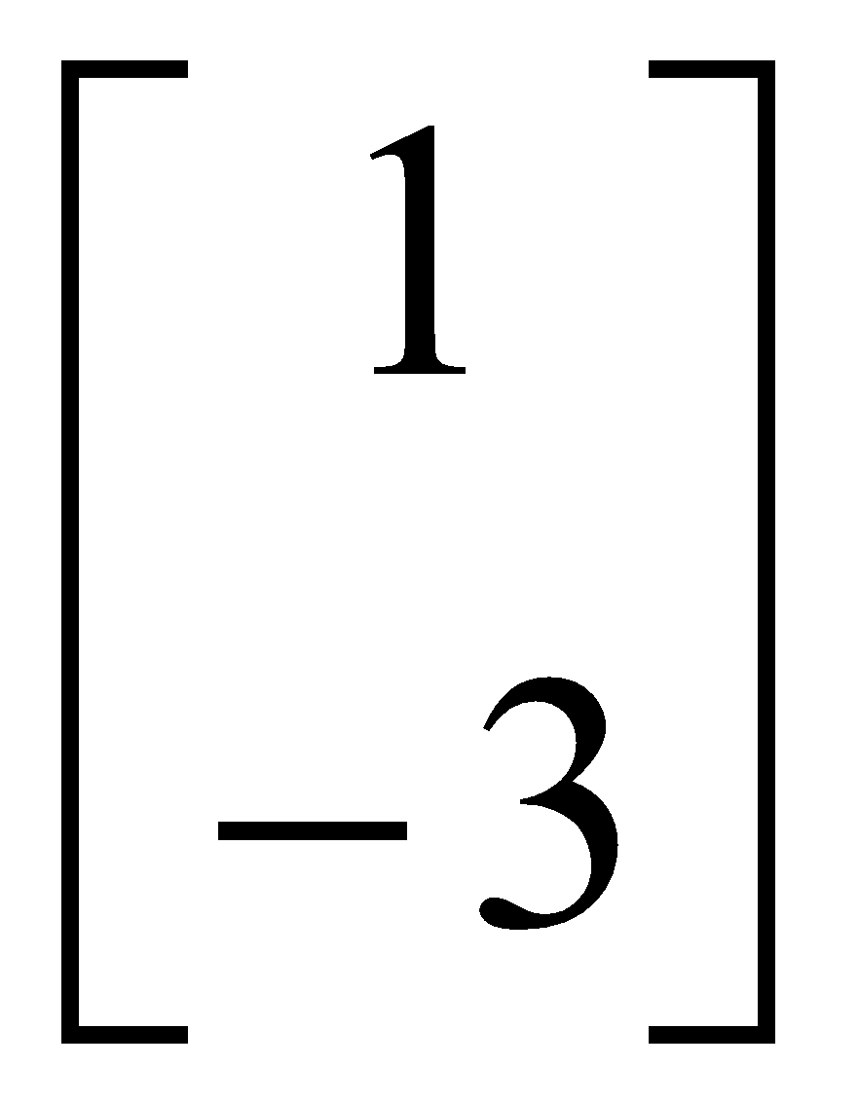
Matrices - Introduction
TYPES OF MATRICES
Column matrix or vector:
The number of rows may be any integer but the number of columns is always 1

Slide 6
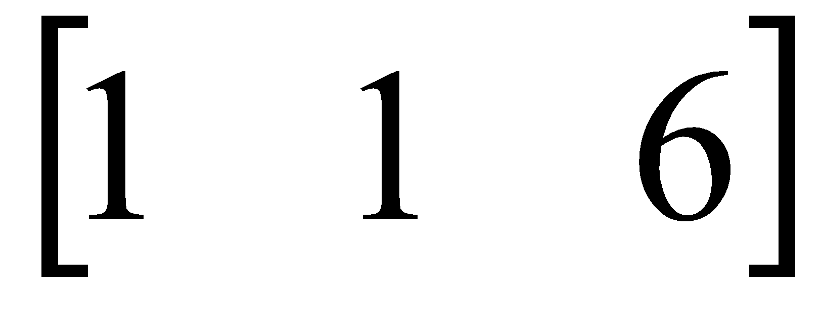
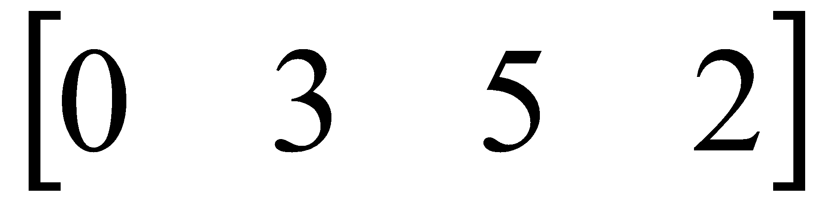
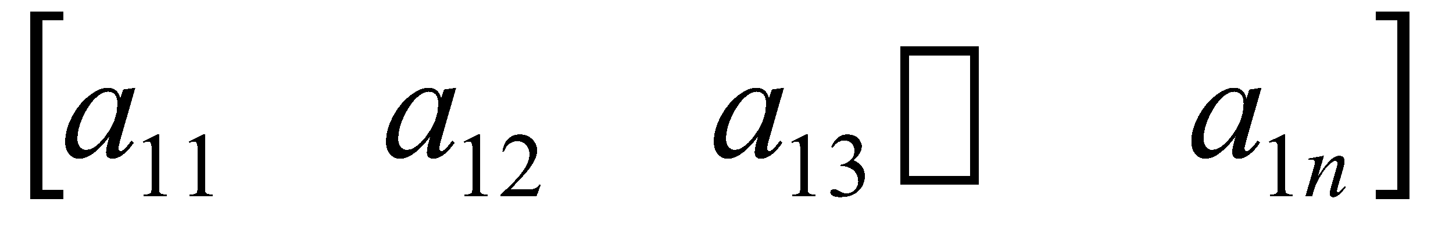
Matrices - Introduction
TYPES OF MATRICES
2. Row matrix or vector
Any number of columns but only one row

Slide 7

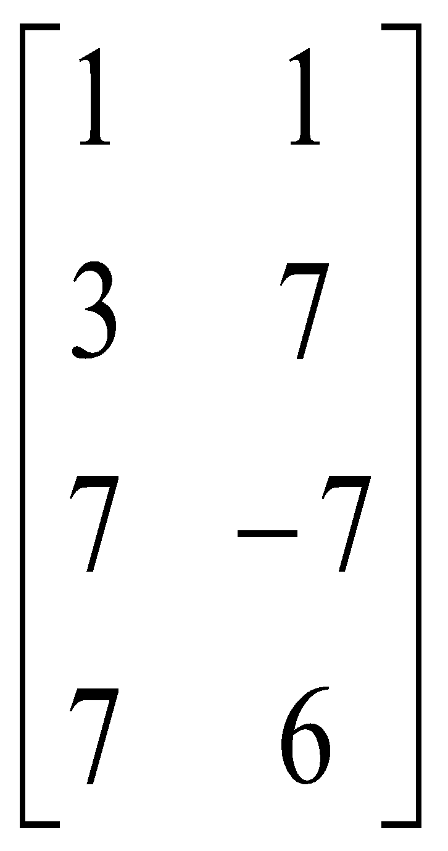
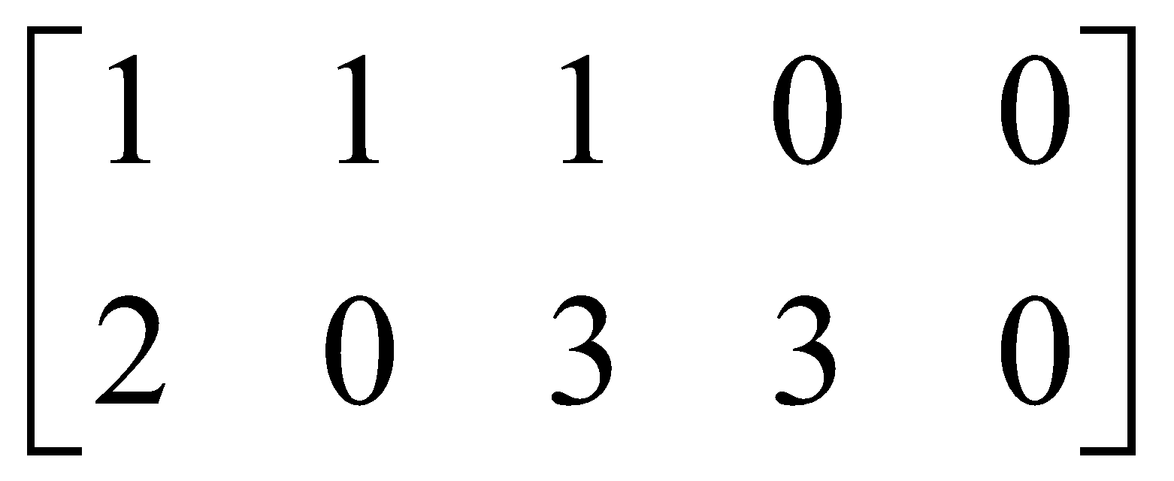
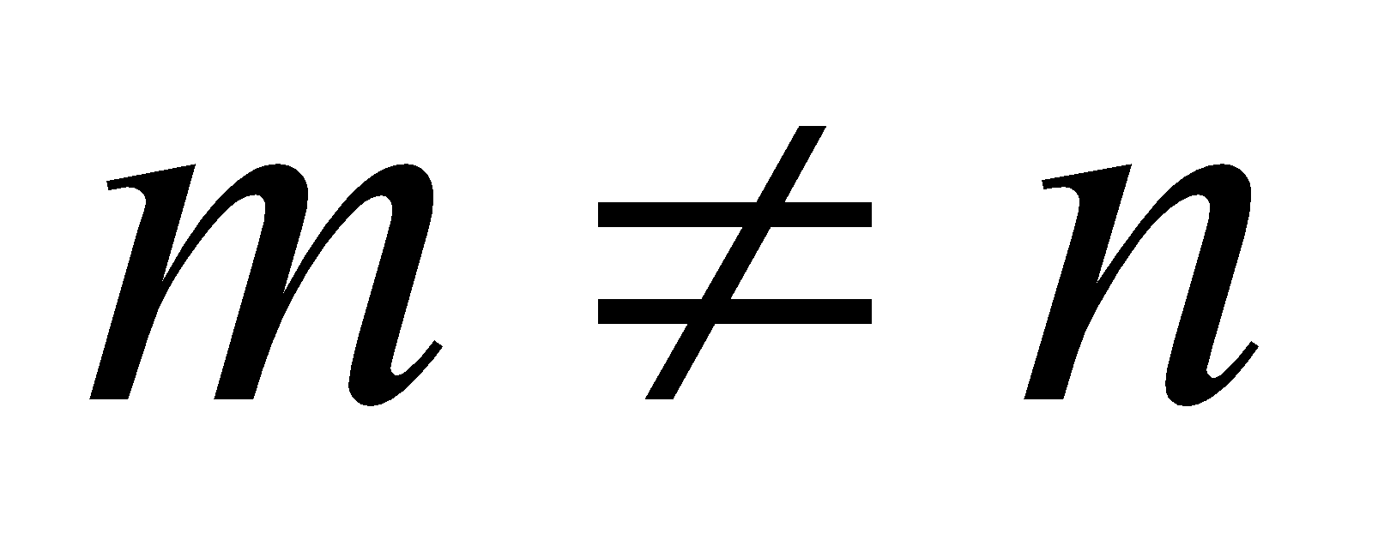
Matrices - Introduction
TYPES OF MATRICES
3. Rectangular matrix
Contains more than one element and number of rows is not equal to the number of columns

Slide 8
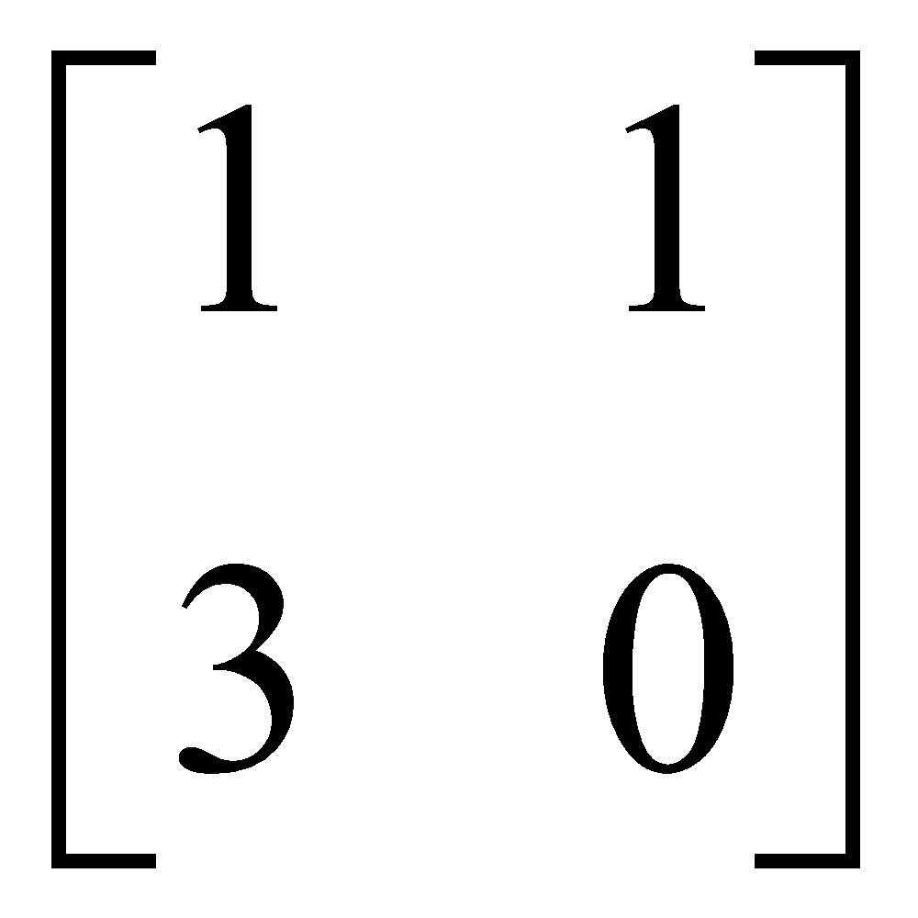
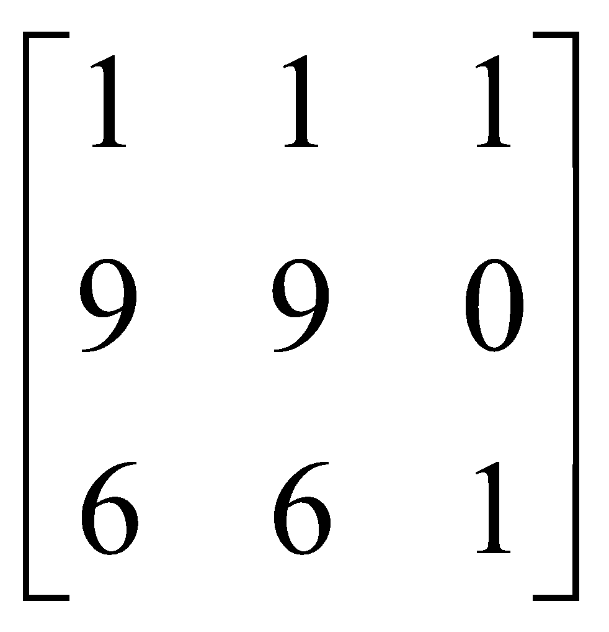
Matrices - Introduction
TYPES OF MATRICES
4. Square matrix
The number of rows is equal to the number of columns
(a square matrix A has an order of m)
m x m
The principal or main diagonal of a square matrix is composed of all elements a_{ij} for which i=j

Slide 9
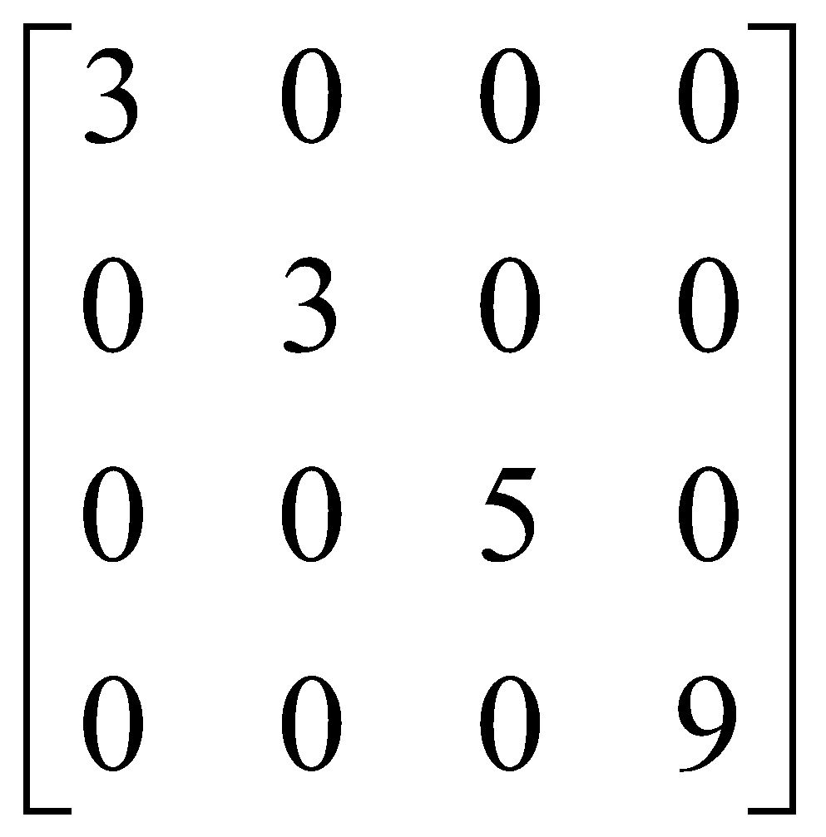
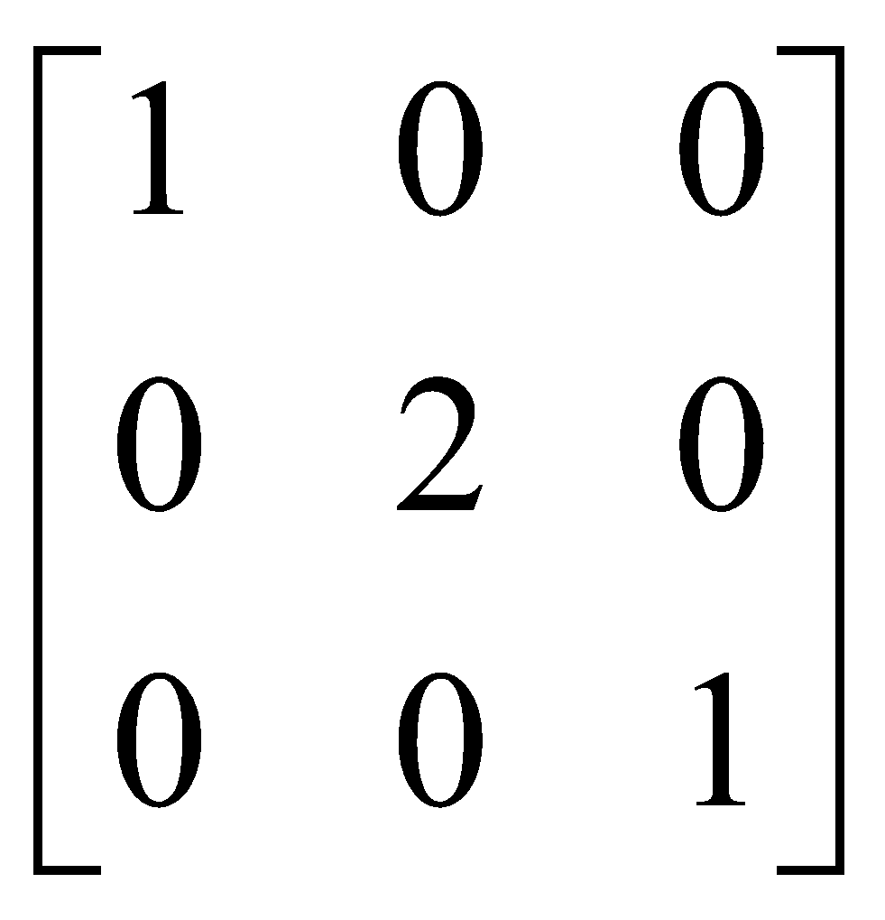
Matrices - Introduction
TYPES OF MATRICES
5. Diagonal matrix
A square matrix where all the elements are zero except those on the main diagonal
i.e. a_{ij} =0 for all i = j
a_{ij} = 0 for some or all i = j

Slide 10
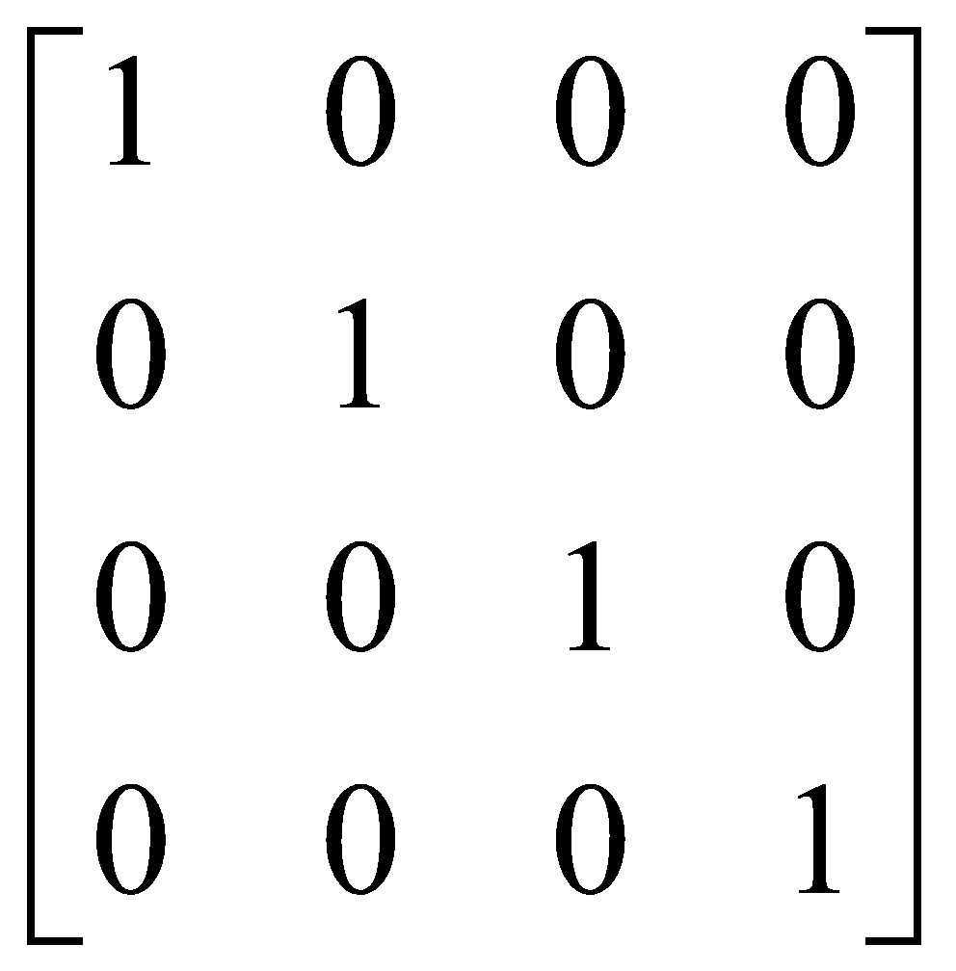
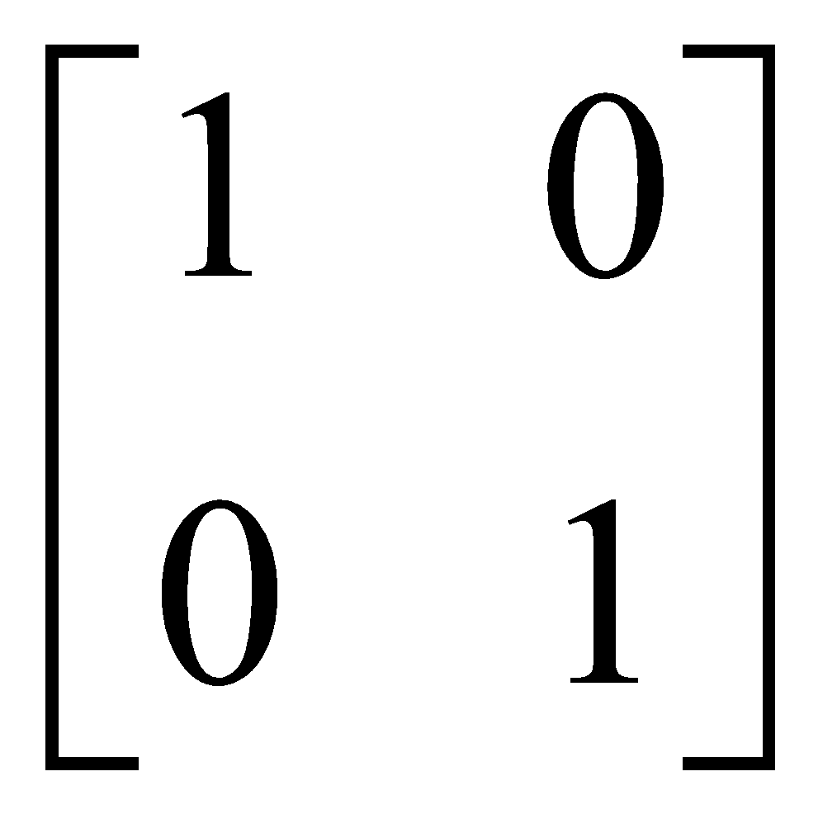
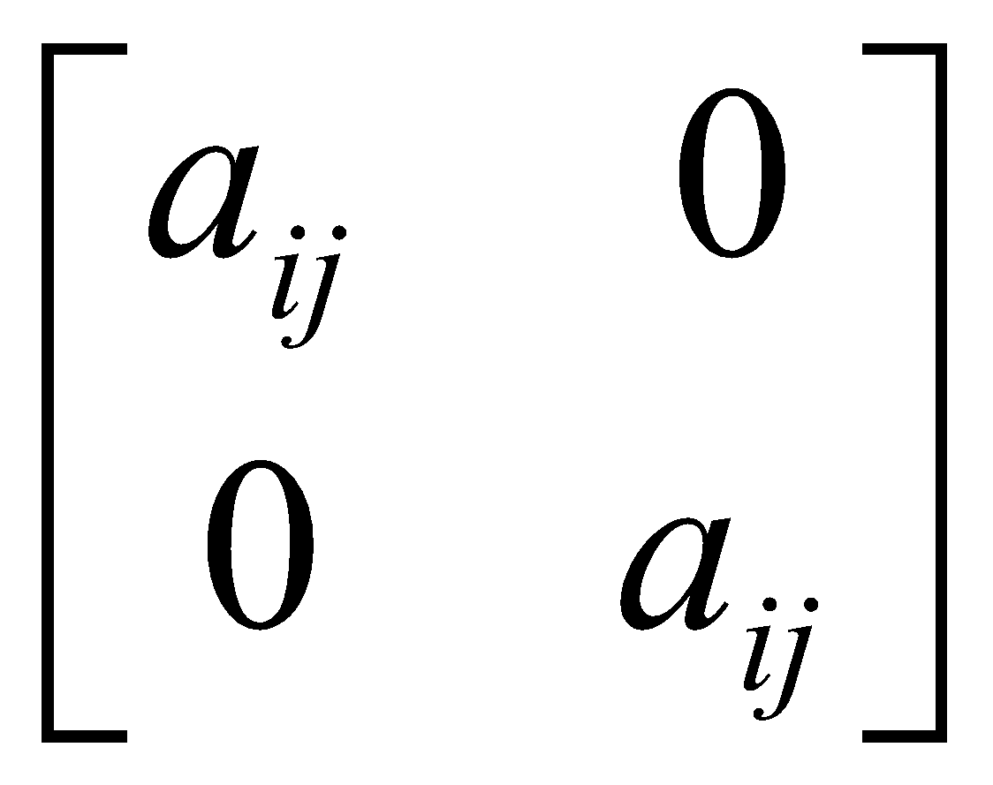
Matrices - Introduction
TYPES OF MATRICES
6. Unit or Identity matrix - I
A diagonal matrix with ones on the main diagonal
i.e. a_{ij} =0 for all i = j
a_{ij} = 1 for some or all i = j

Slide 11
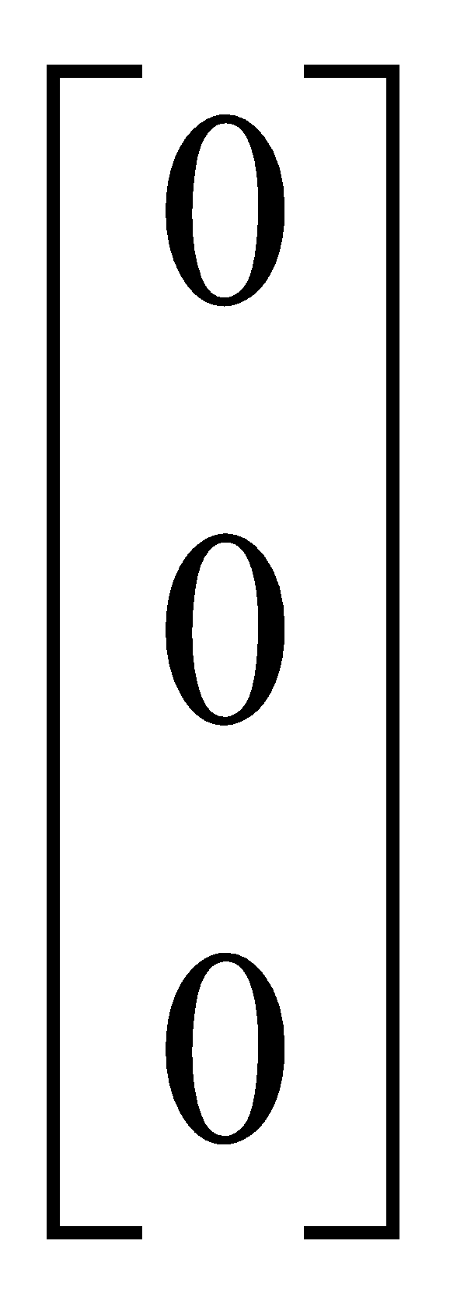
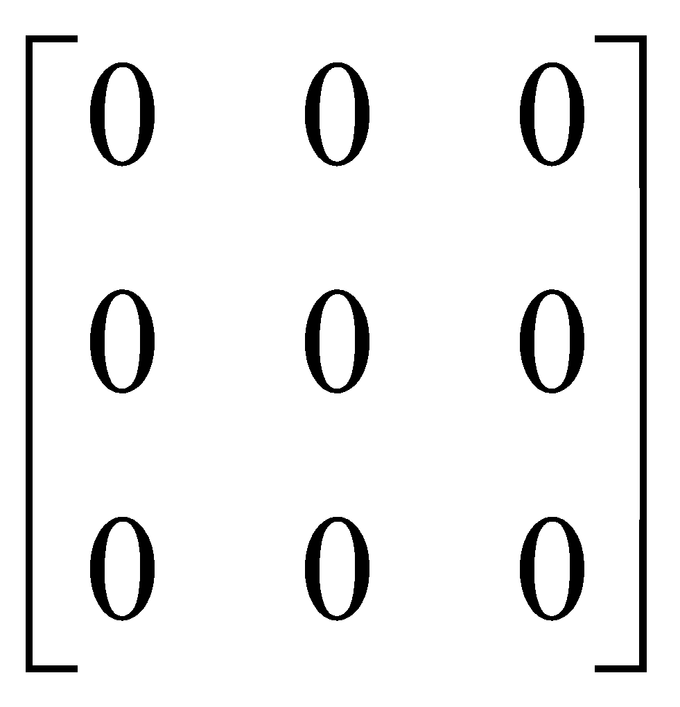
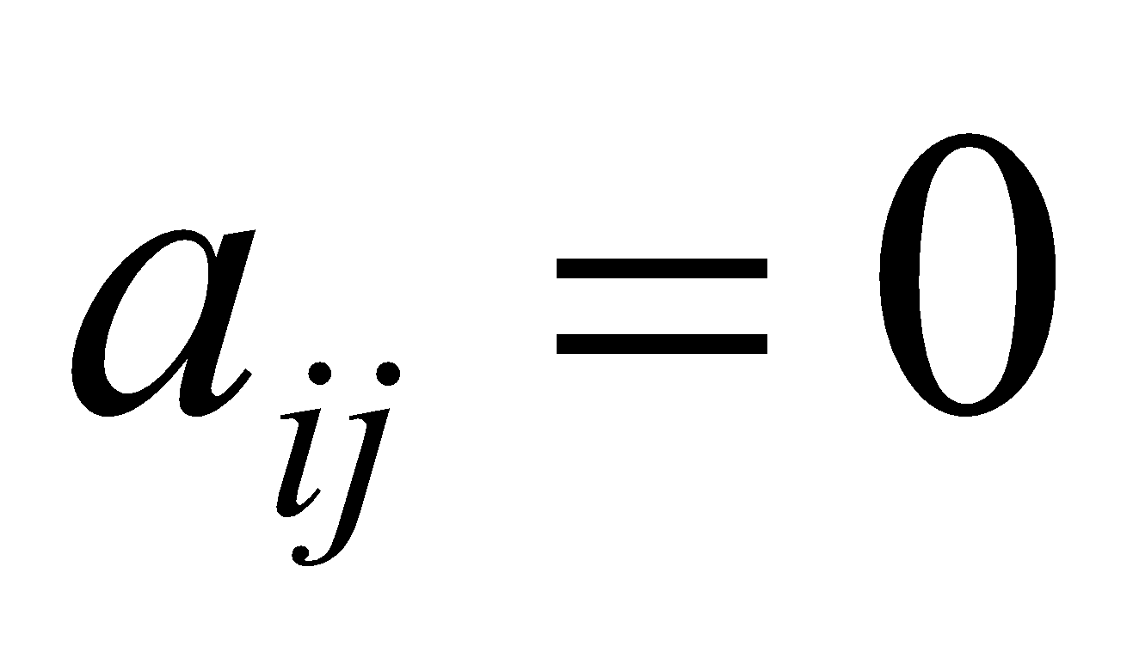
Matrices - Introduction
TYPES OF MATRICES
7. Null (zero) matrix - 0
All elements in the matrix are zero
For all i,j

Slide 12
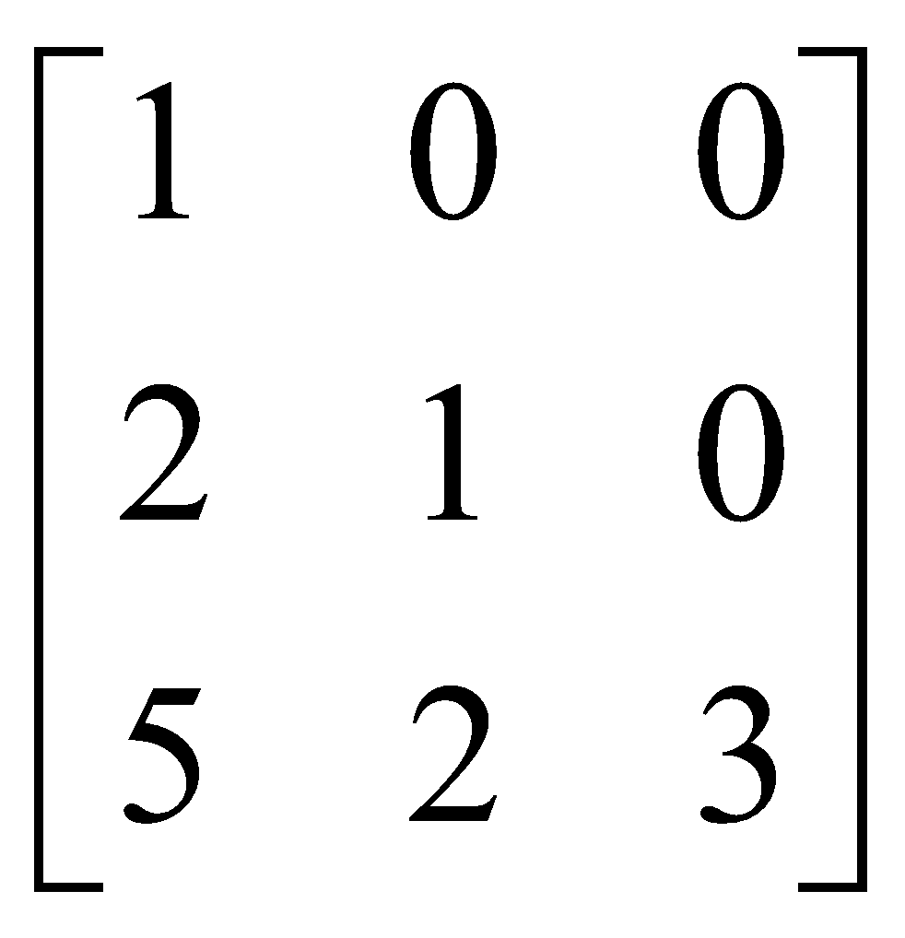
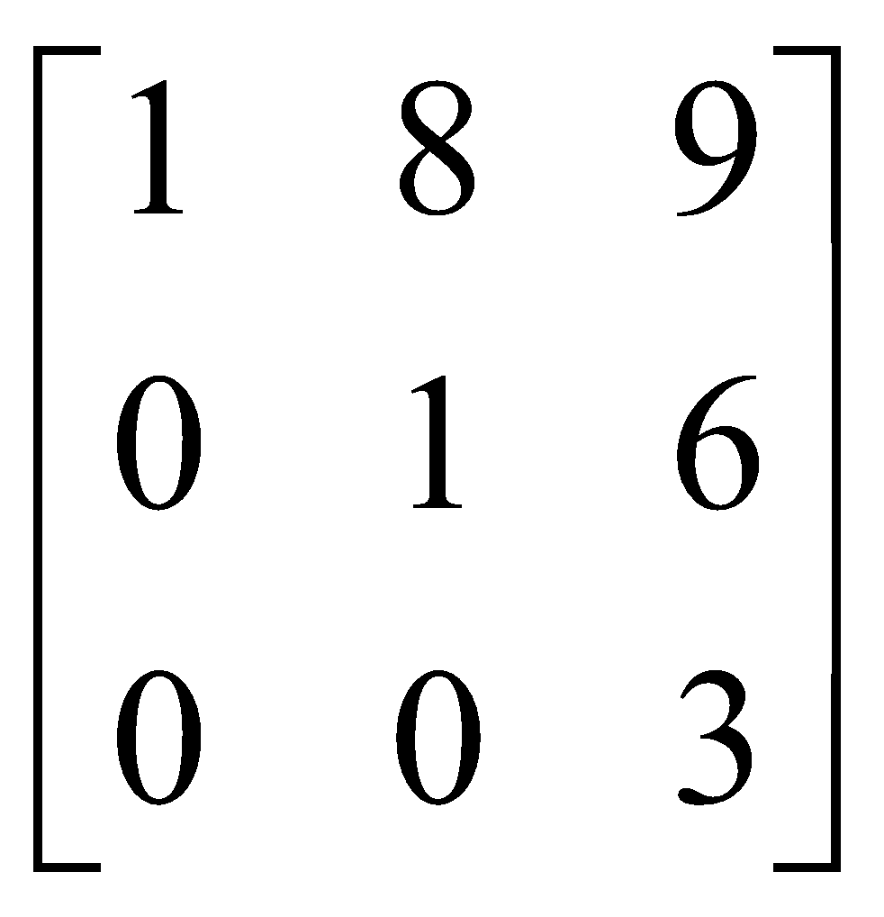
Matrices - Introduction
TYPES OF MATRICES
8. Triangular matrix
A square matrix whose elements above or below the main diagonal are all zero

Slide 13
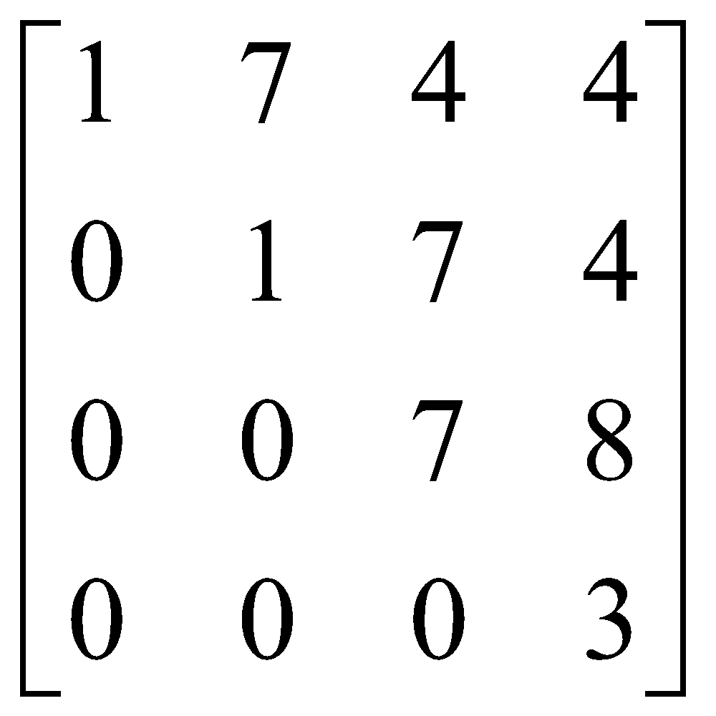
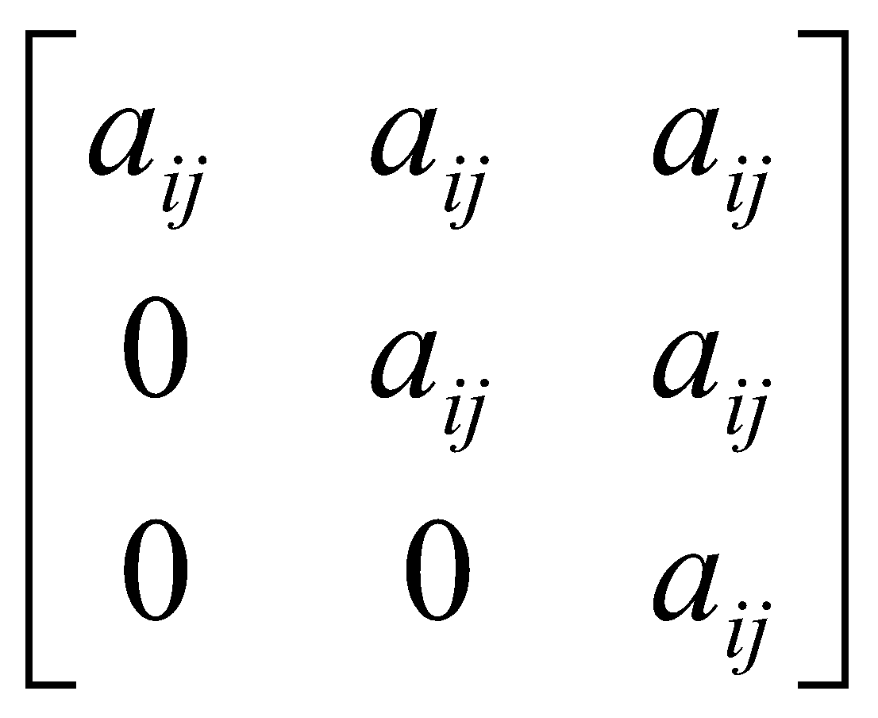
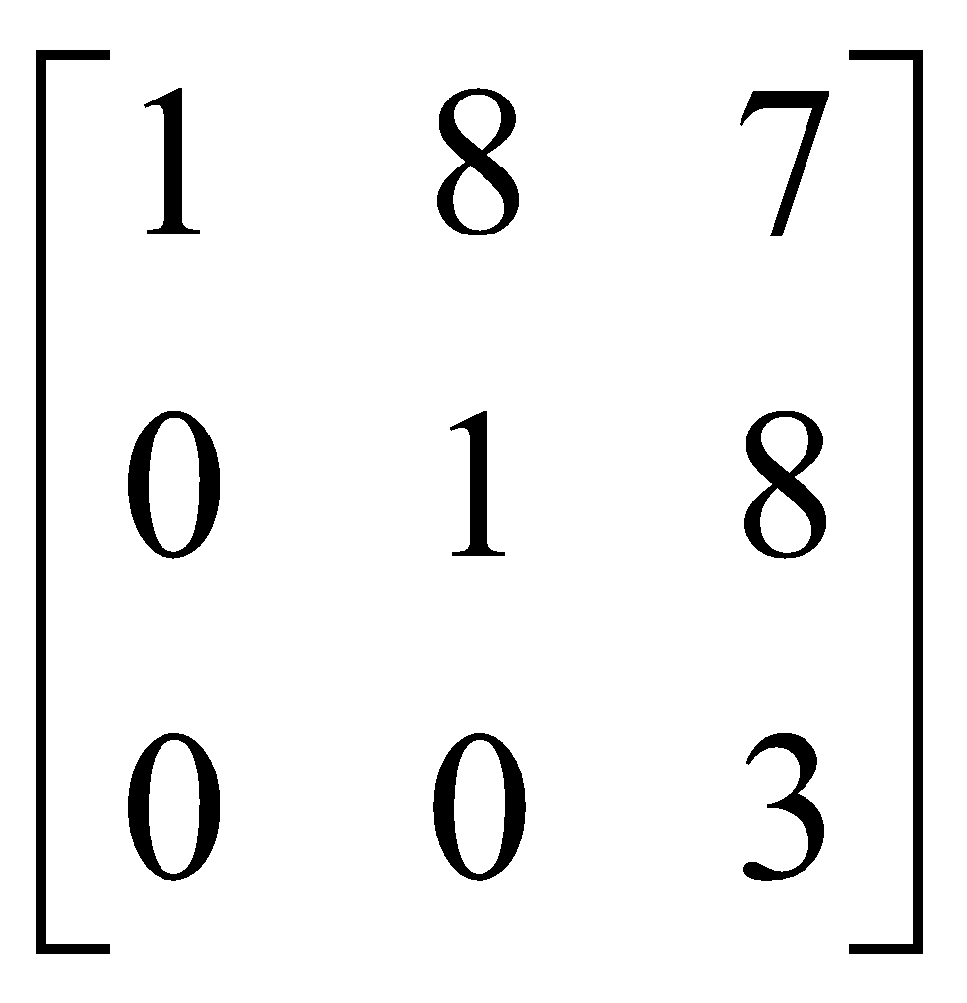
Matrices - Introduction
TYPES OF MATRICES
8a. Upper triangular matrix
A square matrix whose elements below the main diagonal are all zero
i.e. a_{ij} = 0 for all i > j

Slide 14
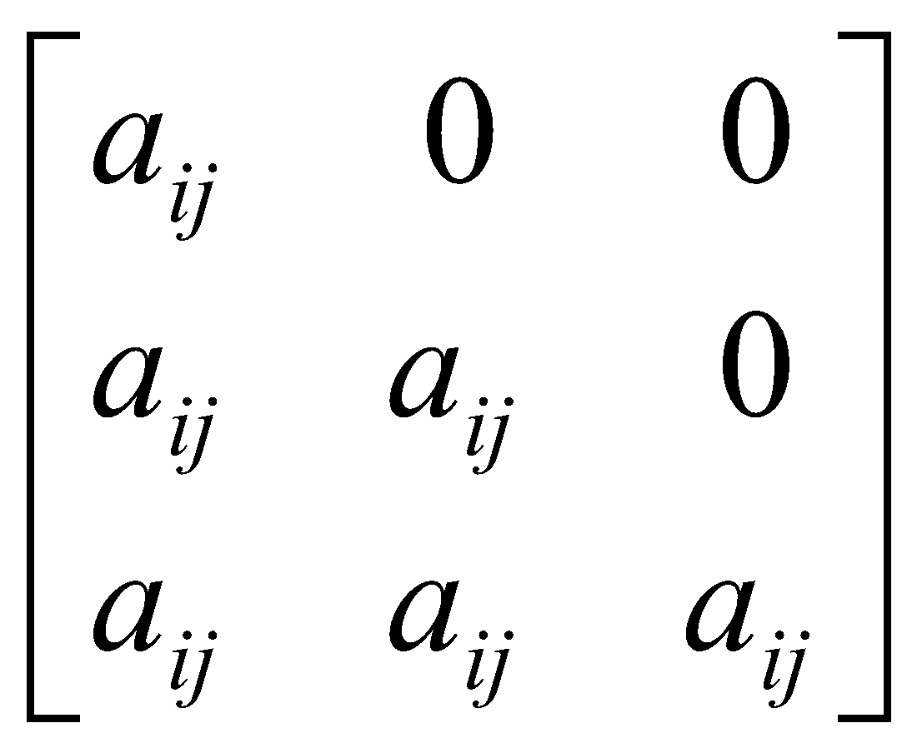
Matrices - Introduction
TYPES OF MATRICES
8b. Lower triangular matrix
A square matrix whose elements above the main diagonal are all zero
i.e. a_{ij} = 0 for all i < j

Slide 15
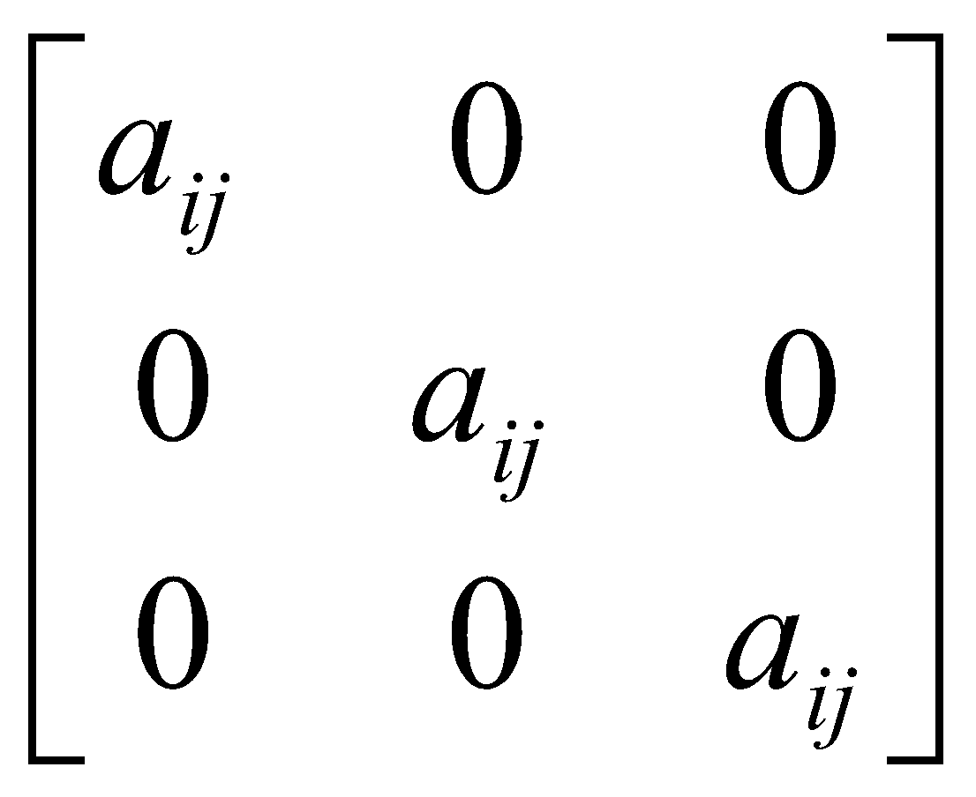
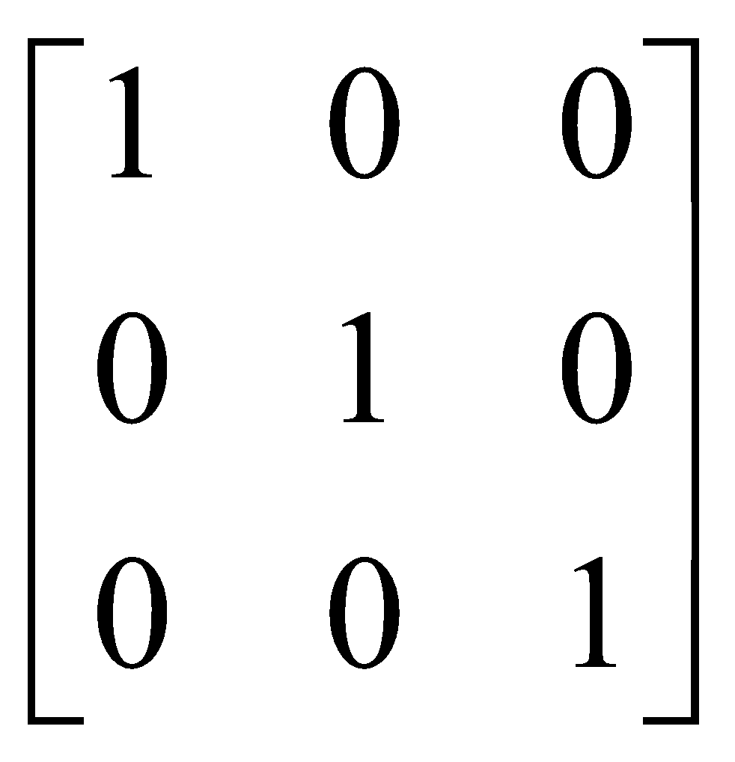
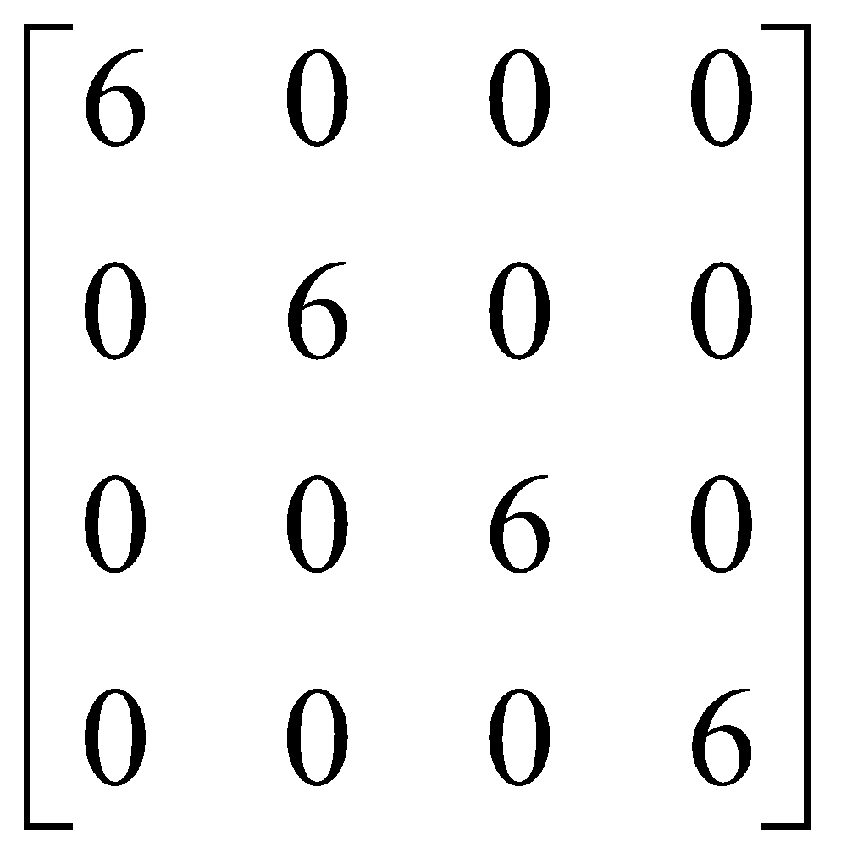
Matrices – Introduction
TYPES OF MATRICES
9. Scalar matrix
A diagonal matrix whose main diagonal elements are equal to the same scalar
A scalar is defined as a single number or constant
i.e. a_{ij} = 0 for all i = j
a_{ij} = a for all i = j

Slide 16
Matrices
Matrix Operations

Slide 17
Matrices - Operations
EQUALITY OF MATRICES
Two matrices are said to be equal only when all corresponding elements are equal
Therefore their size or dimensions are equal as well
A =
B =
A = B

Slide 18
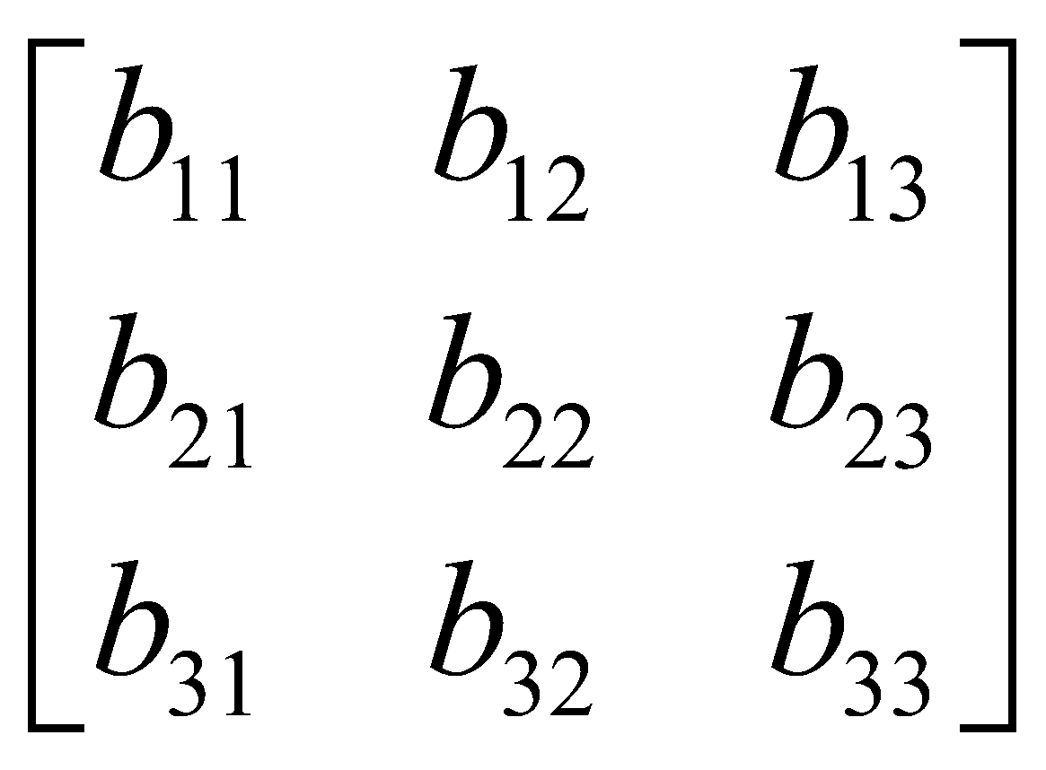
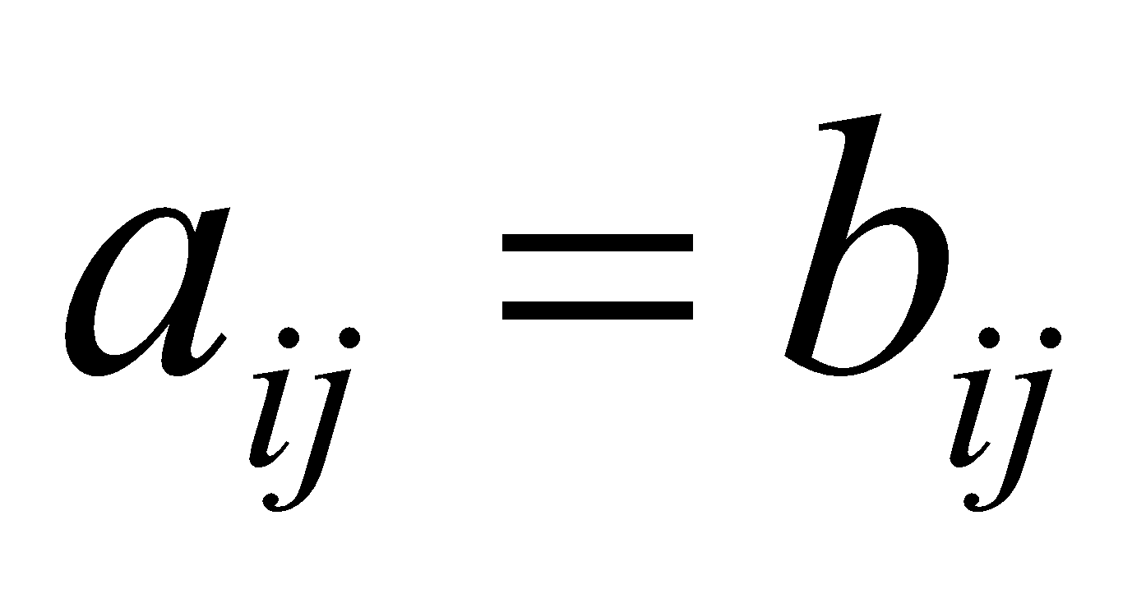
Matrices - Operations
Some properties of equality:
IIf A = B, then B = A for all A and B
IIf A = B, and B = C, then A = C for all A, B and C
A =
B =
If A = B then

Slide 19
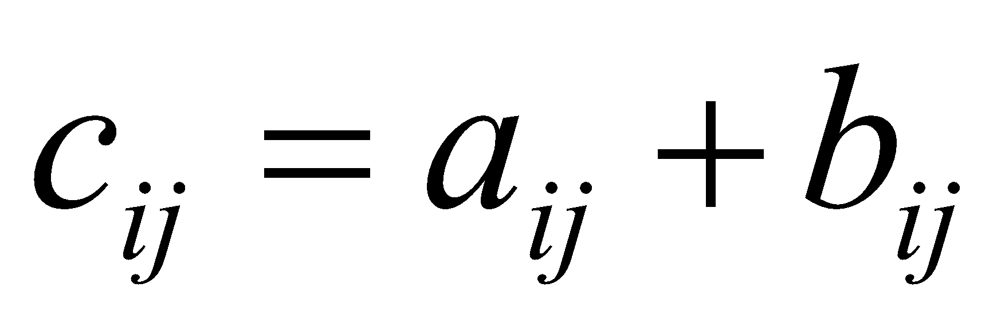
Matrices - Operations
ADDITION AND SUBTRACTION OF MATRICES
The sum or difference of two matrices, A and B of the same size yields a matrix C of the same size
Matrices of different sizes cannot be added or subtracted

Slide 20
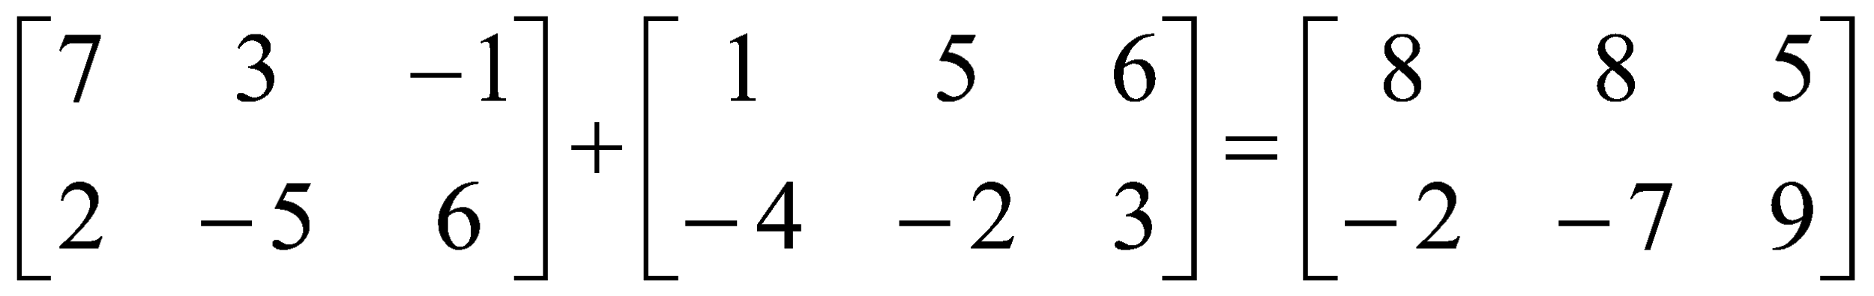
Matrices - Operations
Commutative Law:
A + B = B + A
Associative Law:
A + (B + C) = (A + B) + C = A + B + C
A
2x3
B
2x3
C
2x3

Slide 21
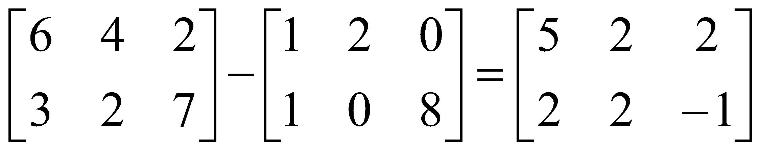
Matrices - Operations
A + 0 = 0 + A = A
A + (-A) = 0 (where –A is the matrix composed of –a_{ij} as elements)

Slide 22
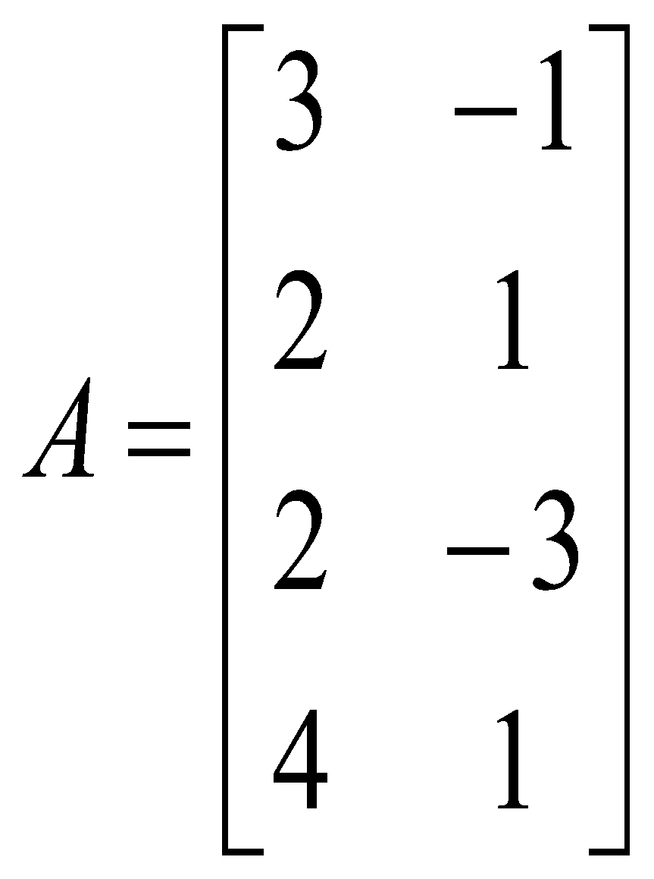
Matrices - Operations
SCALAR MULTIPLICATION OF MATRICES
Matrices can be multiplied by a scalar (constant or single element)
Let k be a scalar quantity; then
kA = Ak
Ex. If k=4 and

Slide 23
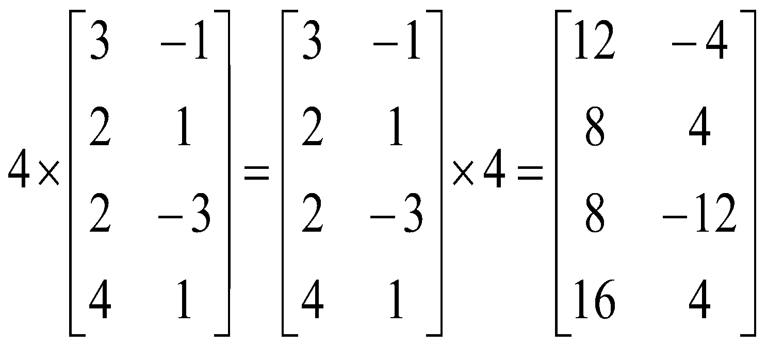
Matrices - Operations
Properties:
k (A + B) = kA + kB
(k + g)A = kA + gA
k(AB) = (kA)B = A(k)B
k(gA) = (kg)A

Slide 24
Matrices - Operations
MULTIPLICATION OF MATRICES
The product of two matrices is another matrix
Two matrices A and B must be conformable for multiplication to be possible
i.e. the number of columns of A must equal the number of rows of B
Example.
A x B = C
(1x3) (3x1) (1x1)

Slide 25
Matrices - Operations
B x A = Not possible!
(2x1) (4x2)
A x B = Not possible!
(6x2) (6x3)
Example
A x B = C
(2x3) (3x2) (2x2)

Slide 26
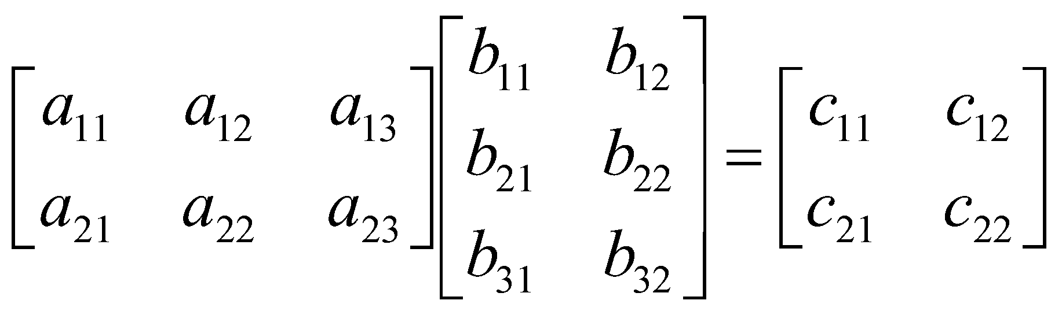
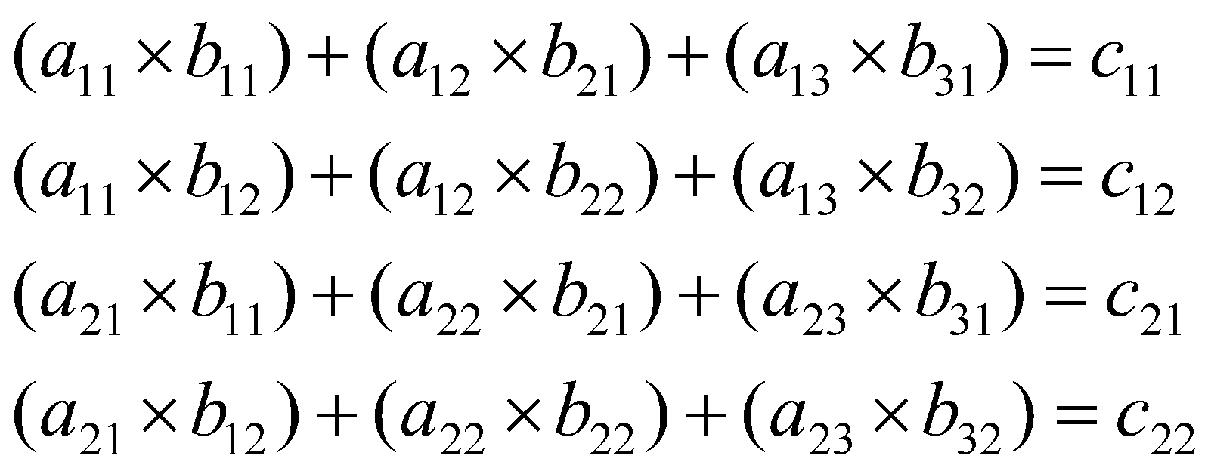
Matrices - Operations
Successive multiplication of row i of A with column j of B – row by column multiplication

Slide 27
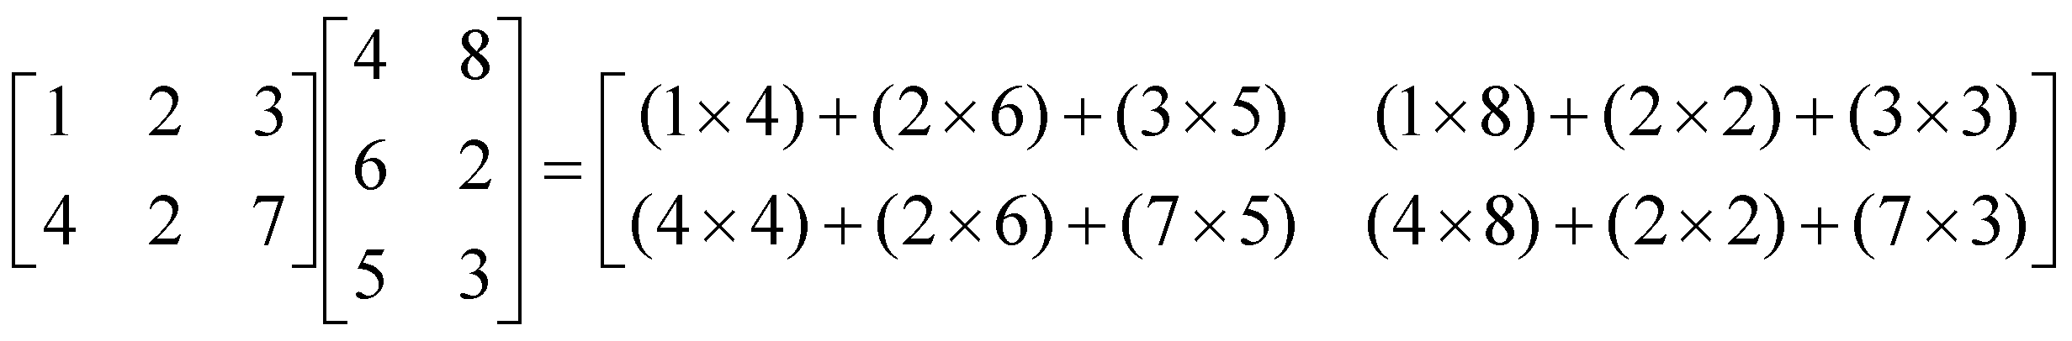
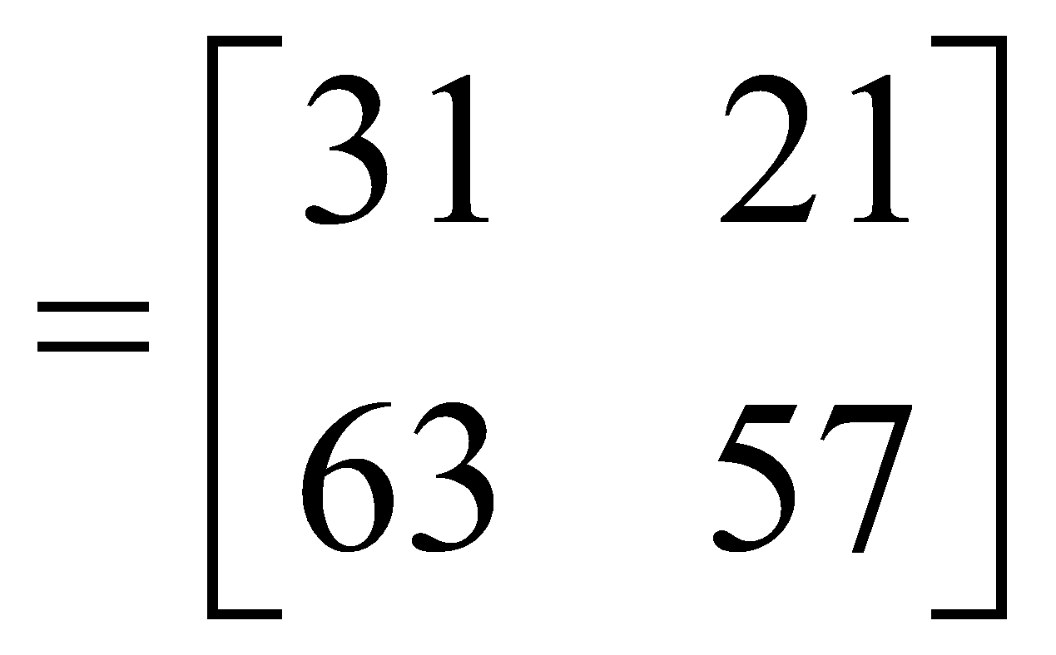
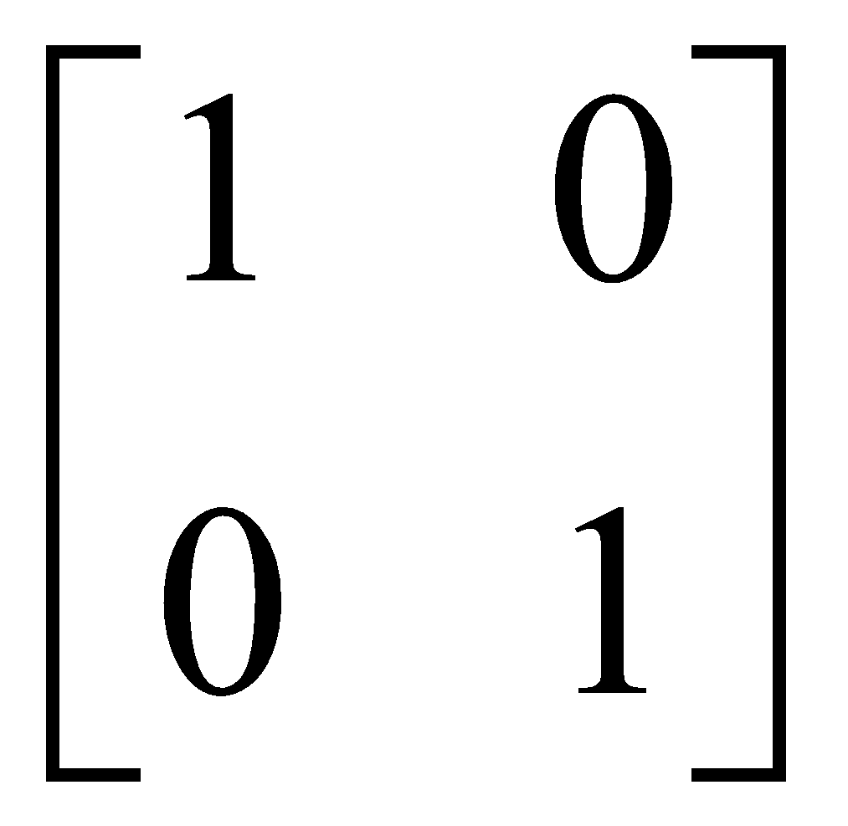
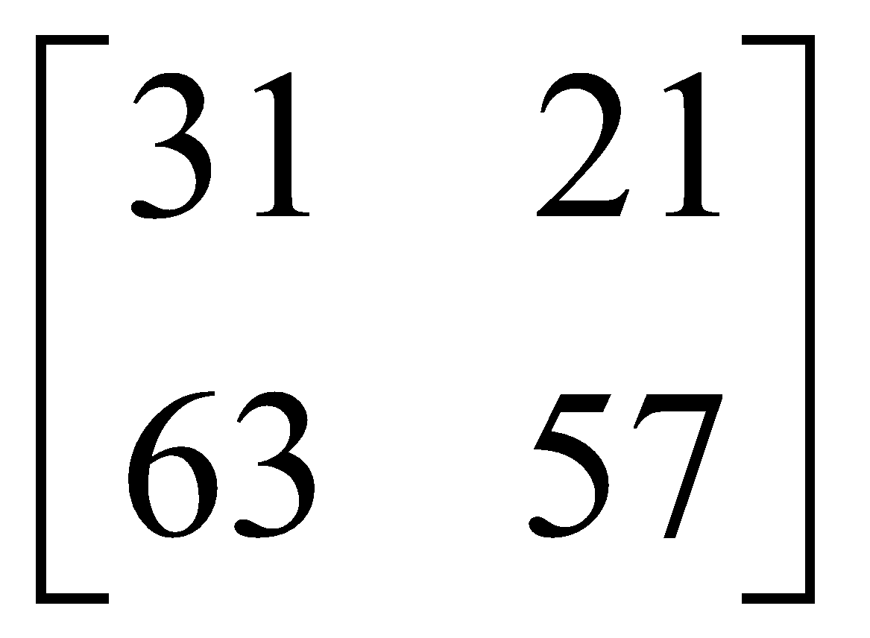
Matrices - Operations
Remember also:
IA = A

Slide 28
Matrices - Operations
Assuming that matrices A, B and C are conformable for the operations indicated, the following are true:
AI = IA = A
A(BC) = (AB)C = ABC - (associative law)
A(B+C) = AB + AC - (first distributive law)
(A+B)C = AC + BC - (second distributive law)
Caution!
AB not generally equal to BA, BA may not be conformable
If AB = 0, neither A nor B necessarily = 0
If AB = AC, B not necessarily = C

Slide 29
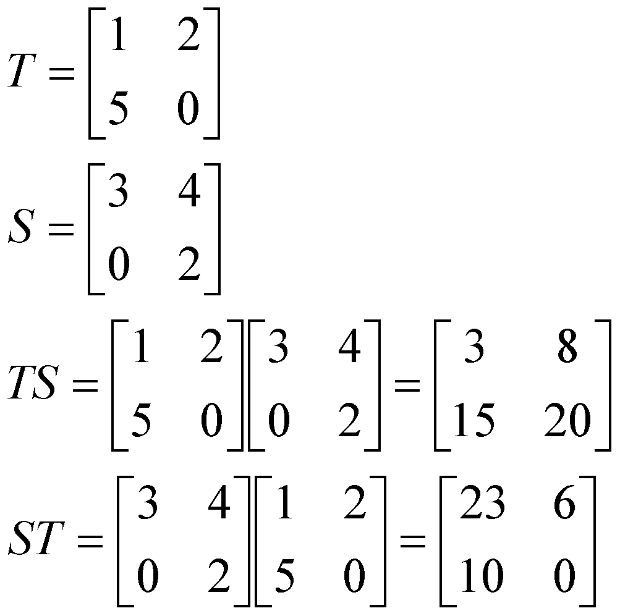
Matrices - Operations
AB not generally equal to BA, BA may not be conformable

Slide 30
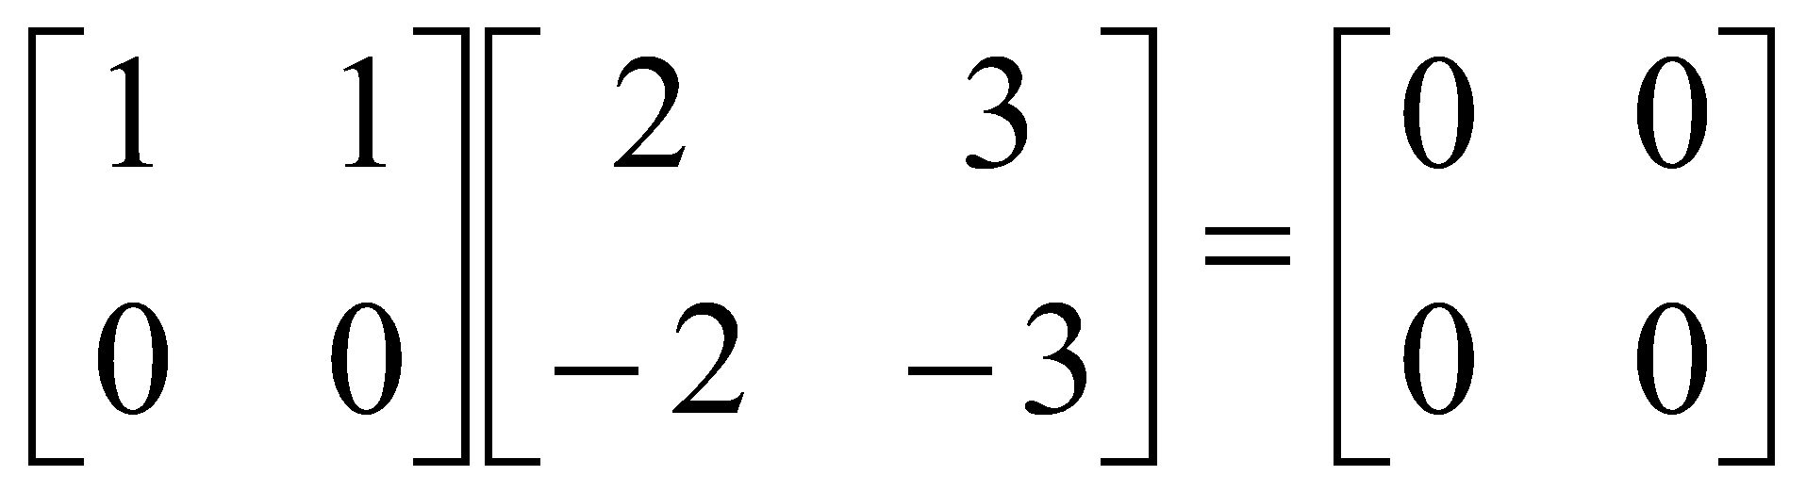
Matrices - Operations
If AB = 0, neither A nor B necessarily = 0

Slide 31
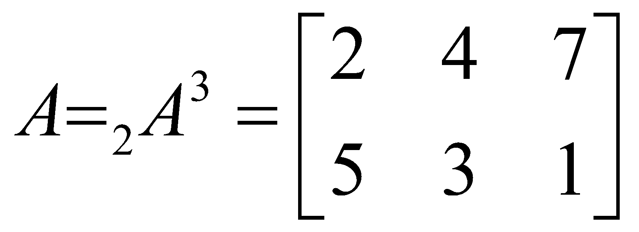
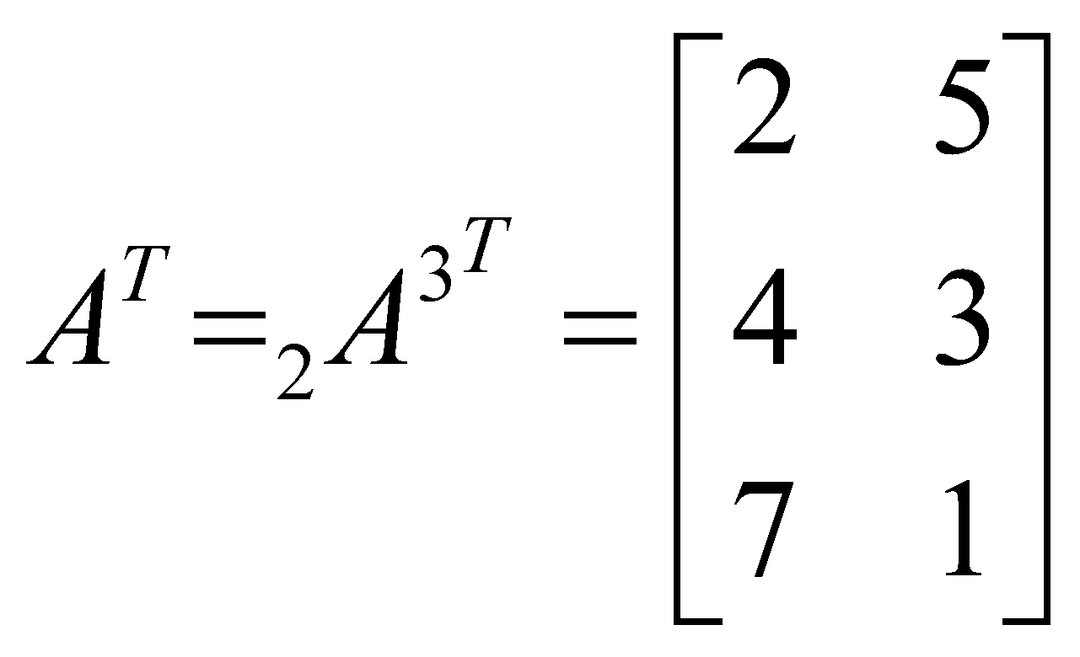

Matrices - Operations
TRANSPOSE OF A MATRIX
If :
2x3
Then transpose of A, denoted A^{T} is:
For all i and j

Slide 32

Matrices - Operations
To transpose:
Interchange rows and columns
The dimensions of A^{T} are the reverse of the dimensions of A
2 x 3
3 x 2

Slide 33
Matrices - Operations
Properties of transposed matrices:
(A+B)^{T} = A^{T} + B^{T}
(AB)^{T} = B^{T} A^{T}
(kA)^{T} = kA^{T}
(A^{T})^{T} = A

Slide 34


Matrices - Operations
(A+B)^{T} = A^{T} + B^{T}

Slide 35

Matrices - Operations
(AB)^{T} = B^{T} A^{T}

Slide 36

Matrices - Operations
SYMMETRIC MATRICES
A Square matrix is symmetric if it is equal to its transpose:
A = A^{T}

Slide 37

Matrices - Operations
When the original matrix is square, transposition does not affect the elements of the main diagonal
The identity matrix, I, a diagonal matrix D, and a scalar matrix, K, are equal to their transpose since the diagonal is unaffected.

